Slide 1
Sinkholes, floods and bin collections
A Twitter tale
Angela Jariwala
Web Services Manager (maternity cover)

Slide 2
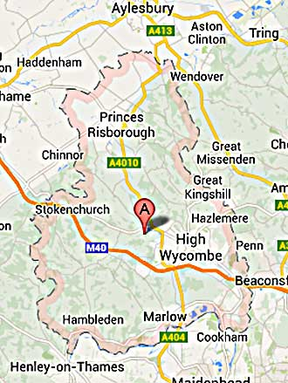
The district of Wycombe (it’s in Buckinghamshire)

Slide 3
Twitter history
On Twitter since May 2009
One communications officer tweeting
Moderate activity
August 2012, 2140 followers

Slide 4
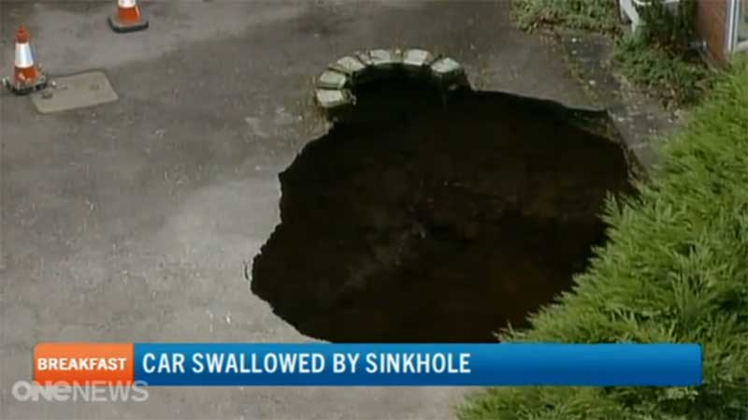
The week before

Slide 5

Last week

Slide 6
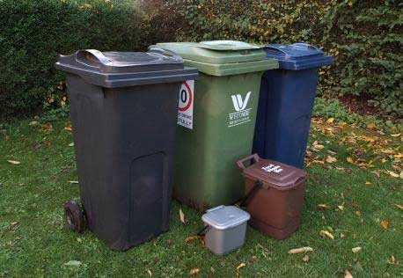
October 2013

Slide 7
What’s the best way to use social media?

Slide 8


Slide 9
What really works for us?

Slide 10

Team working Breaking down barriers
We do it by:
Twitter roster
Coordinating responses from services
Complementing customer service
Directing residents to the right place
One face of Wycombe District Council
Place your picture here

Slide 11
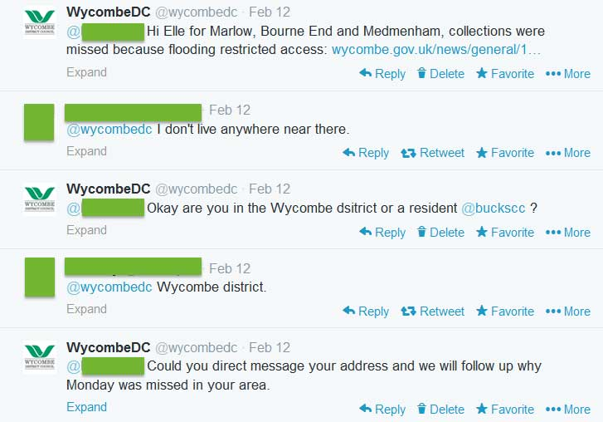
Waste and recycling missed bin collection

Slide 12
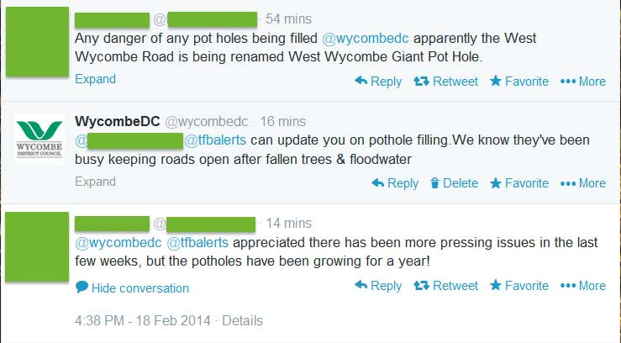
Pot hole handled by Bucks CC

Slide 13
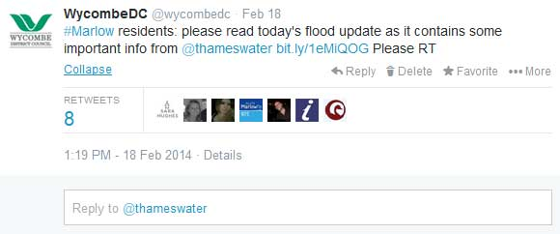
Floods daily update on the website

Slide 14
What is social media for Wycombe?
Successful
Organic
Communication
Increases
Audience
Levels

Slide 15
Residents satisfaction =
# ☺ LOL

Slide 16
#pissoff

Slide 17
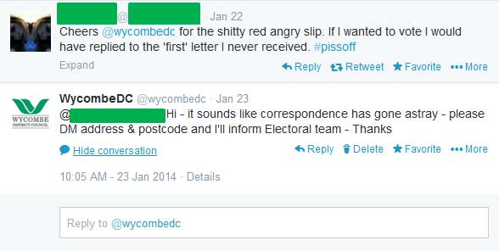
Electoral registration a form reminder

Slide 18
This week…
We have:
Nearly 4,000 followers
Increase in conversations
Reassurance for residents that we’re listening to them
Integrated working practices

Slide 19
Thank you
Angela Jariwala
Web Services Manager (maternity cover)
Tel 01494 421659
Email angela.jariwala@wycombe.gov.uk
www.wycombe.gov.uk
Twitter@wycombedc

