Slide 1

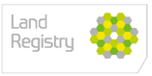

Digital Transformation Day
SPEED SESSION 4
CON29 and the Norwegian Model
Mark Edwards
&
Jamie Winch

Slide 2

Local Land Searches – a single digital gateway
The Challenge
Lack of standardisation in
Format
Price
Service levels
The Proposal
Land Registry widens its range of information services to include standardised provision of Local Land Charges search and Con 29 information by:
Amending legislation to move responsibility for Local Land Charges to Land Registry.
Consolidating the Local Land Charges Register into one central register
Improved access to Con 29 information

Slide 3
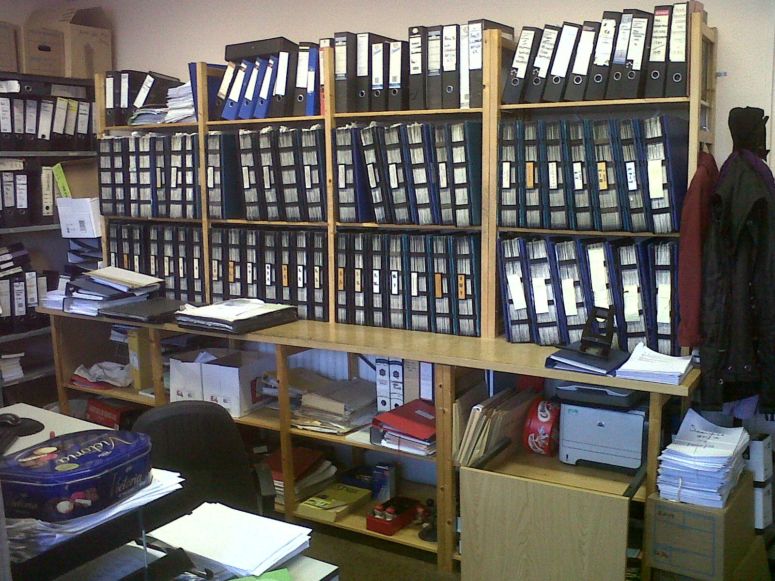
Data transformation?

Slide 4
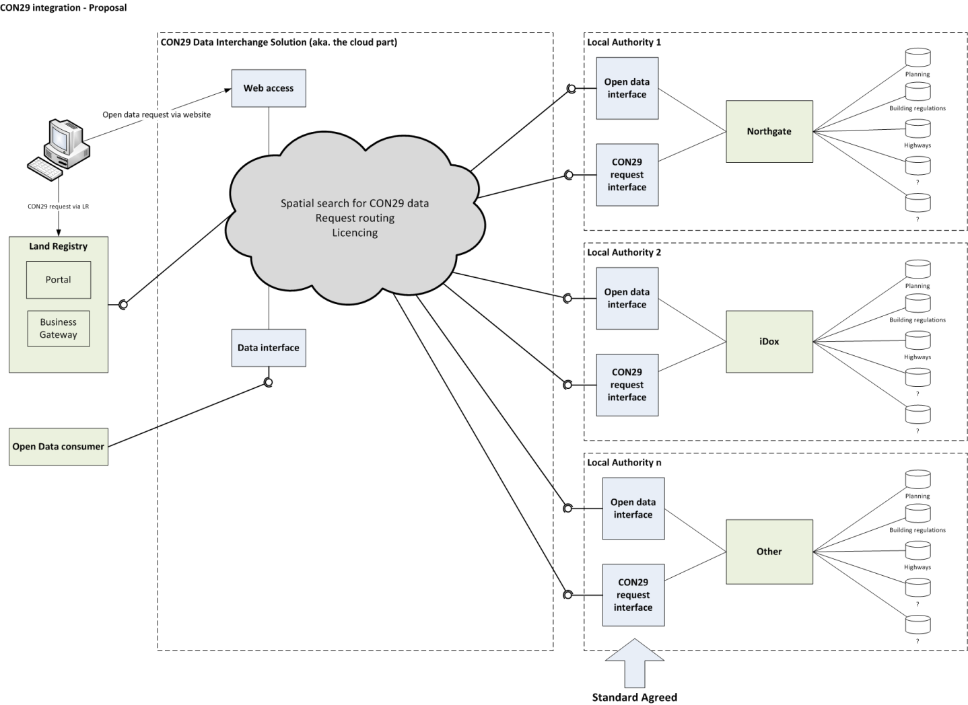
CON29 Proposal

Slide 5
Market Warming Day
Business, Innovation and Skills - 20th June 2013
24 Private Sector companies represented
Encourage innovation and collaboration
Assessing market appetite
18 Expressions of Interest
12 Follow up meetings
Assess capacity and capabilities
Potential partnerships with Land Registry and Local Authorities
CON29 prototype?

Slide 6


Infoland®
Benefits
No billing costs
No payment tracking
No system costs
Internal efficiency gains
No record keeping / archiving
Fewer phonecalls
Reduced desktop work
More time for public service
Greater job satisfaction
Improved customer feedback

Slide 7


Any Questions?

