Slide 1


Creating communities through social media
Jason Thorne, February 2014

Slide 2
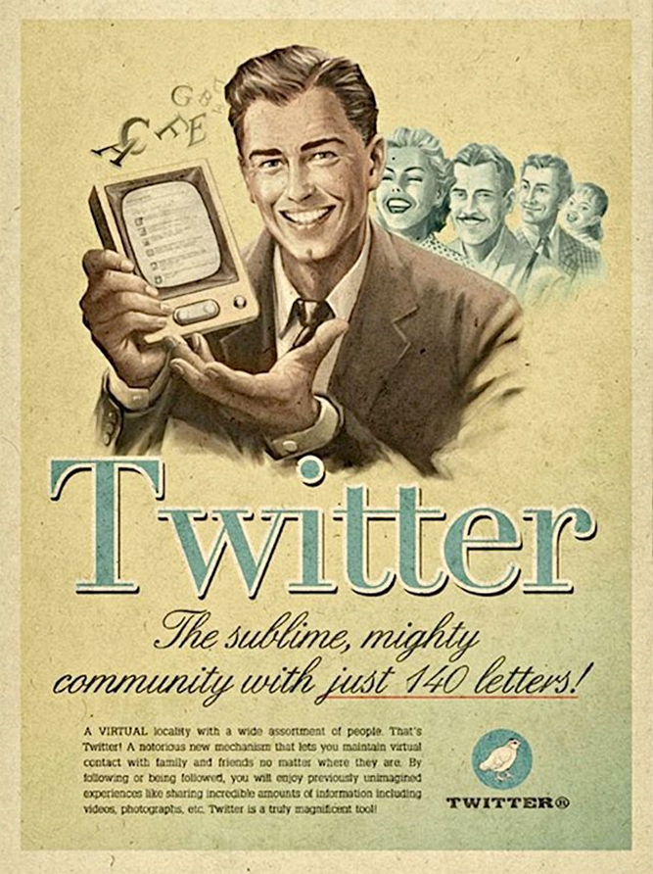

Slide 3
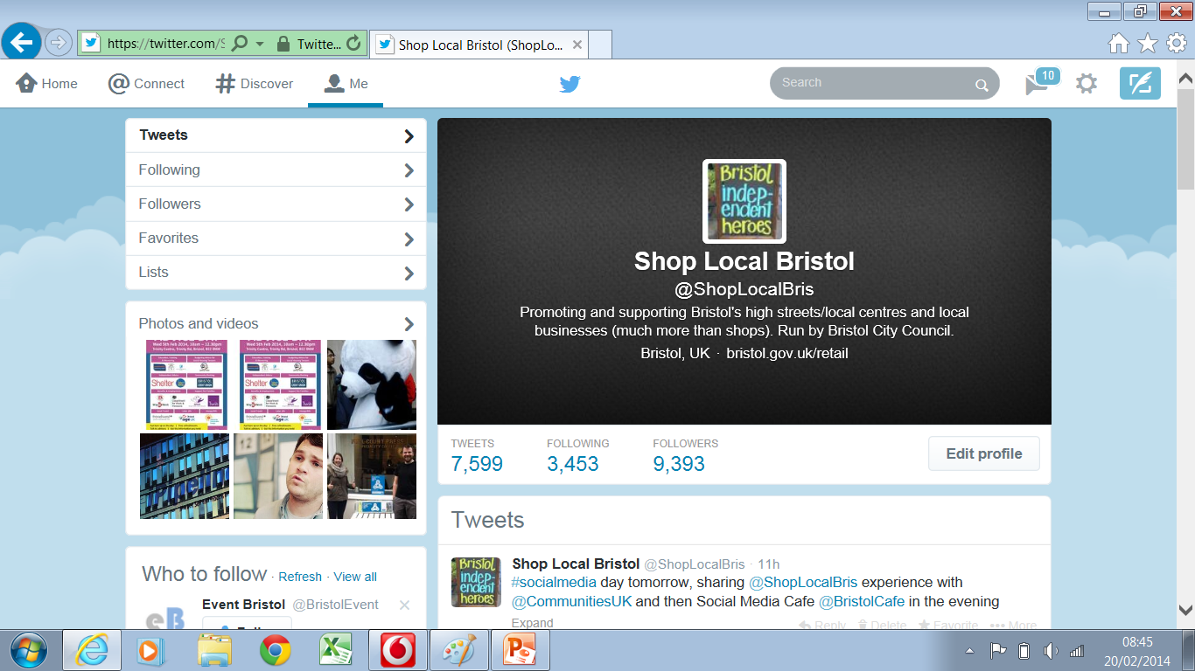

Slide 4
@ShopLocalBris
Started August 2011
Promoting Bristol's high streets/local centres and local businesses
Building relationships with businesses – virtual contact

Slide 5
@ShopLocalBris
Why?

Slide 6
@ShopLocalBris
Business benefits of using social media/free marketing
Encouraging peer support/collaboration and local purchasing
Sharing and collecting information

Slide 7
@ShopLocalBris
Getting businesses involved in initiatives
Businesses have more positive image of BCC

Slide 8
@ShopLocalBris
Assisting businesses with their development
Helps build support package

Slide 9
Tips
Twitter B2B/Facebook B2C
Don’t rely on internet only communication
Think about your audience

Slide 10
Tips
Think about what you want to communicate – values and aims
Think about the conversations you will align yourself with
Be concise – you have 140 characters!

Slide 11
Tips
Tweet regularly
Don’t be scared, the public sector is allowed to tweet!
Don’t say anything stupid!

Slide 12
Tips
Have difficult conversations offline

Slide 13
Tips
Top 20 tips www.marketingdonut.co.uk/marketing/internet-marketing/social-media-and-online-networking/twenty-top-twitter-tips
www.brave.org.uk
Come along to Bristol Social Media Café

