Slide 1

Louise Kidney
Digital Engagement Lead
Government Digital Service
@loulouk
Notes:
Maybe your title too
GDS logo

Slide 2
Social media.
Getting it right
and getting
it wrong
Louise
GDS
Notes:
That seems friendlier and more interesting than ‘agenda’ doesn’t it?

Slide 3
Doing
it
right
Louise
GDS
Notes:
That seems friendlier and more interesting than ‘agenda’ doesn’t it?

Slide 4
Social Media
Guidelines.
We needed
some.
Louise
GDS

Slide 5
So I wrote
some.
And that just
didn’t work.
Louise
GDS

Slide 6

Louise
GDS

Slide 7
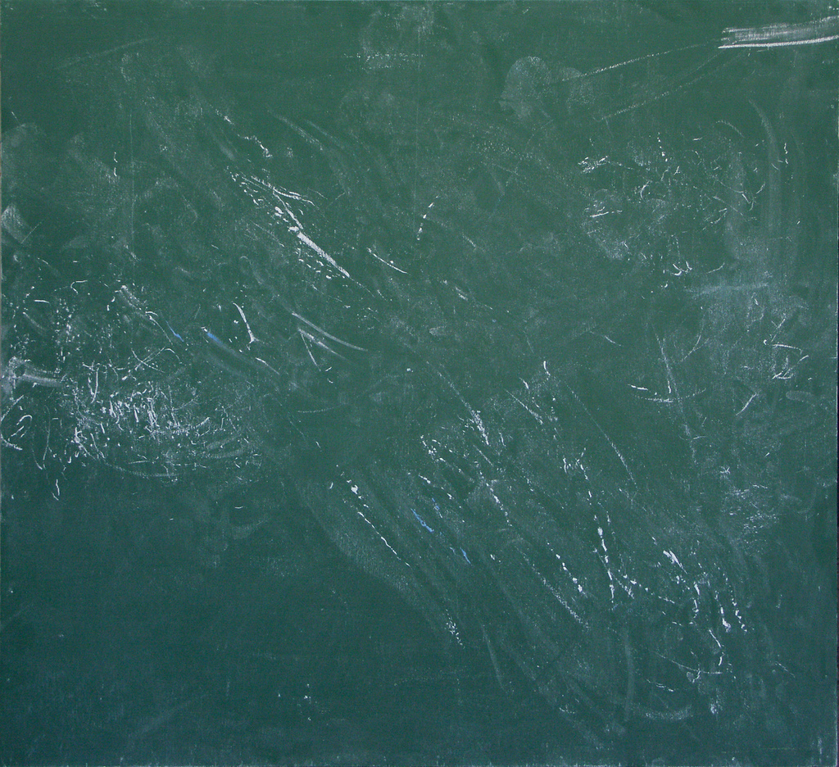
Louise
GDS

Slide 8
What we
needed was
a dragon.
Louise
GDS

Slide 9
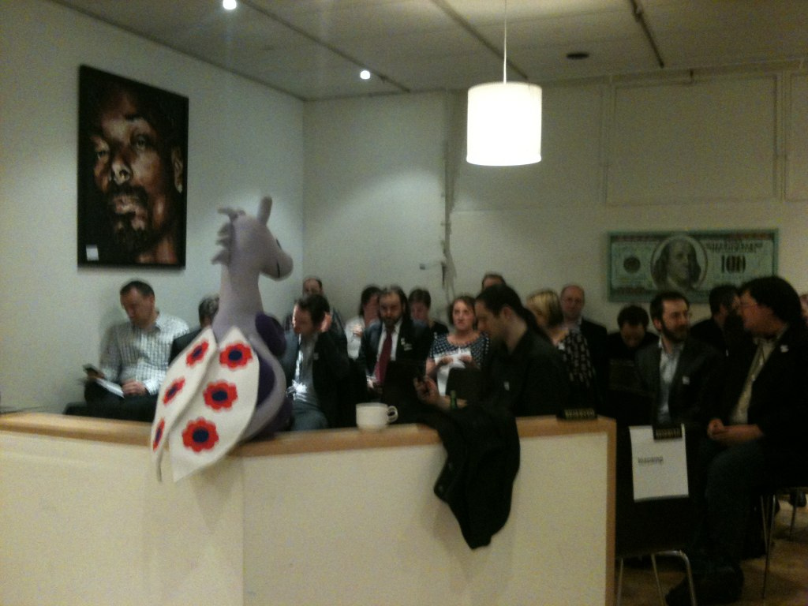
Louise
GDS

Slide 10
If you take nothing
else away from
this…
Digital stakeholders
Louise
GDS

Slide 11
100 people can
write far better
guidelines than
just one
Louise
GDS

Slide 12
Crowdsourced.
Stakeholder buy in.
Everyone owns.
No suggested
revisions.
Louise
GDS

Slide 13
Communicate with citizens where they already are.
Use social media to consult
and engage.
Use social media to be
more transparent and accountable.
Be part of the conversation.
We cannot do everything alone or in isolation.
Adhere to the Civil Service Code.
Louise
GDS

Slide 14
Doing
it
wrong
& dodging the curveballs
Louise
GDS
Notes:
That seems friendlier and more interesting than ‘agenda’ doesn’t it?

Slide 15
Sometimes
less is more
Louise
GDS
Notes:
That seems friendlier and more interesting than ‘agenda’ doesn’t it?

Slide 16
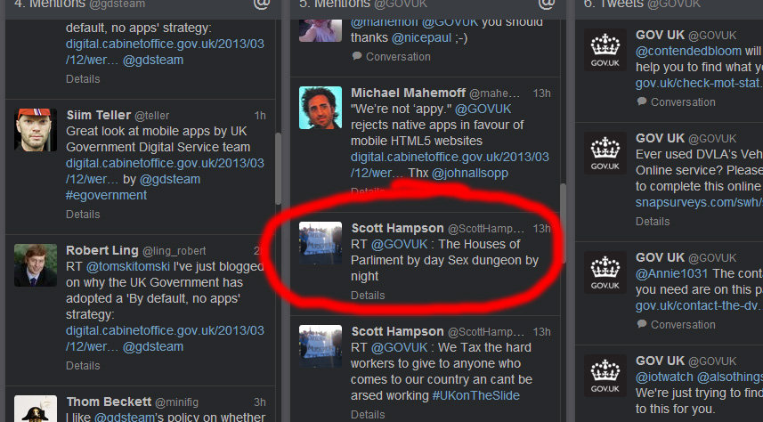
Louise
GDS
Notes:
That seems friendlier and more interesting than ‘agenda’ doesn’t it?

Slide 17
Visibility brings
all the single
issue campaigners
to your yard
Louise
GDS
Notes:
That seems friendlier and more interesting than ‘agenda’ doesn’t it?

Slide 18
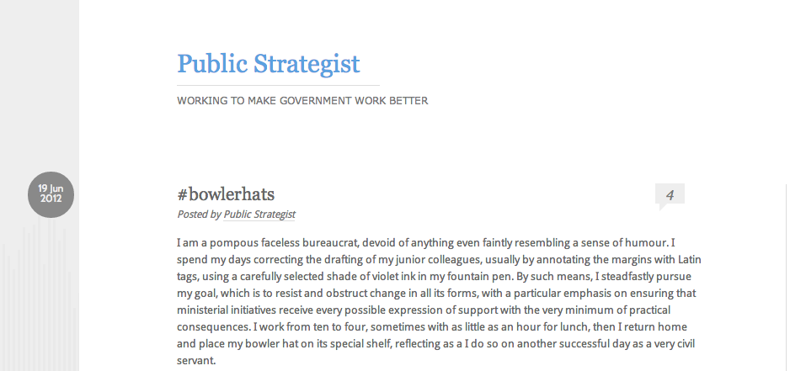
Louise
GDS
Notes:
That seems friendlier and more interesting than ‘agenda’ doesn’t it?

Slide 19
Got a problem?
What you need is a
LinkedIn group!
No.
Louise
GDS
Notes:
That seems friendlier and more interesting than ‘agenda’ doesn’t it?

Slide 20
Why is no one
talking to us?
Did you ask them any
questions?
Louise
GDS
Notes:
That seems friendlier and more interesting than ‘agenda’ doesn’t it?

Slide 21
Lessons
Louise
GDS
Notes:
That seems friendlier and more interesting than ‘agenda’ doesn’t it?

Slide 22
Don’t feed the trolls.
Set objectives. Measure.
Have clear house rules.
LinkedIn groups are not the
answer to everything.
Open policy making doesn’t
have to be big stuff.
Bring a sense of humour
(and perspective)
Louise
GDS
Notes:
That seems friendlier and more interesting than ‘agenda’ doesn’t it?

Slide 23
Quick plug.
Last week we released our Digital by
Default Service Standard.
It explains exactly how we do what we
do.
Read it. Ask questions. Feedback.
Louise
GDS
Notes:
That seems friendlier and more interesting than ‘agenda’ doesn’t it?

Slide 24
Louise Kidney
Digital Engagement Lead
Government Digital Service
@loulouk
Notes:
Maybe your title too
GDS logo

