Slide 1
Really useful stuff

Slide 2

LocalGov digital
Open by default and digital by design
LocalGov Digital are a practitioner network created and functioning in the spirit of local government's sector-led improvement agenda.
The overarching purpose is to raise standards in web provision and the use of digital by councils across the country, and to create a digital framework that is flexible enough to respond to local needs.

Slide 3
Local Direct and LocalGov digital are joining forces to hold 4 joint events this year
Focussing on digital inclusion and assisted
Carlisle and Warwick are finalised

Slide 4
Home Swap/Mutual Exchange
It is a legal requirement that all councils (and housing associations) promote this/make available a link to one of the home swap websites that are signed up to operate the scheme.
As part of research into a request for changes to this page…
https://www.gov.uk/apply-swap-homes-council
…it became clear that not all councils are using these websites or have content relating to home swap on their site.

Slide 5
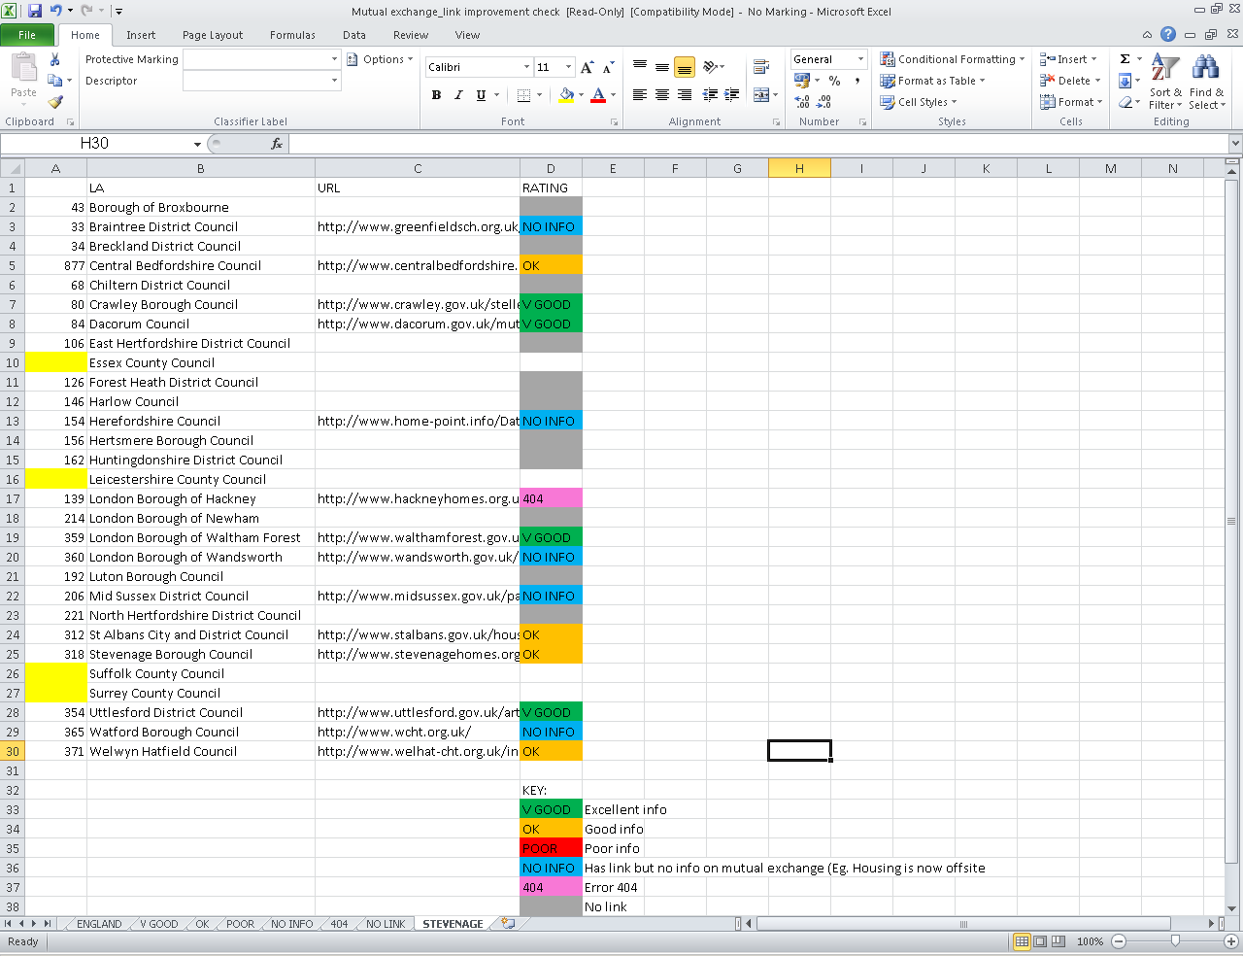
Home swap review

Slide 6
Street parties
Remember the Royal wedding?
Communities and Local Government want to make it as easy as possible for local communities to arrange street parties
Our review shows that a lot of councils do not have user- friendly application forms
Get your websites ready for the summer months and keep the red tape to a minimum

Slide 7
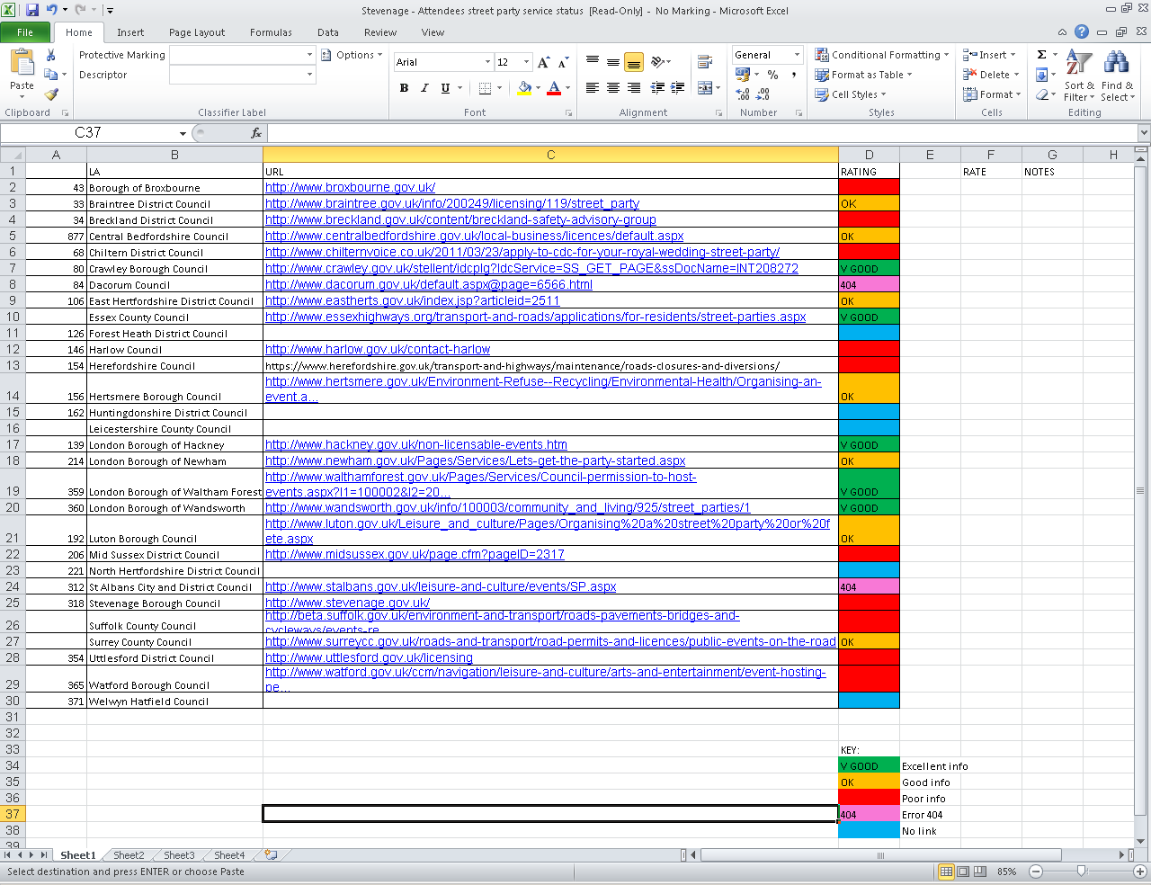
Street Parties

Slide 8
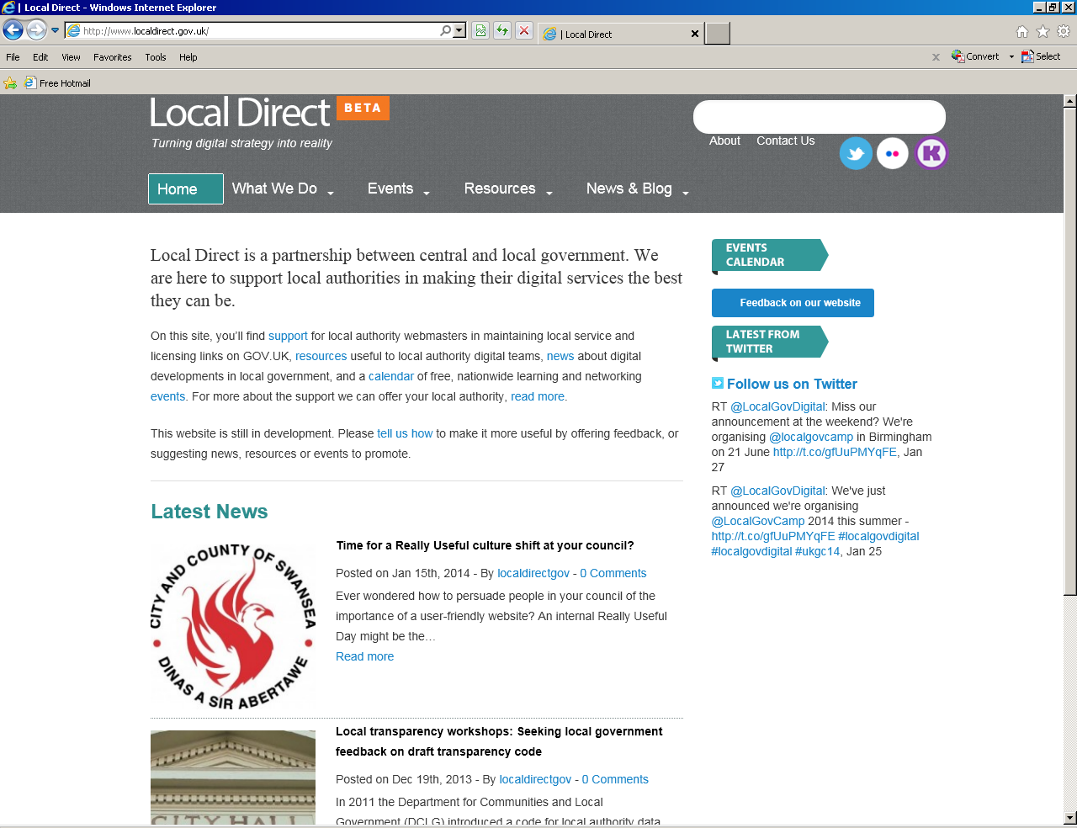
Local Direct website

Slide 9
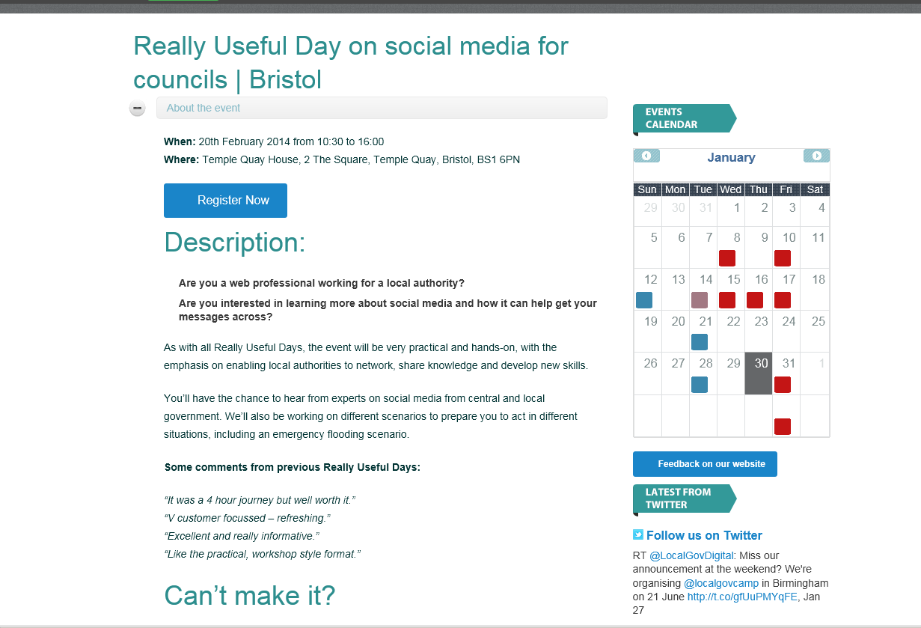

Slide 10
