Slide 1
Website Migration:
A tale of unexpected events
Dawn Turner - Senior New Media Officer

Slide 2
Hello..
Slide <number>

Slide 3
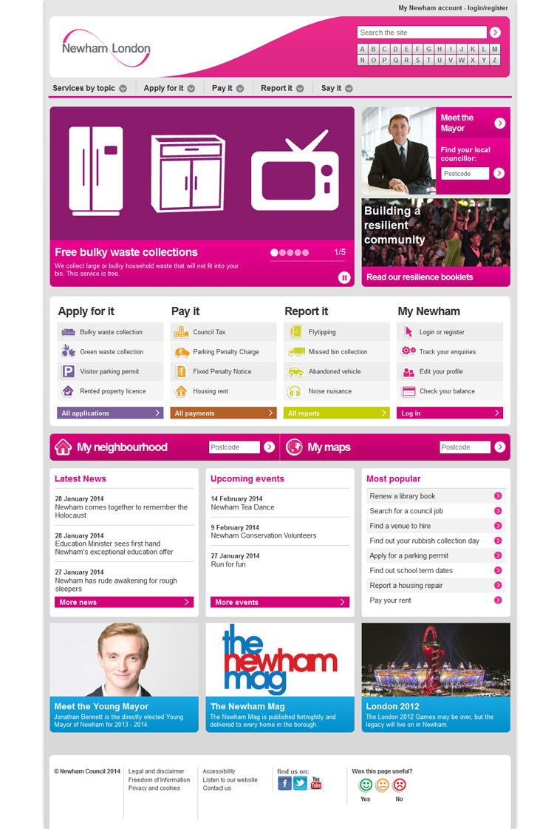
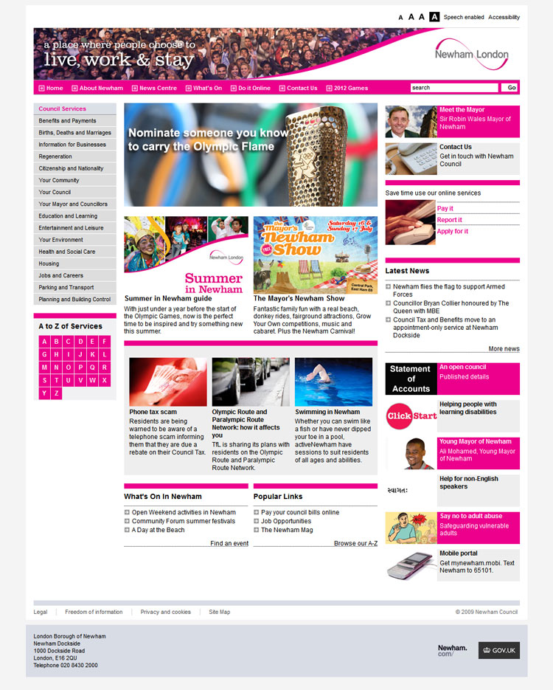
Slide <number>

Slide 4

Centrally managed website
Dedicated content owners
Concise information written for web in plain English
Attractive and intuitive design
Slide <number>

Slide 5

But in reality..
We were given a website
Council not digitally switched on
Whole website needed to be re-written
Slide <number>

Slide 6

Make sure you recruit the best
Slide <number>

Slide 7

Secured a project sponsor
Invited ourselves to senior management meetings
Contacted the people who would be helping us to write the content

Slide 8
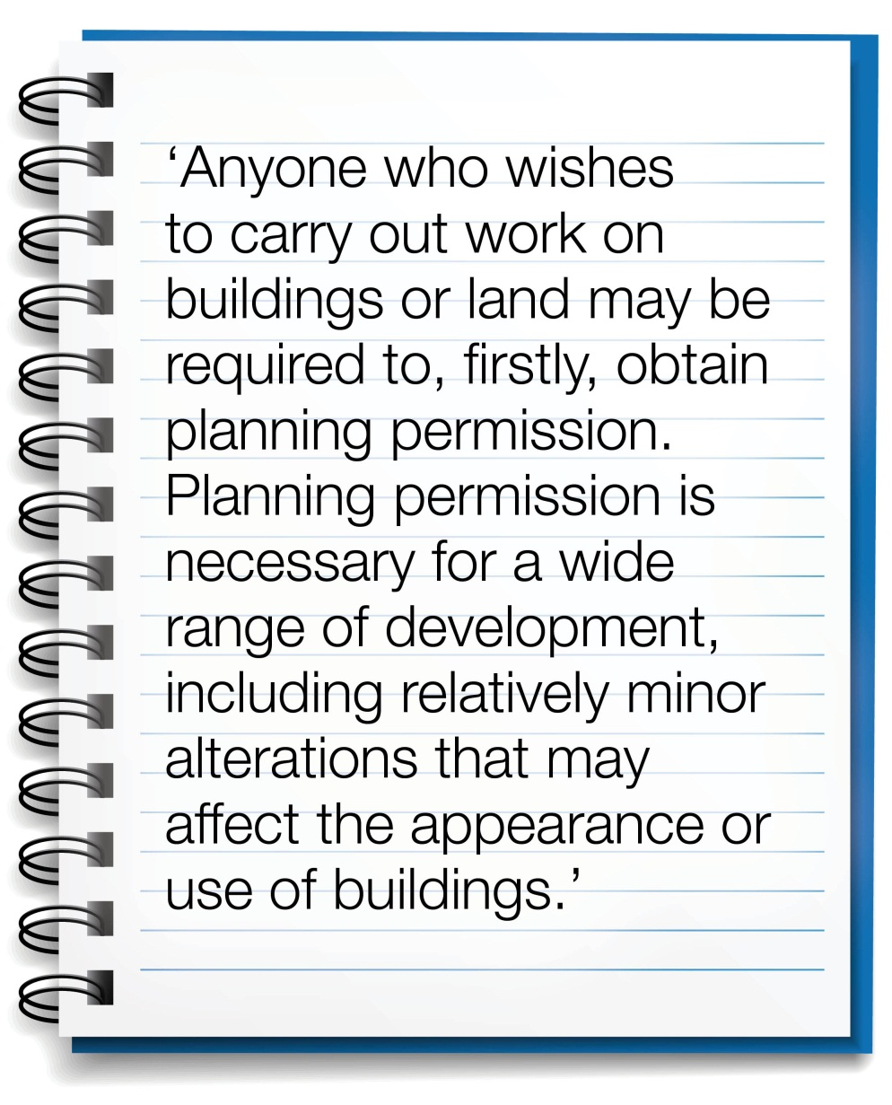
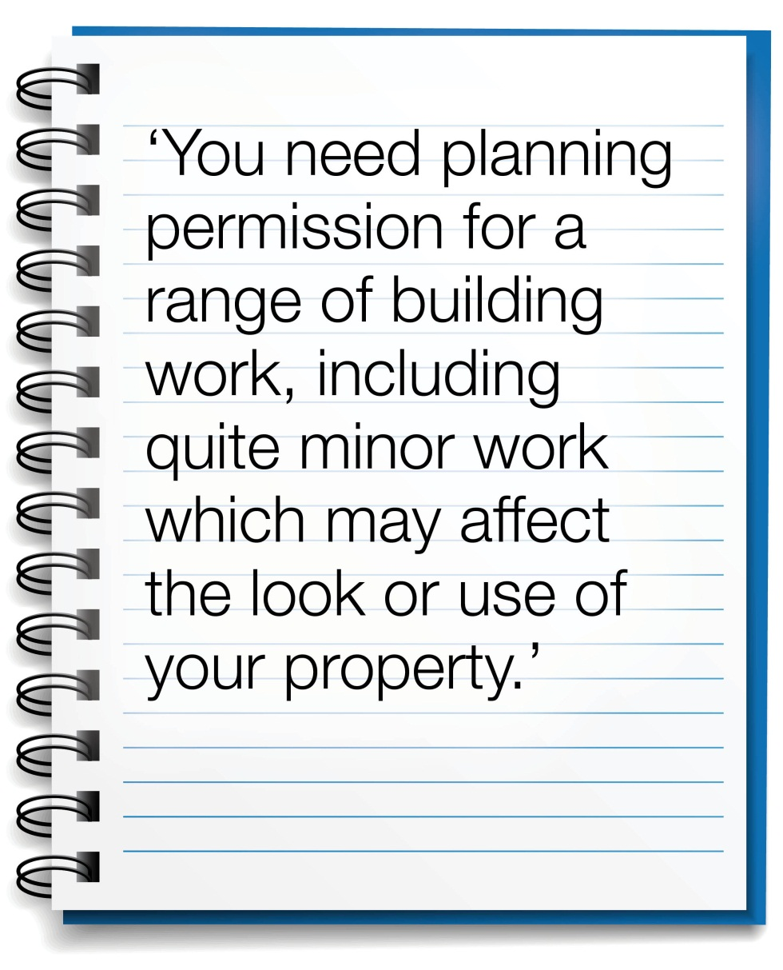
Our plain English mission
Slide <number>

Slide 9





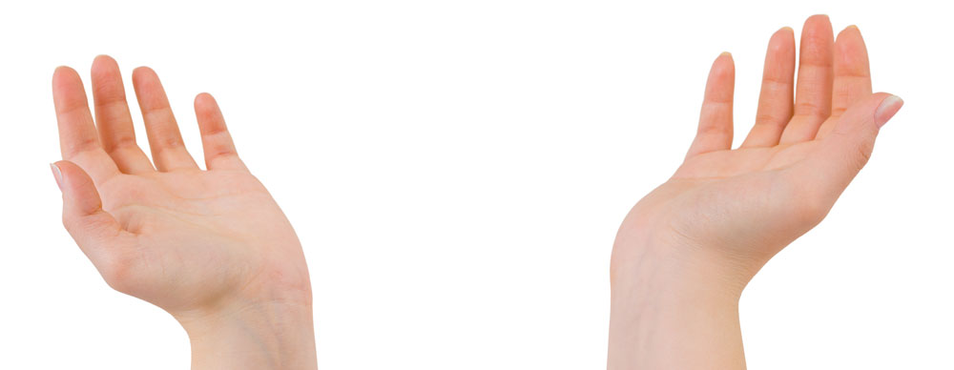
Style guide
Documents
New CMS
Two teams, two sites
2012 Games
Slide <number>

Slide 10
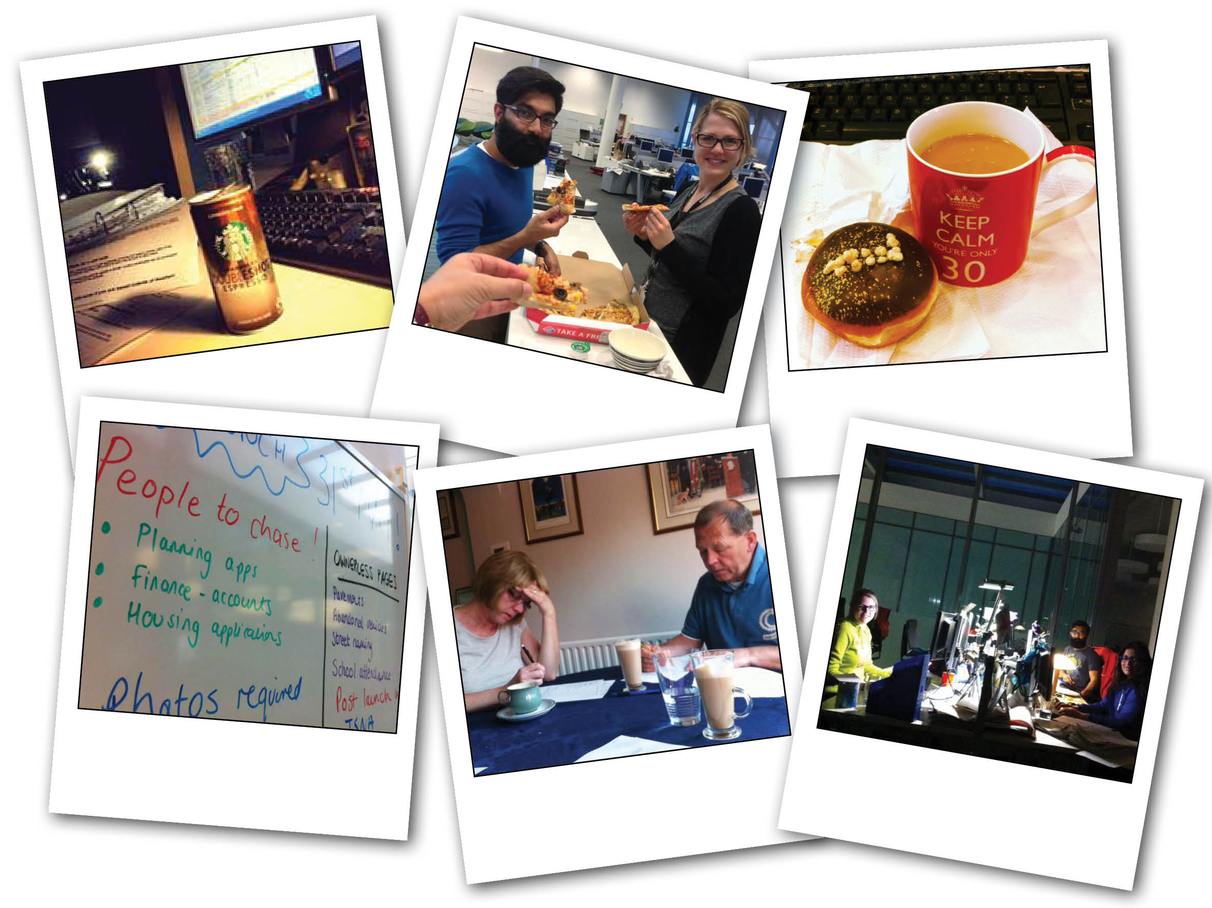
Slide <number>

Slide 11
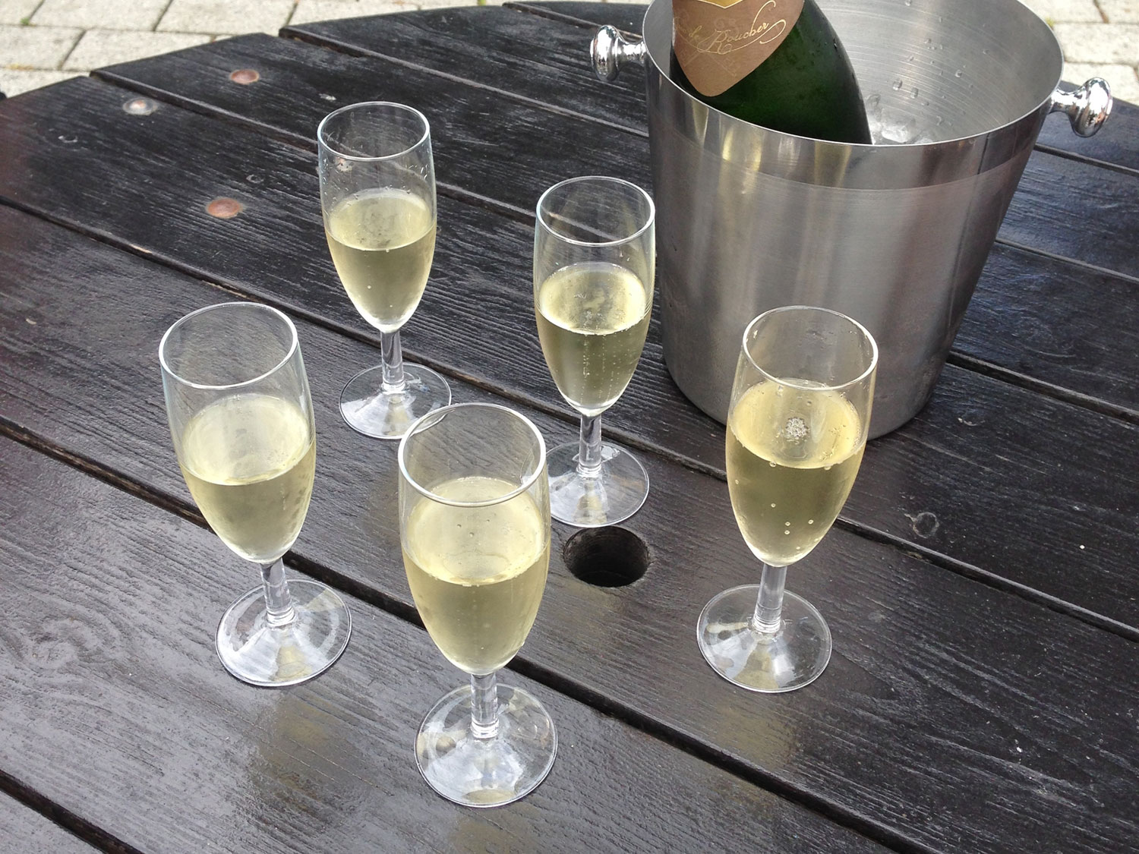
Slide <number>

Slide 12
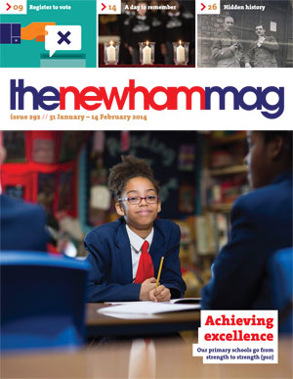
The journey continues..
Review dates for all our pages
Dedicated and trusted content owners
Centrally managed
Senior management panel
Accessibility work
Marketing of our digital offering
Slide <number>

Slide 13
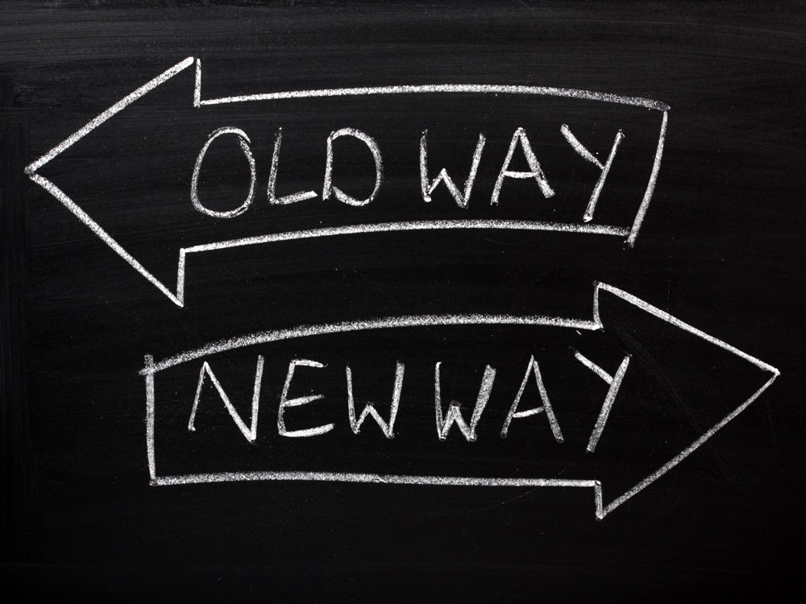
Slide <number>

