Slide 1
Backstory eDelivery

Slide 2
Drivers
Customers
Business Strategy
Government Agenda
Ageing IT architecture

Slide 3
Current Services
Most of our current services were created for the paper world
Silo approach no connection
We’re now working in a digital world – 82% of adults in the UK are online
Most of our customers work digitally
Growing interest in data

Slide 4
Future Services
Redefine our services – really understand customer needs
Join services together in a way that makes sense to customers – tailored interaction
Customers tell us once
Exchange data with customers
Re-use data supplied by customers to create register updates/new registers online for verification by staff

Slide 5
Digital Service Overview
BPM tools
Notional
Register &
Plans
Improved
Data
Quality
Register Update
Register Create
Future
- Increased customer self service
- Greater opportunities for automation
- Focus on LR skills
Data
Validation
(RFT)
Official Copies
Active titles
Spatial
Data
SIM OC DEV
Map Search
Re use of data
Today
- Limited customer self service
- Limited automation
- Double key of customer data
OS GIS Dealings
Notes:
Visual representation
Key names leading on projects
Use of Business Process Modeling tools. This allows the business to control workflow rather than IS. Redirect work delivered electronically

Slide 6








3. Objectives and initiatives
Customer experience roadmap
Future
Digital by Default
Improved customer journey
Customer insight
Customer self service
Lower costs
Digital by Default
& Customer Experience
Empowered &
informed
contact
“My Account”
Efficient
communication
Personalised
experience
Customer
Insight
Enhance web & Social media
Single View
of Customer
Intelligent
Channel Routing
Published
Information
CRM
Process savings
Re-engineering
Today
Many ways to contact
Not a joined up experience
Limited view of customer
Little self help
Time line
& Efficiency

Slide 7
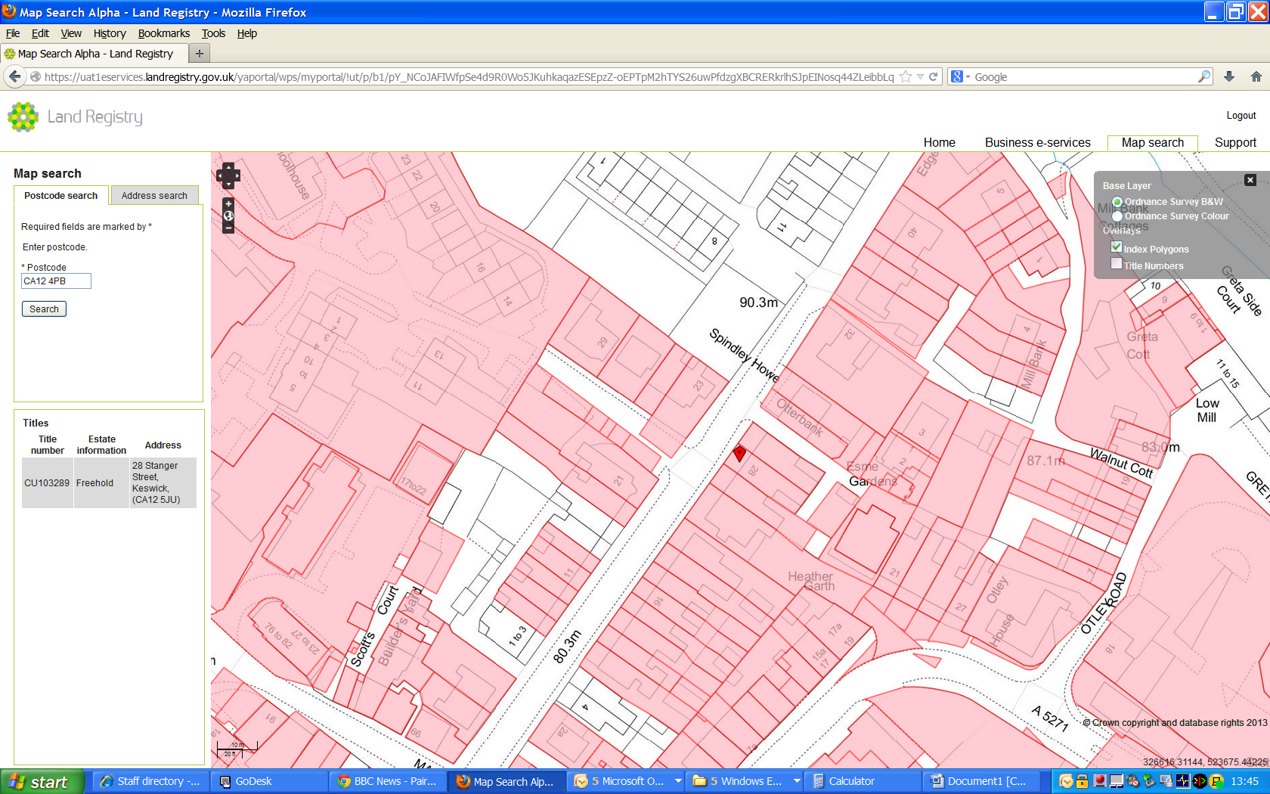

Slide 8
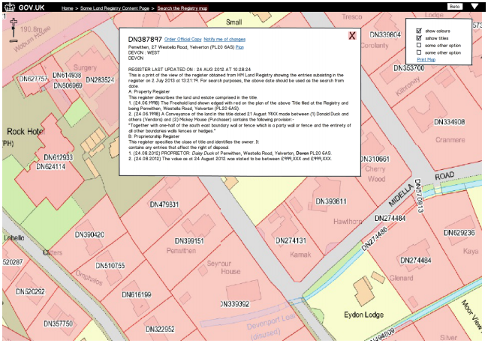

Slide 9

Digital services
Casework systems and processes
Supporting IT Infrastructure

Slide 10
Land Registry Map Search Overview -- A Simple How to Use Guide – YouTube

