Slide 1
Smart Procurement – DCLG Digital Saving through collaboration and frameworks 28 January 2014
Gary Griffin for Geoff Connell – Director of ICT LB Newham & LB Havering

Slide 2
What I will cover
Who am I?
How it works – sub-regionally and regionally
What we are doing
What we plan to do
Though not necessarily in that order
Questions?
Notes:
Good morning, I am not Geoff Connell, my name is Gary Griffin I am an ICT Service Delivery Manager for the London Borough of Havering. Havering operates as part of a joint ICT service with the London Borough of Newham, Geoff my boss is a Newham employee. Havering and Newham are creating a shared service to join together all of the back office

Slide 3
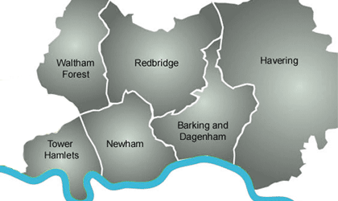
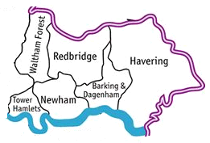

East London Solutions
Notes:
Purpose
To reduce ICT overheads through shared service provision or joint procurement.
To improve the effectiveness of ICT systems in the boroughs through shared knowledge, skills and IP assets.
To standardise systems and processes, removing technological barriers from wider sharing of staff or services.
Objective
By 2020 there will be more shared infrastructure, systems and services, but not one size fits all.
Principles
Each borough leads on a different component and shares knowledge with the others
ICT Strategies and approaches will become aligned over time where beneficial to each authority.
Move at the pace of the fastest but allow others to join in when ready

Slide 4
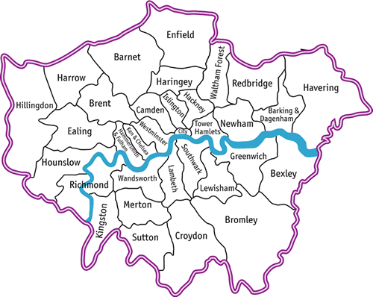
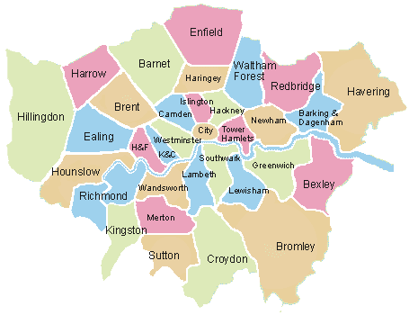
ELS Customer Services Technology Collaboration
Notes:
Newham, Havering & Waltham Forest – are sharing the systems and processes embedded in the systems to provide better customer service, particularly online at the lowest possible cost.
Others have expressed interest at joining in. Even if they don’t join in other boroughs have been benefitting from the lessons learnt as we go through the process.
Looking for a future development partner to take to market.

Slide 5
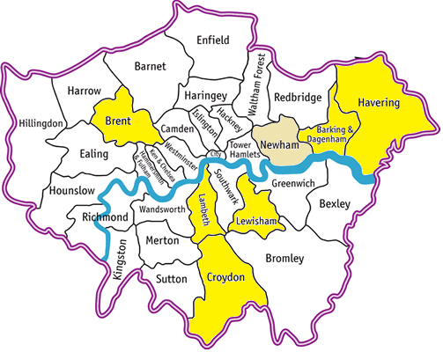

London Wide ICT Partnership Working
Notes:
As well as Newham & Havering + wider ELS joint ICT developments, we have participated in…
London Connects for the 33 London LA CIOs, plus rep’s from health and various other groups such as ISfL.
We have also teamed up with the procurement community in order to drive standardisation and cost savings through better ICT category management and strategic supplier relationship management. I will come onto this further on the next slide.
Athena & One Oracle. I have highlighted the first wave of One Oracle partners in yellow, with Newham as a second wave partner in gold. One Oracle was born out of a programme called Athena which started in the Society of London Treasurers around having a single chart of accounts and then became moving onto single versions of financial, HR software being used within the boroughs. There are 6 boroughs going live with One Oracle with Newham joining next year. Went through a tender, but from a framework and created a framework for other boroughs to join.

Slide 6





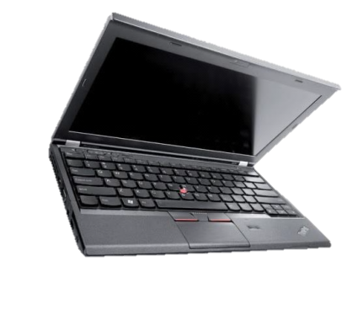

What we’ve achieved so far
Notes:
Effective partnership with key CIOs, procurement leads & GPS. This was mapping how much we all pay for day rates so we could have complete transparency of how much ICT suppliers were costing. This enabled us to get the best price, suppliers saw this as a positive thing as it allowed them to standardise the offer, which makes them more efficient and benefits us. An example is a MOU with Northgate & some other key suppliers on day-rates, etc, and an extended SRD programme.
Extended partnership with GPS – now a dedicated team of 3 senior staff led by Will Laing, reporting to Terry Brewer as category lead.
A collaborative wireless concession contract – the first for participating Boroughs (£10-20m expected income over 10yrs).
An agreed programme of work on future procurement and technology priorities.
Achieved over £2 million in cashable savings through coordinated ICT procurement.
eAuctions: Achieving average savings of 14% on hardware and 50% on mobile phone costs.

Slide 7
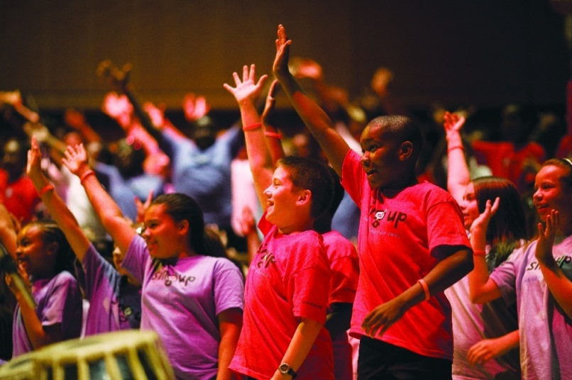
Thanks for Listening. Questions?
geoff.connell@newham.gov.uk
will.laing@gps.gsi.gov.uk
will.laing@camden.gov.uk
7

Slide 8
Contact Details Gary Griffin & Geoff Connell gary.griffin@havering.gov.uk geoff.connell@newham.gov.uk

