Slide 1
A Linked Data Pilot for Air Quality
Steve Crawshaw - Bristol CC
Brian McBride – Epimorphics Ltd.
Notes:
Brian, do you want to insert your logo on the pages? I tried but it came out black

Slide 2
Contents
Air Quality Management – Context
Customers
RU Day #1
The Linked Data Pilot - Demonstration
Notes:
Anything to add?

Slide 3
Air Quality Management
Health cost £20bn = 29,000 people dying 11 years early
Duty for LA’s to manage Air Quality (>1997)
Traffic pollutants – NO₂ & PM₁₀
Annual reports to UK government
Air Quality Action Plan for non complaint areas
UK is currently non – compliant with EU limits

Slide 4
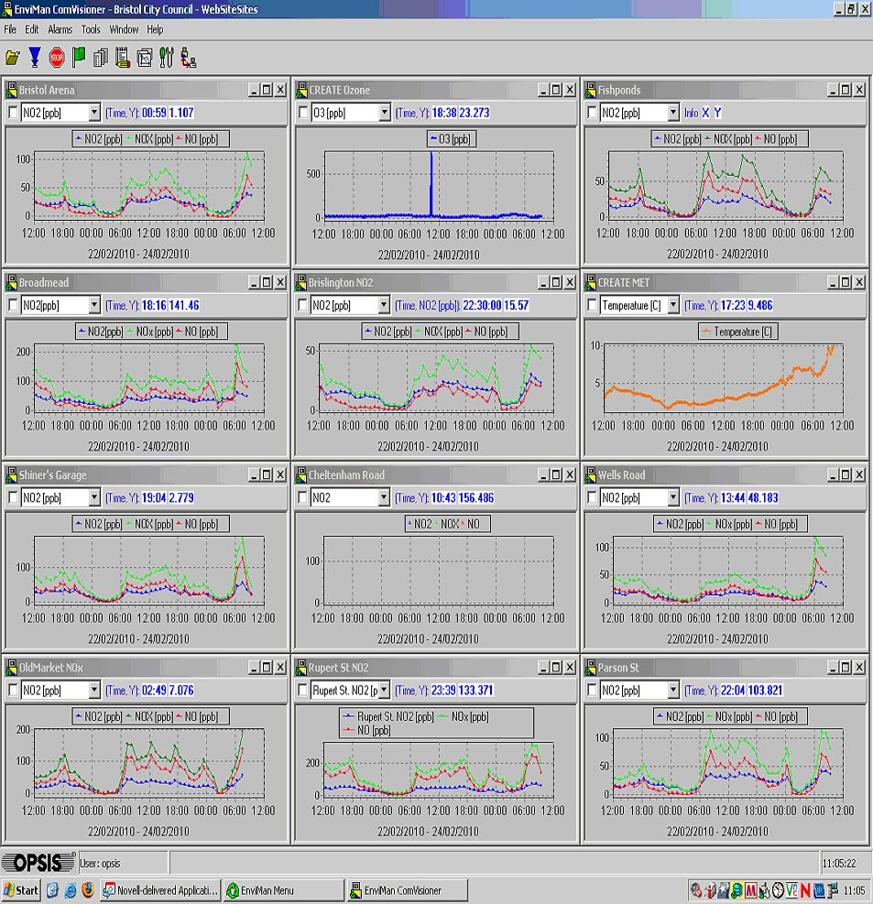
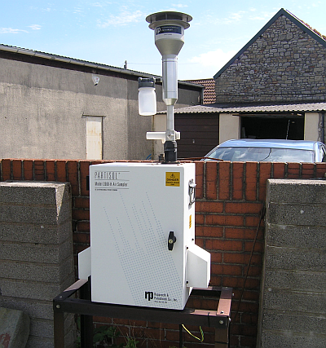
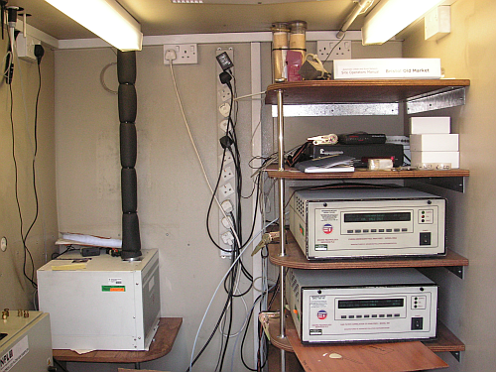
Air Quality Monitoring
Notes:
Discussion of the continuous analyser network, data collection \ telemetry, pollutants, QA \ QC regime

Slide 5
Customers
Bristolians
  What is AQ like where I live?
  What are the council doing about it?
UK Government \ Defra
  Strategic reporting
Academics
  Time series data
Consultants
  Summary data
Notes:
…as this day is all about customer journeys..

Slide 6
Really Useful Day #1 - London
How can we improve the customer journey by better use of public sector data?
Ian from Epimorphics & me
Our idea: Air Quality Sat – Nav App
Extend route planning software to include Air Quality
  Avoid polluted (congested) routes)
  Raise awareness of responsibility for pollution
  Behaviour change

Slide 7
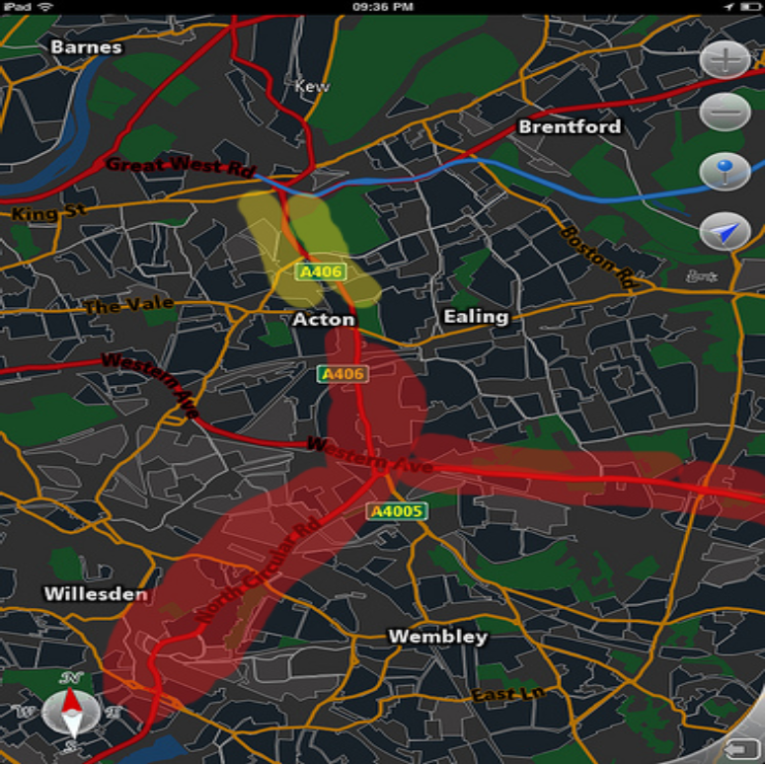
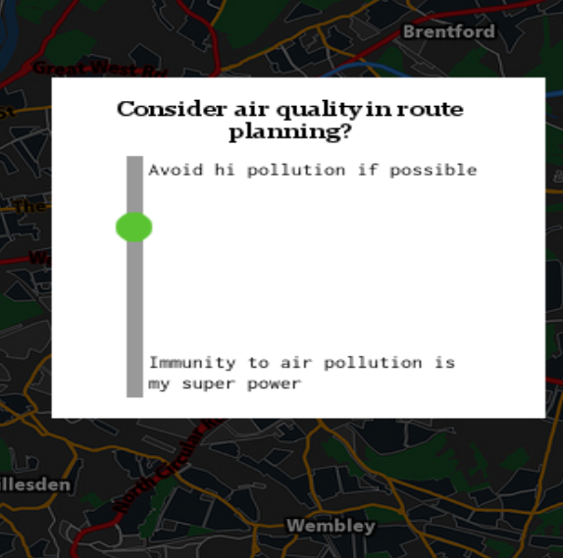

Slide 8
Data Platform
AQ data, like most data, does not live in isolation
AQ data is related to weather, traffic, health
Data Platform should support
  linking data from multiple sources
  Presenting data in different formats
  Accessing the data in a generic way
Notes:
Brian, your bit next..

