Slide 1
Online Licensing
Government Digital Service
GDS

Slide 2

License applications / renewals 2011
Premises | Club | Personal | TEN | Taxis | Drivers | Gambling | Total
200,000 | 17,000 | 430,000 | 123,000 | 78,002 | 143,333 | 13,292 | 1,004,627
Approx 5% online
GDS

Slide 3
The current system....
GDS

Slide 4
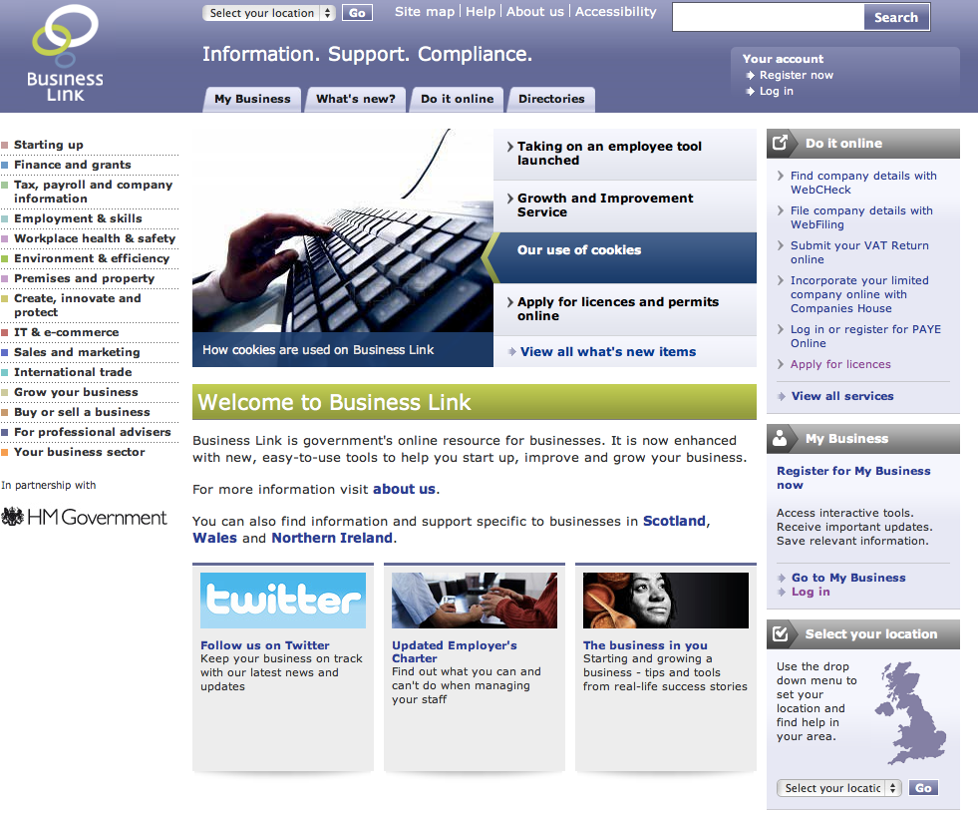
GDS

Slide 5
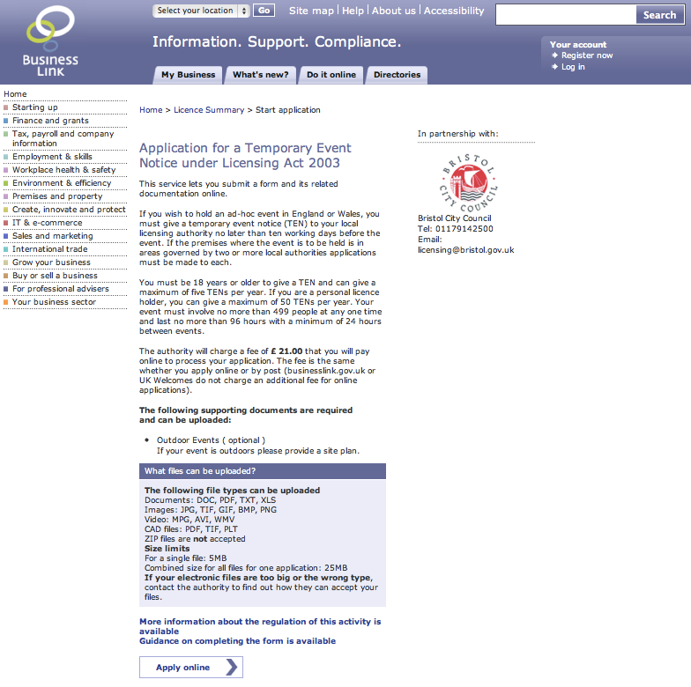
GDS

Slide 6
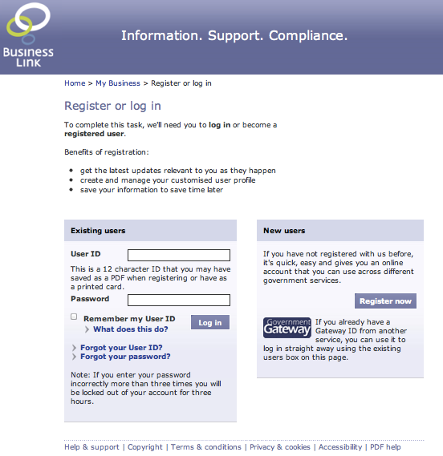
GDS

Slide 7
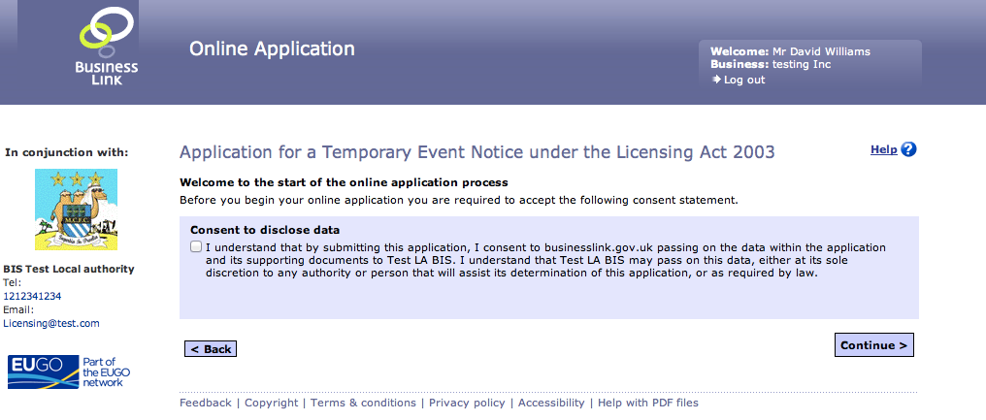
GDS

Slide 8
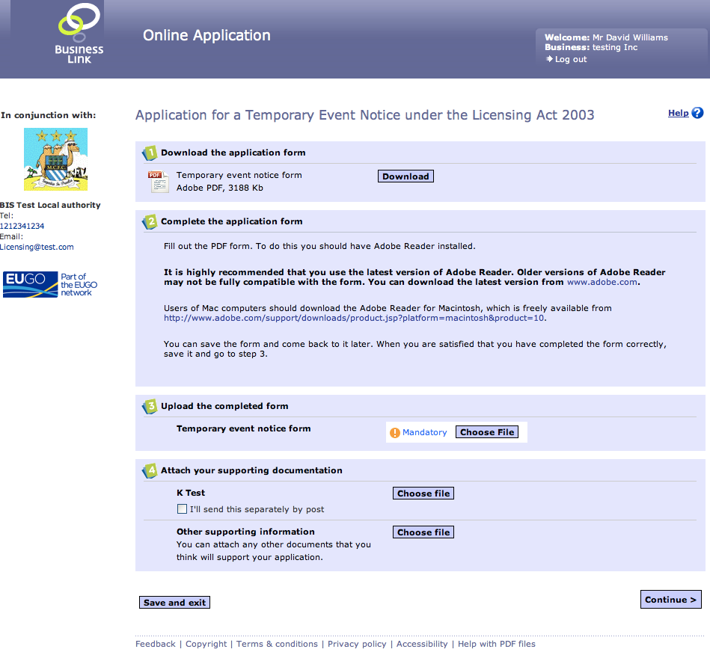
GDS

Slide 9
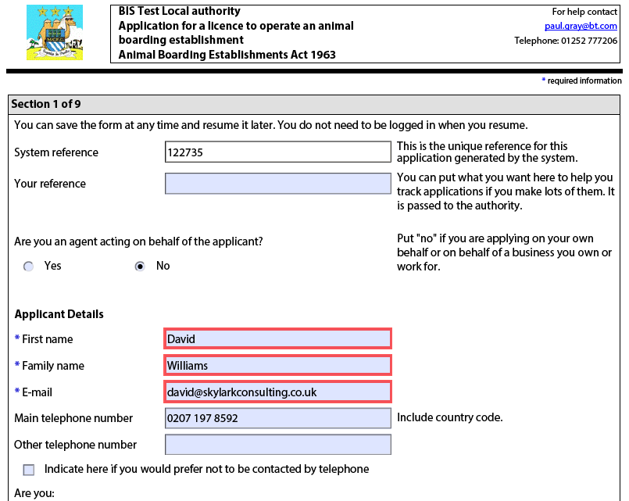
GDS

Slide 10
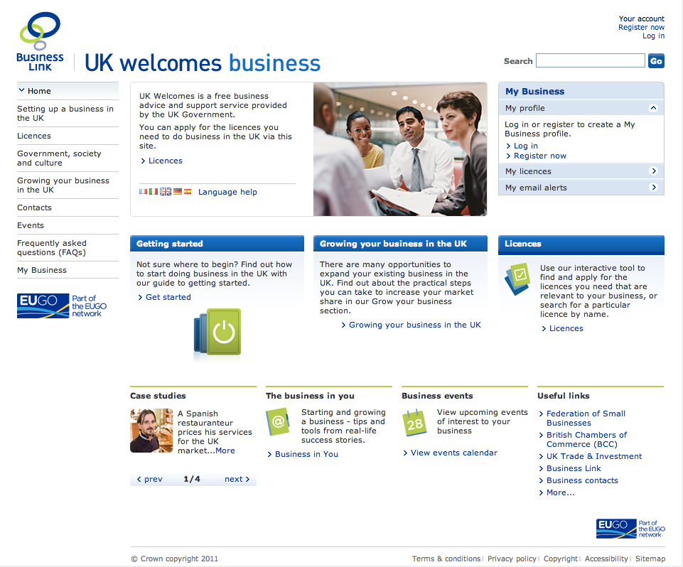
GDS

Slide 11
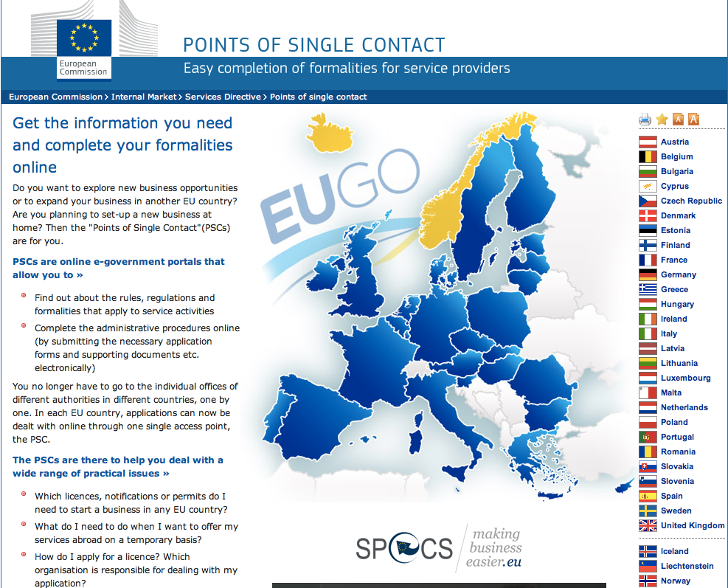
GDS

Slide 12
The new world....
GDS

Slide 13
We're looking at the whole licence journey
GDS

Slide 14
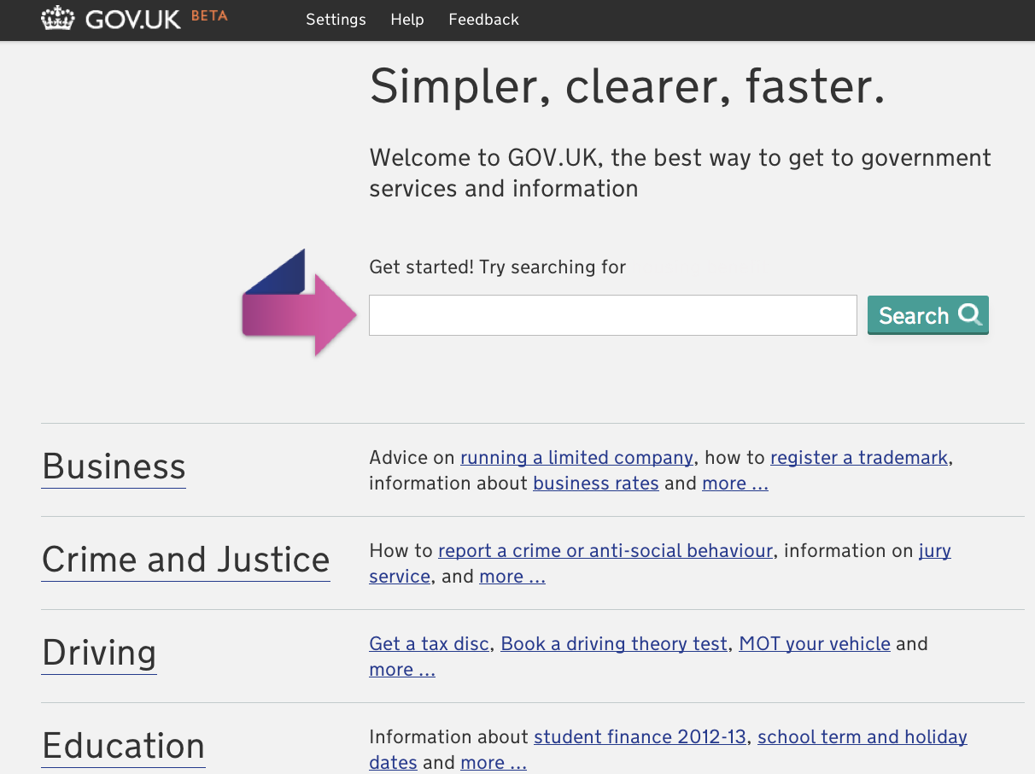
GDS

Slide 15
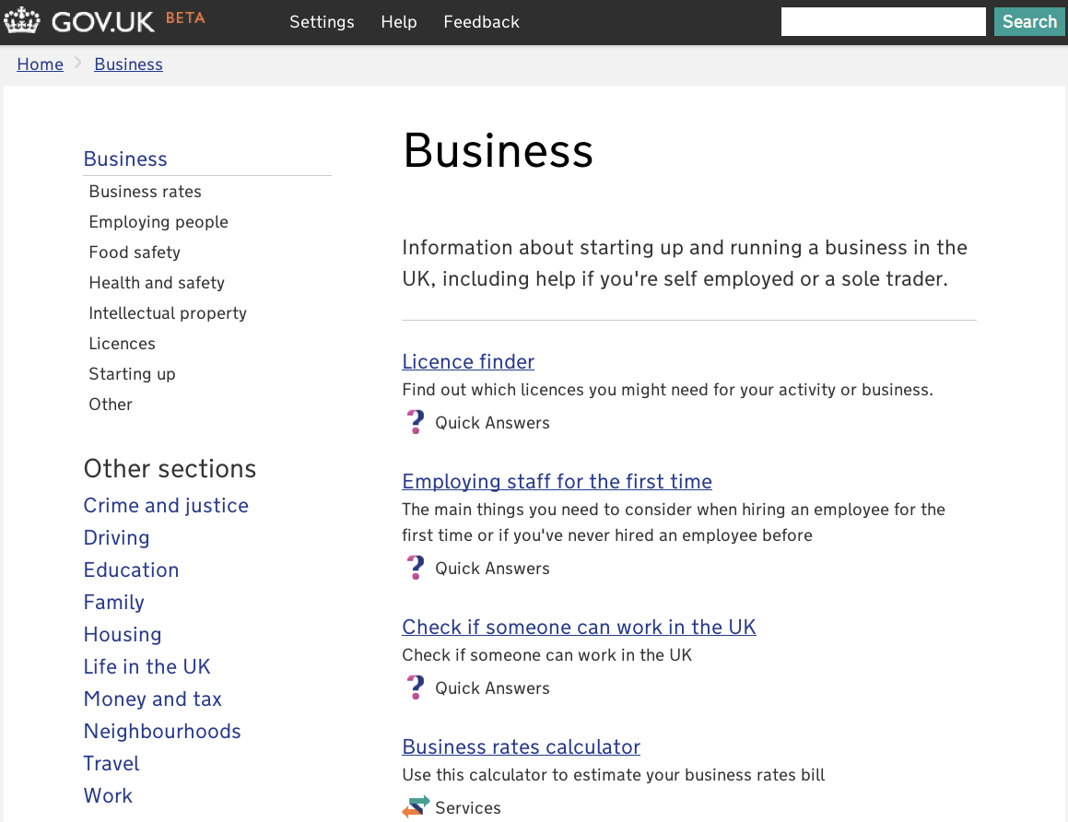
GDS

Slide 16
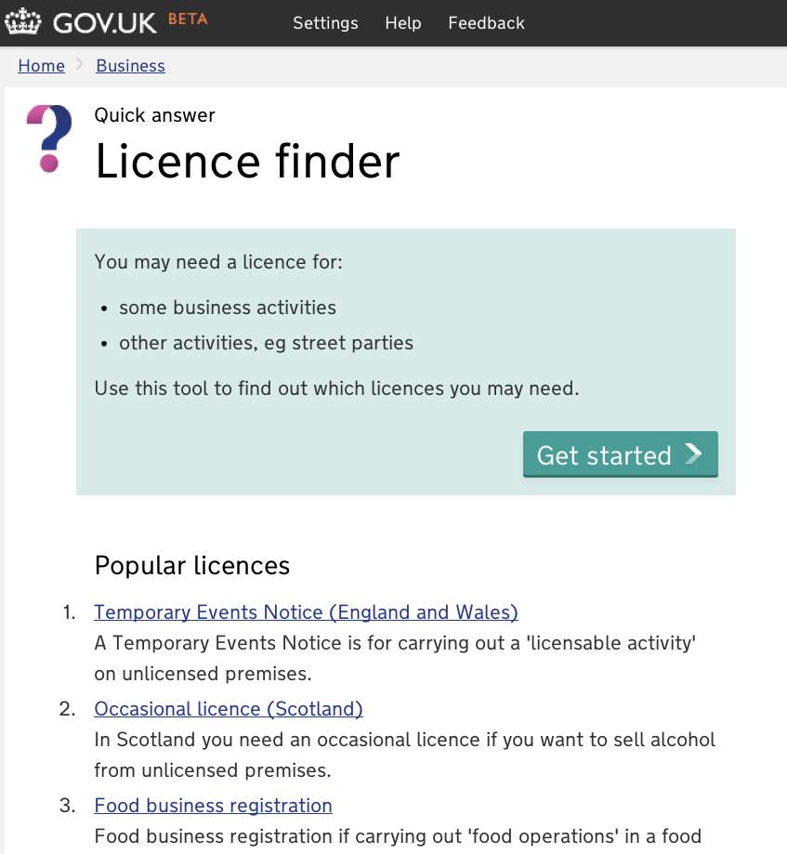
GDS

Slide 17
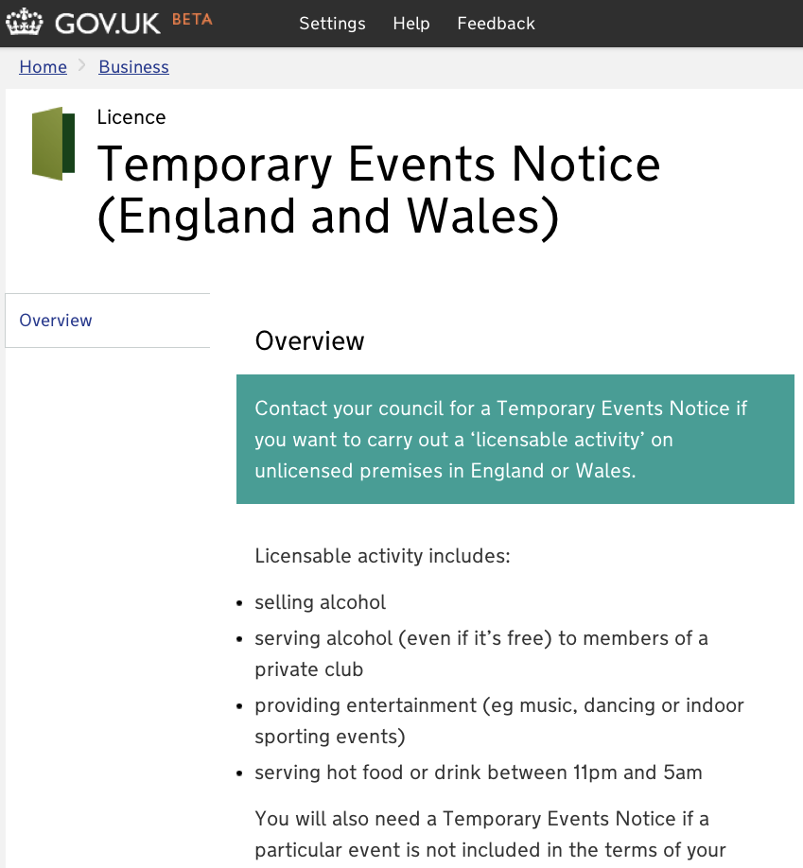
GDS

Slide 18
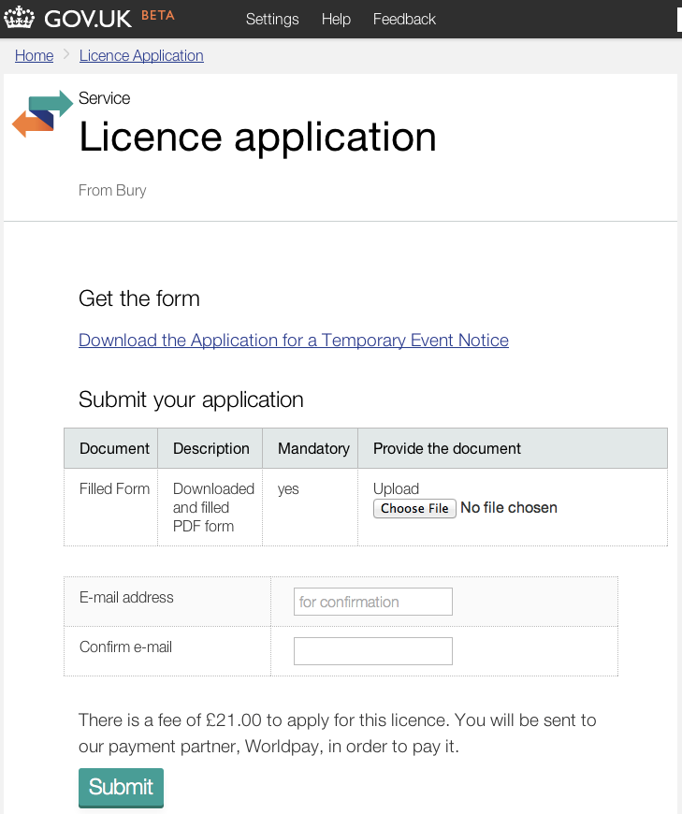
GDS

Slide 19
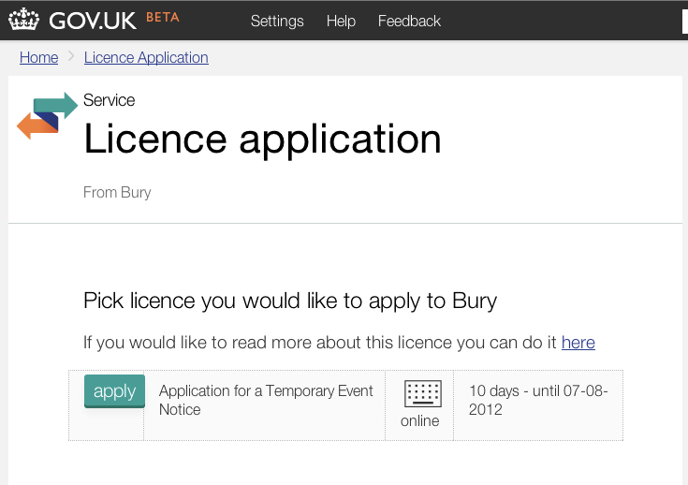
GDS

Slide 20
On the 17 October, GOV.UK Licensing will be launched for members of the public and businesses.
At this point the ability to apply for new licenses through ELMS will be switched off. You'll have two weeks to download the applications from ELMS before ELMS is switched off totally.
From the 17th you can use Licensing to access applications for licenses in your authority.
A test version, or 'beta', will be being launched very shortly so you can experiment with the system before it goes live.
If you're a user of ELMS, GDS will be communicating directly with you about the beta and any other things you need to do in the next week or so.
If you have any questions in the meantime, don't hesitate contact
businesslink-transition@digital.cabinet-office.gov.uk
GDS
Notes:
Service continuity
Current PDF forms retained
Improvements to user journey...
Web forms
Data extraction
Additional (non PSC) licences

