Slide 1



Facebook and community Engagement
Alison Hook

Slide 2

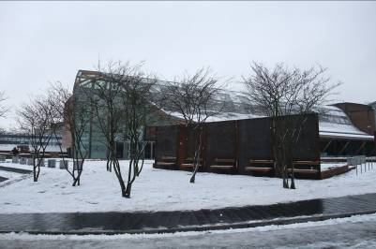
In January 2010 we had 527 fans...then it snowed.
Facebook growth

Slide 3
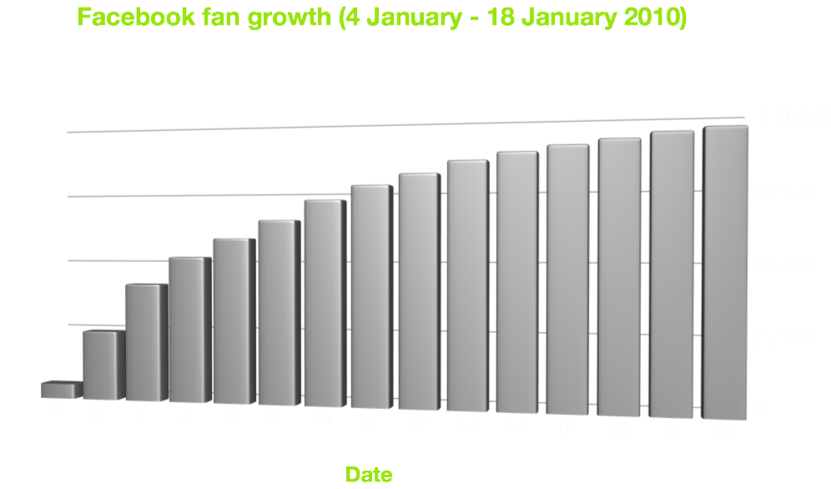
It snowballed.
Facebook growth

Slide 4
We have over 23,000 ‘likes’
More than 4000 unique visitors a week
Over 25% of new ‘likes’ join following a direct link
18% come from Facebook recommendations
50% aged under 25
Facebook growth

Slide 5
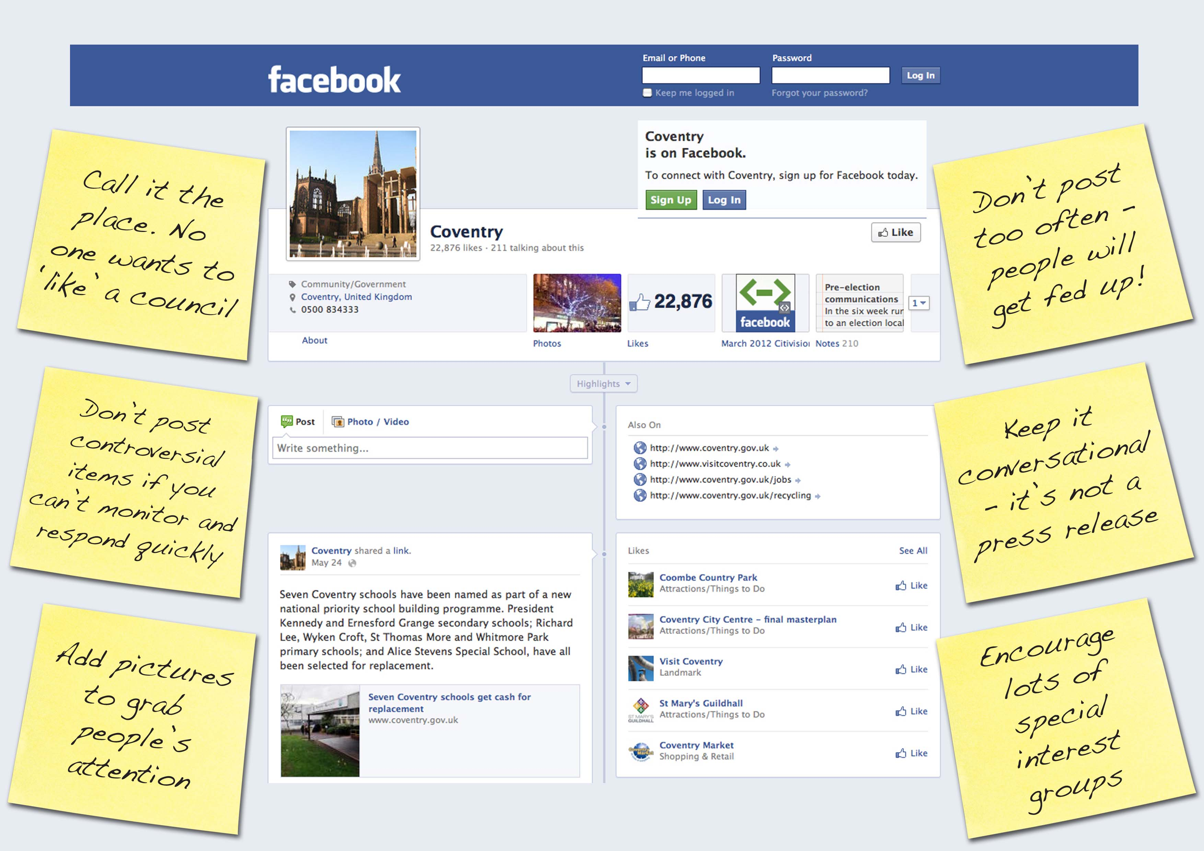
Facebook page

Slide 6
We share news, service updates, photos and videos - nothing is automated
We encourage conversations, and respond to direct questions
We don’t post more than once a day / a few times a week
We signpost to information already available online
We don’t have an overarching social media strategy
Facebook strategy

Slide 7
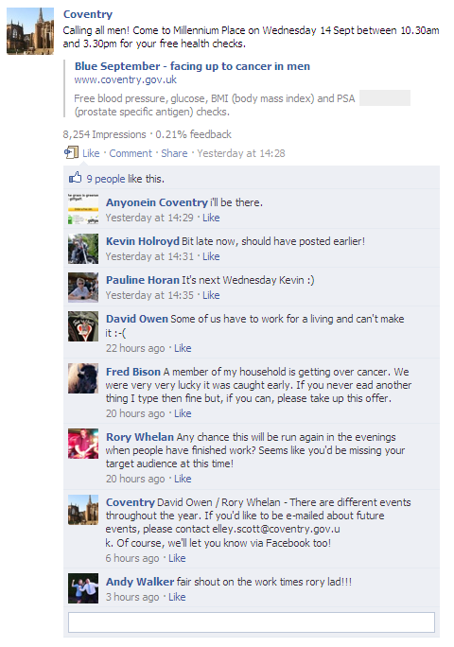
Facebook comments

Slide 8
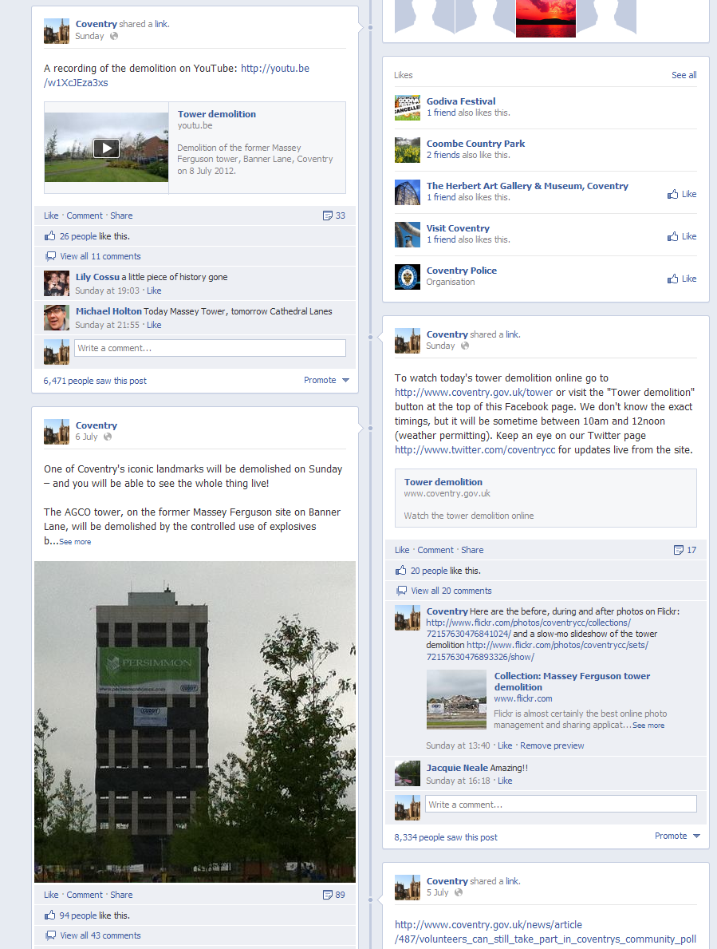
Facebook news

Slide 9
No cost to use Facebook, just staff time
Controversial posts aren’t added late in the afternoon
Managing the conversation
Day-to-day used as an additional channel – not the only channel
In emergencies, used as a primary channel, alongside Twitter
Facebook strategy

Slide 10

Spreading news

Slide 11
Facebook Page Insights show us demographics and how many people are reading and commenting on posts
Sport, employment news and road repairs are our hot topics!
75% of those who comment are over 45, however, 50% of fans are under 24
45% of new visitors to the Council website come from Facebook
Each visitor from Facebook looks at an average of three webpages
Evaluation

Slide 12
More details at
www.coventry.gov.uk/socialmedia
Thank you!

