Slide 1

leeds.gov.uk

Slide 2
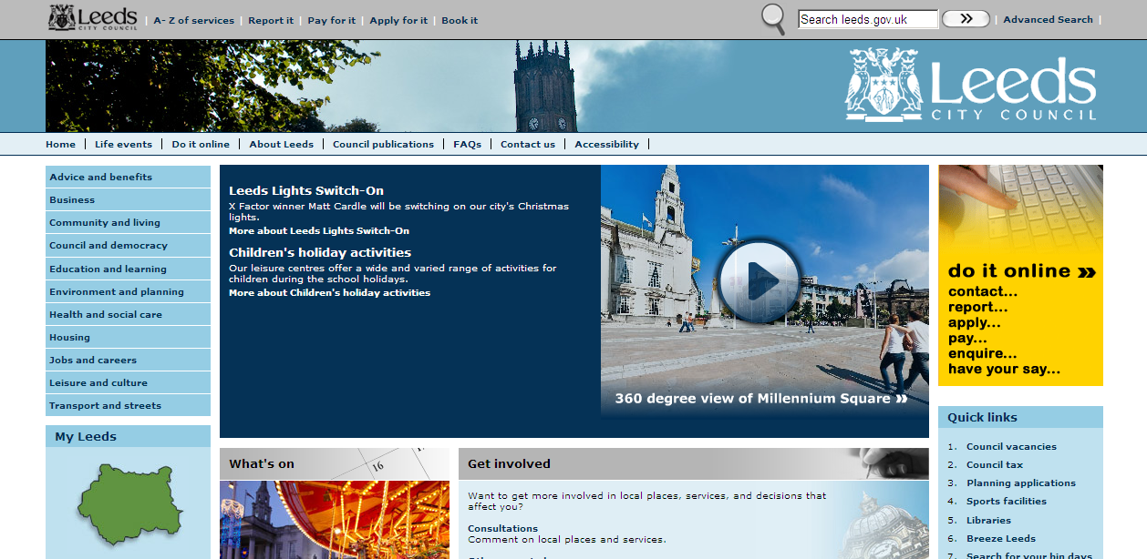
Old leeds.gov.uk highlights
Our top 25 pages account for 65% of our traffic (unique users)
5% pages never visited
10% pages not visited in last 6 months
60% customers come in direct from Google

Slide 3




What do our customers want?
Members of
the public
(These pages have ‘never’ been accessed)
65% of our website traffic …
… accesses just 1.25% of our pages
All pages and content
on leeds.gov.uk

Slide 4
Top 10 areas for the customers & staff
Customers
Staff
Jobs
How to contact LCC
Planning
Online services
Online payments
Housing
Sport
Museums and galleries
Libraries
Council tax
A-Z of services
Council and democracy
Council agendas and minutes
Jobs and careers
Environment and planning
Leisure and culture
Planning
Sport
Housing
Advice and benefits

Slide 5
Top 10 areas for staff
A-Z of services
Council and democracy
Council agendas and minutes
Jobs and careers
Environment and planning
Leisure and culture
Planning
Sport
Housing
Advice and benefits

Slide 6














leeds.gov homepage
Old homepage allocation
Allocation if done by customer demand
News
Jobs
What’s on?
Get involved
Planning
Sport
Recycle for Leeds
Press releases
Contact us
Online payments
Online services
Online services + other features
Housing
Everything else…
Notes:
Add new homepage link

Slide 7
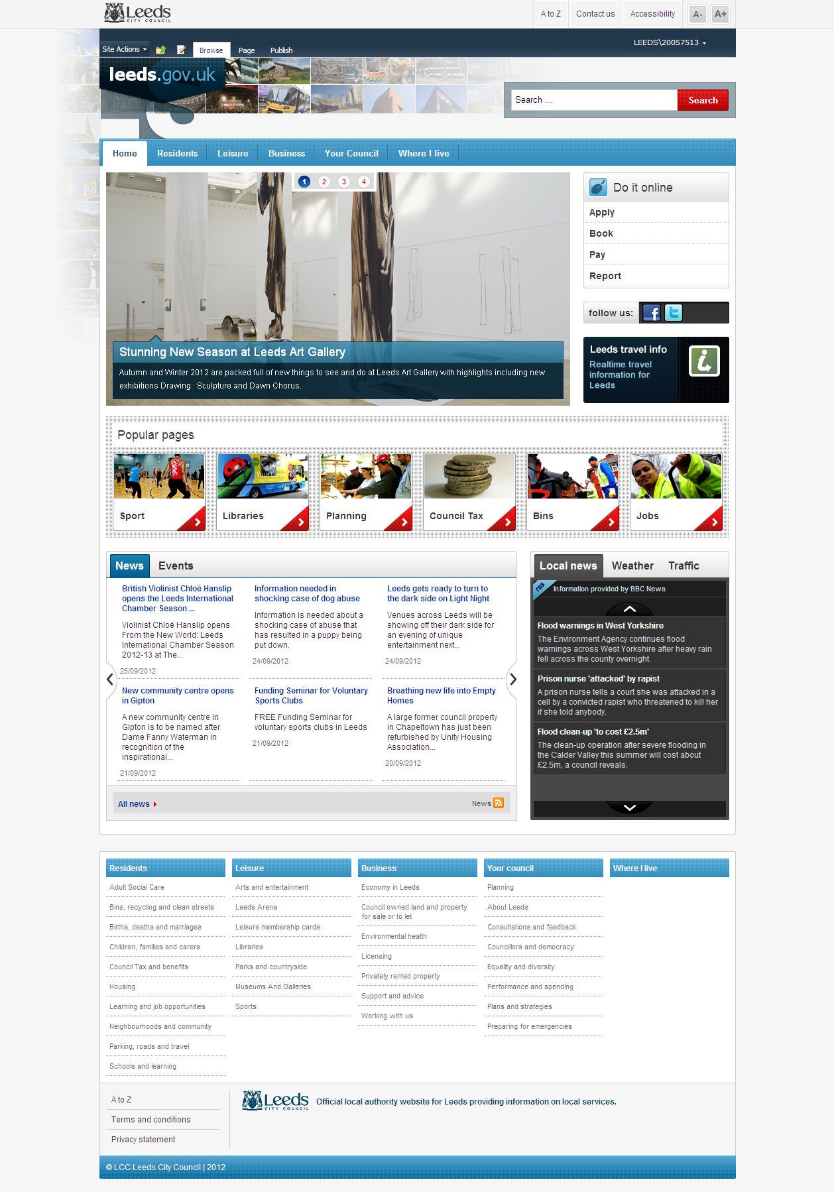

Slide 8
Our top ten forms
(September 2011)
How to make a complaint about noise
Change of address
Protected tree information and enquiry form
Complaints and compliments
Penalty charge notice (parking ticket) appeals
Citizen portal - help form (council tax)
Street cleansing online form
Website feedback
Report a road, path or pothole problem
Register for e-billing (council tax)

Slide 9
Unused content (pages)
Council tax prisoner discount form
Council tax hospital discount form
Council tax student discount form
International Leeds newsletter
Hackney Carriage Forum Constitution
Hypnotism licence
Indices of Deprivation 2010
Enterprise Leeds - Support for new businesses
Street Parties
How residential and day care has been assessed
and quite a lot more …

Slide 10
Documents
We had 6053 documents on leeds.gov (many duplicates)
Sports timetables are most frequently used
Sports timetables are the most frequently complained about

Slide 11

Little used content (downloads)
Statement of the spd matters.pdf
Abnormal loads ready for internet(1).pdf
cce-news 9th may 2011part1.pdf
2011-08-19 siu availability list.pdf
Citypriorityplanintranet lraw(1).pdf
Leeds homecare customer charter 2011(1).pdf
Bus start up cover info final oct10.pdf
Adopted wlg spd oct 2010 web.pdf
Inter 8c3257c4-443f-4af7-a419-3f1f9c078963 c3826886-7910-4729-9196-
578e747599c0.pdf
Cross hall infants school - appendix f - original copies of statutory
Undertakers response.pdf

Slide 12
Our web publishers
171 have been active in last 6 months – we have 354 – 48% active
43 regular (weekly) internet publishers 12%
This activity is unrelated to top tasks

Slide 13
Socitm survey – main criticisms
Sports timetables hard to find
Too much information
Can’t find information
Too complicated
Payments too slow

Slide 14
What does this tell us?
Our one sports publisher needs help
Our customers need even more help
We have too much content
We have too many downloads
Our homepage reflects internal demand
We’ve confused service with policy

Slide 15
Other local authorities
It’s not just Leeds
A similar story in…
Liverpool
Salford
Lincolnshire
Brent

Slide 16
Subsites
It’s a similar story …

Slide 17



Subsites
Museums and galleries
Current homepage allocation homepage by customer demand
Welcome text
Abbey house Leeds Art Gallery
Armley Mills
News
News
Discovery Centre
Kirkstall Abbey
Art gallery
Lotherton Hall
Temple Newsam
City Museum
Thwaite Mills
What’s on

Slide 18
Housing
Almos – homepages by customer demand
Rent a home
Contact details
Leeds homes
Repairs
Jobs

Slide 19
Leeds homes
Homepage allocation based on customer demand
Leeds homes
Log in
Search for home

Slide 20
Contact centre calls
Housing
Bins
Benefits
Adult social care
Registrars
Council tax
Children's services
Pest/pollution/noise/dogs
Education Leeds
Highways
Highest demand for a single service - bulky item removal (part of bins)
  4 clicks from homepage (if you know where it’s likely to be – then ring up)
Does not include planning/parking/libraries

Slide 21
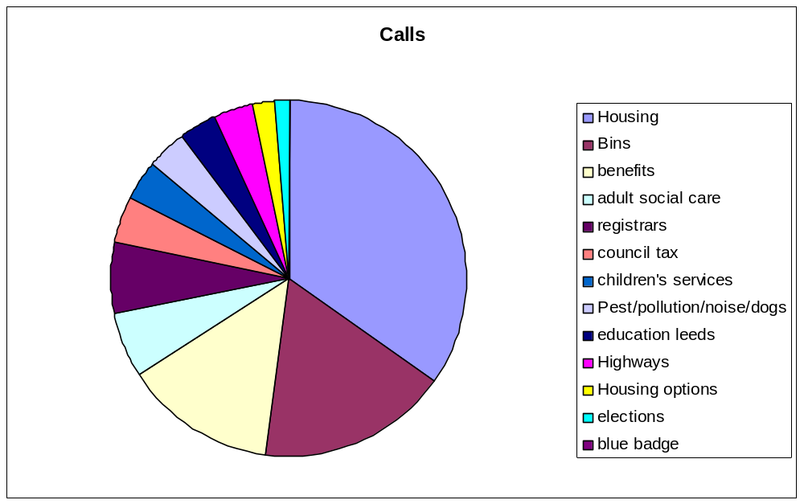
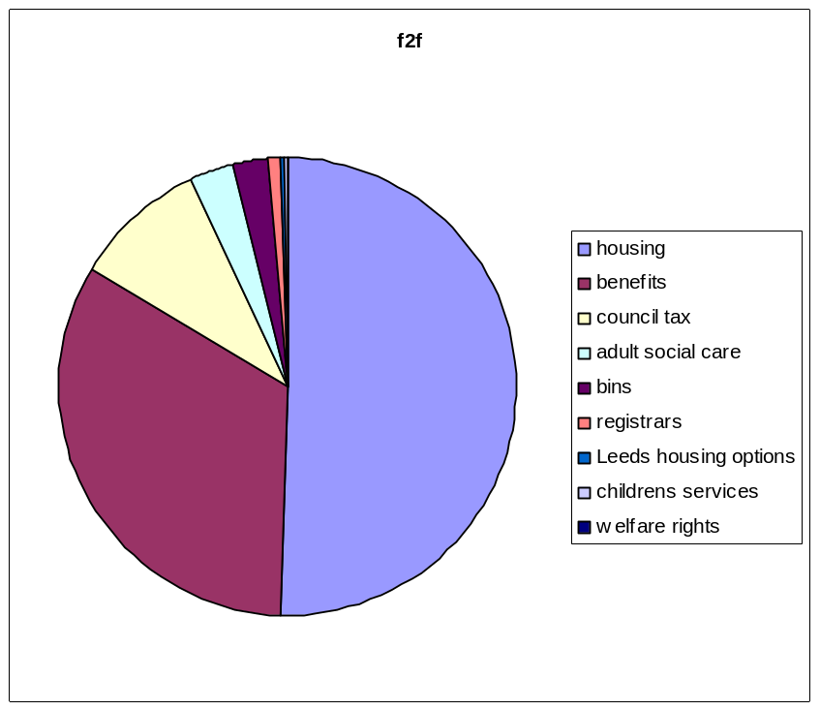
Telephone calls & Face to face contact

Slide 22
Face to face contact

Slide 23
Social media – most frequent
Twitter – traffic, bins, news, events, updates such as site closures (John Charles), schools – real time events, some rants
Re-tweets for events, real time events,
Facebook – jobs, competition, events, some rants – parking tickets

Slide 24
emails to the council
Council tax (mostly change of circumstance although there is a form on website)
Benefits
Refuse
General enquiries

Slide 25
What we changed
Make it easy for customers to find their top tasks
Make customer’s life simpler rather than ours (leeds.gov for customers not staff)
Help customers save time
Measure what customers do – not just by what page they visit
No demand for content = no content
Reallocate resources to high demand services
Stop using our websites to tell people to ring us

Slide 26
Working with ICT
Agile (SCRUM)
Testing
Quality assurance
Dealing with technical debt

Slide 27
The future
Measuring success
Content management
Demand led principle
Working with comms & customer services

Slide 28
webmaster@leeds.gov.uk

