Slide 1

Introducing Social Media (actually I’m only covering Twitter) to Bristol City Council
Kevin O’Malley, Future City Team Manager
(*With thanks to Philip Higgins, Consultation & Research Officer)

Slide 2


Slide 3






Social Media Launches
Friends Reunited July 2000
Wikipedia launches January 2001
Facebook February 2004
Flickr February 2004
Youtube February 2005
Twitter March 2006

Slide 4
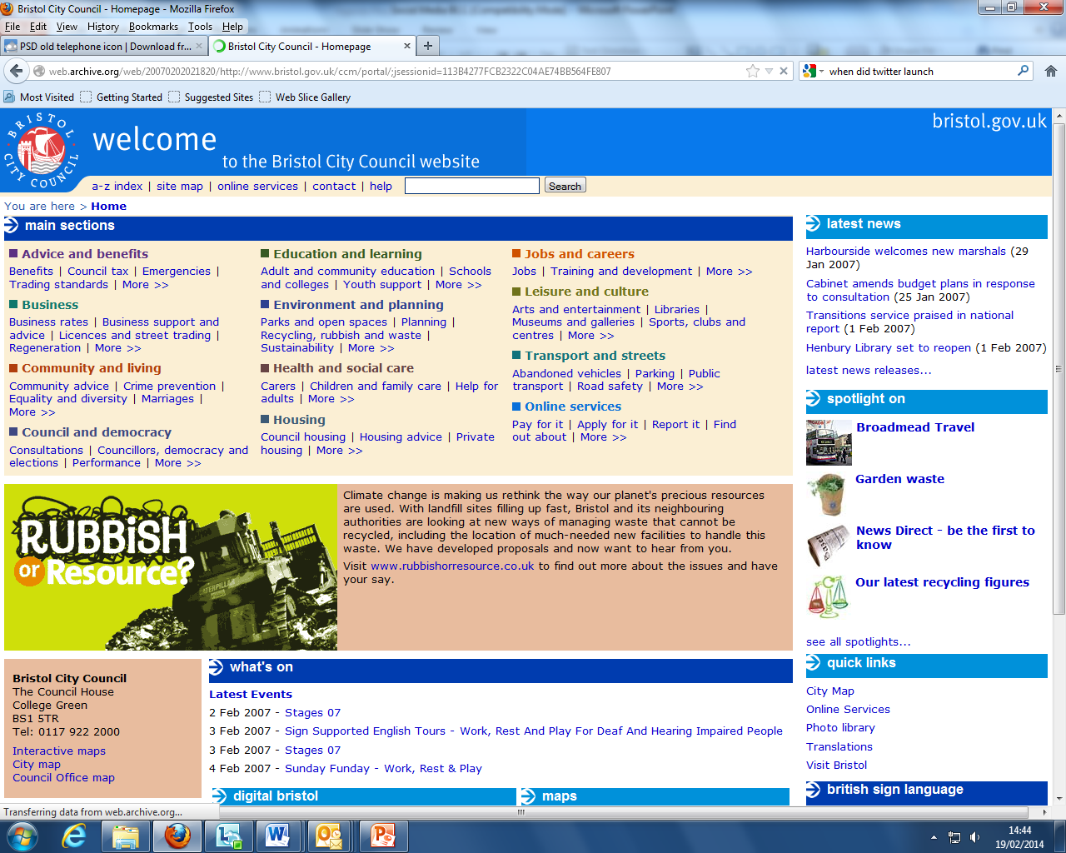
Notes:
Launched 2007

Slide 5
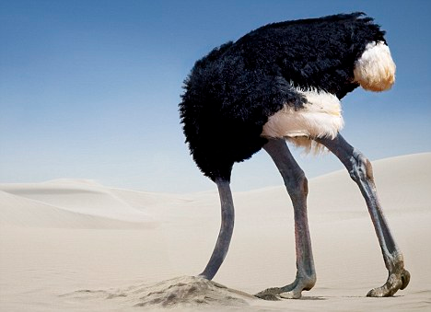

Slide 6
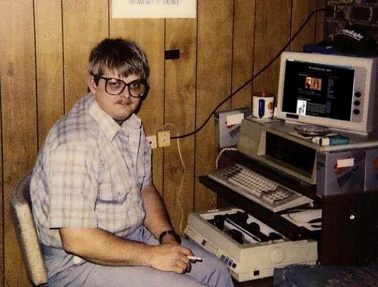
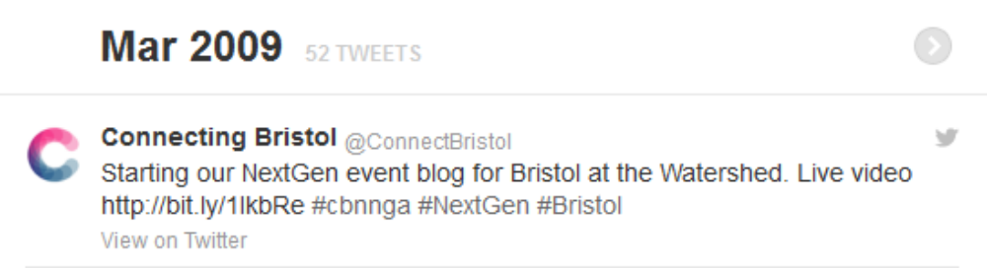
eDemocracy and Connecting Bristol
Experimenting with eDemocracy and digital innovation
  Online consultations
  Surveys
  Discussion forums
  Webcasting
  eParticipation
@ConnectBristol
  March 2009
Notes:
Tweeting started by stealth in 200x
Didn’t ask for permission, no process or procedure, give it a go

Slide 7
Connecting Bristol Social Media Policy
Don’t say anything stupid

Slide 8
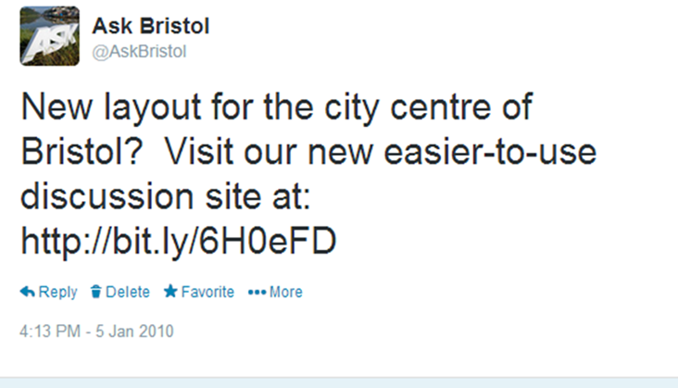
Permission to launch
First full use by a council service @askbristol Jan 2010
@BristolCouncil tweeting from June 2010
Total of 27 twitter accounts now

Slide 9
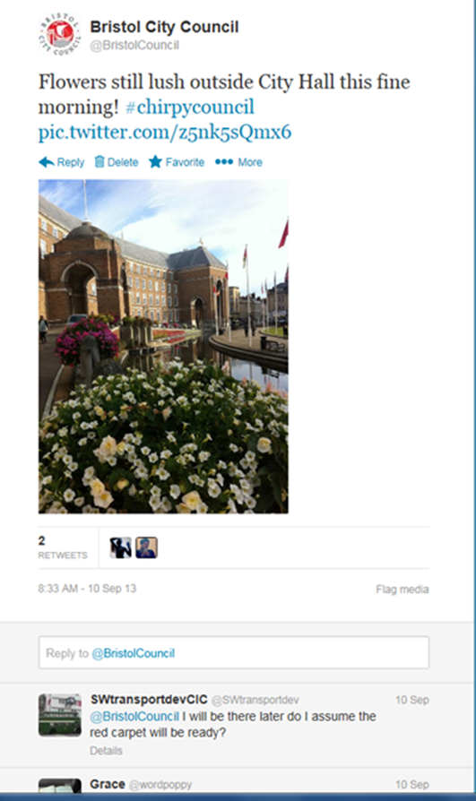
Tweeting with Personality (and attitude)
New comms director (@PeterHolt99) joins 2010
Tweets from corporate account regularly and with personality
Introduces #chirpycouncil hashtag
Social media protocol and toolkit developed autumn 2012

Slide 10
Where are we at?
@ConnectBristol
  7.4k followers
  1261 tweets
@AskBristol
  6.5k followers
  3262 tweets
@BristolCouncil
  17.6k followers
  10k tweets
@GeorgeFergusonx
  16.6k followers
  8000 tweets

Slide 11
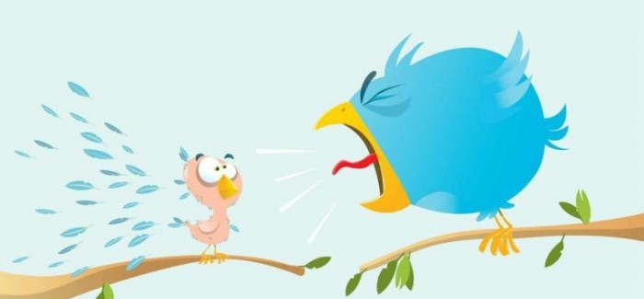
Challenges and Issues
Shortcutting the processes
Civic trolling
Resource requirement to manage traffic
Notes:
Shortcutting online processes that have been heavily invested in

Slide 12
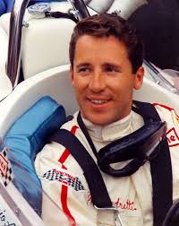
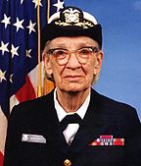
Thanks
“If everything seems under control, you're just not going fast enough.”
Mario Andretti, F1 Racing Driver
“If it's a good idea, go ahead and do it. It is much easier to apologize than it is to get permission.”
Grace Hopper, U.S. Naval officer and an early computer programmer
www.connectingbristol.org
Kevin.omalley@bristol.gov.uk
@ConnectBristol

