Slide 1


in 10
This presentation was developed by:

Slide 2
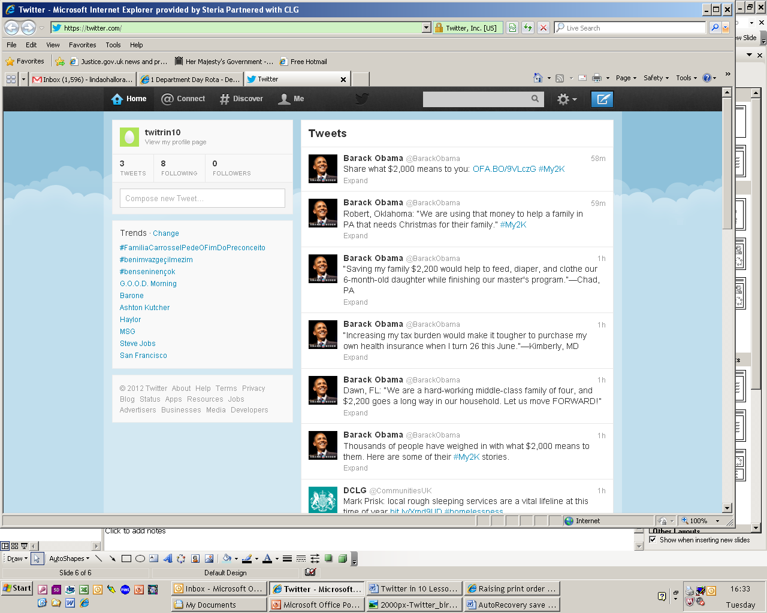
1. Essentially, it’s a news feed
… where you can follow what people are chatting about in real time

Slide 3
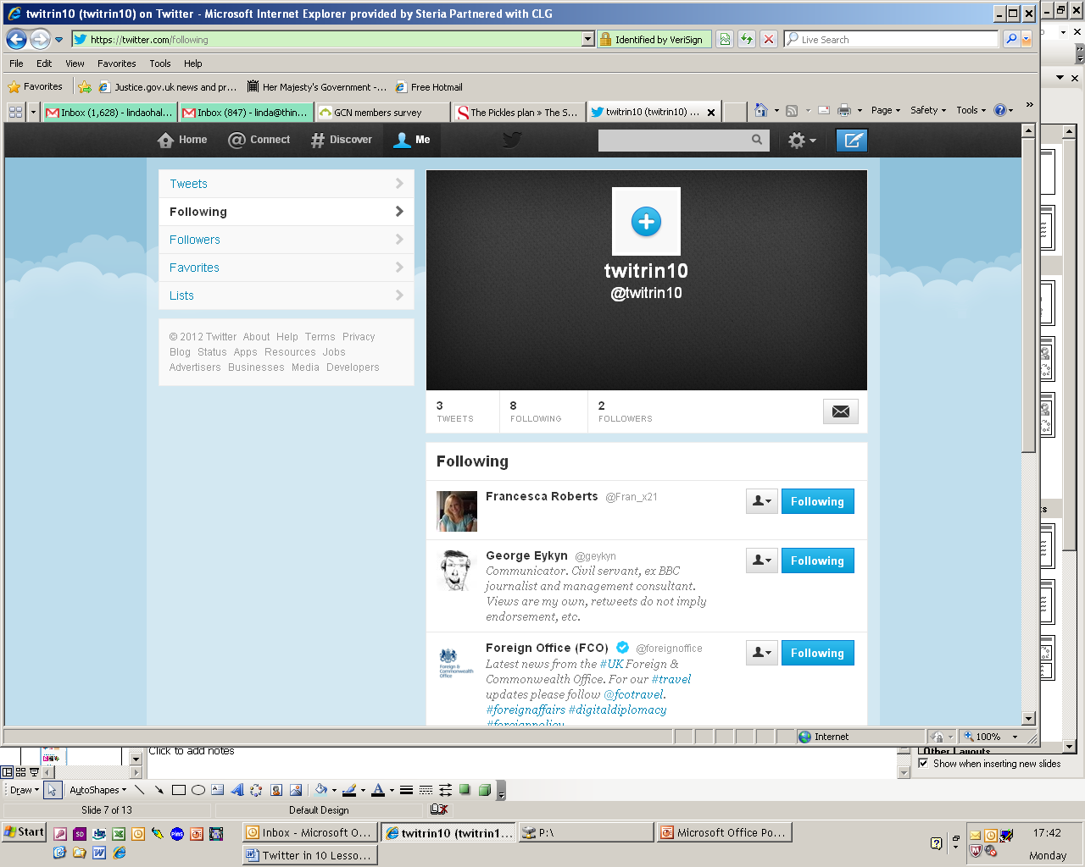
2. It’s made up of ‘tweets’
These are MAXIMUM of 140 characters
(spaces included)
3. You ‘follow’ people or organisations…
…who share your interests, and their ‘tweets’ appear on your news feed

Slide 4
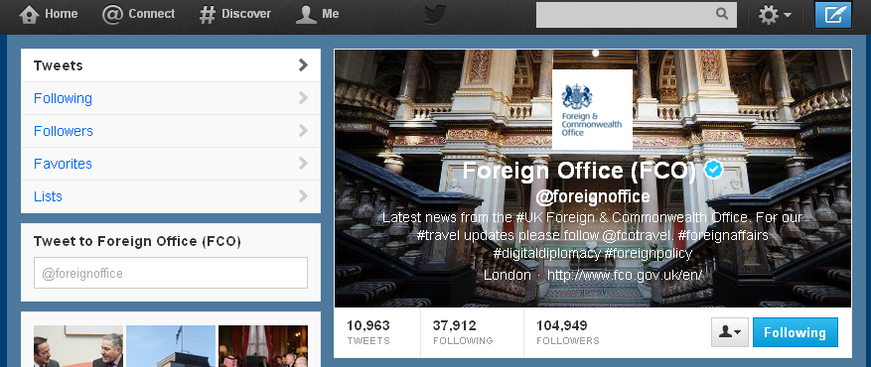

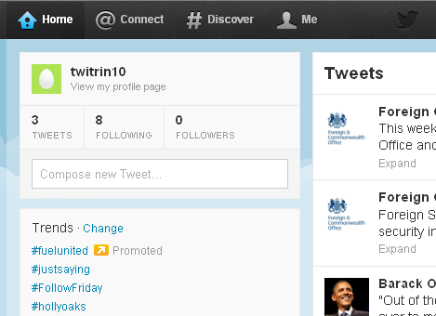

4. You hope that people follow you back…
…so you build an audience to read your tweets

Slide 5
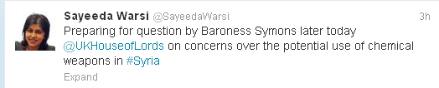
4. Tweets are grouped in 2 main ways
‘@’ denotes a twitter user. So, this tweet will show up on 1) Baroness Warsi’s page, 2) the news feed of everyone who follows her AND 3) on the House of Lords page.
‘#’ gathers tweets by theme. So, this one will appear in a list with every other tweet containing #Syria. (You’ll arrive at that list by clicking on the highlighted link, or by searching #Syria in the top right corner of your twitter page.)

Slide 6
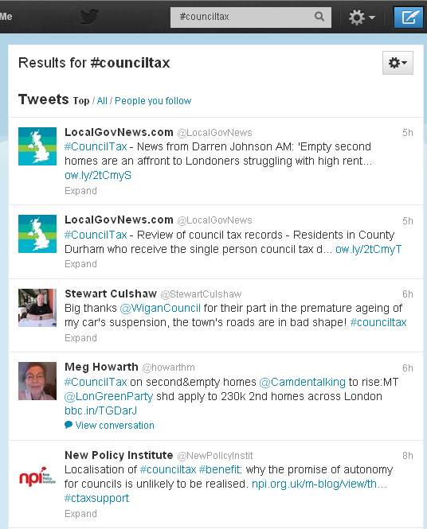
5. Why should I use it?
1. It’s quick and mobile!
2. Monitor what people are discussing in your interest area
3. Grow your network (Start following people saying interesting things, re-tweet people, or share links with people directly.)
4. Engage people in your interest area (by sharing news, inviting feedback/ advice, or hosting live twitter chats using a ‘#’)

Slide 7
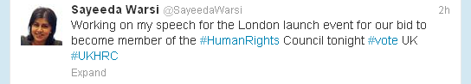
6. Tone and Tips
1. Twitter is informal, personable, and abbreviated to fit 140 characters
2. You may have to get permission from your council to set up a council-related account.
3. As such, particularly if you want to tweet about work-related things, it’s advisable to add disclaimer to your twitter profile…

Slide 8
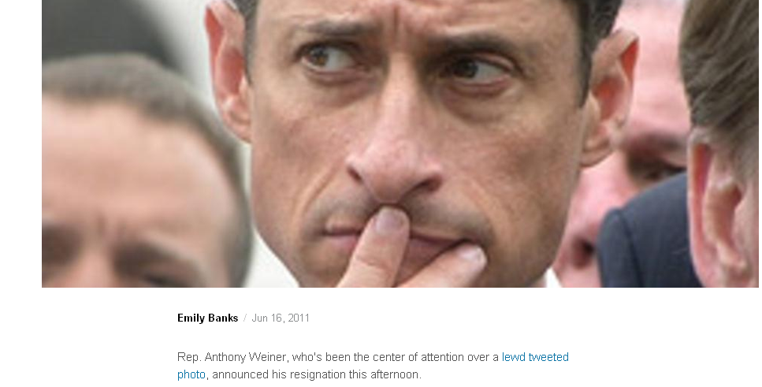
6. Tone and Tips
4. Unlike with other website, Twitter is 100% public, so never write something confidential or potentially offensive, as it could come back to haunt you…

Slide 9
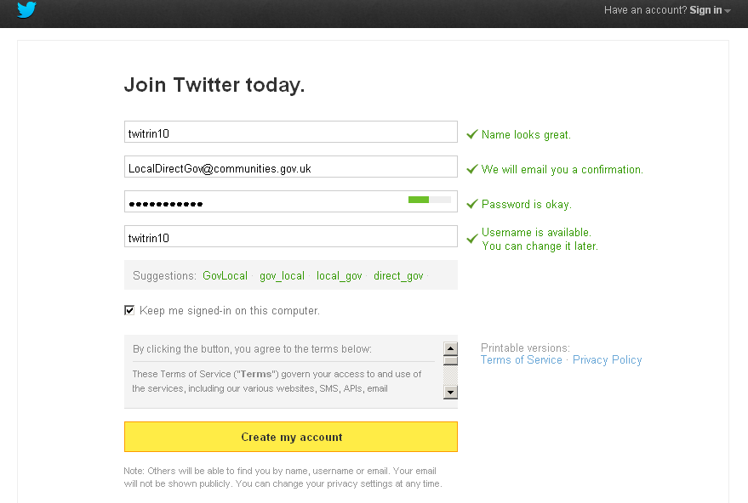
7. Setting Up Your Account

Slide 10
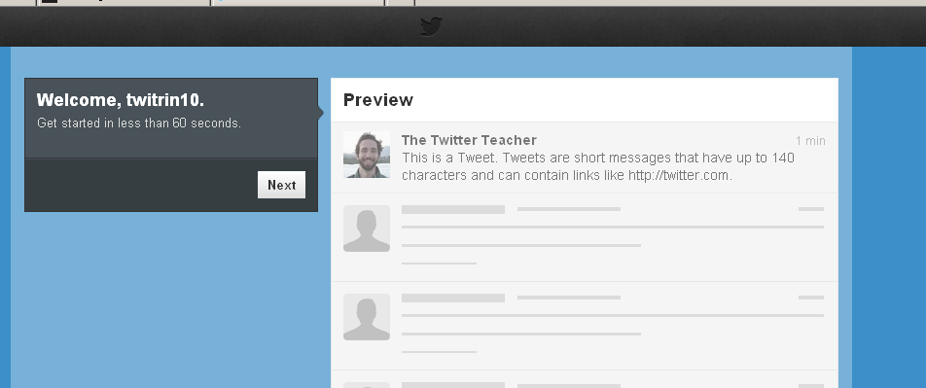
You Land Here…
…It’s a little start-up guide.
(you’ll still need to click on the link in your email inbox to get full access)

Slide 11
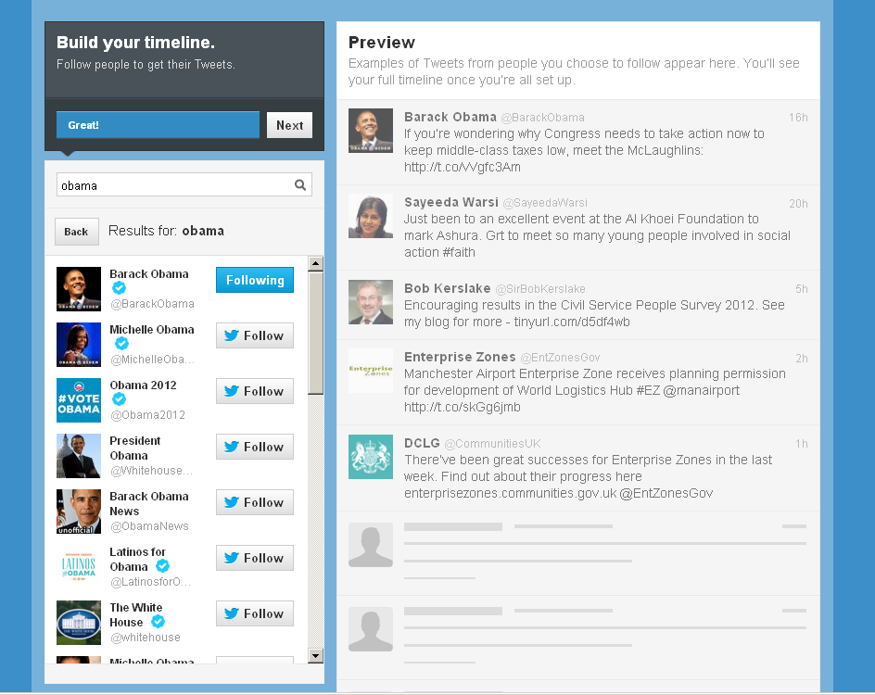
After clicking next, you can search for the people/ organisations you’d like to follow…

Slide 12
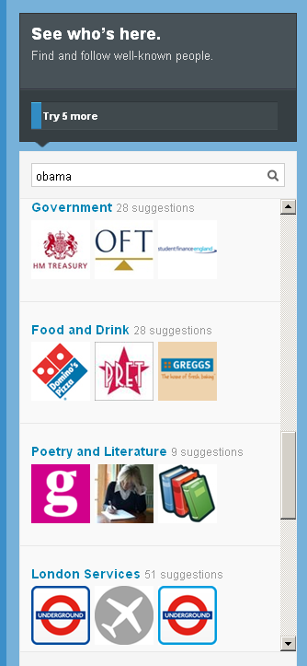
…And get a taste for what’s there…
At this point, you can keeping adding people, or click on the link in your inbox to get started for real

Slide 13
Get on with it…
MAKE A COMMITMENT!
Dedicate 5 minutes, 3 times a day to scanning Twitter for information relevant to you.
2. Follow people in your network
3. Observe interesting hashtags and keep a note of them
4. Search a few words in the top right search bar and see what comes up
5. Retweet things that look interesting
6. When you’re ready and you want to get a conversation started or news out, try tweeting. Remember the essential symbols: #topic and @name.

