Slide 1
7 Practical (and proven) steps to a better website:
Getting www.guildford.gov.uk from SOCITM 2 stars to 4 stars
Adam Bevington
@adambevington
adam.bevington@guildford.gov.uk

Slide 2
Who we are
Guildford Borough Council (District Council)
137,000 residents
Vibrant education and research hub:
Surrey University, Surrey Research Park, Guildford College
Busy retail and entertainment centre:
Shopping, Eating, Theatre, Music
The Web Team
Part of Corporate Development
1.75 FTE’s
Budget for change £0

Slide 3
What we had already?
CMS (GOSS ICM) with support contract
In-house technical experience
Ability to use a limited development resource internally
Lots of research: What others had done, what had worked, what hadn’t, and our own web analytics
A ‘No one’s going to stop us’ attitude to making things better

Slide 4
What was wrong with our site?
Too much content
Overly complicated content
Too many writing styles
Confusing navigation
Too many navigation choices
A to Z, most used, pages you last looked at, top tasks, news, announcements, most recent tweets etc.
Not mobile friendly
= Poor user experience
Notes:
The site was clearly written by many voices, all different, all with there own version of what was correct, in terms of content style and navigation

Slide 5
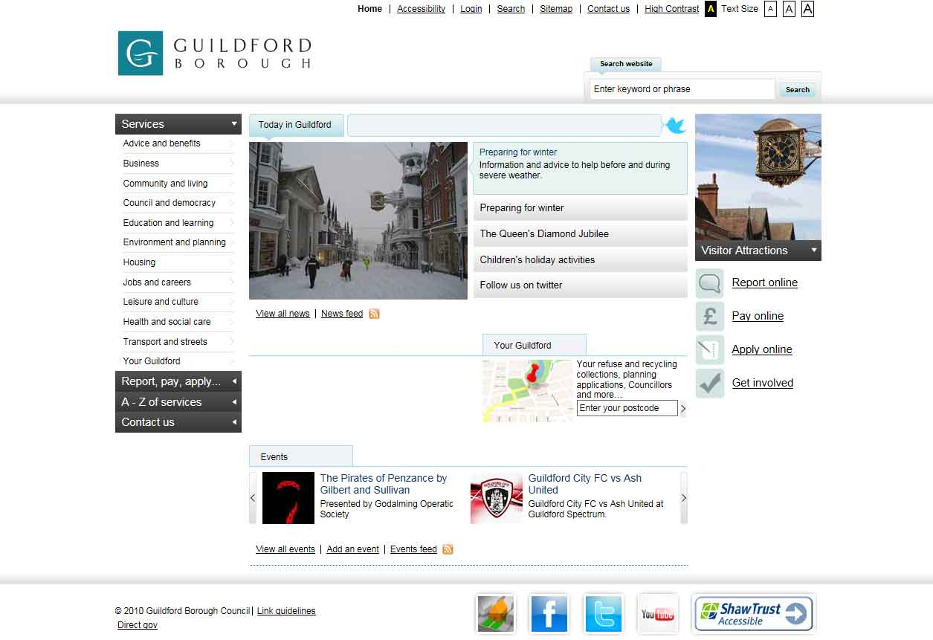

Slide 6
Shh! Don’t tell SOCITM…
We didn’t set out for more stars
We just wanted a better website

Slide 7
The 7 Steps

Slide 8
Management buy-in: Step 1
What we did:
Carried out survey of web admins time spent editing the website
Presented cost analysis and savings that would be made by centralising content creation
Management Team and Directors given enough information to understand Web Team decisions
The Web Team decisions were final (Only Directors could over rule)
Notes:
Presented cost analysis and savings that would be made: Cost of 2hrs per web admin per week x100 = 200hrs at a cost of, say, £15 per hour salary + heat and light etc. £3000 a week
Presented cost analysis and savings that would be made by centralising content creation: £30,000 a year just in savings
Management Team and Directors given enough information to understand Web Team decisions: Presented on a number of occaisions to Management Team explaining, mobile usage and web management overall.
The Web Team decisions were final (Only Directors could over rule): This didn’t happen once.

Slide 9
Management buy-in: Step 1
Advice:
Get strong management backing, it’s vital
Do this by making a business case (for change) that is impossible to argue against
Proactive communication from Management Team promoting your changes via internal comms channels, intranet, blogs etc.

Slide 10
Mobile first design: Step 2
What we did:
Used Twitter Bootstrap framework (responsive)
Made forms mobile friendly
Loads quickly (Minified javascript etc.)
Try not to use PDF’s or Word documents
Where non-html files are used we keep them small
Implemented OpenDyslexic font (opendyslexic.org)
Notes:
Bootstrap is a free collection of tools for creating websites and web applications. It contains HTML and CSS-based design templates for typography, forms, buttons, navigation and other interface components, as well as optional JavaScript extensions. It is the No.1 project on GitHub with 65,000+ stars and 23,800 forks (as of March 2014) [1] and has been used by NASA and MSNBC, among many others.

Slide 11
Mobile first design: Step 2
Advice:
Make your site responsive
Don’t build a separate mobile site or have an app!
Design content for mobile means you will keep it brief – this makes it better for everyone! Helps plan a simple navigation
Design for mobile speeds (3G)
Make sure everything you can do with a desktop you can do on a mobile

Slide 12
Content review: Step 3
What we did:
WRAP - 10k+ pages to 500 - These 500 pages represented 90+% of traffic
Reduced PDF’s
Created a 100% customer focused site
The Web Team rewrote all 500 remaining pages
Removed jargon (bins are bins)
Increased the use of plain English (basic but it gets ‘forgotten’ about over time)
Put in place a schedule of continuous improvement we call this our ‘rolling review’

Slide 13
Content review: Step 3
Advice:
Use your stats! What do users do on your site? What do they do over the phone?
Make those tasks as easy as possible to do
Reduce volume of content (pages and wording)
Remove any vanity publishing, e.g. “Welcome to XX Department and we’ve won XX award”, “I am the XX officer and this is what I do everyday….”
Rewrite content from scratch (saves time in the long run!)

Slide 14
Centralised content: Step 4
What we did:
From hub and spoke (100+ web admins)
Resource heavy (moderation)
Cost analysis (100 web admins at 2hrs week etc)
Slow to make changes
Move to centralised content creation
React quickly
Better resource planning
Appropriately skilled staff writing content
New content requests have to pass ‘Digital Content Test’ (appealed cases go before monthly board)

Slide 15
Centralised content: Step 4
Advice:
Review content creation process
Measure quality of content: Can you make it better doing things differently?
Measure how much moderation has to be done: If you spent this time writing the content would it be better?
Work out which is more cost effective: centralised v decentralised content creation
Create a ‘Digital Content Test’ refuse content that doesn’t pass it.

Slide 16
Simple navigation: Step 5
What we did:
One form of navigation
As few click as possible to get to content (3 golden clicks)
Gave navigation the largest amount of real estate on the homepage (over half)
Ignored departmental structures
Disagreed with internal customers…..a lot!
Use analytics to measure: visitor flow, goals.
Measured non-financial transactions

Slide 17
Simple navigation: Step 5
Advice:
Build a navigation you have the resource to manage
Call a ‘bin a bin’
Work hard on this (you are going to need to challenge departmental thinking)
Use analytics to measure customer flow
Continuous improvement using feedback from customers (internal and external)
Ignore departmental structures
Demonstrate improvement using analytics (goals etc.)

Slide 18
Great search: Step 6
What we did:
Implemented Google Custom Search
Made search work across disparate portals
Reviewed our search regularly
Used synonyms and auto-suggest
Analyse what people search for and adapt accordingly
Used campaigns to help promote transactions in search

Slide 19
Great search: Step 6
Advice:
Choose a tool that lets non-technical staff customise the search experience
Use search that recognises misspelt words
Review search more or at least as often as you review content
Use campaigns to promote various transactions: make a plan, implement and measure

Slide 20
Communication: Step 7
What we did:
Held workshops with each department explaining what work we had done: After we had done it but before it went live
Consulted Senior Management on design
Didn’t ‘over-consult’ with colleagues
Communicated progress internally at regular intervals via intranet and updates from Management Team
Used the website to inform and consult external customers

Slide 21
Communication: Step 7
Advice:
Sometimes getting on with what you know is better than any drop in session
Get colleagues involved only with decisions you are happy for them to make
Don’t be afraid to sound like a broken record
Communicate success: Increased engagement, better survey satisfaction results, decreases in offline contact etc.

Slide 22
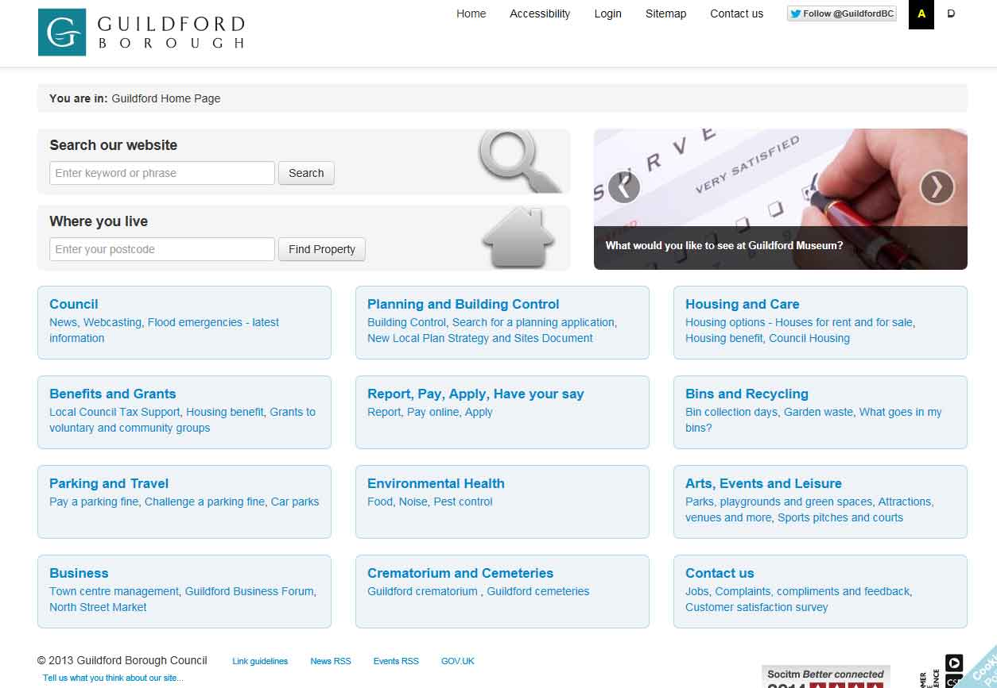
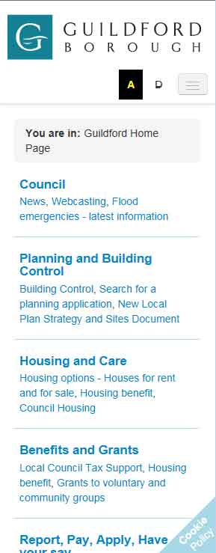

Slide 23
The 7 Steps
Management buy-in
Mobile first design
Content review
Centralised content
Simple navigation
Great search
Communication
Notes:
Management buy-in
Content review
Centralised content
Mobile first
Simple navigation
Great search
Communication

Slide 24
Any questions?
Adam Bevington
@adambevington
adam.bevington@guildford.gov.uk

