Slide 1

GOV.UK
How does it work?
Notes:
Me = involved in writing content for the mainstream part of the site. Qualified to tallk to you about GOV.UK and how to find content on it.
Going to talk you through the GOV.UK website, then take questions and then, if there’s time, go through an exercise where we try and find content on the site together with you.

Slide 2
Overview of the site

Slide 3
2 main sections serving
2 broad types of audience

Slide 4
Services and information
(Detailed guidance)
2. Departments and policy
Notes:
Eagle eyed spot an extra section lurking there. It’s a bit of a hidden area of GOV.UK that I’m going to explain later.

Slide 5
Services and information

Slide 6
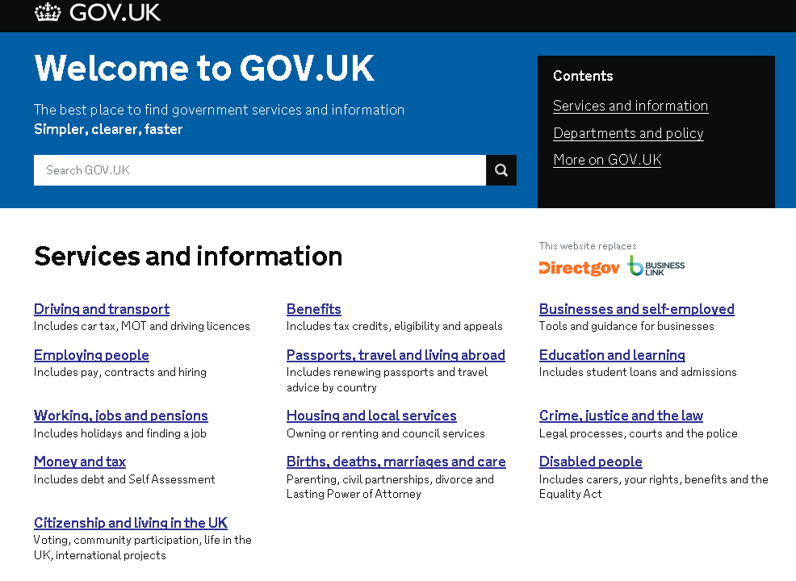
Notes:
General = mainstream and high-level. Caters for common needs. Short, easy-to-read, not huge amounts of detail.
Content that was on Directgov and Businesslink

Slide 7
Who is it aimed at?
Citizens and businesses

Slide 8
Finding content
Content is grouped into sections
Notes:
General = mainstream and high-level. Caters for common needs. Short, easy-to-read, not huge amounts of detail.

Slide 9

Most people use search
69% of people come to GOV.UK through search.
Only 8% of people land on the homepage
Search is improving all the time.
More on search later…
Notes:
As Louise said, Gov.uk was built on the premise that “Google is the homepage” and most people will find what they want without using the navigation on a site.
So most people will use the search on GOV.Uk or an external search engine.
Detail
60% of visits to GOV.UK come from external search straight to a content page; another 5% come from search to a browse page, and 4% come from search to the homepage.
In total, 69% of visits come from organic search. The rest are 16% referrals from other sites, and 15% direct, plus a little bit of campaigns etc.
The homepage makes up 8% of all landing pages from any source: 4% from external search, 3% direct and 1% referrals from other sites.

Slide 10
(Detailed guidance)
…a tricky one…
Notes:
GOV.UK used to be split into 3 sections and this was one of them.
But people found it very confusing.
So GOV.UK got rid of the division, and now it is counted as part of ‘Services and information’
But you will occasionally come across detailed guidance and it looks a bit different to normal ‘Services and information’ content

Slide 11
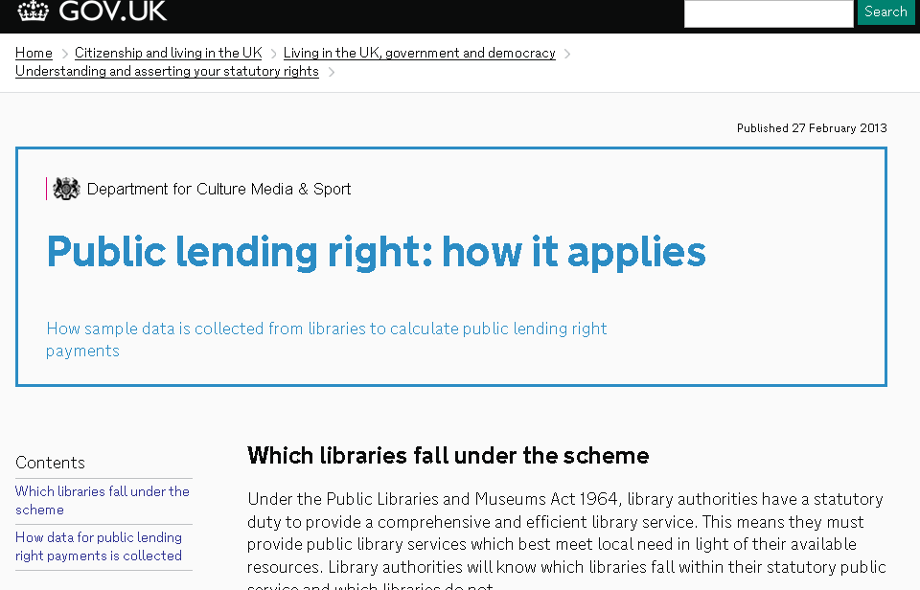
Notes:
Blue box

Slide 12
Detailed Guidance
Answers a specific user need for detailed information – usually ending in a user action with government
Linked to mainstream subjects (providing more detail)
NOT designed to give general advice or explain government policy
Notes:
Detailed guidance = much more detail. Guidance that government has a duty to provide - statutory guidance, rather than general advice.
Should give users information to complete a specific action.
Clear as mud?

Slide 13
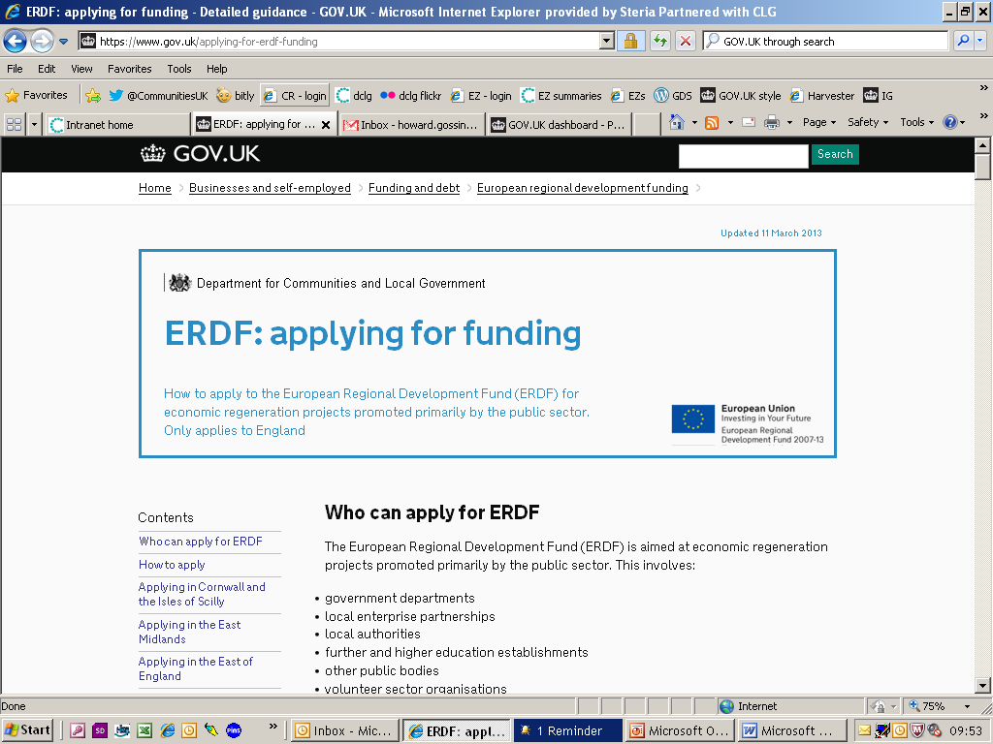
Detailed Guidance
Linked to mainstream content
Notes:
Because a piece of detailed guidance is ALWAYS linked to an article in the ‘Services and Information’ section (SEE ABOVE) that’s where you will find it in search.

Slide 14
2. Departments and policy

Slide 15
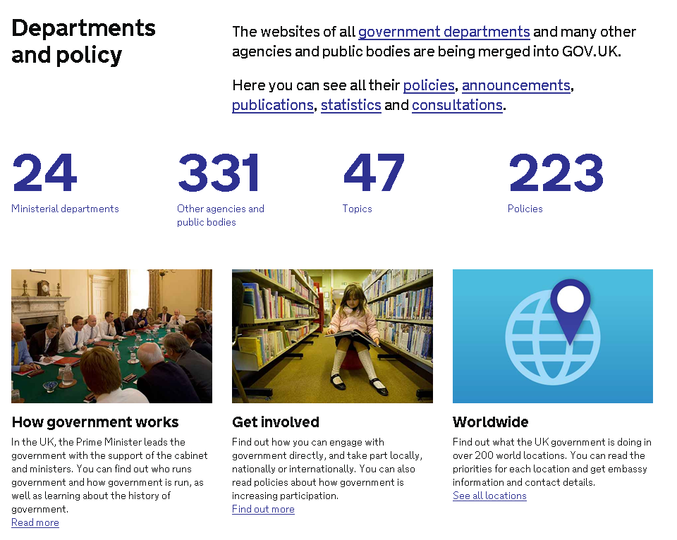
Notes:
Inside Govt = policy documents, statistics, all the corporate and policy info from departmental sites.
All 24 ministerial depts on it.
37 out of 300+ other agencies and public bodies on it – most of the others will also be moved across.

Slide 16
Who is it aimed at?
Anyone interested
in the workings
of government

Slide 17
A new approach
Completely different way of presenting information
Aggregates government policy content in one place
Content is all tagged – to a department, topic, policy, etc
‘Google is the homepage’ – you don’t have to know your way round department websites

Slide 18
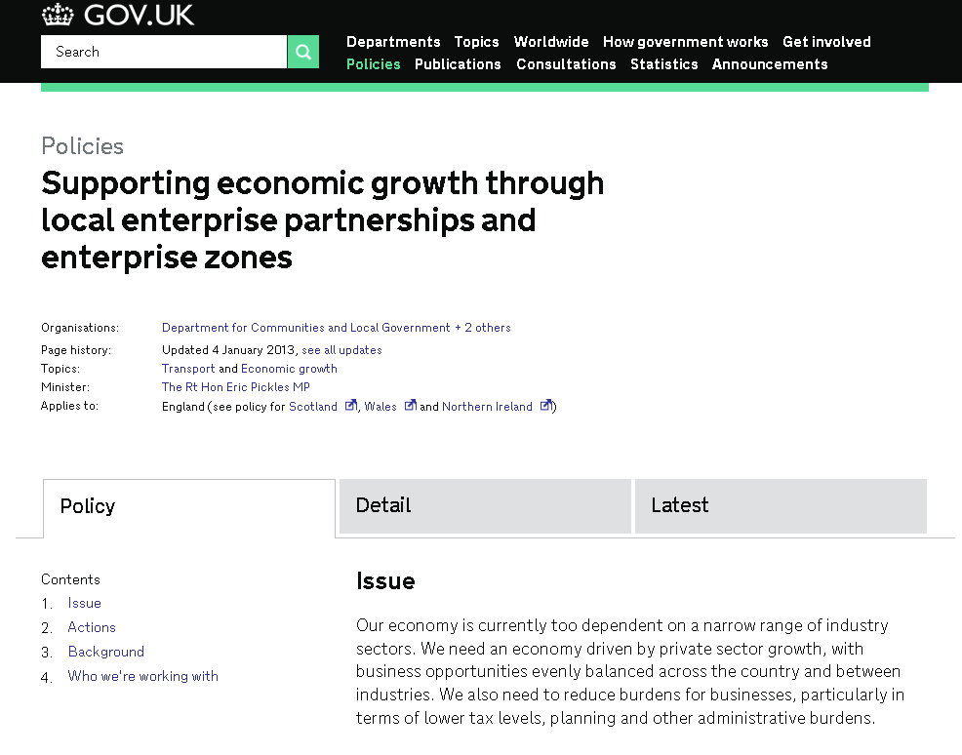
Example:-
‘Owned’ by more than one department
Falls under 2 topics
Notes:
Example
Policy = “Supporting economic growth through local enterprise partnerships and enterprise zones”
Owned by BIS (business, innovation and skills), DCLG and DFT
In the old days, you’d have to go to 3 separate websites to find what BIS, DCLG and DFT are all doing about this policy
Tagged for topics = Transport and Economic growth – will show up if you search for either topic

Slide 19
Policy format
Policies say what government is trying to achieve and why
Policies are the ‘spine’ of Inside Gov – most content in Inside Government is tagged to a policy
Currently 223 policies on GOV.UK, including:
  Supporting the library services provided by local authorities (DCMS)
  Keeping the UK safe in cyberspace (CO, FCO, NSI, TSE)
  Making local councils more transparent and accountable to local people (DCLG)

Slide 20
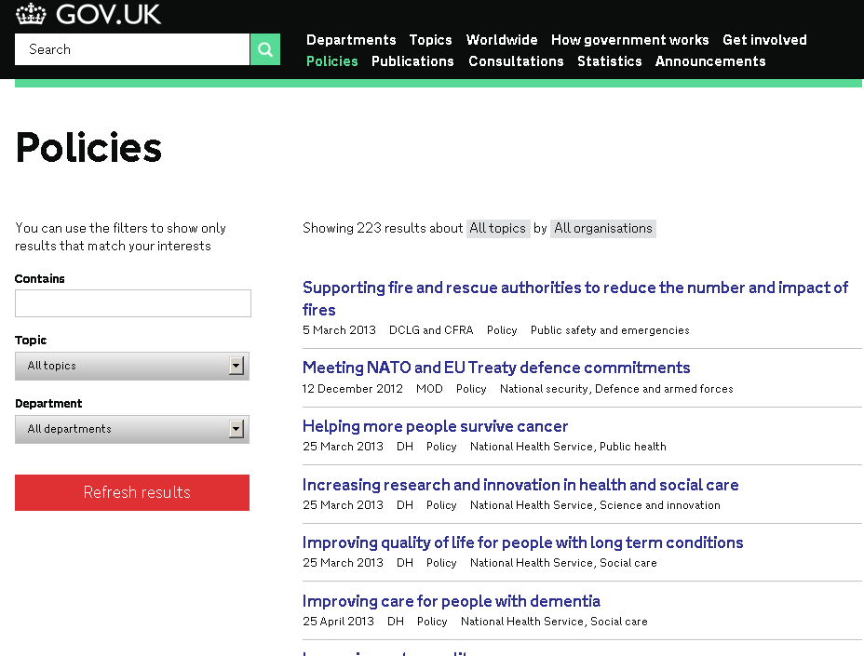
Searching by policy
Filter by:
Keyword
Topic
Department
Same structure shown here applies to publications, consultations, statistics and announcements

Slide 21
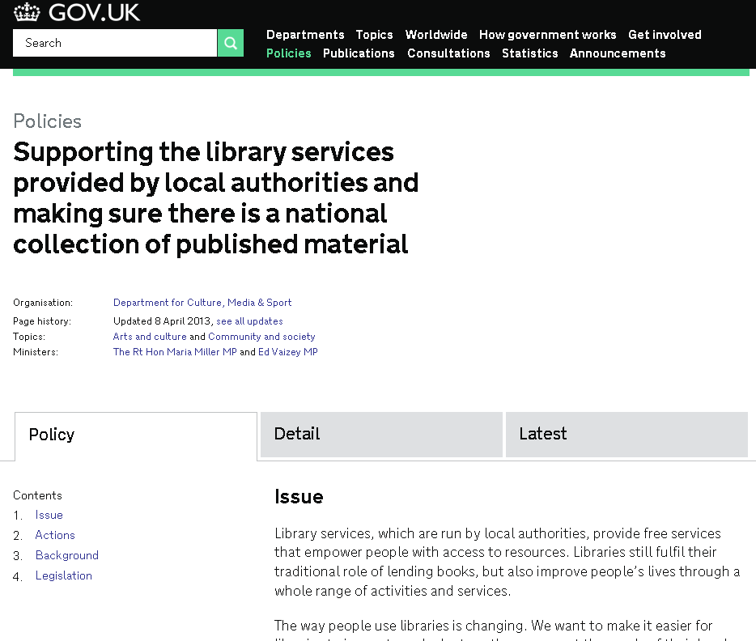
Policy page
Notes:
Each contains top-level page with a set format:
Issue, Actions, Background, Legislation

Slide 22
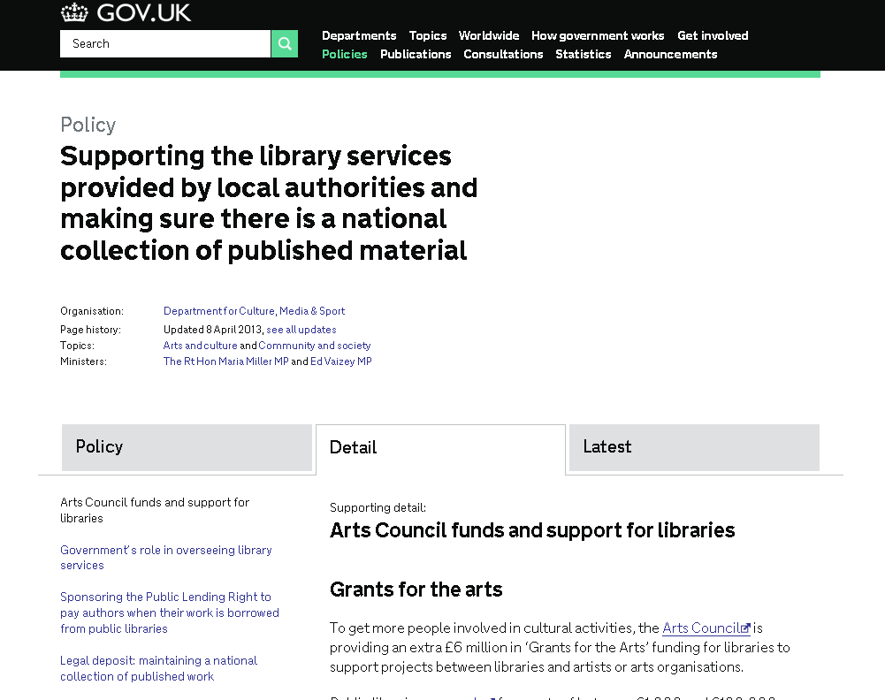
Policy: supporting detail
Notes:
Supporting detail page

Slide 23
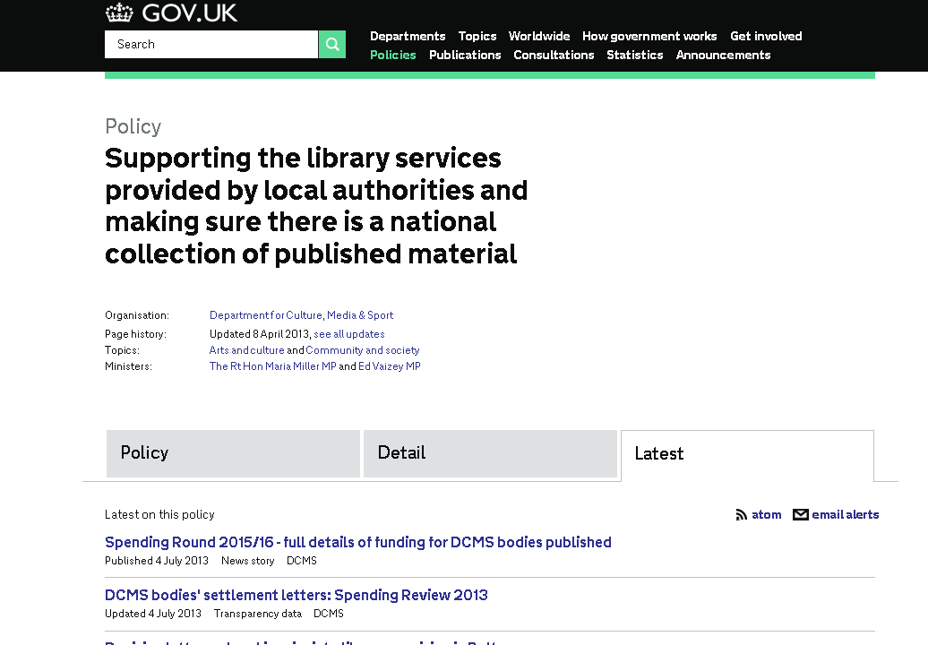
Latest related content
Notes:
Latest page – announcements, press releases, news stories, speeches, etc – in chronological order, most recent first

Slide 24
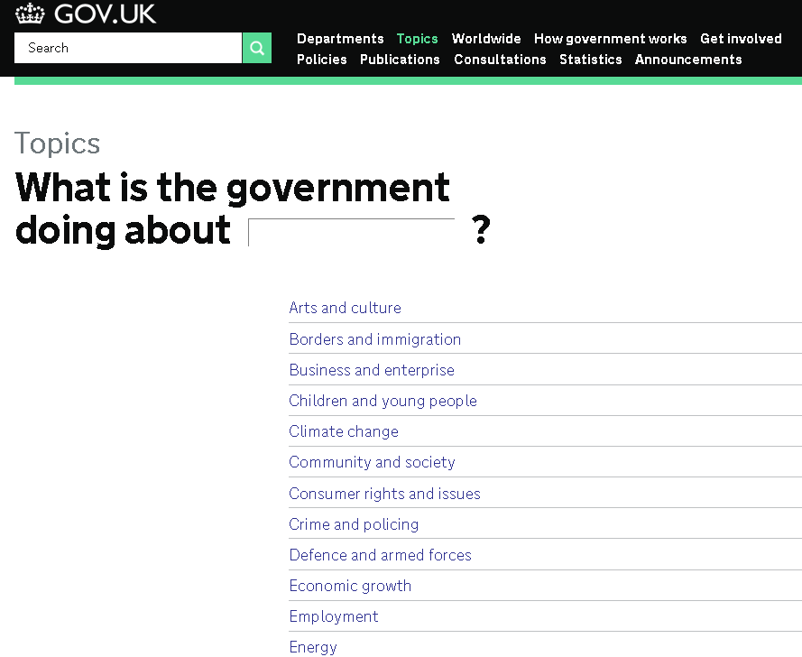
Topics
Content is aggregated across departments and grouped by topics.
Topics are broad headings describing what the government as a whole is doing about an issue.
All departments with an input into the topic are listed.
There are 47 topics so far.

Slide 25
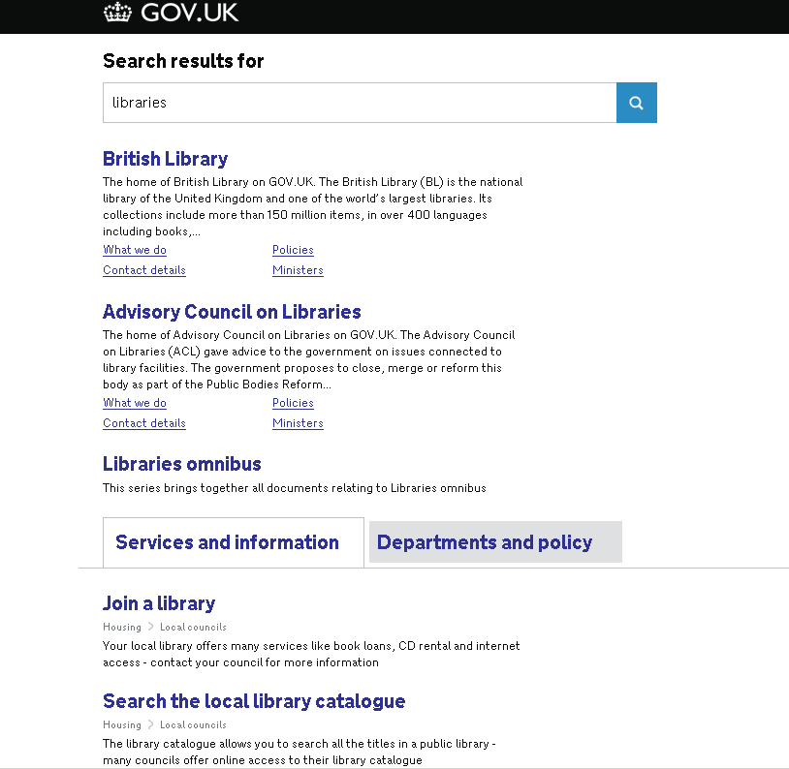
General search
What GOV.UK thinks is most relevant from all parts of site – including websites of organisations
Notes:
3 tabs relate to 3 audience types. You’re shown a different tab according to which part of the site you’re on.

Slide 26
General search
Underneath top results, 2 tabs.
First tab is all content in the ‘Services and Information’ section.
(For citizens and businesses – plus detailed guidance)
Notes:
3 tabs relate to 3 audience types. You’re shown a different tab according to which part of the site you’re on.

Slide 27
General search
Second tab is all content in the ‘Departments and policy’ section.
(For people interested in the workings of government)
Notes:
3 tabs relate to 3 audience types. You’re shown a different tab according to which part of the site you’re on.

Slide 28
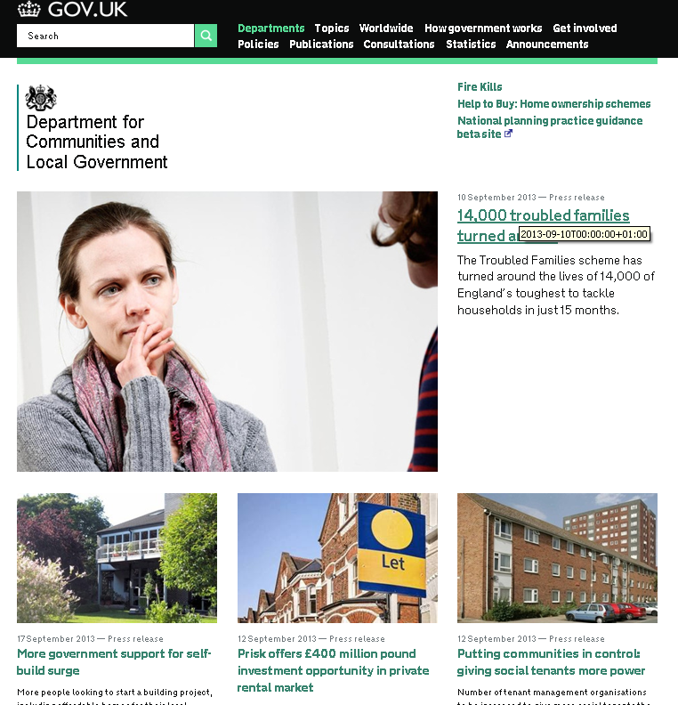
Departmental webpages
Each department still has its own ‘homepage’, together with a number of personalised pages.
But most information is aggregated with other departments’ information.

Slide 29
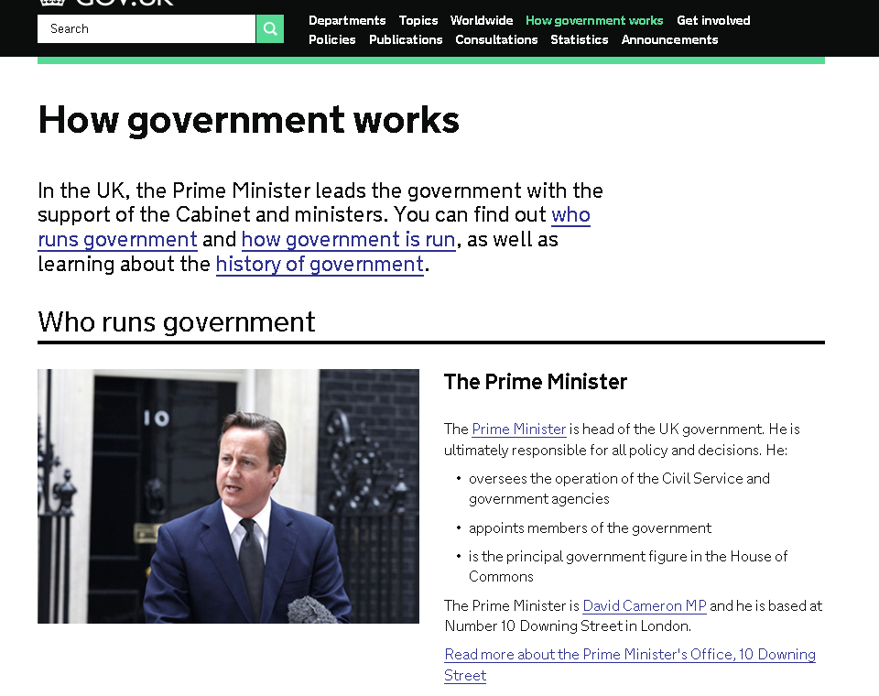
How government works
  Who runs government
  How government is run
  History of government…

Slide 30
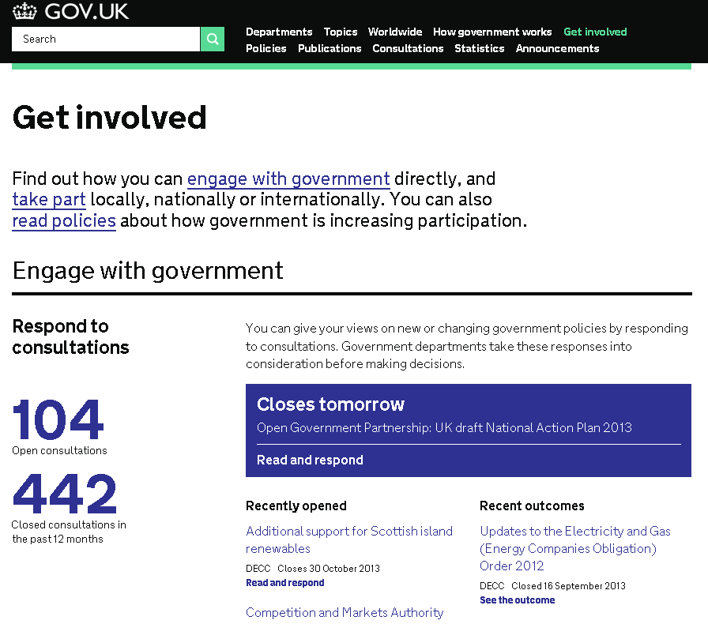
Get involved
Respond to consultations
Start a petition
Follow a blog
Make a neighbourhood plan
Start a social enterprise
And more…
Notes:
A ‘get involved’ page showcasing the opportunities to participate in policy development and society

Slide 31
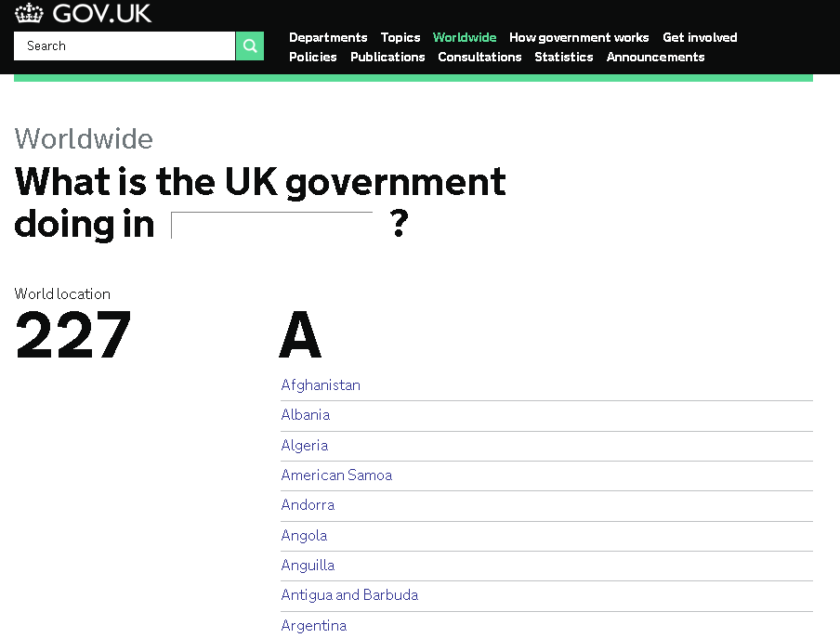
UK government worldwide
Notes:
Another example of using tagging.
Information tagged to a country, as well as to a policy and a topic

Slide 32
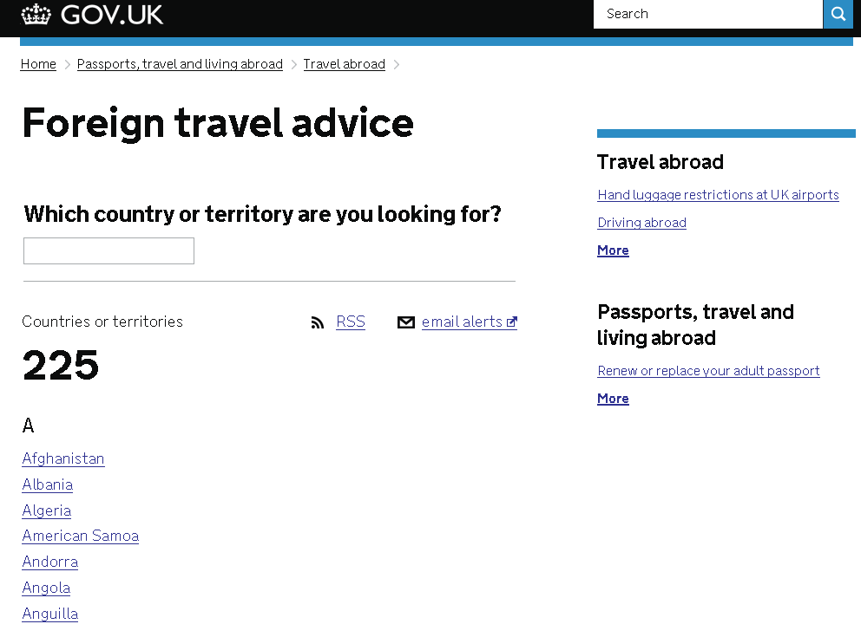
Foreign travel advice
For citizens – so it’s in the ‘Services and Information’ section
Notes:
Another example of using tagging.
Information tagged to a country, as well as to a policy and a topic

Slide 33
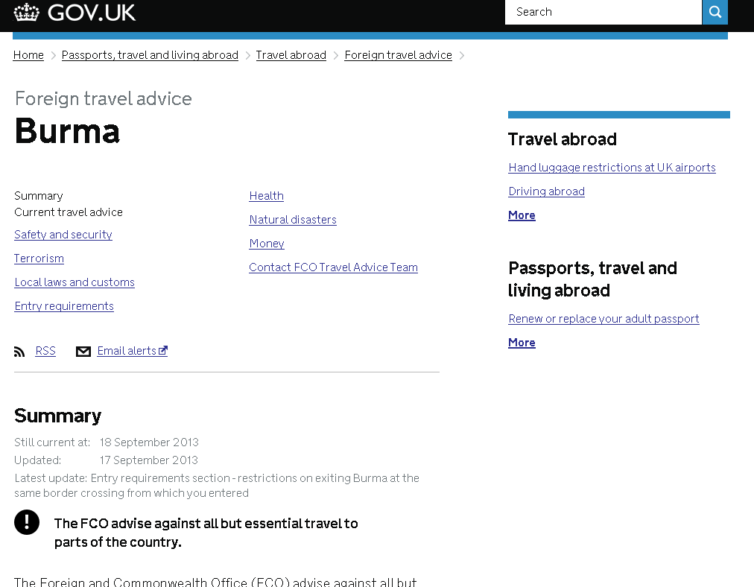
Foreign travel advice
Further information
Most important information and latest updates
Notes:
Another example of using tagging.
Information tagged to a country, as well as to a policy and a topic

Slide 34
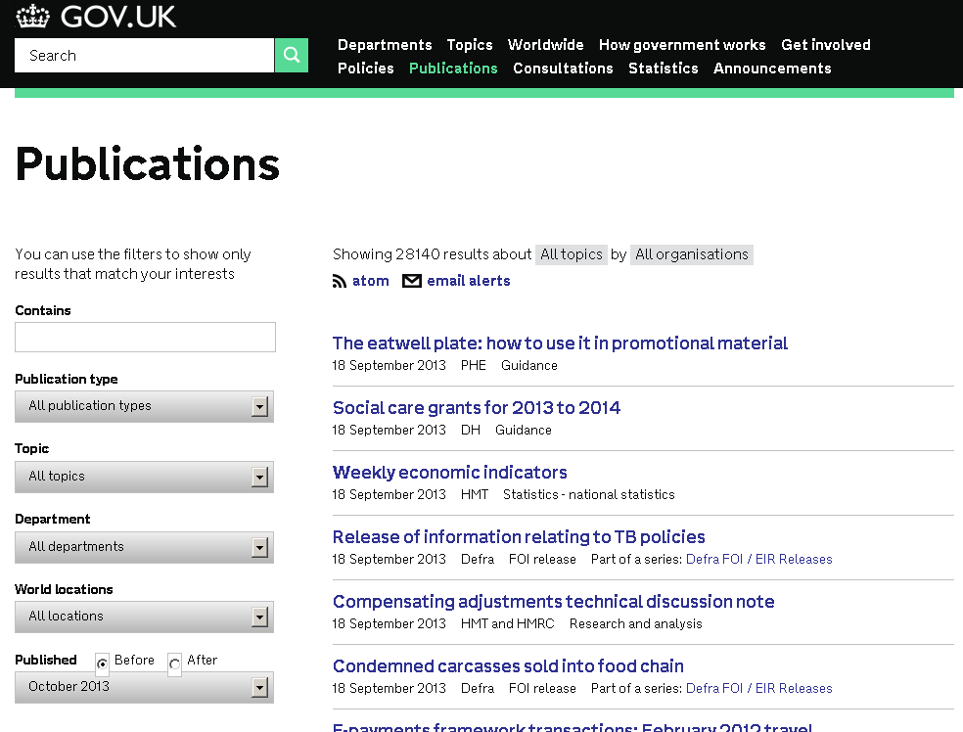
Keeping up-to-date
Email alerts and atom (RSS feed)
Notes:
Find sign up options on all pages in ‘Departments and policies’
Usually where the ‘latest information’ is

Slide 35
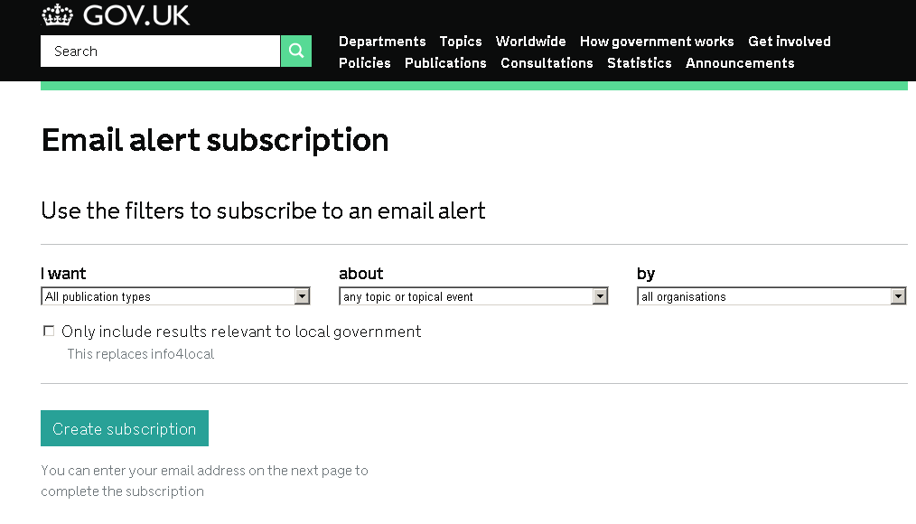
Keeping up-to-date
Can specify:- Type of document >Topic or topical event >Organisation
Local Government option – replaces Info4local

Slide 36
Continual improvement
The Government Digital Service (GDS) has on average 4 releases a week
Continuous improvements to the site – Agile, iterative approach.

Slide 37
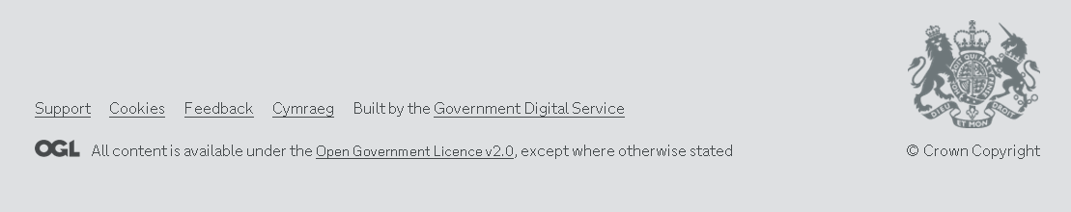
Tell ‘em what you think!
If you’ve got any feedback on GOV.UK, scroll to the bottom of any page and click ‘feedback’.

