Slide 1
Data protection and data sharing
Victoria Cetinkaya, Senior Policy Officer, Information Commissioner’s Office
29 November 2013, DCLG Really Useful Day for Suppliers

Slide 2
The eight principles of the DPA98
Fair and lawful processing
Processed for limited & specified purposes
Adequate, relevant and not excessive
Accurate and up to date
Not kept for longer than necessary
Processed in line with individuals’ rights
Kept secure – appropriate measures
Not transferred outside the EEA without adequate protection

Slide 3
Access to information
- DPA right of subject access - Individuals have a right of
access to their personal data held by you
- 40 day time limit; maximum fee of £10 can be charged
- FOIA right to request information – anyone can request
information held by a public authority. This includes local
authorities.
- 20 working day time limit

Slide 4
Data security
Common themes:
- loss/theft of unencrypted laptops and memory sticks
- insecure disposal of personal data
- lost records
- information posted, faxed or emailed to the wrong recipient
- lack of staff training and proper procedure
- insecure websites
- remote working
Notes:
It’s usually basic failings that lead to enforcement action.

Slide 5
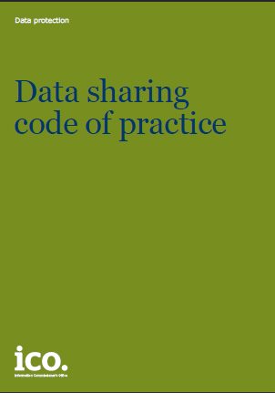
Data sharing: the ICO approach
- DPA is not a barrier where information sharing is justified,
necessary and proportionate
- DPA provides a framework for sharing in a secure, lawful
and reasonable way
- Limitations and safeguards essential
- Vital to get it right with partnerships,
multi-agencies, outsourcing
- Statutory code

Slide 6
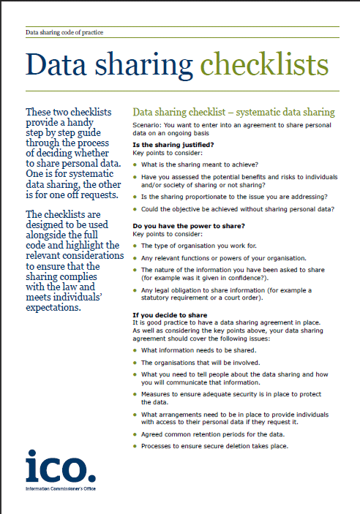
Data sharing
- Why do you want to share – purposes
- Can you achieve your aims without sharing personal data?
- A proportionate approach?
- Minimise the data shared
- Risks of sharing vs. risks of not sharing
- Ask or tell?
- Data sharing agreements

