Slide 1
Digital Services: Managing Demand & Building Self Reliance
James Winterbottom, Assistant Director Strategy & Partnerships, Wigan Council

Slide 2
Context
Large Met within Greater Manchester
320,000 population
77 Square Miles
Priority for transformation – Building Self Reliance through Public Service Reform.
£110m budget reduction to 2017

Slide 3
Interaction with our residents is on a large scale…..
Web – over 8.2 million page views
Telephone – 650,000 calls
Face to face - Wigan Life Centre 55,598 visits
Local Life Centres 29,079 visits
Notes:
Web and Telephone – October 2011 to September 2012
Wigan Life Centre – January to September 2012
Local Life Centres – October 2011 to September 2012

Slide 4
Digital Services
Transforming through technology key to our strategy and our Deal with residents – reduce demand, build self reliance.
Web as primary vehicle for customer contact and transactions.
But….
Satisfaction with telephone & face to face contact high 90%
Satisfaction with web 40%
And resources skewed to telephone & face to face

Slide 5
Telephone – high demand areas
Waste collection
Payments
Benefits
Change in circumstances / details
Notes:
Waste collection – Missed bins, damaged/replacement bins,
Payments – Direct debits, overpayments, queries
Benefits – General enquiries, FSM, Manual calculation
Change in circumstances – Address details, benefit changes,

Slide 6
Face to face – high demand areas
Benefits enquiry
Council Tax
Payments
Waste collection
Notes:
Benefits enquiry – Housing benefit, change in circumstances
Council Tax – General enquiries
Payments – Council services, parking fines/permits
Waste collection – Missed bins, recycling bin rollout, permit scheme

Slide 7
Web pre change
Visits = 2,292,109
Pages viewed = 8,250,354*
48% of people visited 1 page and then left
*plus 1.77 million WLCT page views
Notes:
October 2011 to September 2012
48% of people visited 1 page and then left – this could be a good thing or a bad thing – we need to understand this

Slide 8
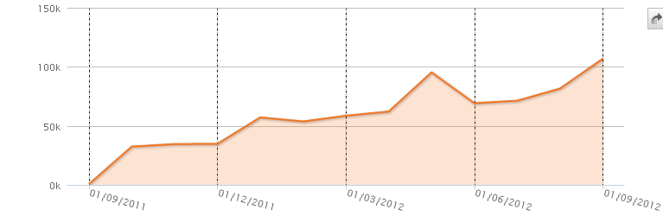
Importance of mobile
Mobile accessibility over the last 3 years has steadily increased
Notes:
This graph shows the trend increasing over the last year. There has been a steady increase in mobile usage to access council web pages over the last 3 years.

Slide 9
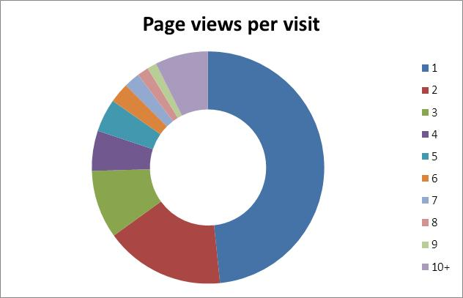
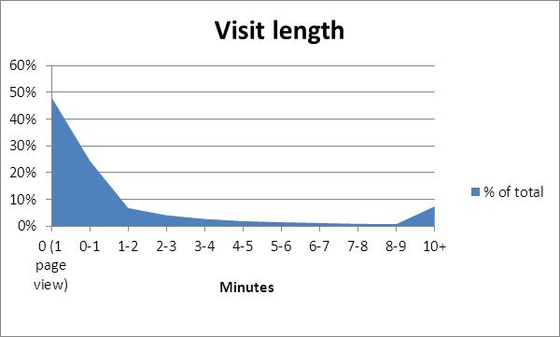
Here for a good time not a long time…..

Slide 10
The case for change
Approx. 4000 pages on the old website
Mostly news and services – limited transactions.
50% of all page views are on just 200 of these pages
…..which is 4.2 million views
SOCITM 2 star

Slide 11
Principles
Design isn’t just look and feel – it is about user experience and user interaction design
Agile approach – design, build and test
Make changes as we go along based on feedback and knowledge gained in building the site
Don’t do everything at once – Get foundations in place
Based on best practice in local gov – Gov.uk

Slide 12
Responsive Design
Design for mobile first
Design that will work on all devices
NOT native apps – expensive to develop maintain and keep updated as new phones / operating systems introduced frequently
Accessibility fundamental to the design.
Notes:
WAI Accessibility standards
Making a site accessible is about allowing user with varying disabilities to access the information using a wide variety of assistive devices
It isn’t about the badge it is about doing what is right and it can enable and improve somebodys lifestyle
Testing of new design templates to be done by charitable trust who employ users with varying disabilities to test the user experience
Making the site accessible fits all users, it is about simplicity / clarity and ease of use, it also fits in with how content displays on mobile devices

Slide 13
Structure & Content
Focus on customer – top transactions – not service based
Navigation - Simple, Clear - and faster to get to content.
Splitting the content to Resident / Business / Council.
Structure is important but isn’t everything – 60% of traffic comes directly from google to the landing pages.
Wholesale content review
Notes:
Less is more,
less pages is easier to maintain and update and is easier to navigate
Why produce content when we can signpost people to existing online resources
Have people viewed the content / is it needed?
Clearer and shorter pages – less waffle – teams / awards
Top tasks / Interactions at the top of pages
Users want to get on and get info or do transactions and the leave
Lasting experience is about can the person do what they wanted to
Customers generally want to know:
What is the service?
Do I qualify for the service?
How to apply for it?
How do I report it?
How / Where can access the service?
Is there a cost for there service?
How to do I pay?

Slide 14
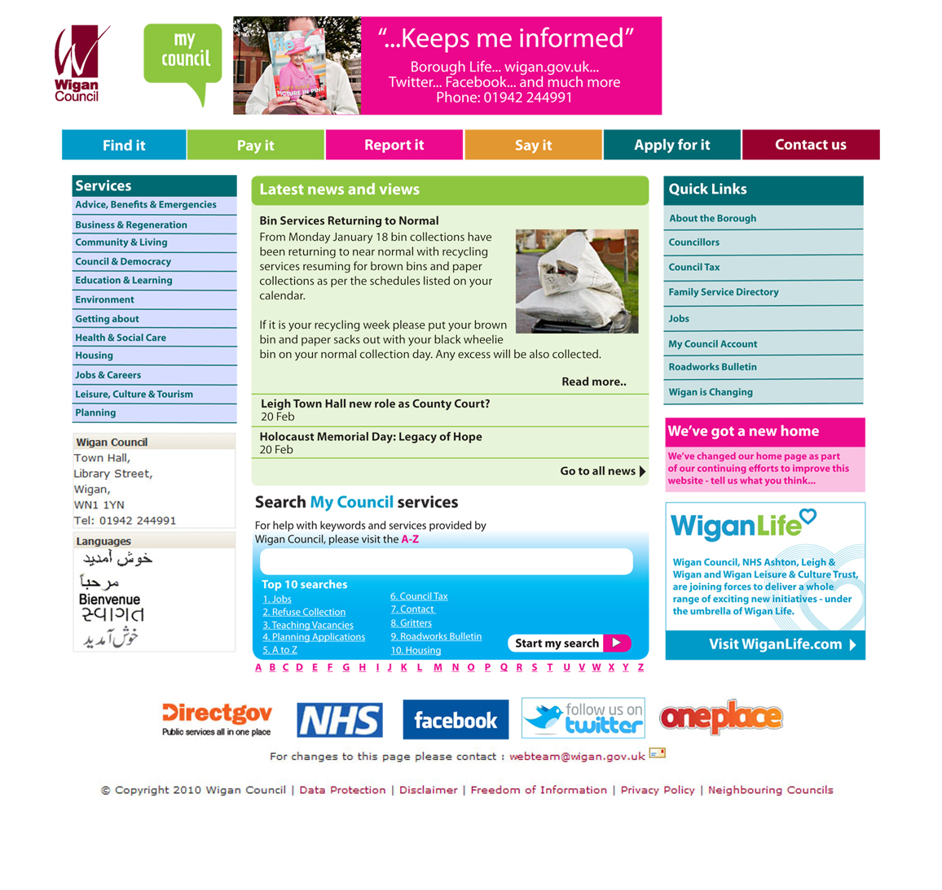
Old…

Slide 15
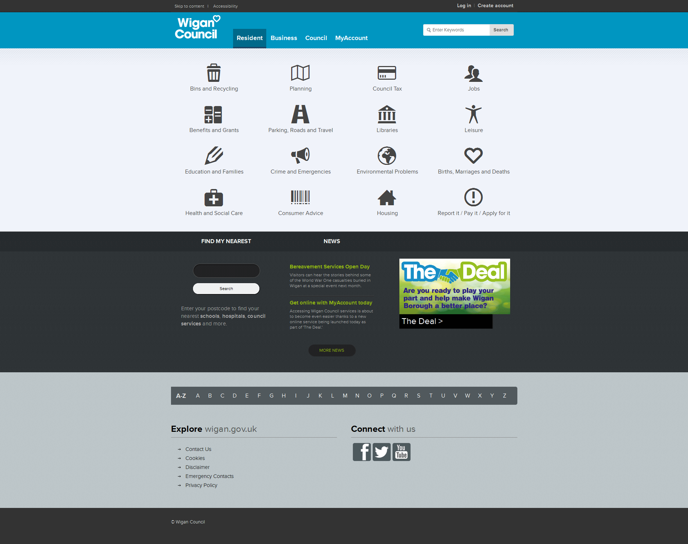
New…

Slide 16
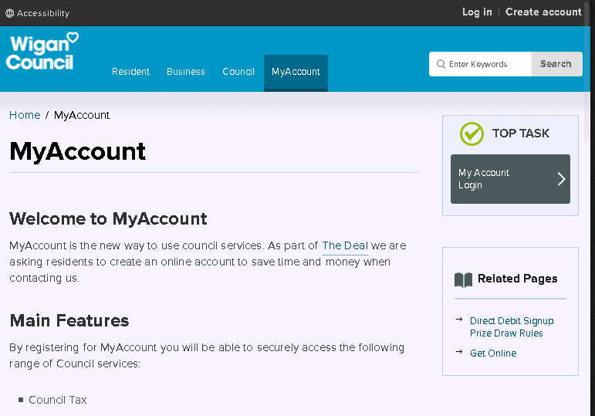
My Account
Notes:
3,000 registrations in first few days
Direct debit sign ups for council tax
First phase – council tax, Housing benefits, housing rents.
More to come

Slide 17
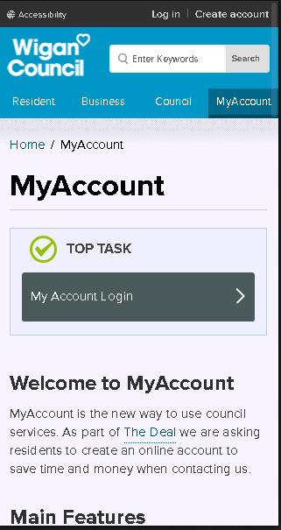

Slide 18
Lessons / Challenges
To migrate or not to migrate
Decide on publishing model
Time!! - Don’t underestimate resources required – get a good and committed project team
Copywriting process far lengthier and needed more resource than we initially predicted
Working within the boundaries of the CMS. Department and service team engagement and working with them to convince them what you are doing is for the greater good.
Stick to the design principles.
Notes:
– Do you start from scratch or do you migrate and adapt. We chose to migrate and then review content due to time restrictions and resources. We probably would have started from scratch if we were to do it again.

Slide 19
Ongoing improvements
Continual process of analysing user behaviour and adapting the site, NOT a one off exercise
Improving the site we will also improve our base data which will give us more to analyse
Ability to see what people are doing more and how the interact using different devices
Knowing why there is a high bounce rate
Knowing when they have needed to click to get a phone number
Analyse user journeys

Slide 20
Next Steps
Expansion of the web team
Linked to Wigan Deal
MyAccount additions
Adding other interactions not on the MyAccount roadmap
Development of Wigan Council icon pack rather than using icon packs from around the web
Redesign of landing pages adding the use of new icons
Additional search functionality

Slide 21
Thank you for your time and attention. Questions and Answers

