Slide 1

Website update
Louise Halloway

Slide 2
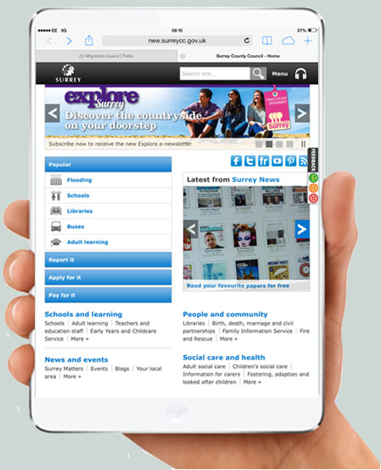

Slide 3
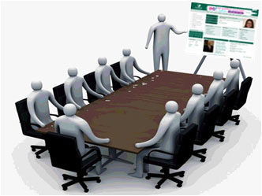


Redesign

Slide 4
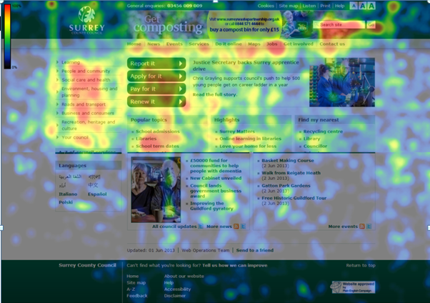
Notes:
Have heat maps to show customer usage of the site. Red is where most heat – most people click and then yellow, then green. Use this to share with services and help them understand what customers do on their sections of the site. Big help as part of the redesign work.

Slide 5
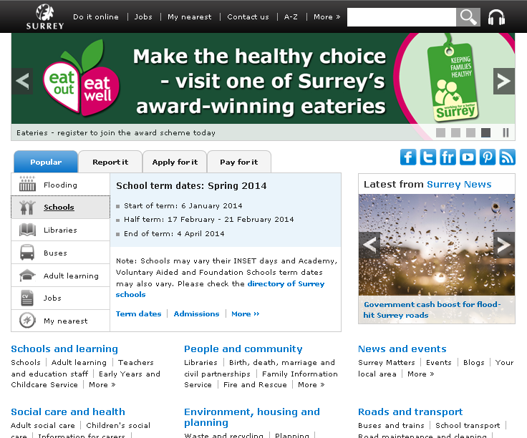

Slide 6
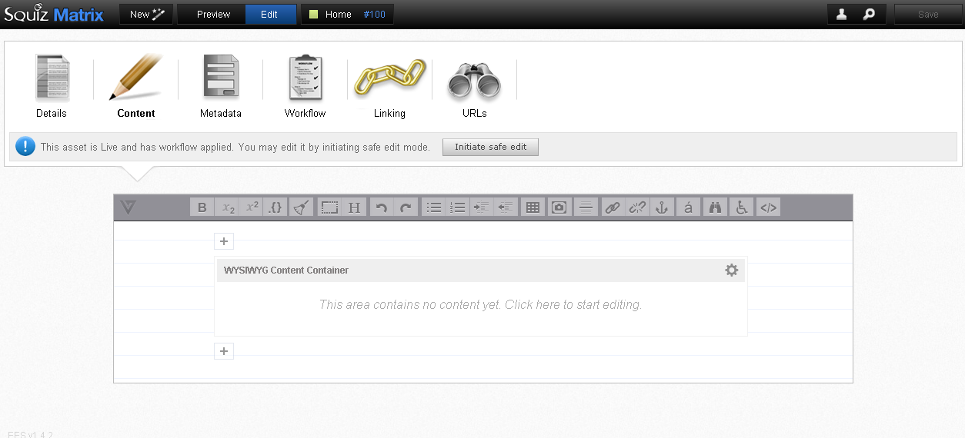
Squiz Matrix - CMS

Slide 7

Umbrella sites

Slide 8

Questions?

