Slide 1
What’s The Point?

Slide 2
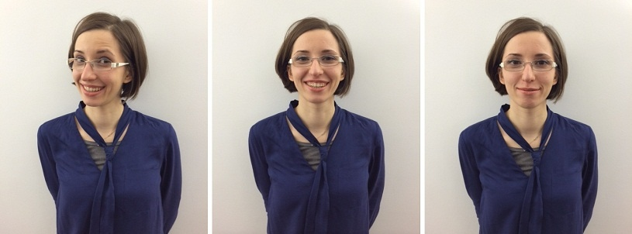

Slide 3
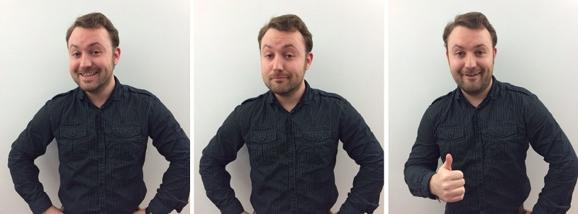

Slide 4
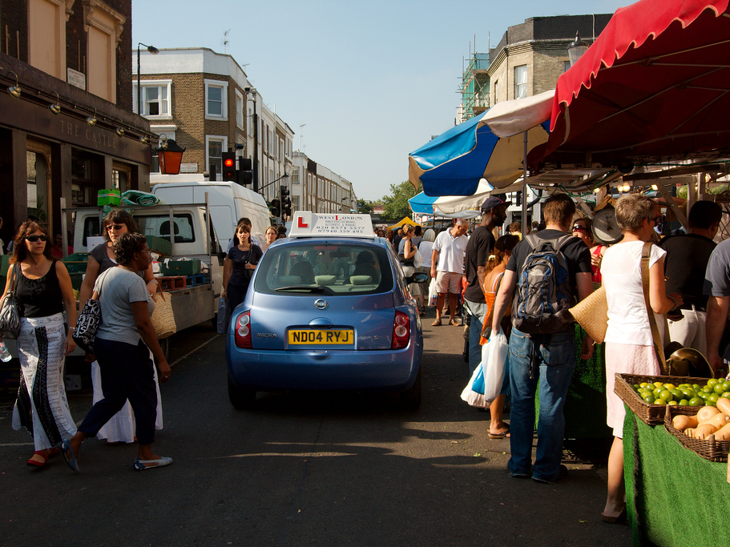

To communicate a clear message that’s easily understood.

Slide 5
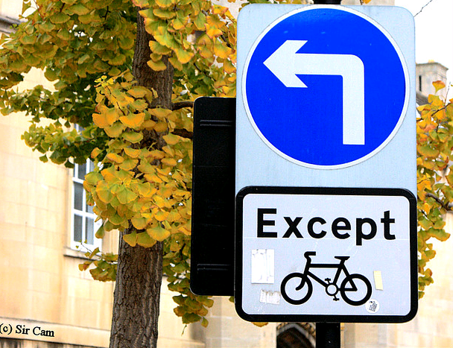

To trigger a response or encourage a preferred action.

Slide 6
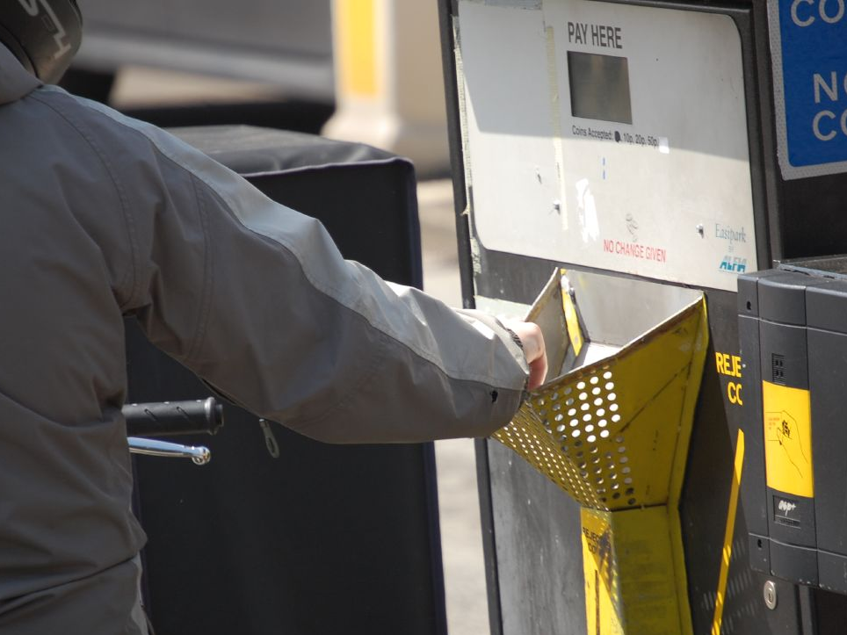

To elicit self service and reduce avoidable contact.

Slide 7
Bin Collections
“Imagine you live at [this address].
Use the website to find out when your next bin collection day is.”

Slide 8


Slide 9
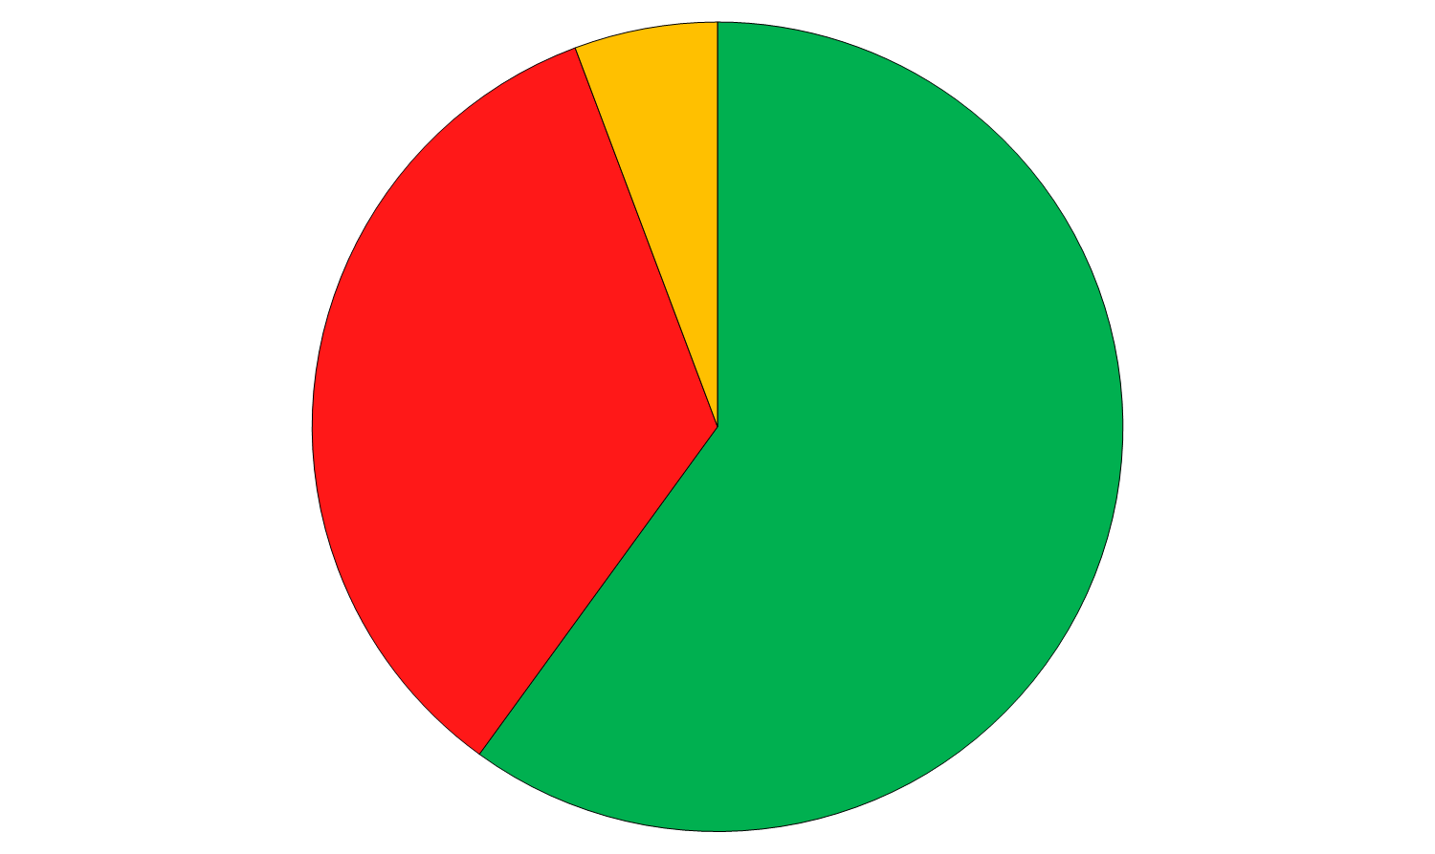

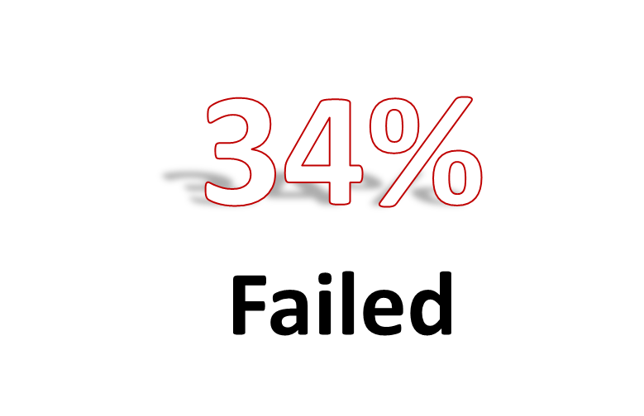
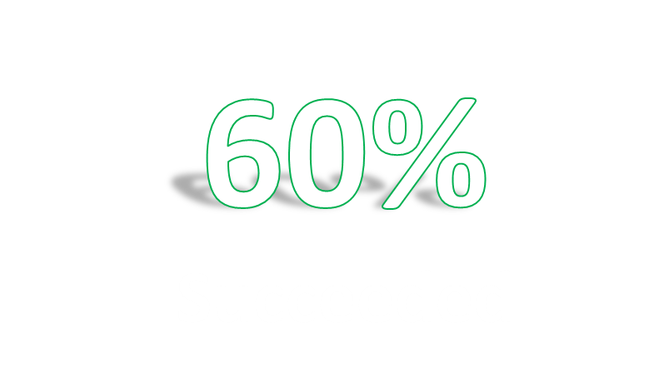

Slide 10
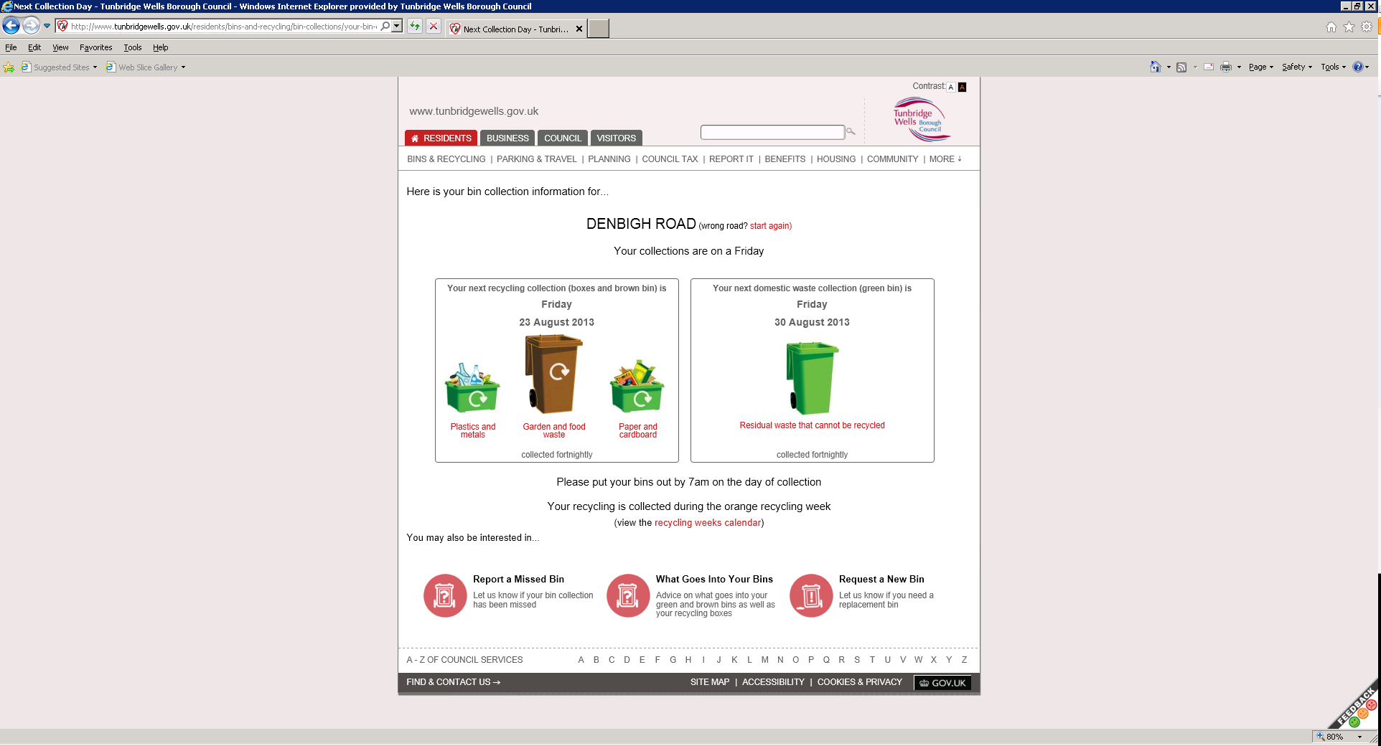
Notes:
Why only 90% task completion? Some people thought they were looking for their own road, rather than the road we gave them to find. Success rate would go up to 96%.

Slide 11
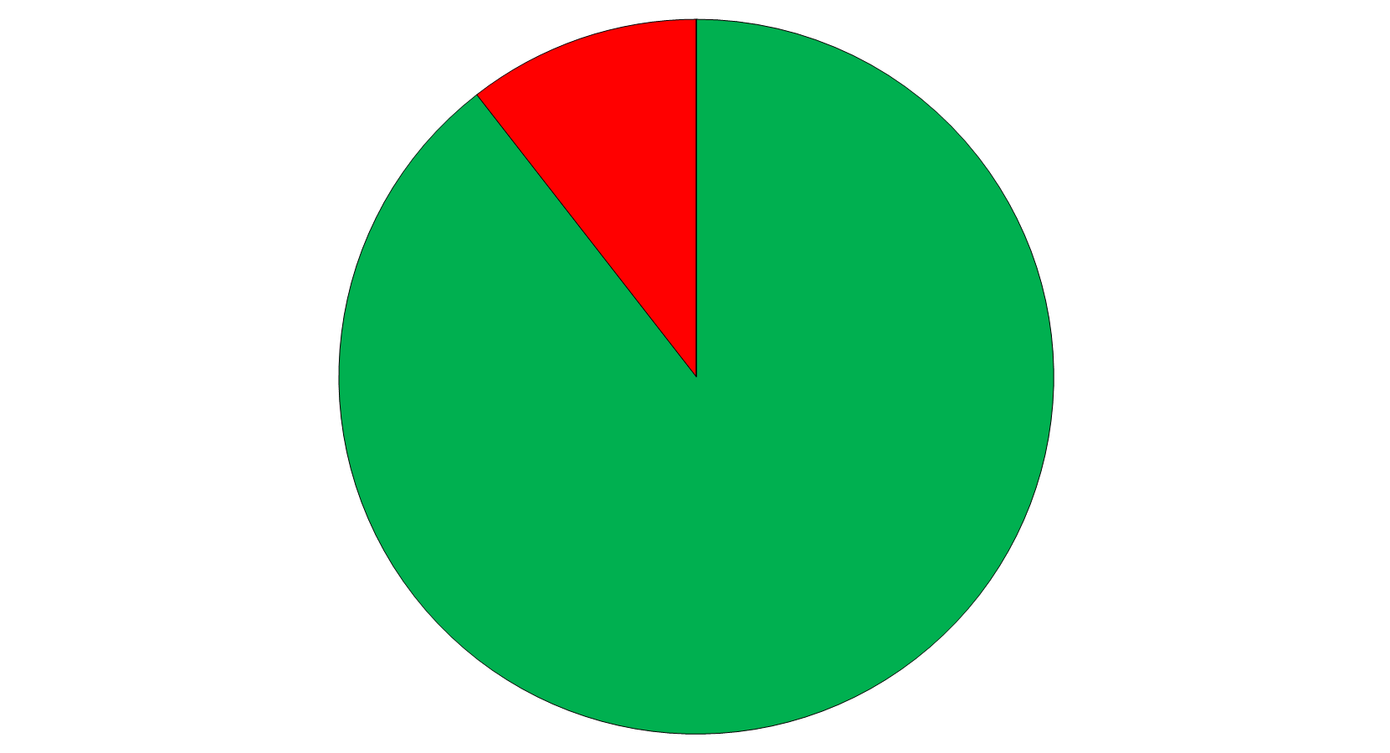
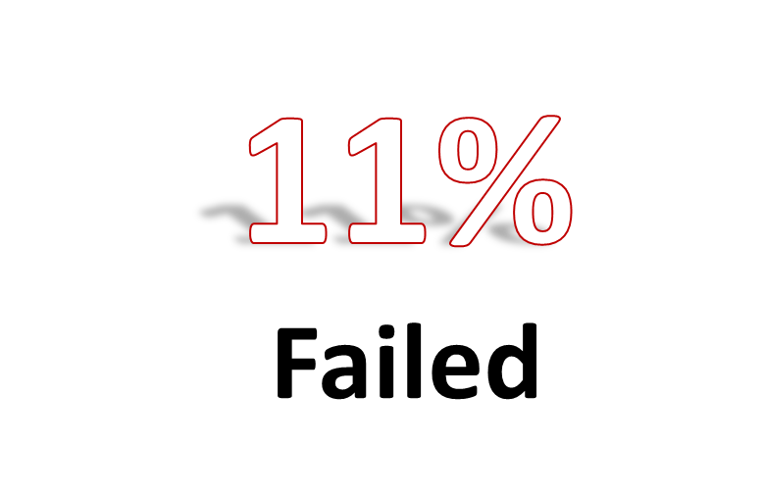


Slide 12

“
I mean, it allows me to be me, looking for what I want, rather than having to trawl through some office worker’s idea of what’s helpful.
”
Participant 3

Slide 13
Who is Liable to Pay (Hierarchy of Liability)
You will be liable to pay Council tax if you are:
a resident with a freehold interest or a leasehold interest (if the leasehold interest is not inferior to any other resident)
a resident who has a statutory or secure tenancy
a resident who has a contractual license
a resident (e.g. a squatter)
a non-resident owner

Slide 14
A Temporary Event Notice (TEN) is required, ……Applications must be made at least 10 working days prior to the event to be considered a standard TEN, however a late TEN can also be made which is given not before 9 working days and not later than 5 working days before the event…. ….If you have a personal licence, you can give 50 TENs (made up of standard and late TENs) a year; if you don't have a personal licence you can only give 5 (made up of standard and late TENs). If you have a personal licence, you can give 10 late TENs a year; if you don't have a personal licence you can only give 2 late TENs.

Slide 15
“The priorities for the partnership will focus on where we can make the biggest difference by working together towards the key issues for our community.”

Slide 16


Slide 17
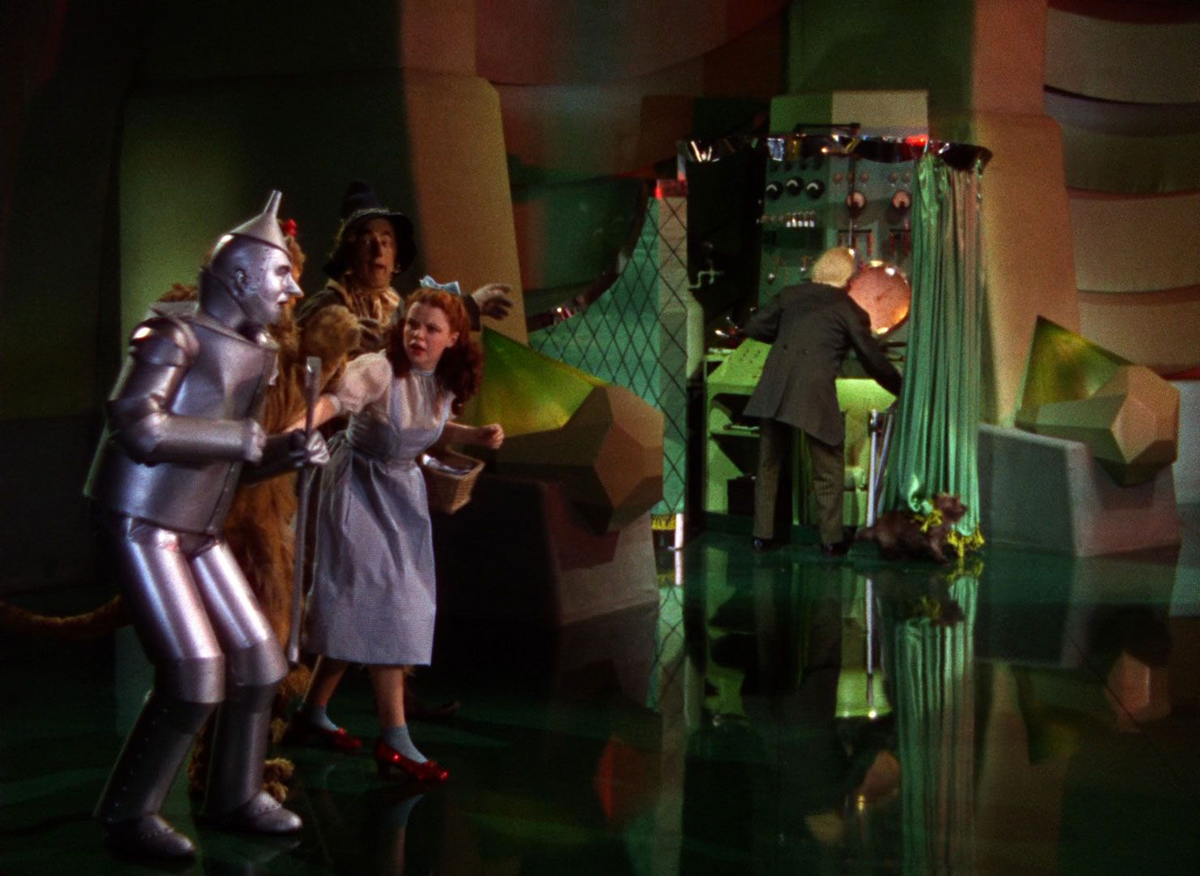

Slide 18
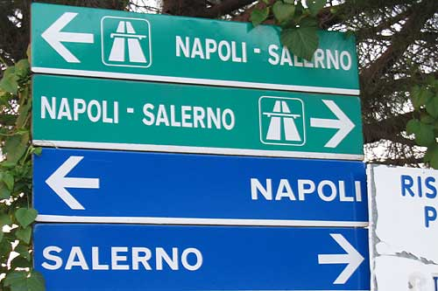

Slide 19


Slide 20


Slide 21


Slide 22
ASK THEM

Slide 23
What’s the point?

