Slide 1

Improving the customer experience on a council website
The journey from 1 star to 4 star

Slide 2
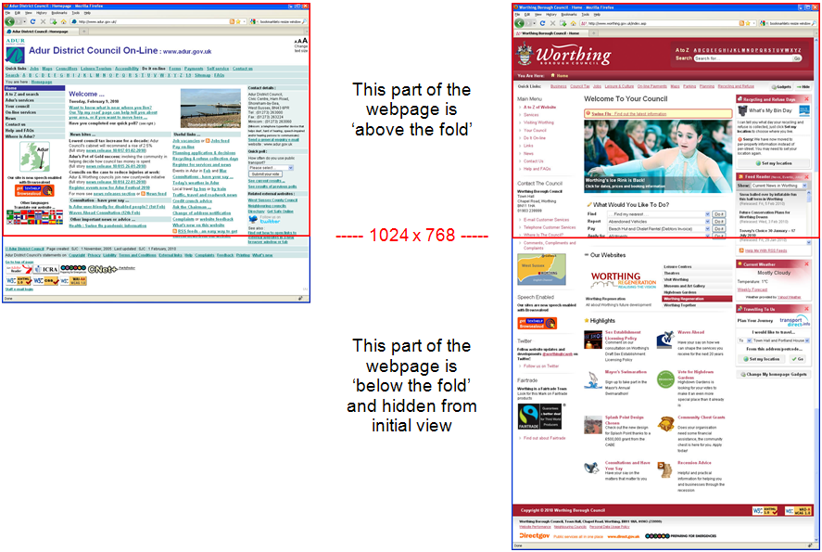
Where we were
Originally two separate websites
Dated designs and information overload

Slide 3
Interim progress - 2007 to 2010
Partnership working of the two councils made increasing sense to join the websites up
Content of the two websites was duplicated, similar but different
Some information appeared on one website but not the other
Growing number of links between the two websites to avoid duplication
Lack of joined up feel and appearance

Slide 4
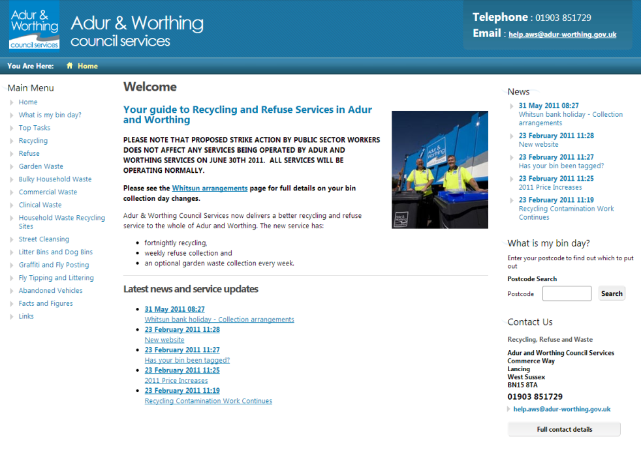
Separate recycling & waste website
Recycling & waste
was split out to create
a separate website
in 2007
This was linked to
from the two council
websites
Subsequently pulled back into the main website when the new joint site was launched

Slide 5
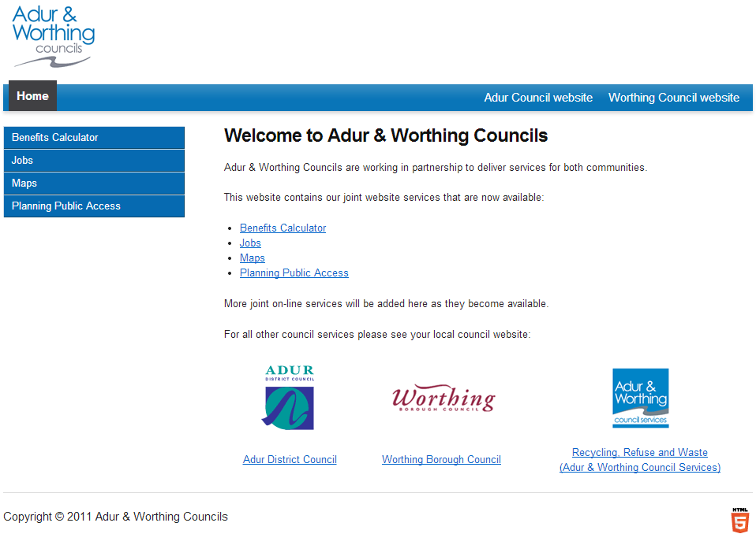
Interim partnership joint website
A few services were
initially launched on
a basic joint website:
  Benefits calculator
  Jobs
  Maps
  Planning Public Access
Linked back to existing websites for all other content
Ran for about 18 months - 2011 to 2012

Slide 6
Getting user feedback
Ran surveys (public and staff) asking:
  What people liked and disliked about sites
  What they might like to see on a new joint site
Very little ‘useful’ feedback ☹
  Comments about colours
  Don't change it, don’t merge them, I like it as it is … !!!
We did get some useful feedback though
  Reduce clicks, quick links to content
  Reduce clutter and weight on pages
  Make it mobile/tablet friendly
Other feedback taken on board (eg via e-mail)

Slide 7
Design of site decided…
Started with a ‘blank sheet of paper’
Decided on a design look and feel
Came up with navigation structure
  Use of: pull down menus, tiles, icons, photos
Worked with the departments to come up with a content skeleton/framework for their information
  This allowed us to come up with a better understanding of services’ needs and problems
  Eg housing application form not on-line as they need to talk to applicant before they fill the form out

Slide 8
How to approach the new site …
Decided to base key sections on user stats:
  most popular pages easiest to find
  pages and content deleted if not used
Subject driven, not arranged departmentally
‘Top task’ lead (SOCITM Better Connected)
Top level categories:
Residents – Businesses – The Councils – A to Z
Referred to other websites for:
  best practice
  design and navigation ideas

Slide 9
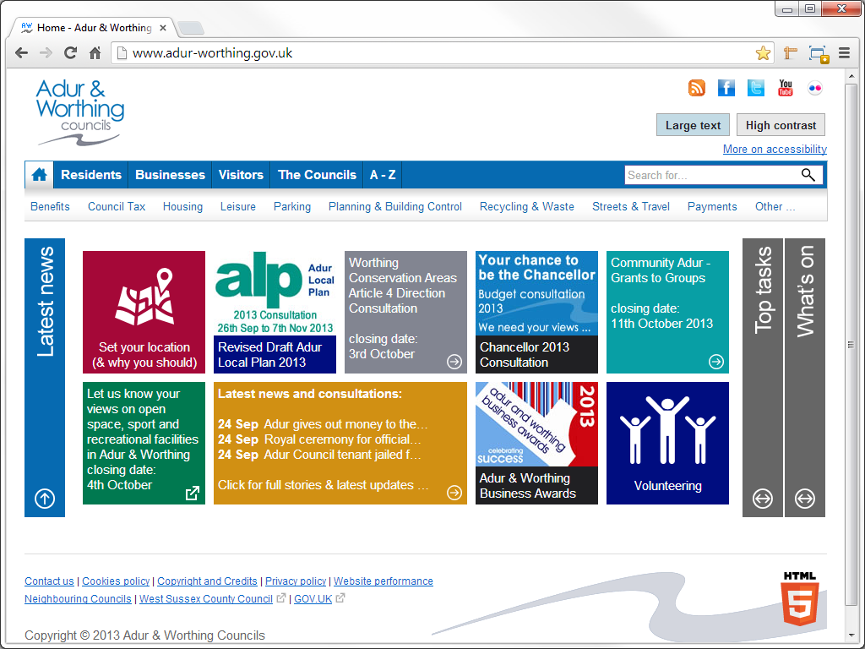
Homepage

Slide 10
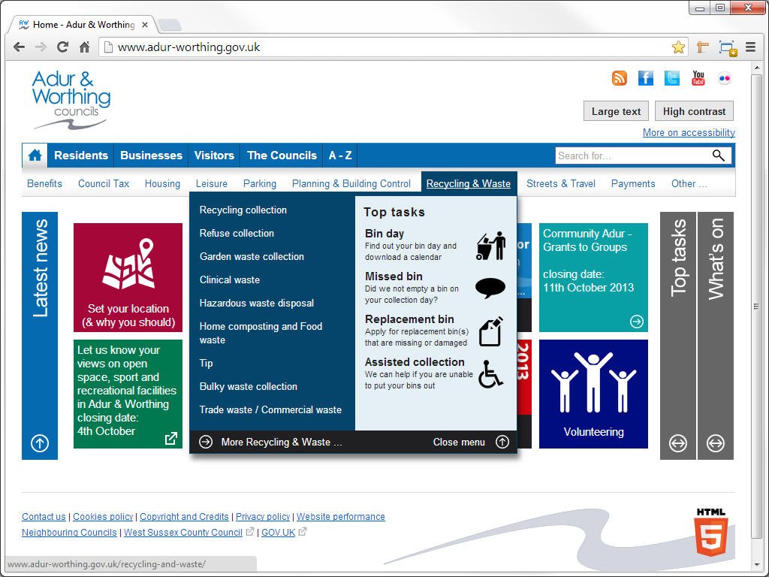
Menus with top tasks and main links

Slide 11
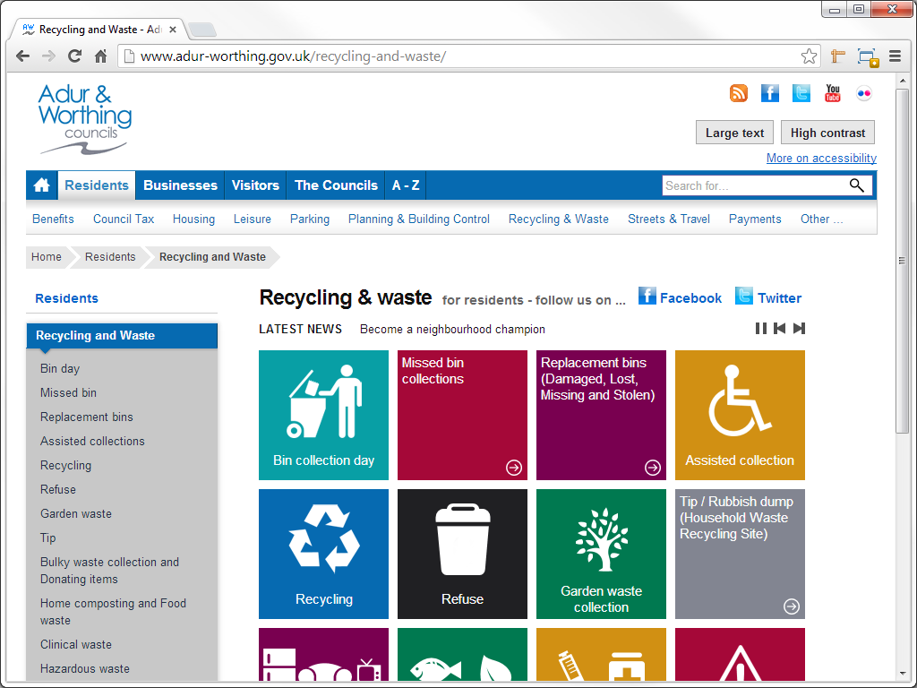
Section page – use of icons & text

Slide 12
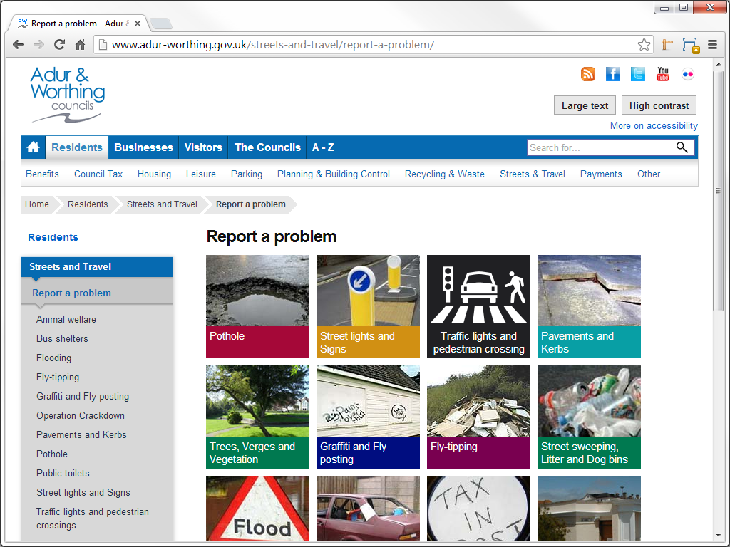
… or use of photos

Slide 13
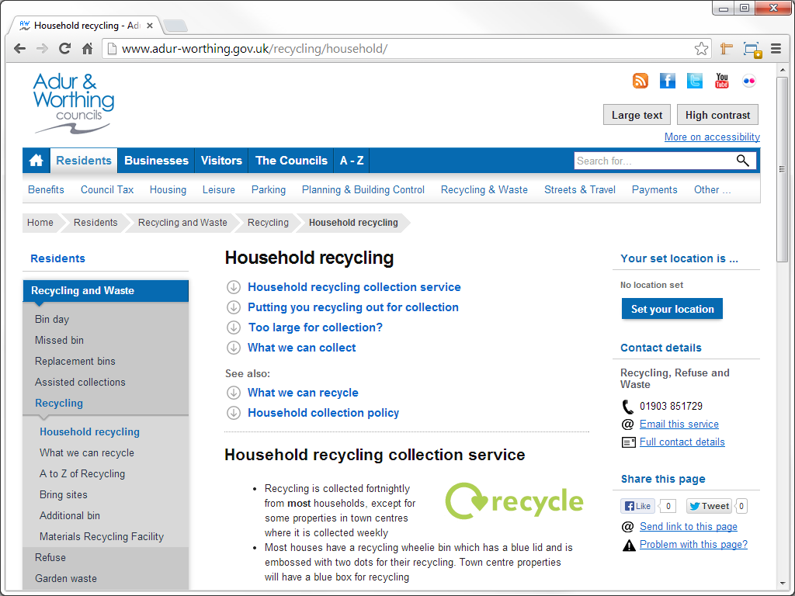
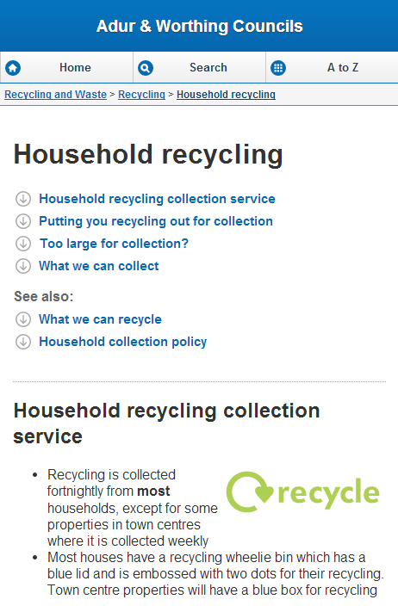
Information page

Slide 14
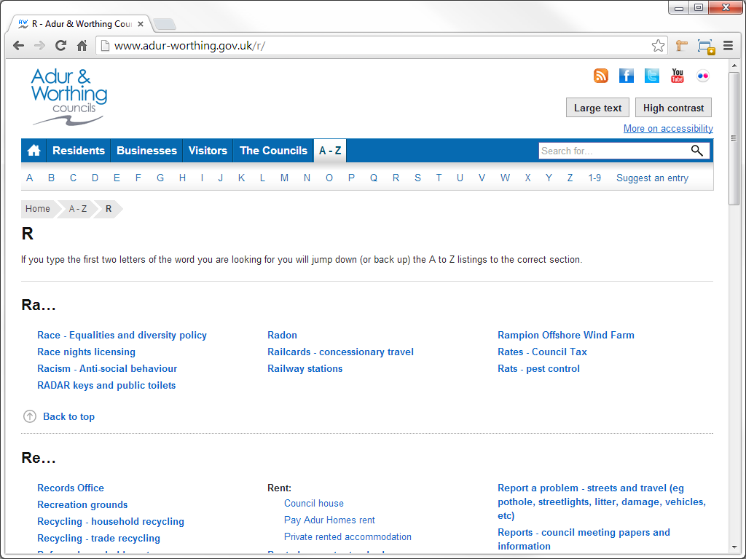
Comprehensive A to Z section

Slide 15
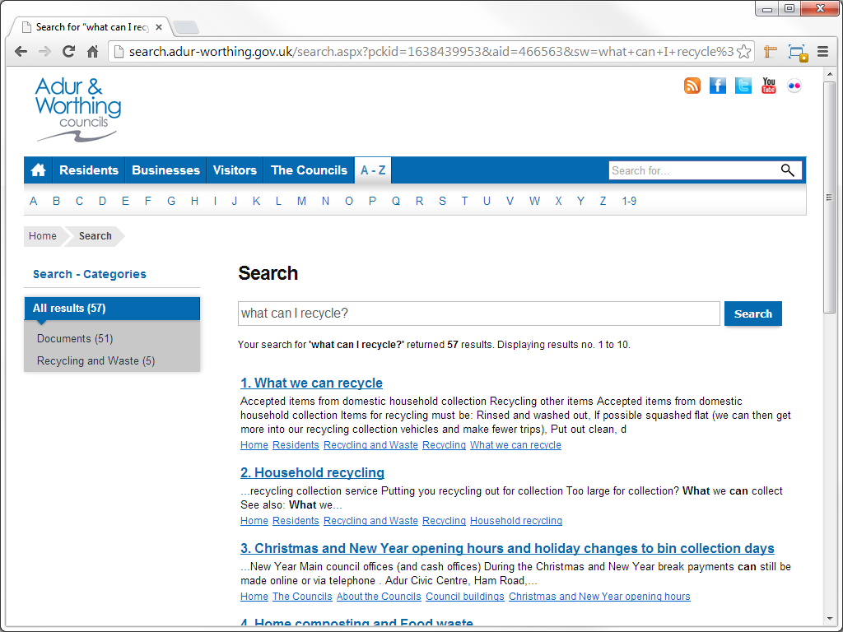
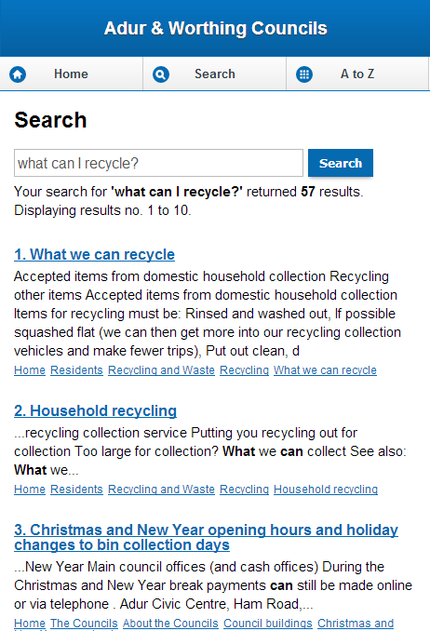
Search engine

Slide 16
Coming up with the content…
Old websites’ information was similar but localised to the separate council areas
Content completely rewritten to provide clear information for customers – not cut & paste
Plain English promoted throughout
– avoid jargon and legalese

Slide 17
Coming up with the content…
Keep information as short as possible
Bite size chunks
Avoid information overload
Links to other sites if info provided there, eg:
  Environmental Health – how to cook burgers
  links to Food Standards Agency website
  Health advice – food poisoning
  links to NHS websites
  Planning & Building Control
  links to Planning Portal

Slide 18
Looking to the future
Fully responsive design
E-form usability, design and integration
Design of external sites (planning applications)
Monitor web stats to maintain top tasks
Refine and optimise search engine results
Content ownership by departments to be formalised (review dates and updates)

