Slide 1
A Framework for Digital Local Public Services
Carl Haggerty
Digital Communications Manager Devon County Council
& Chair of LocalGov Digital Steering Group
@carlhaggerty

Slide 2
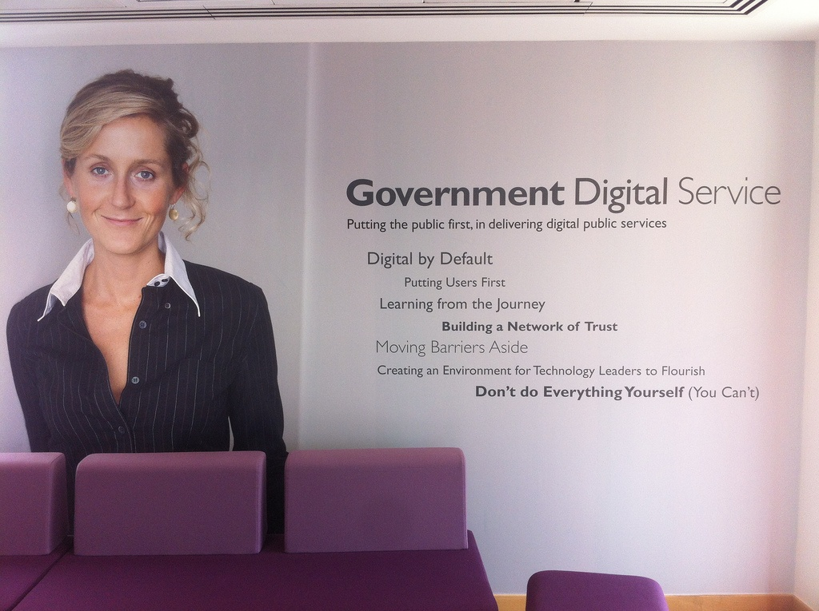
Changing Expectations
By Ben Terrett - Flickr
Notes:
By Ben Terrett - Flickr

Slide 3
What about Local Government? Or better still Local Communities (our people and our places)

Slide 4
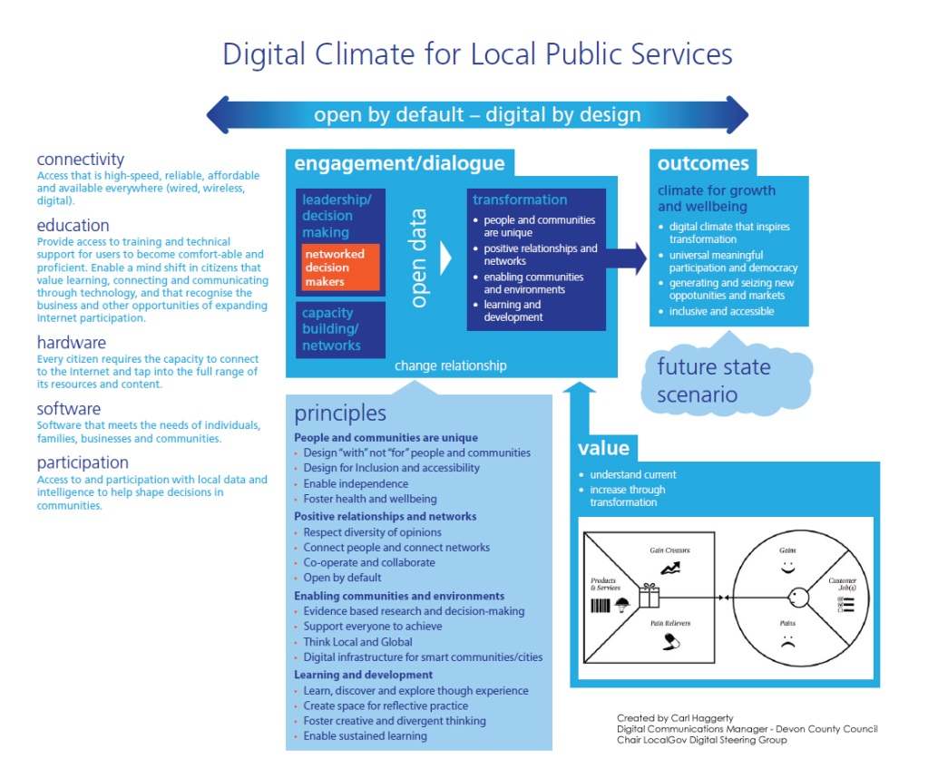
This is a draft sketch…
It’s evolving through discussion

Slide 5
“The following focuses on the underlying proposition that every citizen can and will meaningfully integrate the internet into their daily lives.”
The sketch explained…

Slide 6

Open by Default, Digital by Design
“Active and capable participation should allow for new opportunities to emerge which reduce and divert demand to alternative tools which are open by default and digital by design.”
By Paul Keller - Flickr

Slide 7

Unlocking Capabilities
Connectivity - Education - Hardware Software - Participation
By Slack pics - Flickr
Notes:
By Slack pics – Flickr
Capabilities
Connectivity: Access that is high-speed, reliable, affordable and available everywhere (wired, wireless, digital).
Education: Provide access to training and technical support for users to become comfort-able and proficient. Enable a mind shift in citizens that value learning, connecting and communicating through technology, and that recognise the business and other opportunities of expanding Internet participation.
Hardware : every citizen requires the capacity to connect to the Internet and tap into the full range of its resources and content.
Software: that meets the needs of individuals, families, businesses and communities.
Participation: Access to and participation with local data and intelligence to help shape decisions in communities.

Slide 8

The Journey
“a shift in thinking in which people and institutions are
routinely aware of and constantly incorporate
digital technology and opportunity into whatever they do.”
By Slack pics - Flickr
Notes:
By opensourceway – Flickr
Open by default = Everything we do is open, our processes, our data, our decision-making etc
Digital by design = Digital by default is a channel decision and my personal opinion is that digital by design is a philosophy which we should adopt to ensure that others can build on our open platforms and processes.

Slide 9

Supported by…
networked people
core principles
understanding value
proto-typing
capacity building
open data
co-creation / co-design

Slide 10
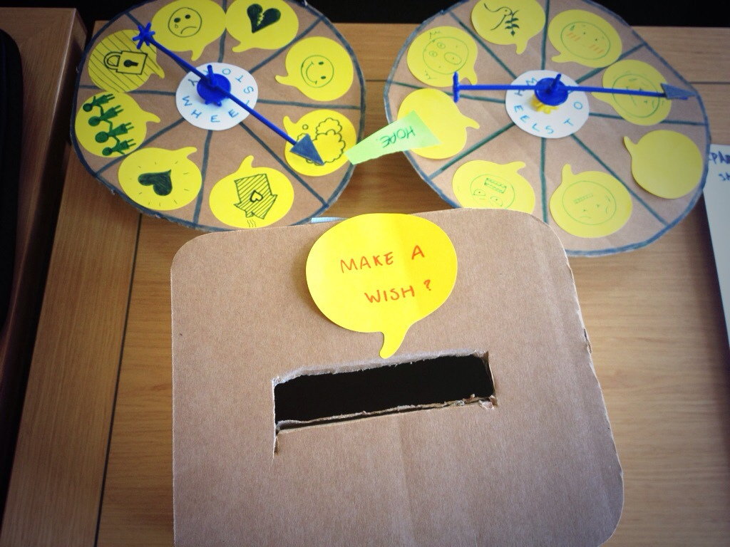
proto-typing @ XJamGov

Slide 11

Climate for Growth and Wellbeing
“a ubiquitous digital climate that animates and inspires
creativity and transformation and enables growth and wellbeing.”
By Skånska Matupplevelser - Flickr

Slide 12


