Slide 1

Time to put
your customer hat on
Notes:
It’s now time to put your customer hat on and stop thinking as a council employee…

Slide 2
Each table =
3 examples of a user journey
Notes:
On your tables are 3 examples of the “Getting on the electoral register” journey

Slide 3
1 = good
1 = average
1 = not very good
Notes:
1 example is pretty good, 1 example is pretty bad, and 1 is average

Slide 4
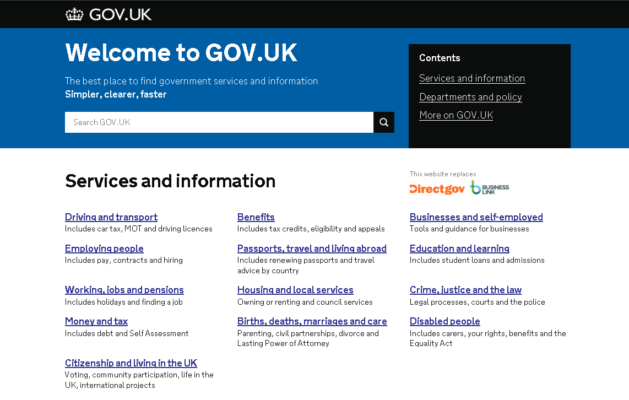
GOV.UK homepage
Notes:
Your journeys today all start from GOV.UK
For those of you who haven’t seen it, I’m going to show you how that journey begins
Here I am on the homepage of GOV.UK, which links out to around 200 local government services

Slide 5
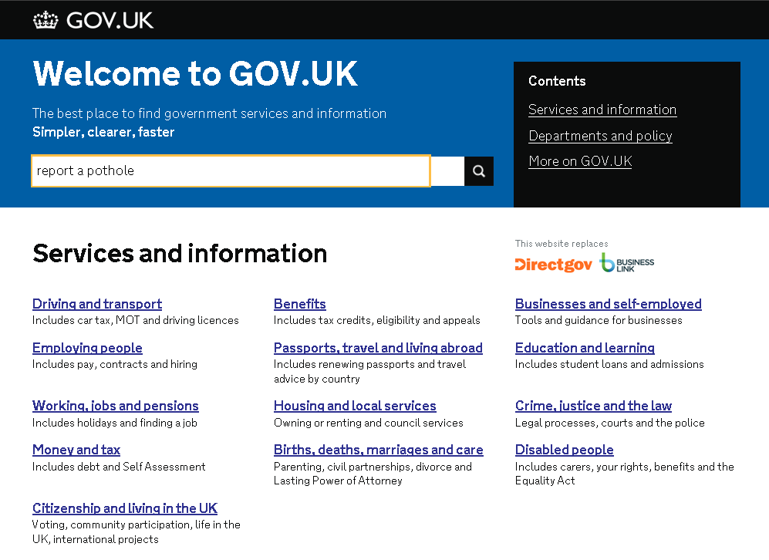
We want to report a pothole.
Notes:
In this example I decide I’m going to report a pothole.
I put ‘report a pothole’ into the search box

Slide 6
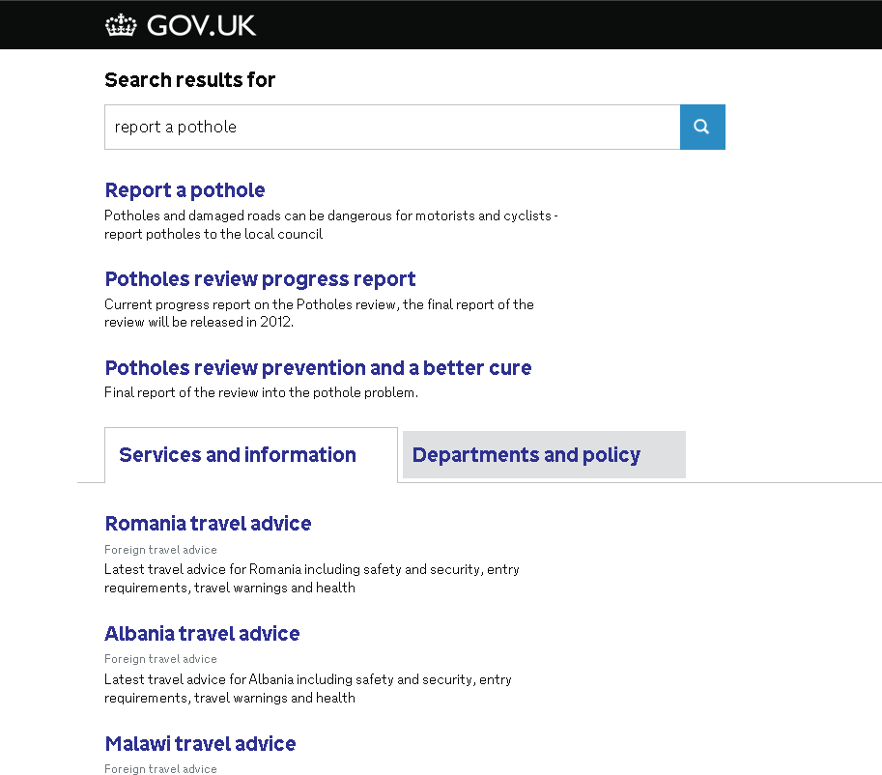
Notes:
I get a list of search results with ‘report a pothole’ at the top…

Slide 7
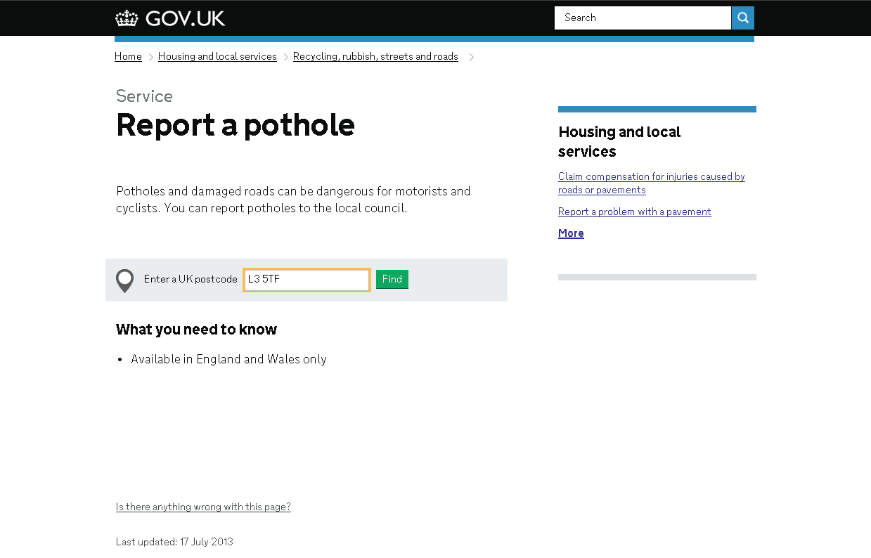
We need to put in our postcode (Liverpool in case you’re wondering).
Notes:
I click on it and am taken to a page that asks me to enter my postcode.
I put in my postcode (Liverpool in this case)…

Slide 8
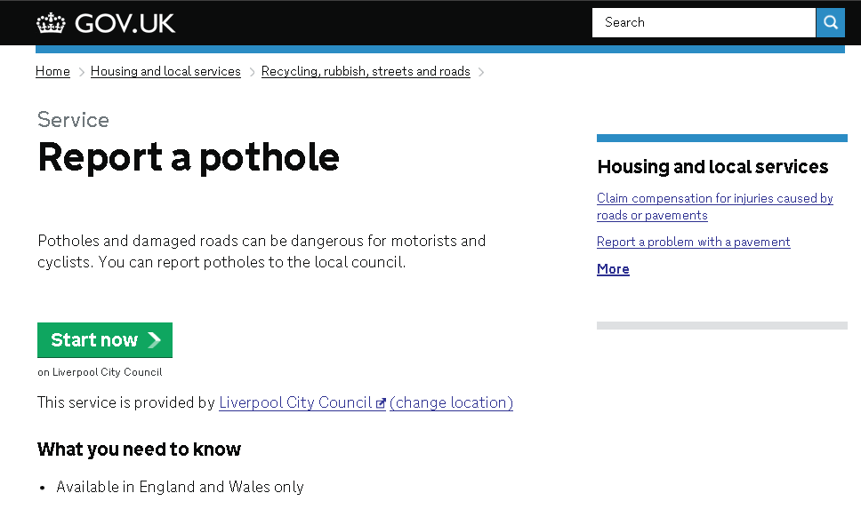
GOV.UK confirms our location
Notes:
GOV.UK confirms that I really do want to go to Liverpool council’s website…
I press ‘Start now’…

Slide 9
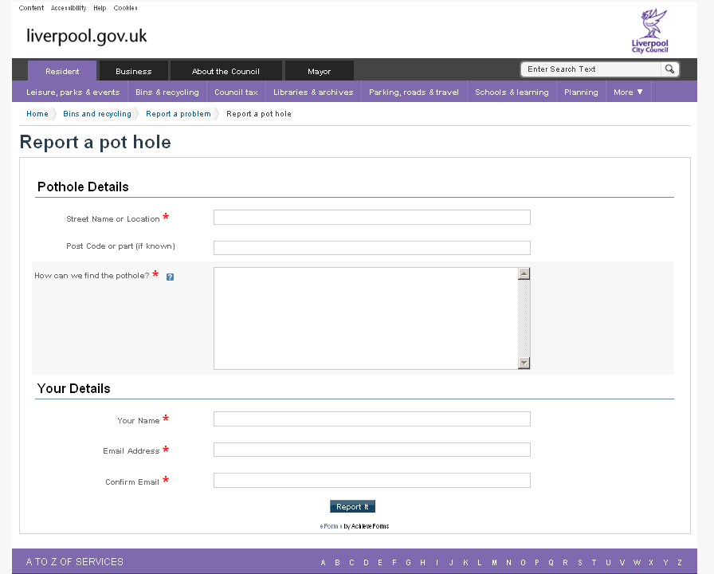
GOV.UK has taken us to a deep-link on Liverpool Council’s site.
It tells us quickly and simply how to report a pothole
Notes:
And GOV.UK takes me directly to the page I need on Liverpool council’s website!
This is a great user journey – it’s quick and easy for the user.
And this is where you come in – all the user journeys on your table start at this point.

Slide 10
Your task
(should you
choose to
accept it…)
Notes:
So your task today is…

Slide 11
1. Nominate:
  someone to take notes
  someone to present the group’s findings
Notes:
Firstly, take a couple of minutes to nominate someone to take notes and someone to present the group’s findings…

Slide 12


2. For each journey:-
- What’s good?
- What’s bad?
Notes:
You then have 30 minutes to discuss as a group ‘what’s good’ and ‘what’s bad’ about each of your 3 examples.
What really works well about the journeys? And what really doesn’t work at all?
There are 2 copies on each table, so 1 side of the table can take 1 copy, and the other side of the table can take the other.
Please work together as a group on the first example before moving on together to example 2 and 3

Slide 13
1. Nominate:
  note-taker
  presenter
2 mins
2. For each journey:
  - What’s good?
  - What’s bad?
30 mins for all 3
Notes:
So to reiterate:-
2 minutes to nominate a note-taker and a presenter
30 minutes to look at your 3 user journeys and decide on good and bad points for each.
Any questions?

Slide 14
Over to you
Notes:
Your time starts now!
(Let them work for 30 minutes)

Slide 15
Getting on the electoral register acceptance criteria
It’s done when the user:
Knows whether they are eligible
Knows how to apply
Knows ……?
Knows ……?
10 mins
Notes:
The next part of the exercise is going to involve you designing a model/ perfect user journey
But before you do that, with your customer hat on, please spend 5 minutes thinking about the acceptance criteria for this journey.
Ie. At the end of the customer journey, what should the user know or have done?
(Some ideas for this =
Knows whether they are eligible
Knows how to apply
Knows how long it takes
Knows how much it costs
Knows what happens after they’ve submitted the application)

Slide 16
3. Come up with your group’s model customer journey
20 mins
Notes:
So now you know what outcome you want for your user, have a go at coming up with a model customer journey.
If you could design the perfect user journey, what would it look like?
Use your acceptance criteria to check you’ve covered all the bases

Slide 17
Feedback
Good Stuff about the journeys you looked at
Bad Stuff about the journeys you looked at
Your model user journey
Notes:
You’re now going to present your findings to the group.
What good and bad things did you find?
And what does your model user journey look like?

Slide 18
4. Look at this user journey on your council’s website
15 mins
Notes:
The next step is to see how our own council’s website performs…

Slide 19
4. Look at this user journey on your council’s website
How does it compare to the model user journey?
Does it answer the acceptance criteria?
How do you rate the journey from 1 to 10?
What changes, if any, do you need to make to it?
15 mins
Notes:
On your tables, have a look at the user journey and try and answer the 4 questions above.

Slide 20
Feedback
Open discussion – tell me what you found out
Notes:
Prompt the group by asking the 4 questions they were looking at, but this can turn into a group discussion where everyone joins in.
How does it compare to the model user journey?
Does it answer the acceptance criteria?
How do you rate it? (good? bad?)
What changes, if any, do you need to make to it?
Other questions:
Were you surprised at the journey on your council website?
Had you looked at it before you knew you were coming to this workshop?

Slide 21
Final 3 questions for our discussion…

Slide 22
1. What might stop you implementing the user journey you’ve come up with? (blockers)

Slide 23
2. What solutions can you think of for these ‘blockers’.

Slide 24
3. What are the next steps for our council?
Notes:
Try and come up with a rough action plan for making some of these improvements.

