Slide 1
Local Government Performance Dashboard
Library Renewals
Warwickshire County Council

Slide 2
Background
Ideas for the data we might want to present:
Library locations - which areas attract the most customers renewing online (and conversely, which have fewest online renewals)?
Online renewals for WCC libraries vs. community libraries
Digital vs. non-digital renewals
Successful completion rates
Renewals by borrower category (senior, under-5, adult, learning disabilities, visually impaired…..)

Slide 3
Data Extract Ideas
Date of renewal
Time of renewal
How the renewal was done - automated phone line, online, In Library Renewal
Original lending library location
What was being renewed? (book, CD, DVD, etc…)
Is the library a community library?
Fine associated with renewal?
Borrower category

Slide 4
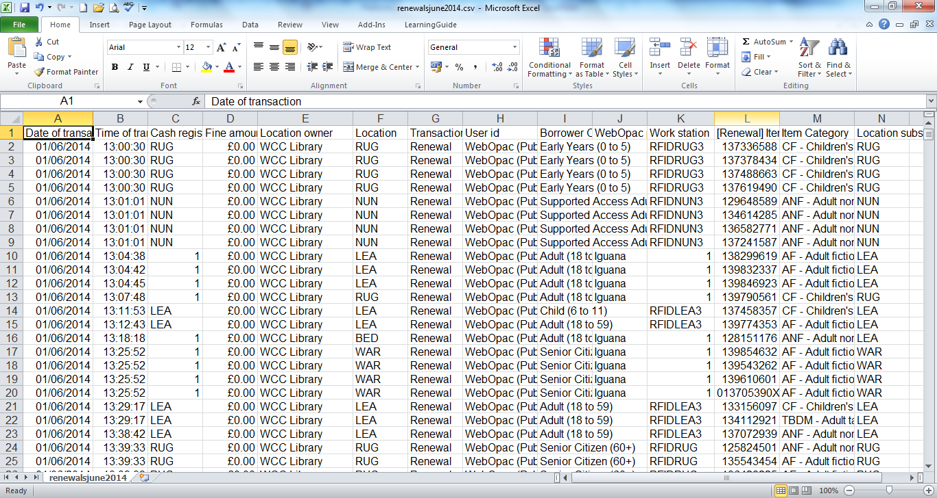
Initial Data Extract

Slide 5
Ways to renew in Warwickshire
Online
via our automated 24/7 renewal line, available 24 hours a day
by phone, fax or email to your library
in person at any library
Auto-renewal via a kiosk
Support from a staff member

Slide 6
Agreed first iteration
volumes by channel (graph)
digital take-up (graph)
digital take-up by borrower type (sorted table)

Slide 7
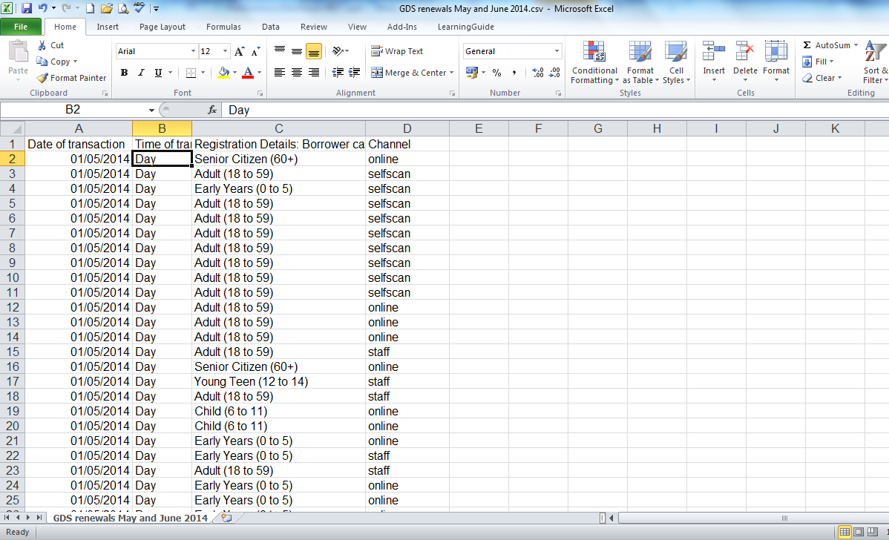
Agreed Extract

Slide 8
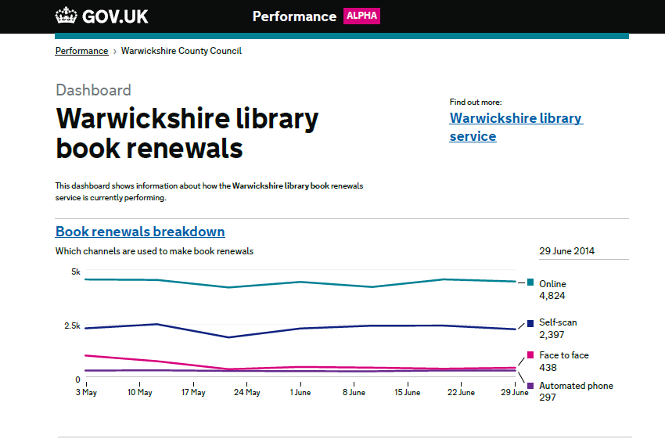
Initial Version

Slide 9
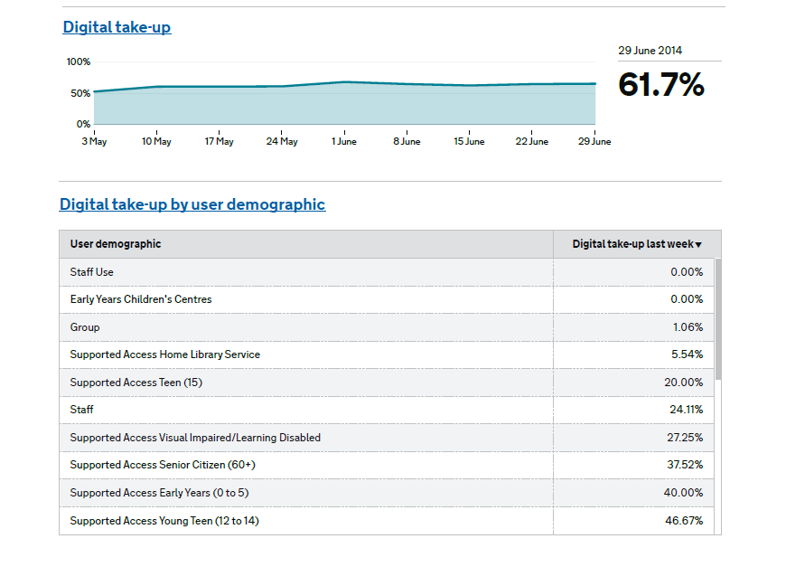

Slide 10
What might this uncover?
Will the digital take up rates by borrower type provide evidence around digital exclusion for some of our customers?
If we added location of borrower, might we identify areas of digital exclusion within Warwickshire?
Do we want to encourage people to do more online, or is self-scan OK if we want to deliver other services through our libraries?
If we look at fines, can we encourage people to renew online in order to reduce fines being issued?

Slide 11
Kate Sahota Digital by Default Programme Manager Warwickshire County Council
@808kate
katesahota@warwickshire.gov.uk

