Slide 1
Digital Transformation
Funding Approach
March 2016
Daniel Bromley | dan.bromley@rainmaker.solutions

Slide 2


UK Authority Digital Campaign
Viewpoints of Denise McDonagh and Chris Chant
Transformation at pace - the strategy is delivery
Putting the dream team together
http://www.ukauthority.com/local-digital-news-blog/entry/5741/transformation-at-pace-the-strategy-is-delivery-a-guest-blog-by-chris-chant
http://ukauthority.com/local-digital-news-blog/entry/5794/guest-blog-putting-the-dream-team-together

Slide 3
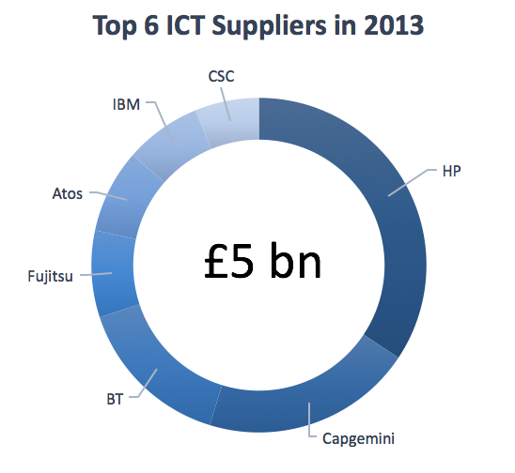
Central Government and ICT
Central Government and the “Oligopoly”
2010s
Wave of
Renewals
1990s
Wave of Mega-Deal outsourcing
1957
Central Computing Telecommunications Agency founded
Government is currently over-reliant on a small “oligopoly” of large suppliers Government and IT ‘A recipe for rip-offs’ Public Select Committee Report
circa1905
first telephone purchased by UK Government
1885
first typewriter purchased by UK Government
Government is in an abusive relationship with some ICT suppliers. Bill Crothers Government CPO

Slide 4
Today in Central Government
Coming from a world after…
09/10 Spending Review – ICT costs under inspection with cost savings programmes launched
Major supplier renegotiations from Cabinet Office
Quick wins/low hanging fruit – savings cashed
Likely to encounter
Natural expiry points reached or being reached from the 1990 1st wave of outsources i.e. what is ‘in it’ for the supplier to cooperate?
Suppliers claiming low profit or making a loss
Staff weariness/resistance to change or fear of unknown
Supplier responses to disaggregation; reinvention vs denial

Slide 5
Foundations for Savings (1)
Where to start
Relationship with incumbent and negotiation strategy
Principled negotiation?
1
4
Internal Stakeholders
What is a saving?
2
5
Cross Functional Team
Strategy and getting going
3
Set credible targets
6
Spend Data

Slide 6
Foundations for Savings (2)
Getting going
Be creative
Have you tackled the easy things?
- commodity spend e.g. mobile tariffs, printer cartridges,
demand management e.g. print footprint, app rationalisation, single device
Tail of suppliers outside the larger contracts?
Avoid analysis paralysis, get going but based on evidence and consideration

Slide 7
Four case studies
Where has the market changed, since the initial deal was let?
Networks: contract let in early 2000’s, mega-deal of entire ICT stack, reset in 2009, WAN re-competed with 40% saving
Onerous terms: contract let early 04, reset twice in 2006 and 2009), pensions indemnity removed in 2013. >£1m in exchange for risk owned by customer, but workforce had dropped from 300 staff on civil service pensions to circa 40 which was more tolerable for public sector to own)
Cloud Example 1: infrastructure contract let 05, migrated hosting to the cloud with >60% saving (>£1.4m)
Cloud Example 2: fresh build to cloud, did not understand workload of application. Chose pricing model that exacerbated costs i.e. hosting element huge savings, data transmission expensive. Cost increased compared to an off-premise traditional hosting approach.
Final thoughts: you won’t find savings if you don’t look. Do examine and test before acting. Don’t get caught up in analysis paralysis.

