Slide 1
PROJECT TITLE: Mobile App For Direct Access For Farmers
CSE7101- Capstone Project
Review-1
Batch Number: COM_20
Roll no Student Name
20221COM0095 ANUSH BG
20221COM0088 THANUSH G GOWDA
20221COM0204 ADARSHA DA
Under the Supervision of,
Dr. Sudha P
Associate Professor
School of Computer Science and Engineering
Presidency University
Name of the Program: B.Tech. Computer Engineering (Artificial Intelligence And Machine Learning)
Name of the HoD: Dr Pallavi R
Name of the Program Project Coordinator: Ms. Benitha Christinal J
Name of the School Project Coordinators: Dr. Sampath A K , Dr. Geetha A

Slide 2
Content
Problem Statement
Objectives
Background and Related work for title Selection
Analysis of Problem Statement
Innovation or Novel Contributions
Git hub Link
Timeline of the Project
References

Slide 3
Problem Statement Number: PSCS_281
Organization: Ministry of Agriculture And Farmers Welfare
Category :Software
Problem Description :Create a mobile application that connects farmers directly with consumers and retailers. The app should include features for listing produce, negotiating prices, and managing transactions, thereby reducing dependence on intermediaries.

Slide 4
Objectives
Eliminate intermediaries & exploitation
Increase farmers' income.
Provide real-time market access & price transparency
Digitally empower rural communities
Support SDG 9: Industry, Innovation & Infrastructure

Slide 5
Background & Related Work
Existing agri-market platforms rely on static listings and keyword-based filters, lacking contextual understanding or multilingual interaction.
AI chatbots (ChatGPT, Google Bard) demonstrate potential for intuitive, natural conversations, useful for tech adoption in rural areas.
Personalized assistance and support for regional languages enhance usability for farmers with limited digital literacy.
Current government apps/platforms (e.g., eNAM, AgriMarket) do not offer LLM-driven interfaces, making navigation and price discovery less efficient.

Slide 6
Analysis of Problem Statement
Challenges:
Digital Literacy Gap
Internet Connectivity Issues
Trust and Adoption Resistance
Competition with Middlemen
Solution:
User-Friendly Interface (UI/UX)
Secure Digital Payments
Real-Time Market Prices
Awareness & Training Programs
Offline Mode

Slide 7
Innovation / Novel Contributions
Direct Farmer–Retailer/Consumer Connection (no middlemen).
Price Negotiation Feature within the app.
Produce Listing with Photos & Details (quantity, price, quality).
Simple Multilingual Support (e.g., Kannada & English).
Digital Transactions & Order Tracking for transparency.

Slide 8
Github Link
The Github link provided should have public access permission.
Github Link

Slide 9
Tech stack
Frontend: React Native (Mobile App)
Backend: FastAPI / Spring Boot (API Services)
Database: PostgreSQL (Supabase)
Authentication: Supabase Auth / Secure Login
Storage: Supabase for images (produce photos)

Slide 10
Software & Hardware Requirements
Software:
React Native (Mobile App)
Node.js
FastAPI / Spring Boot (Backend API)
PostgreSQL (Database)
Supabase (Authentication, Storage, Hosting)
GitHub (Version Control & Collaboration)Hardware:
Farmers/Retailers: Android or iOS Smartphone (≥2GB RAM, Internet 3G/4G, GPS-enabled)
Developers: PC/Laptop (i5 or higher, 8GB RAM, SSD, 64-bit OS, Internet)
Optional: Basic Server/Cloud hosting for backend services

Slide 11
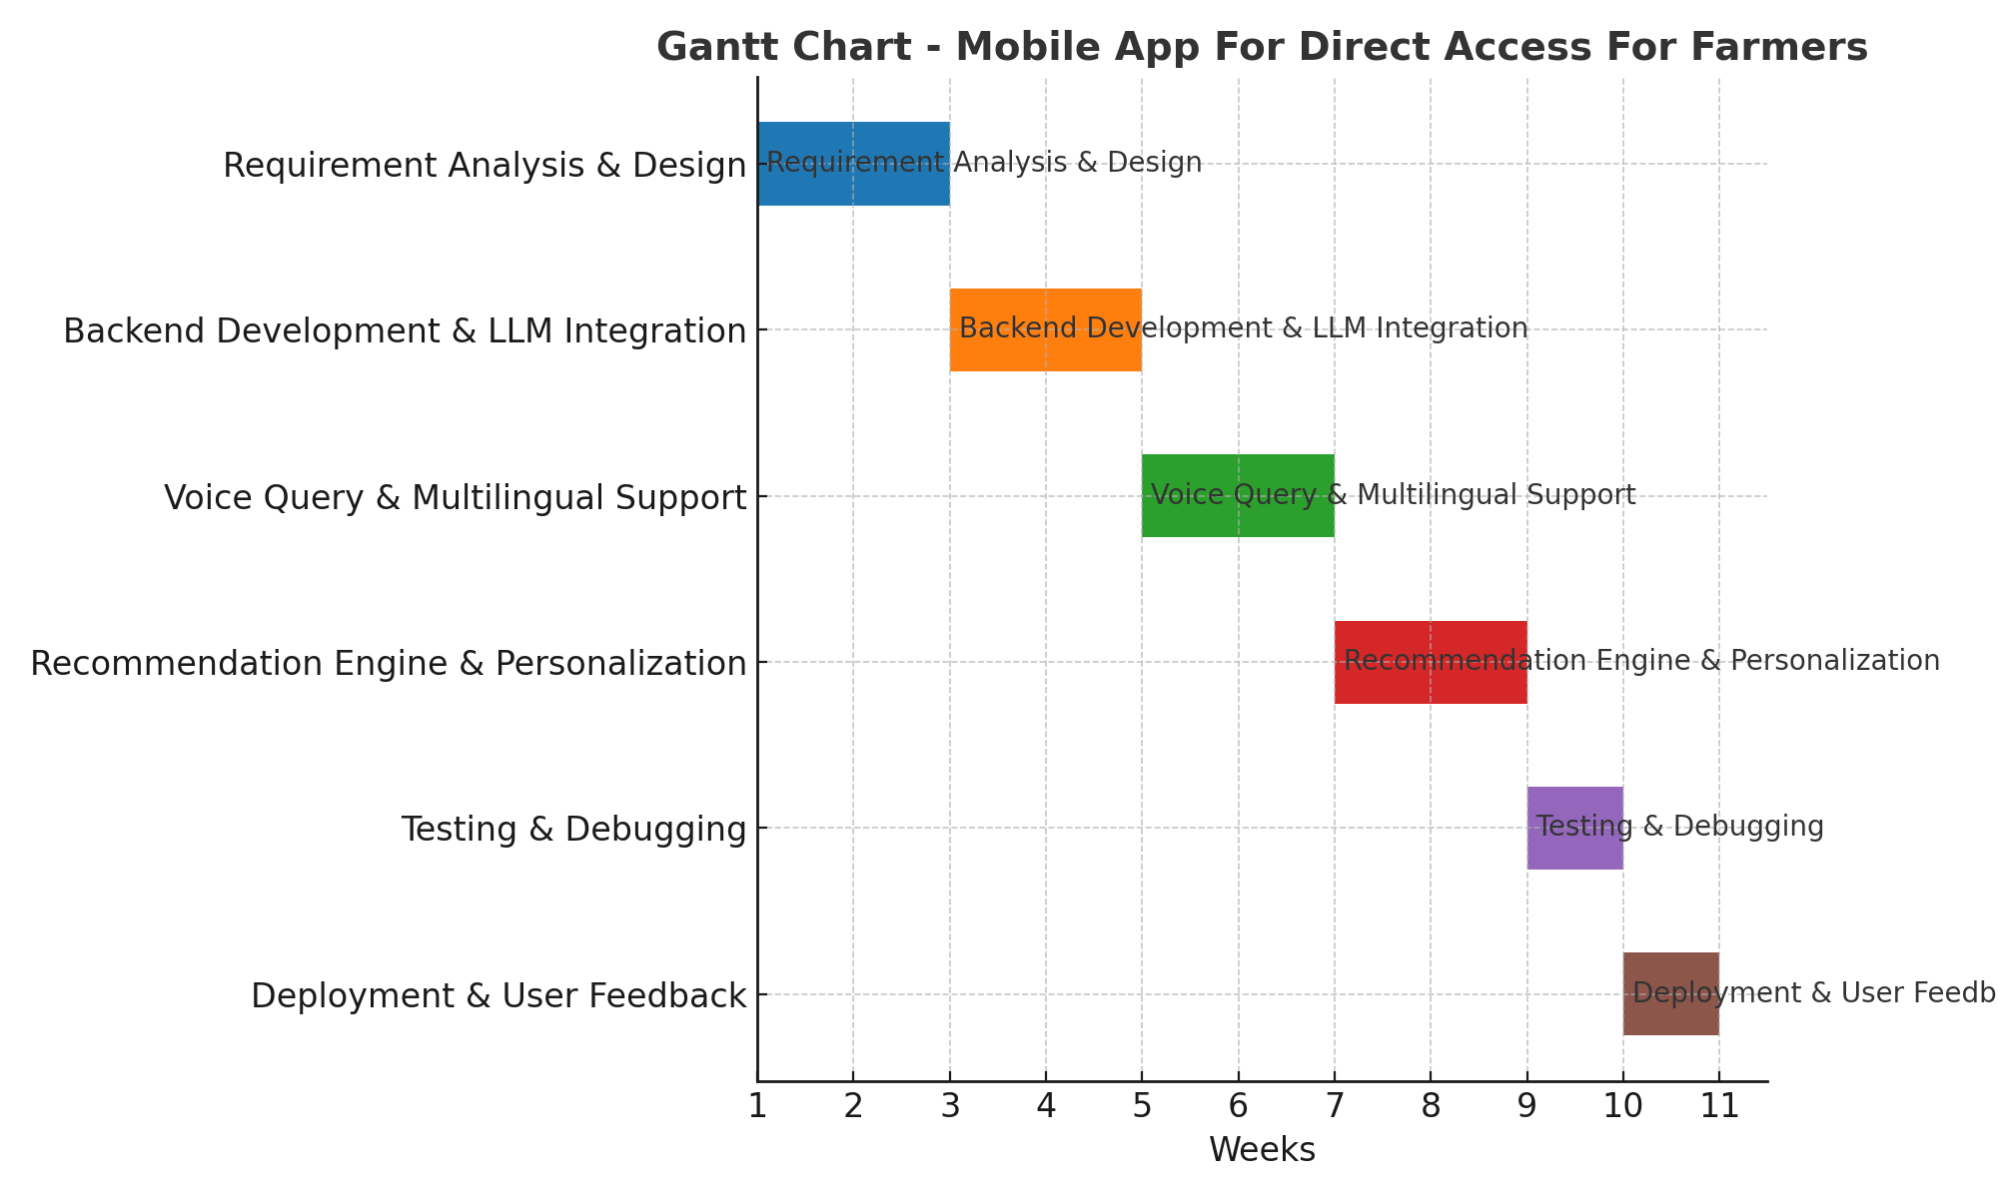
Timeline (Gantt Chart)

Slide 12
References
[1] E. S. Kishan, H. B. Tarun, and M. S. Prasad, "Mobile App for Direct Market Access for Farmers," International Journal of Innovative Research in Technology (IJIRT), vol. 11, no. 11, pp. 45–50, Apr. 2025.
[2] A. D. Bhavani, M. S. Varshini, P. P. Reddy, and V. C. Varshith, "Mobile Application for Direct Market Access for Farmers," International Journal of Engineering and Management Sciences (IJEMS), vol. 6, no. 3, pp. 112–118, Mar. 2025.
[3] T. S. Tati, O. K. Landage, and R. K. Sangle, "Mobile Application for Farmer to Get Direct Access to Market, Transport, Fertilizer Shops," International Journal for Research in Applied Science and Engineering Technology (IJRASET), vol. 13, no. 4, pp. 2330–2336, Apr. 2025.
[4] K. Sughasini, R. S. Gowda, and P. M. Reddy, "Mobile App for Direct Market Access for Farmers," Journal of Emerging Technologies and Innovative Research (JETIR), vol. 11, no. 12, pp. 89–95, Dec. 2024.
[5] J. P. Gomez, A. M. Lozano, and C. A. Lopez, "AgroTIC: A Mobile Application for Crop Monitoring and Direct Market Access," arXiv preprint arXiv:2305.12418, 2023.
[6] R. C. Mwakalinga, A. C. Kaijage, and P. E. Mushi, "eKichabi v2: A Dual-Platform Mobile Agricultural Directory for Farmers in Tanzania," arXiv preprint arXiv:2403.09980, 2024.

Slide 13


