Slide 1

Hacking the Lifebox
because they said it wasn’t possible
Joe Jordan
Simon Funke
Kaelan Fouwels
HackBox

Slide 2
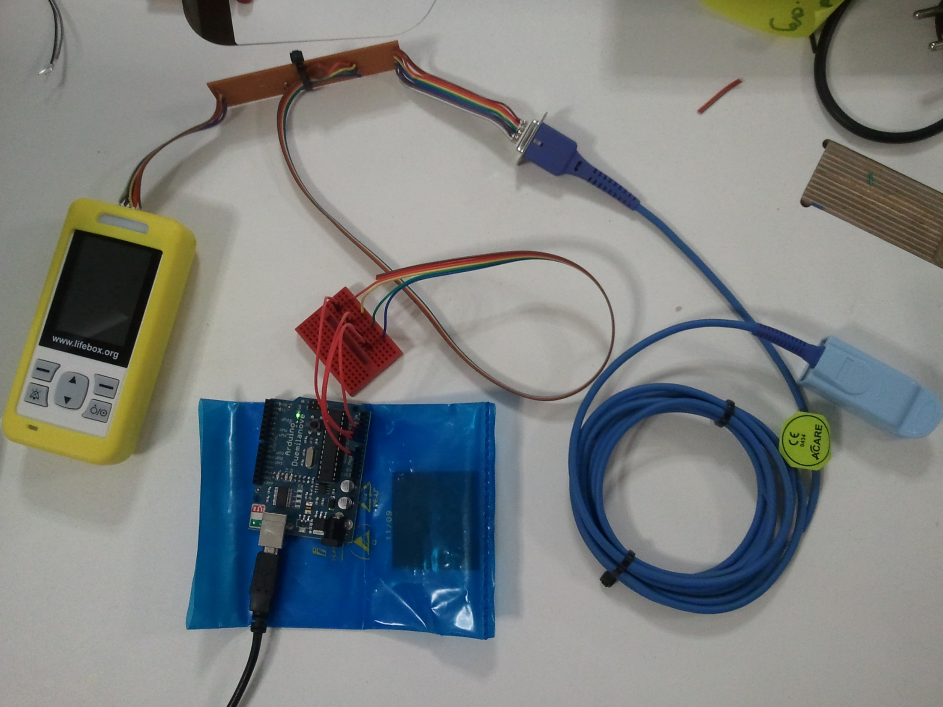
Hardware

Slide 3
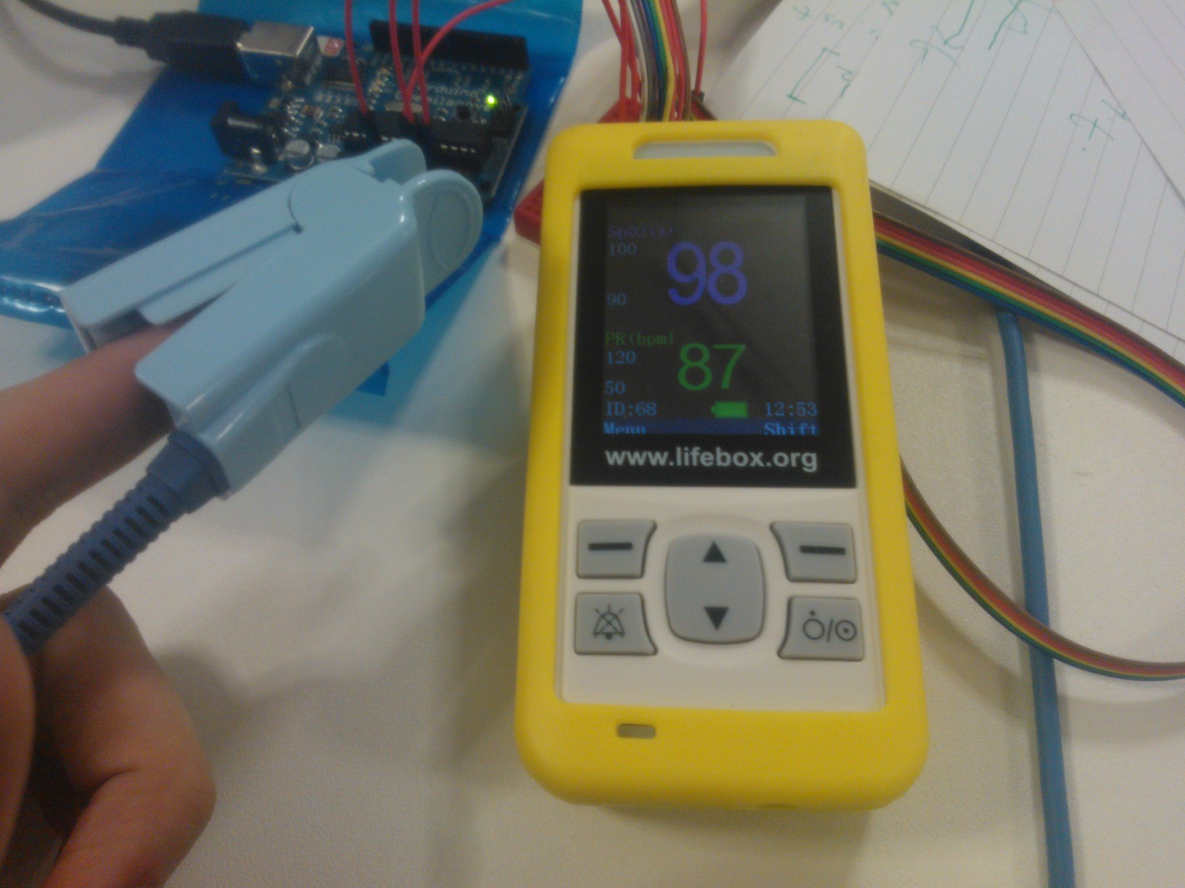
LifeBox

Slide 4
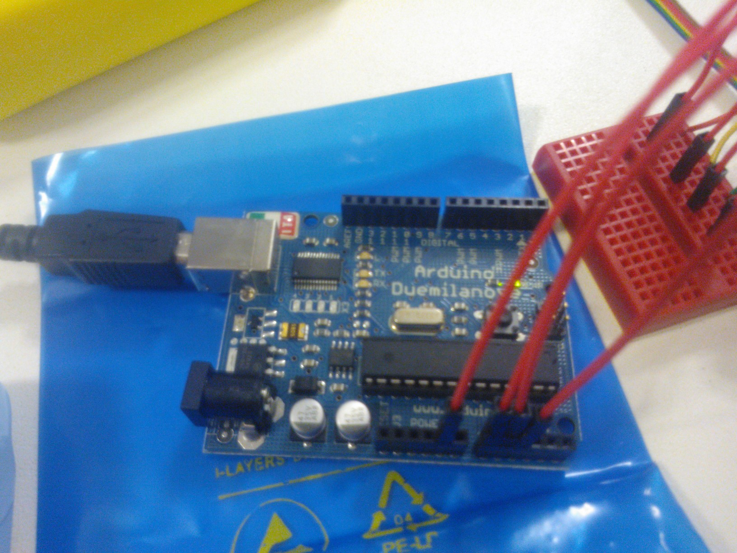
Arduino

Slide 5

Reverse Engineering

Slide 6
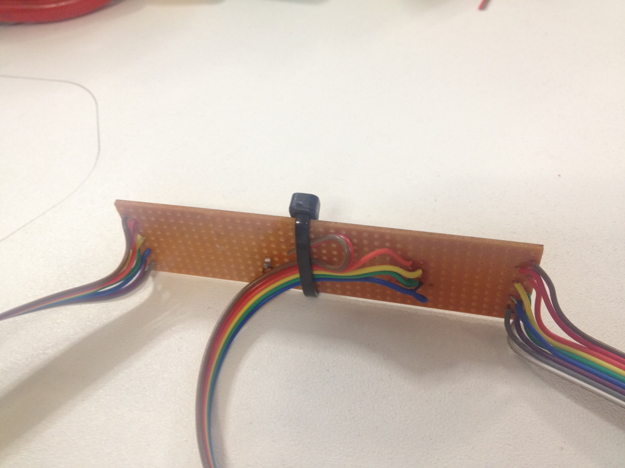
Bridge

Slide 7
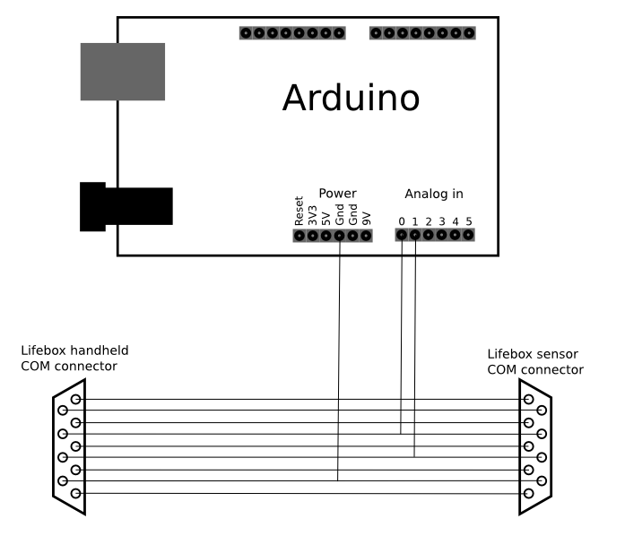
Schematic

Slide 8

Data

Slide 9

Data

Slide 10
Hacking hardware is fun.
(soldering Iron!!!!!!!11)
BUT Reverse engineering is non trivial.
(There’s real science inside)
Clinical devices can be hacked.
(despite what we were told)
Conclusion
(Please don’t sue us)

