Slide 1
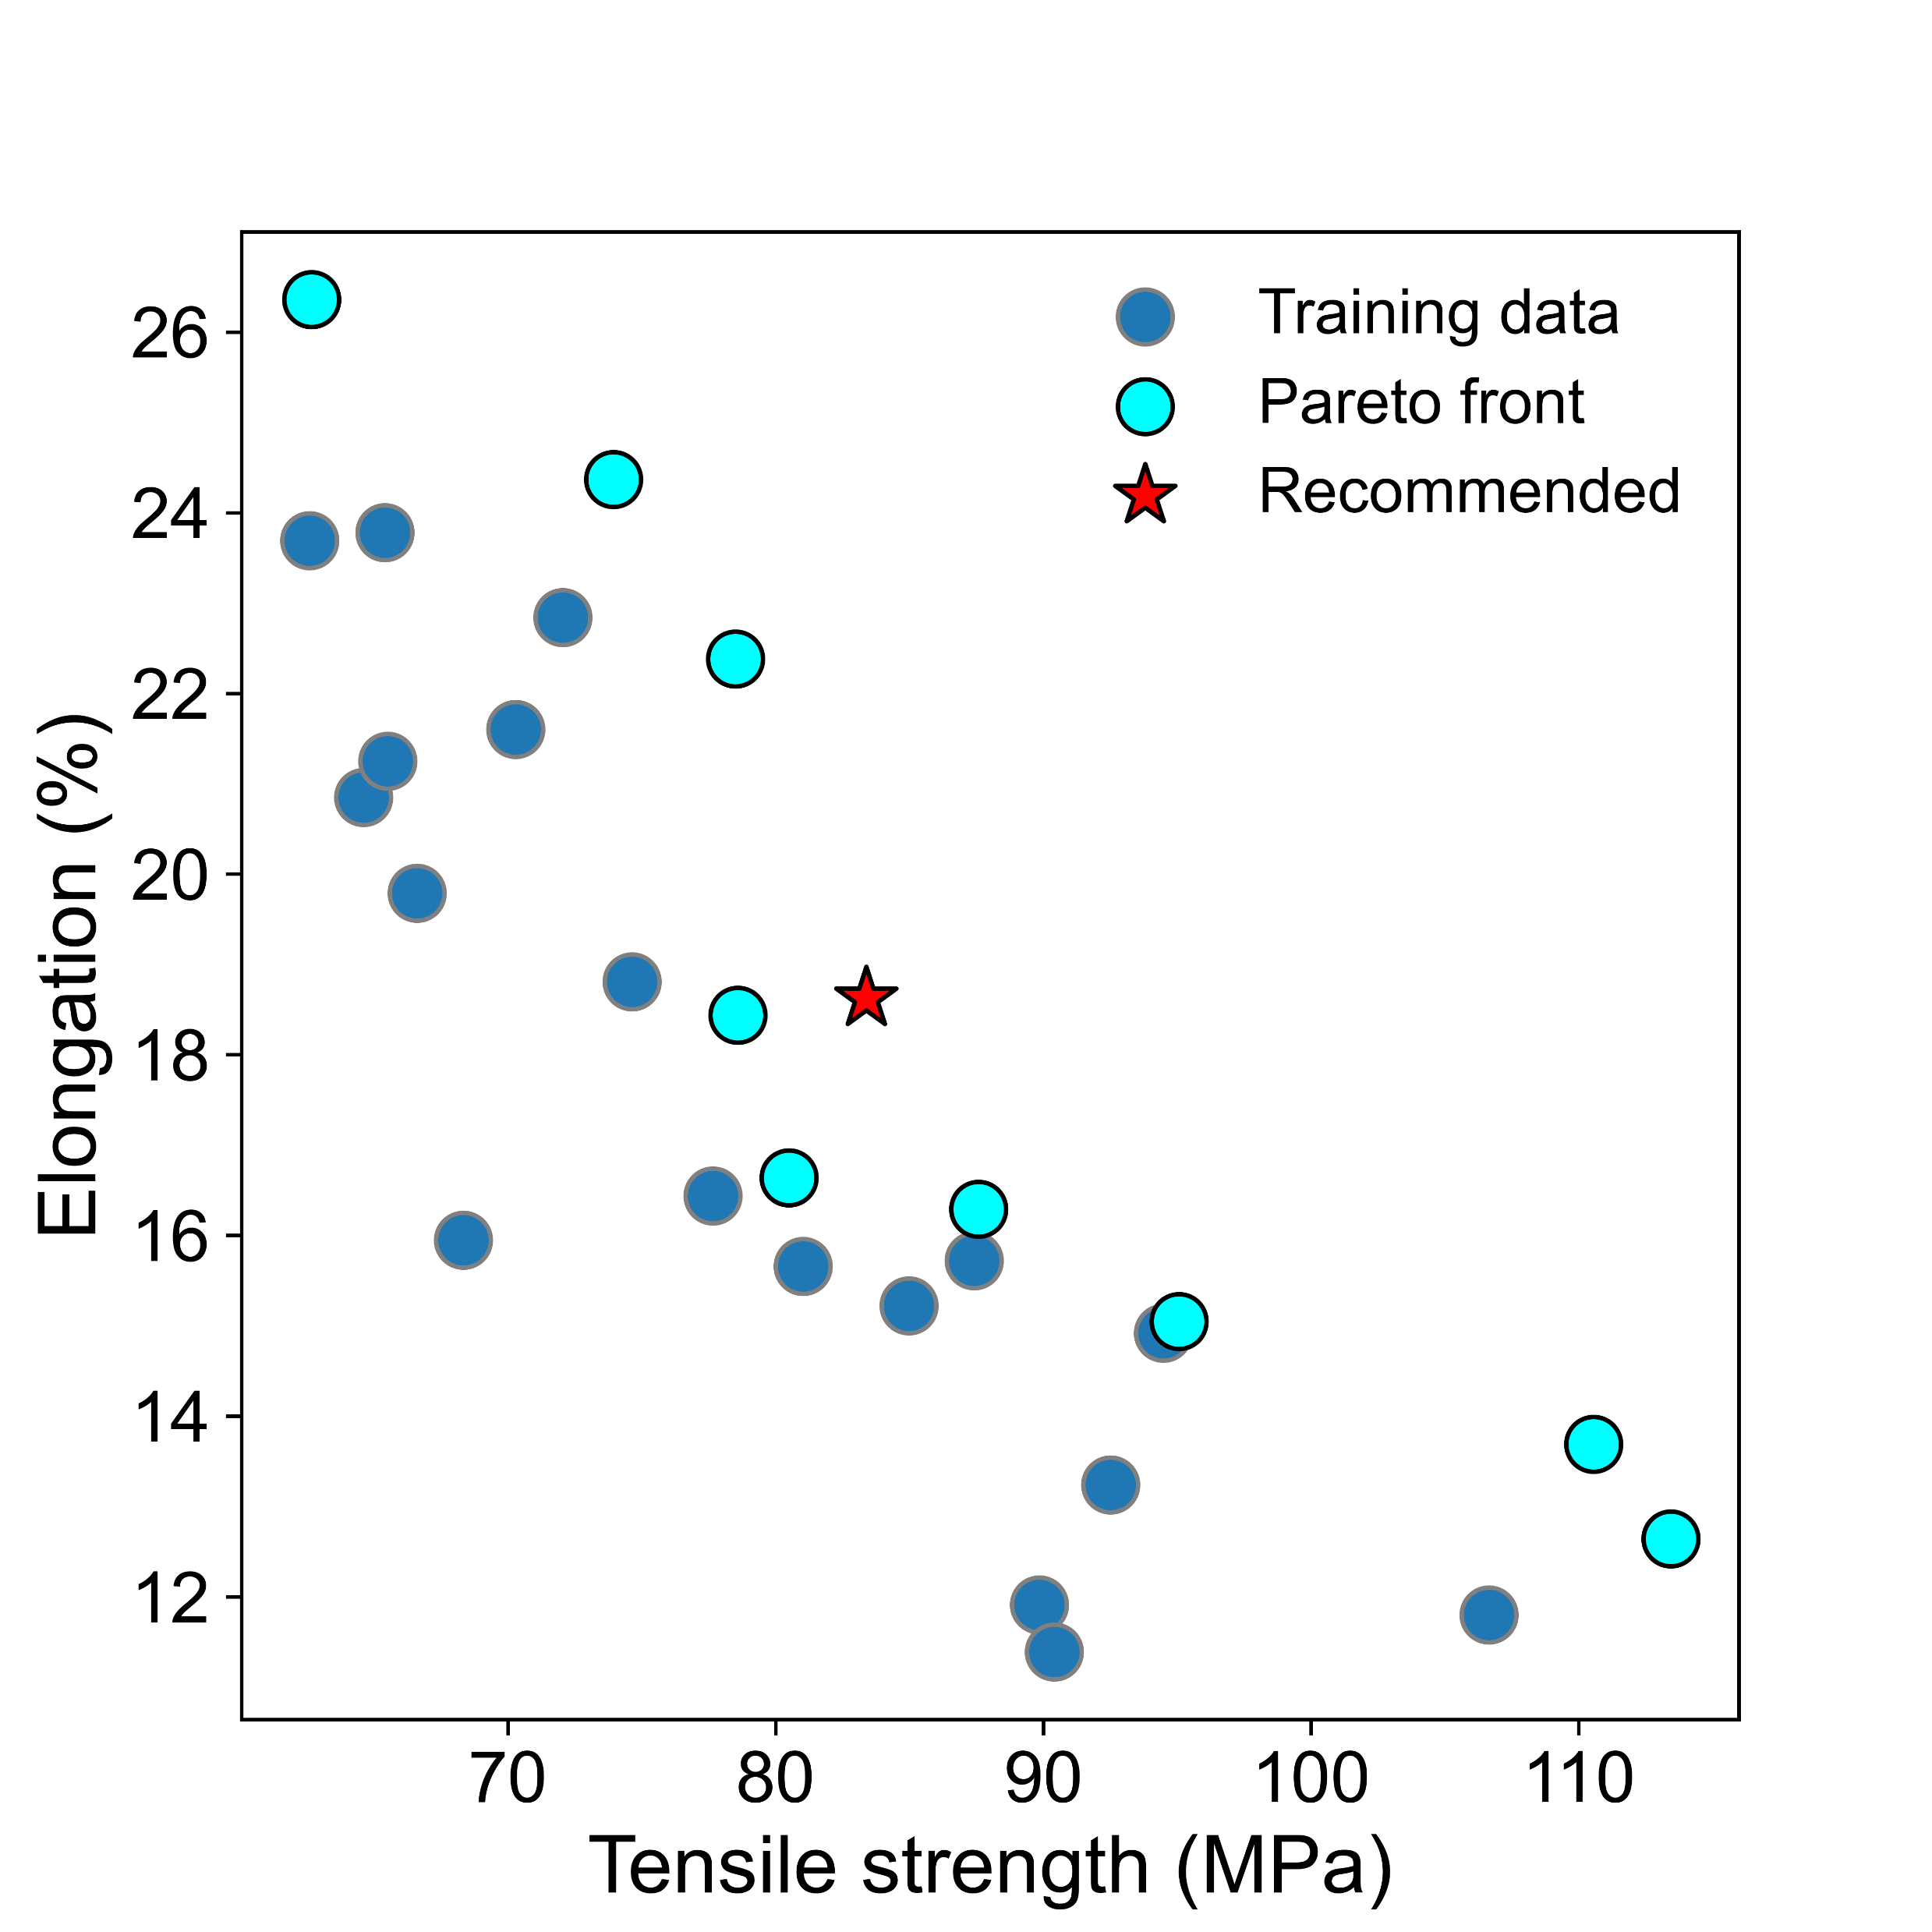
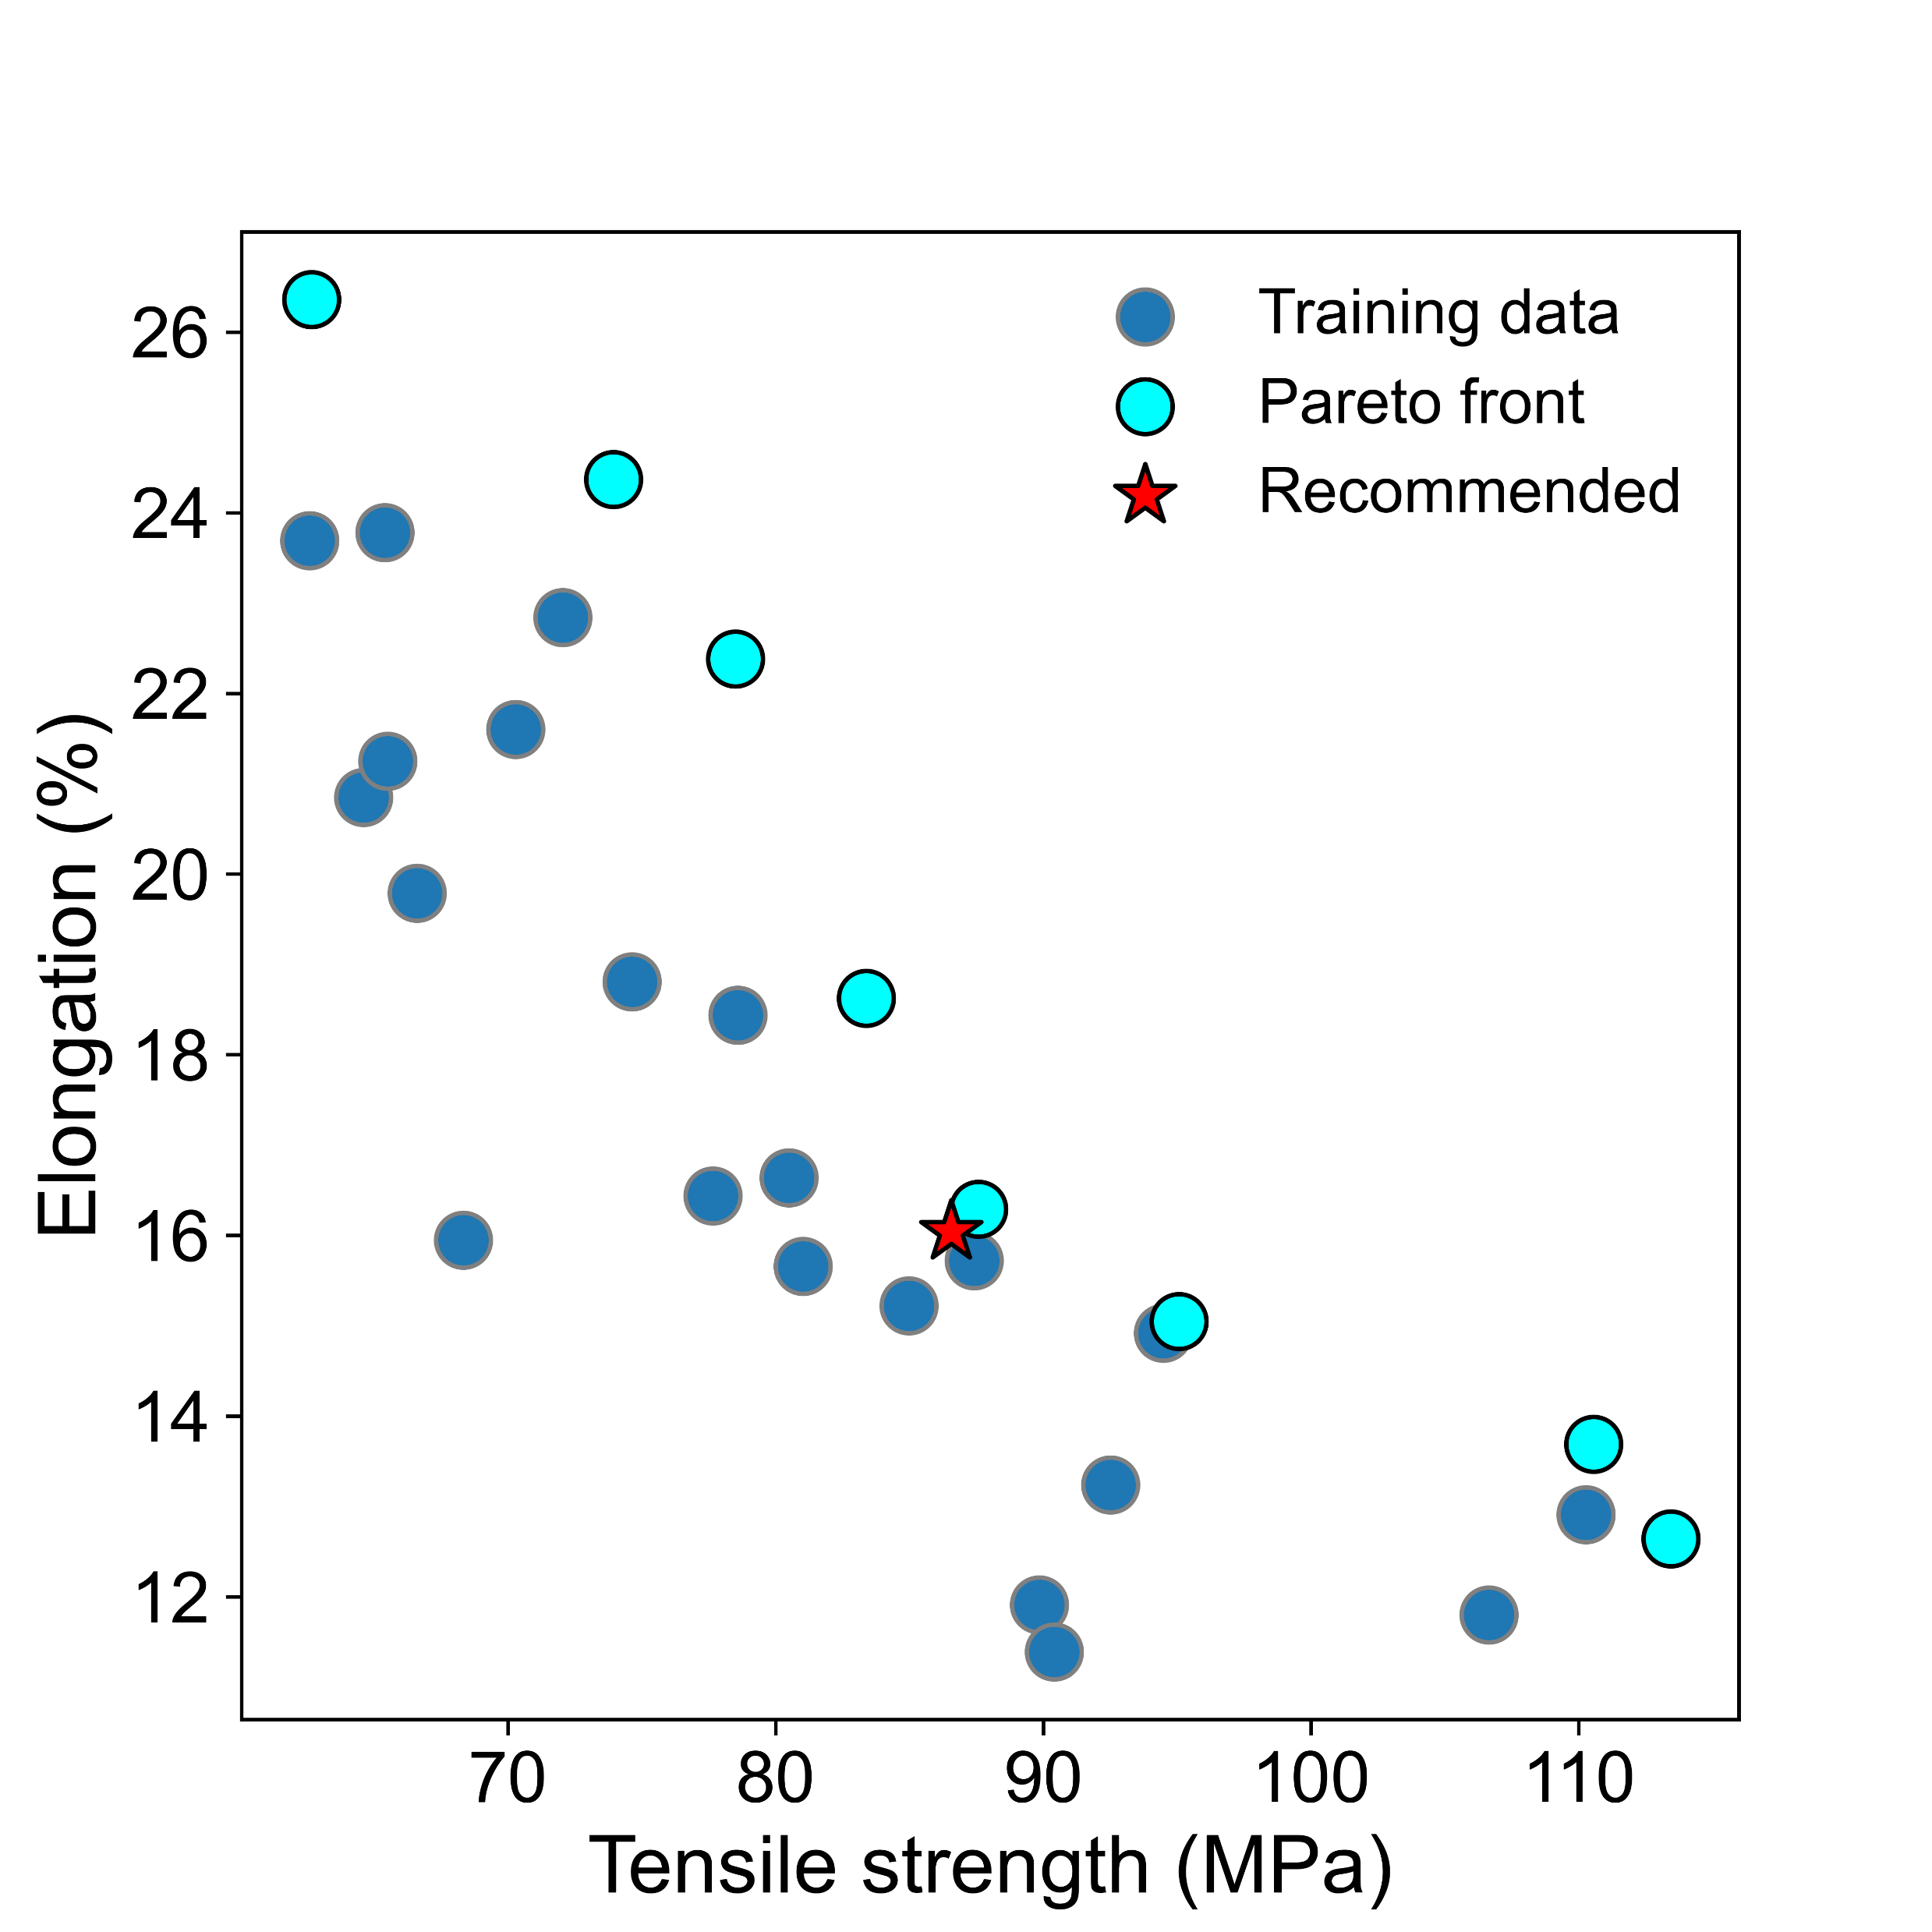
Alpha = 1
(a)
(b)
SVM values
SVM values

Slide 2
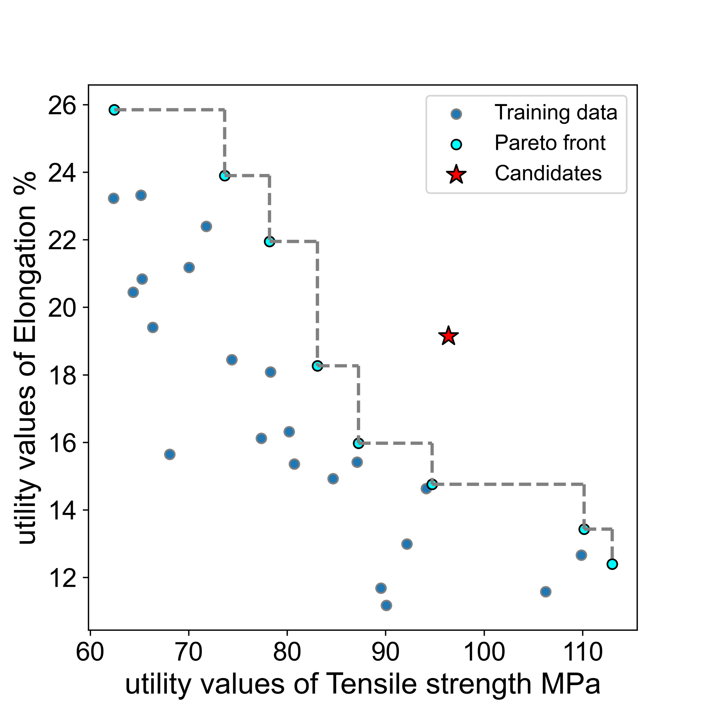
Alpha = 1

