Slide 1
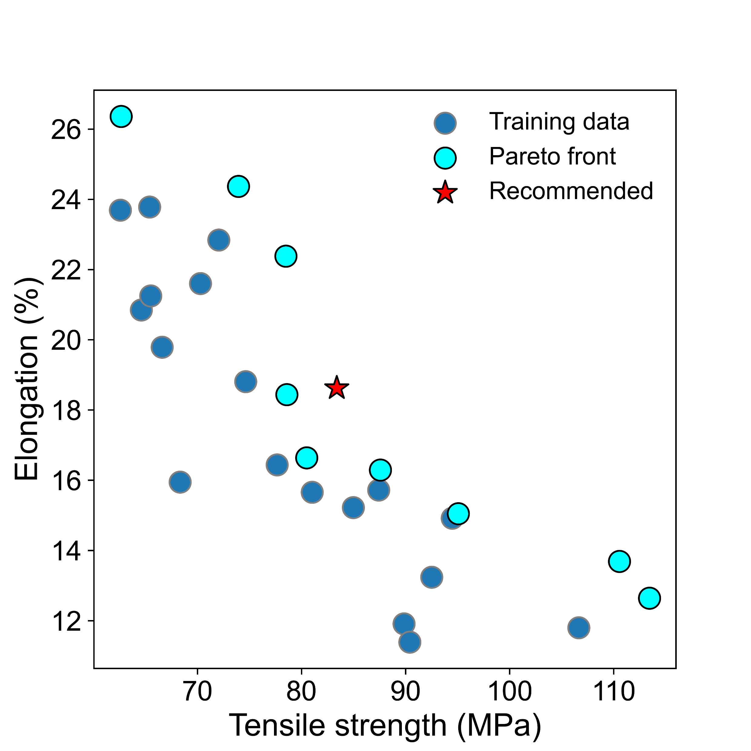
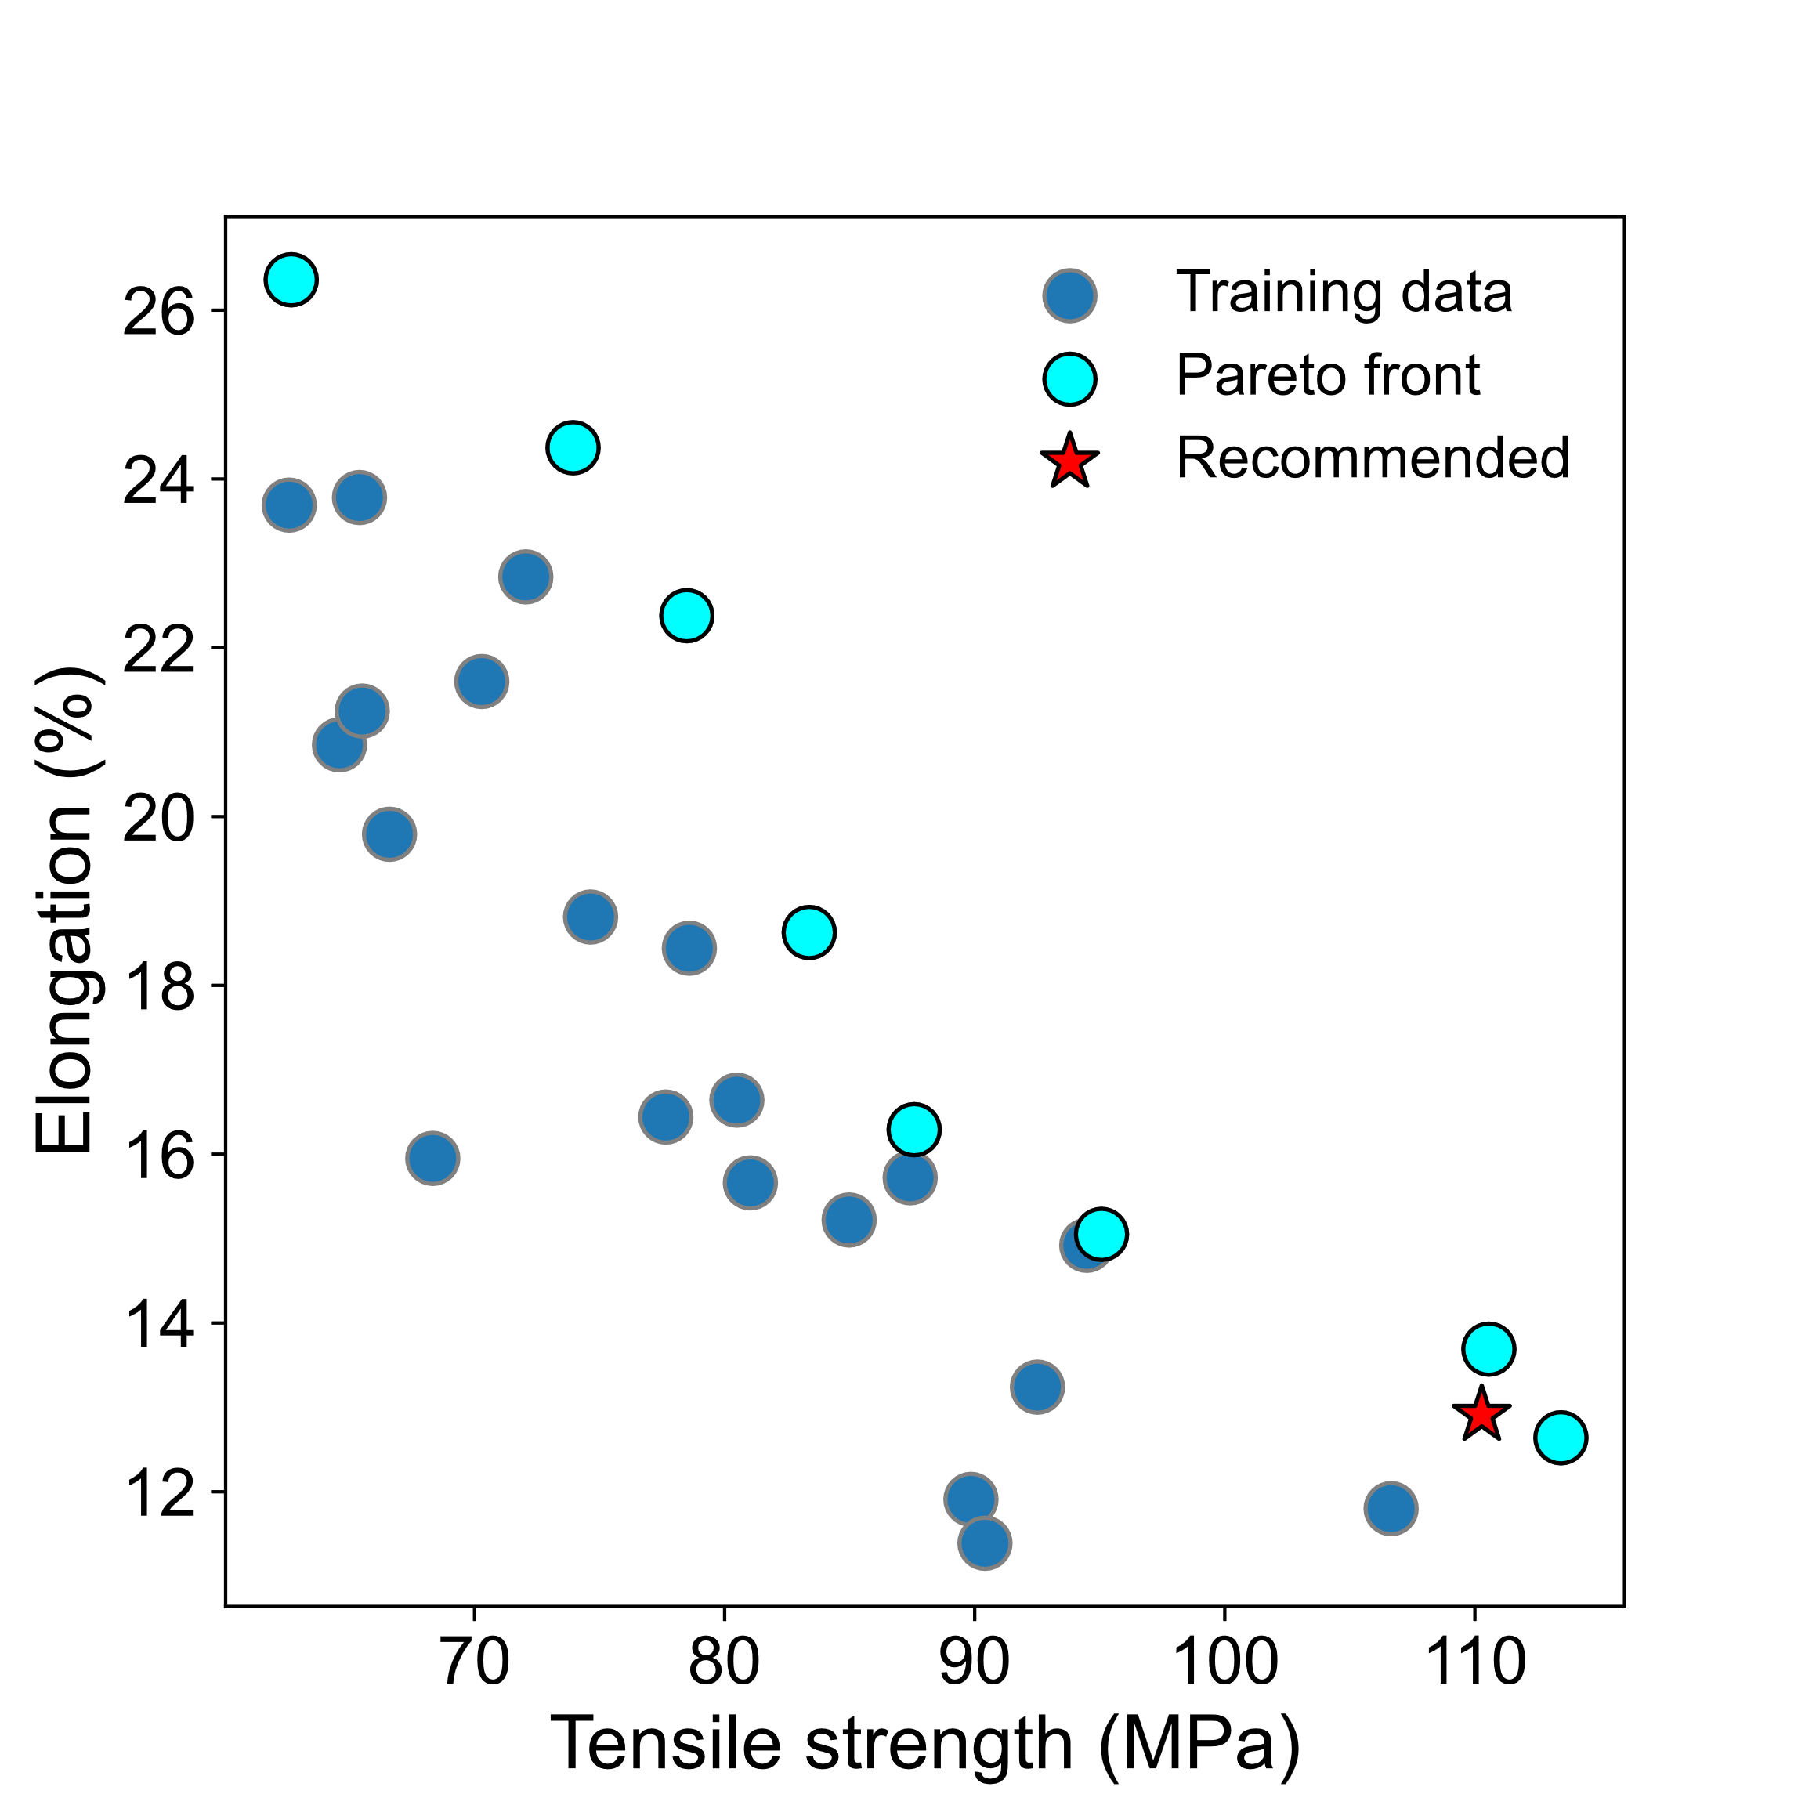
(a)
(b)
SVM values
SVM values
Alpha = 1.5

Slide 2
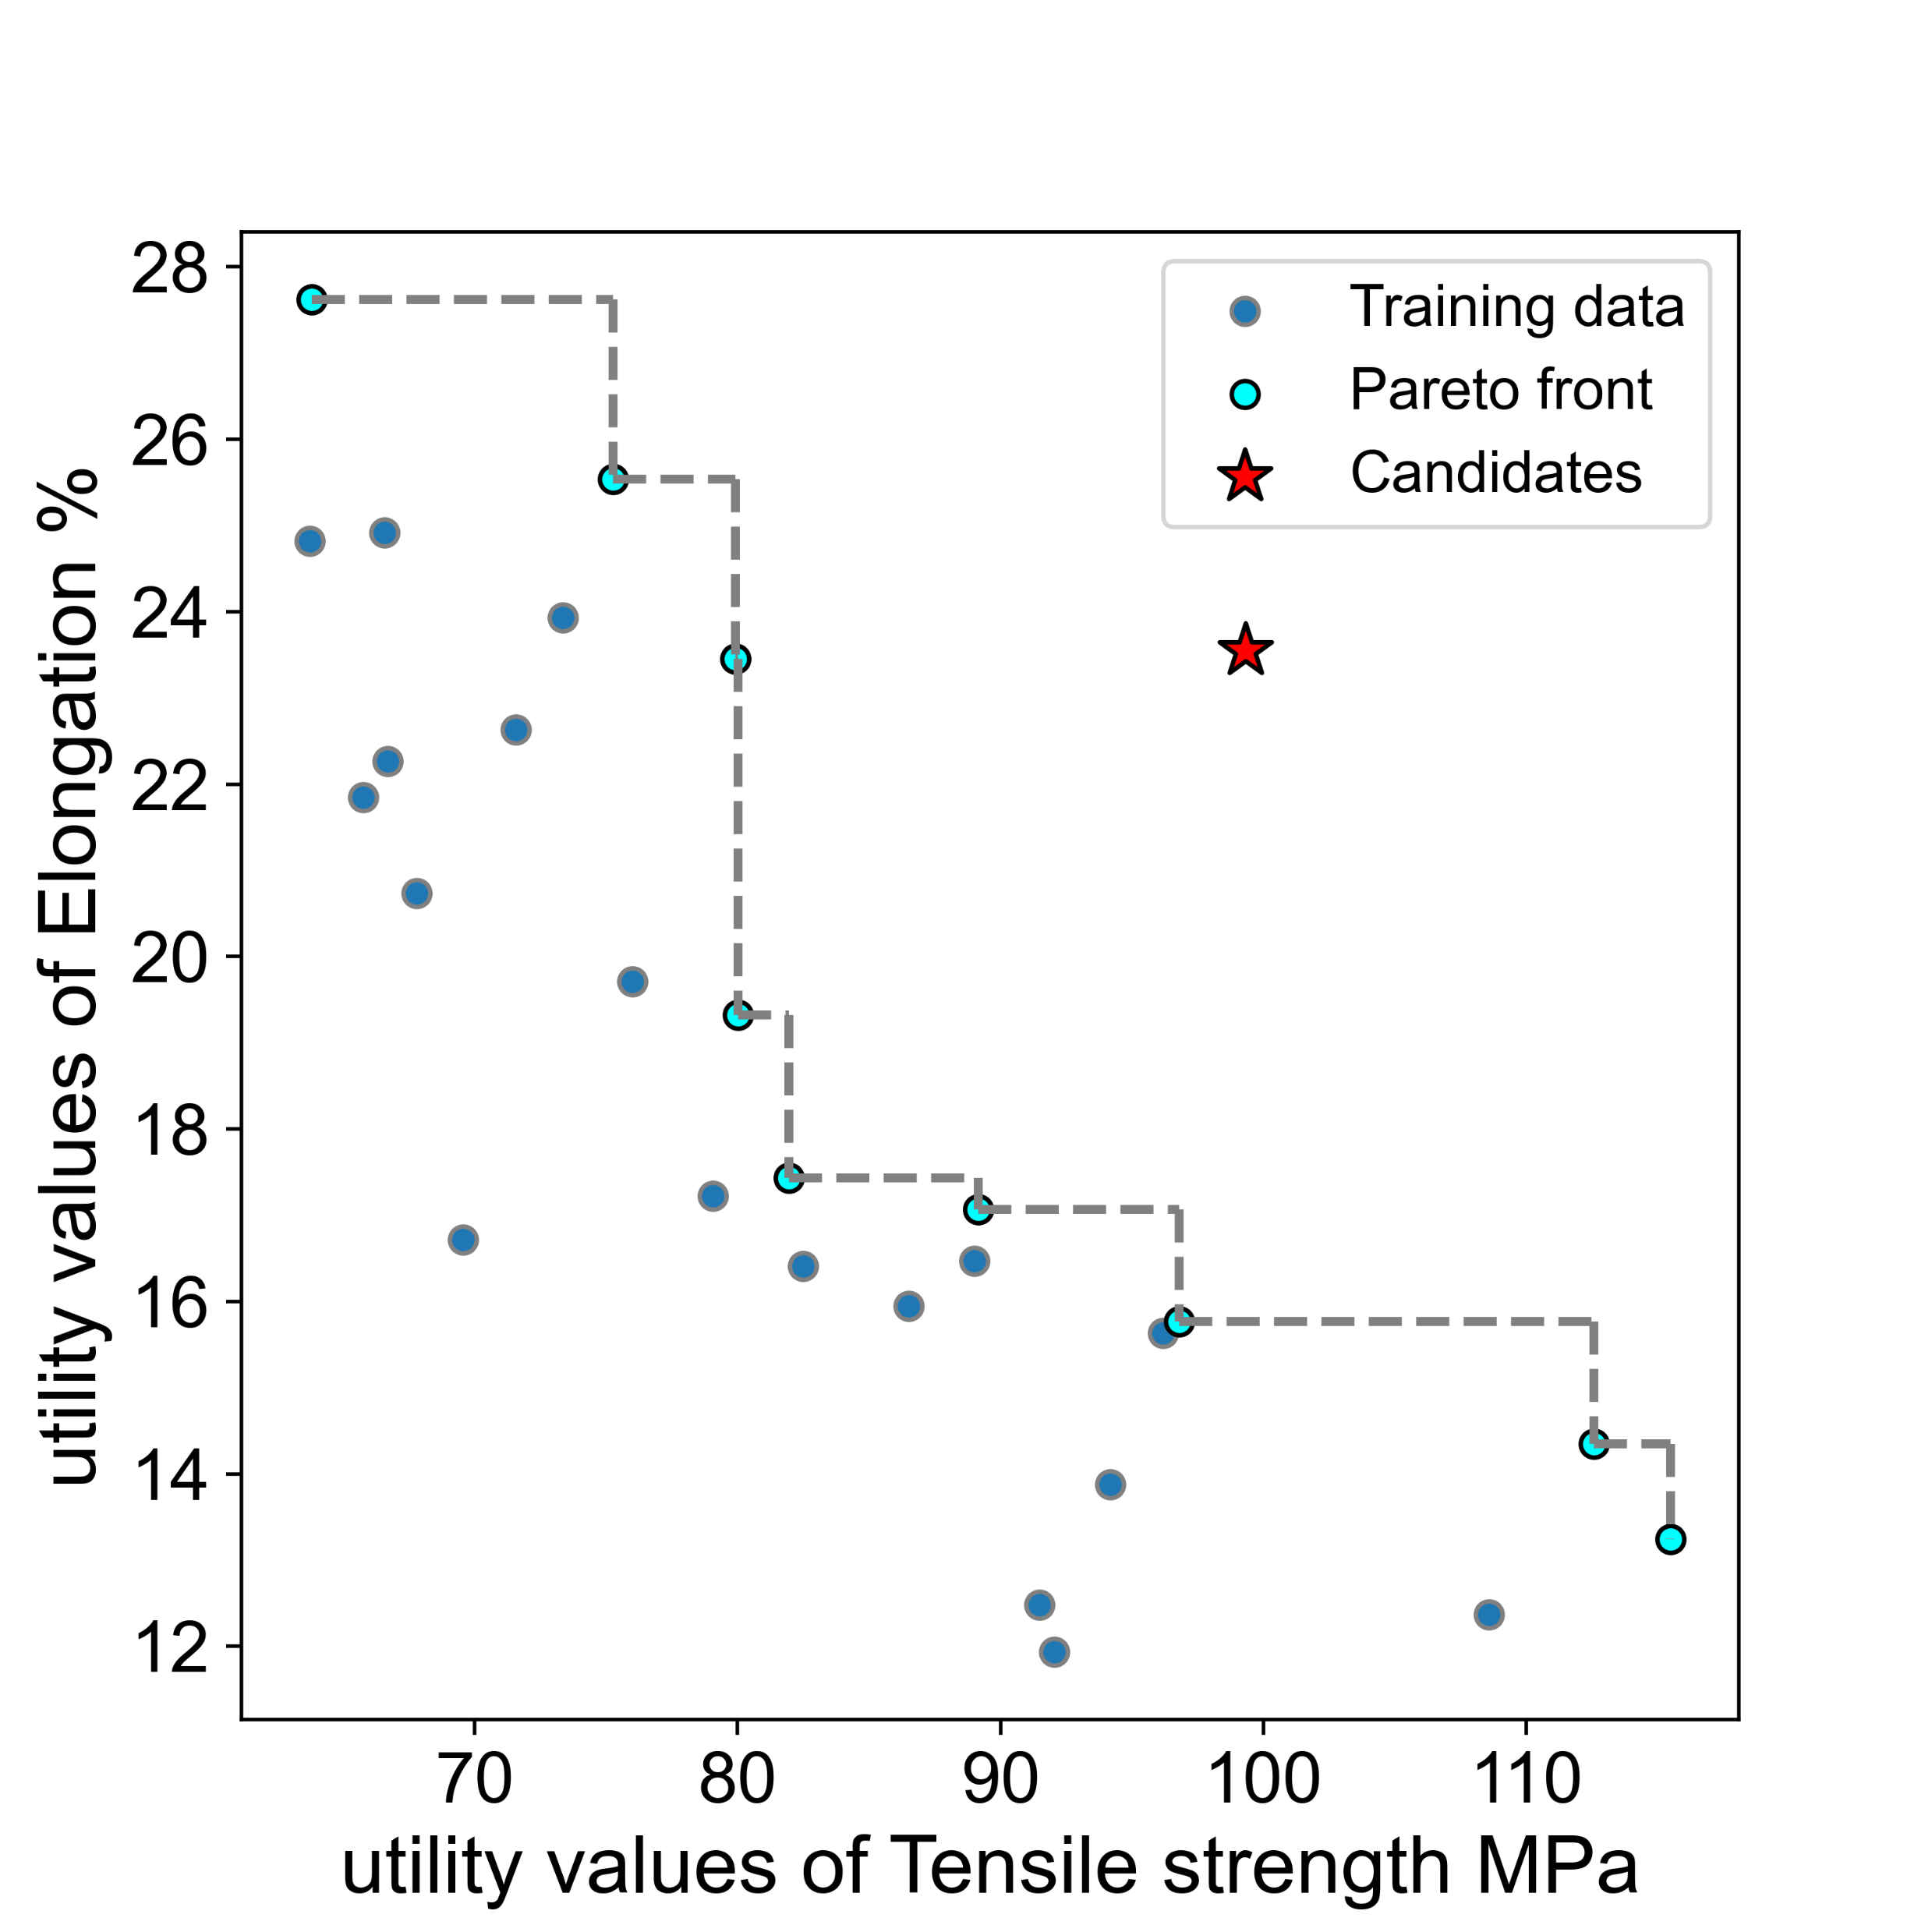
Alpha = 1.5

