Slide 1
II Leverage Items Battery cells and modules: These are major components that dictate the performance of the battery packs. Although the supply risk is relatively low due to a growing number of suppliers, they have a high profit impact. Strategies: Use competitive bidding and volume discounts, standardize designs to increase purchasing power, and negotiate contracts with key suppliers to secure better terms and reliability | IV Strategic Items Lithium: This is a critical raw materials used in the production of Li-ion batteries. They have a high supply risk due to limited sources and geopolitical issues, and a high profit impact because they directly influence the quality and cost of the final product. Strategies: Develop strong relationships with multiple suppliers, explore long-term contracts to ensure supply continuity, invest in recycling technologies, and engage in strategic alliances or joint ventures in countries with these mineral resources.
I Noncritical Items Packaging materials and standard electronic components: These items are readily available and have multiple suppliers, with low impact on profits. Strategies: Standardize items to increase purchasing efficiency, automate reordering processes, and consolidate purchases to achieve lower prices through bulk buying. | III Bottleneck Items Specialty chemicals for electrolytes: These chemicals are critical for the battery's performance but may come from a limited number of suppliers. Strategies: Identify alternative suppliers, invest in research for substitute materials, stock strategic reserves, and negotiate contracts that include risk-sharing provisions.

Slide 2
High
II Leverage Items | IV Strategic Items
I Noncritical Items | III Bottleneck Items
1
Lithium Carbonate
1
2
2
Cobalt Oxide
7
6
3
Lithium Fluoride Salt
5
4
Ethyl Acetate
5
Artificial Graphite
8
6
Not Alloyed Aluminium
Importance of Purchasing
7
Nickel Powders
4
8
Stainless-Steel Alloy
11
10
3
9
Polyethylene
9
10
Battery Management System
12
11
Battery Cooling System
Low
12
Battery Packaging System
Low
Complexity of the supply Market
High

Slide 3
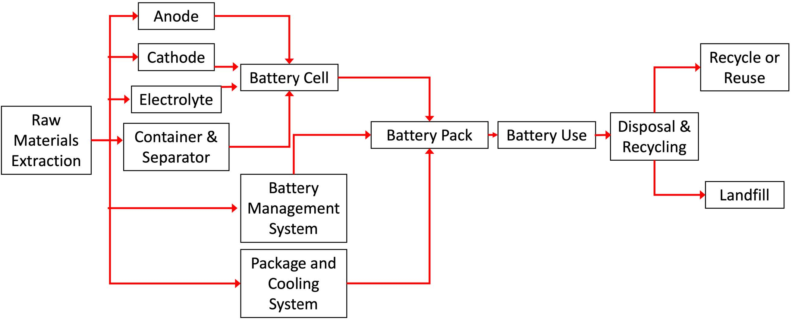
System Boundary
End of Life
Energy Out
Energy In
Global Warning
Acidification
Eutrophication

