Slide 1



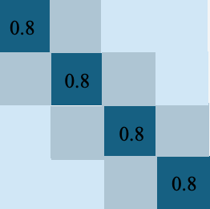
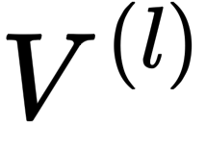
LayerNorm
Softmax
M
M

Slide 2


LayerNorm
Softmax
M
M

