Slide 1

Community Service Project
On
MODERN IRRIGATIONS
Presented by Batch D18
V.V THRIVENDRA REDDY(23481A12O9)
S.HYMAVATHI(23481A12K0)
R.PRAVALLIKA(23481A12J7)
T.CHAITANYA BHUSHAN(23481A12N7)
Under the Enviable and Esteemed Guidance of
Mrs D.SRI DIVYA, M.Tech.,(ph.D)
Assistant Professor
DEPARTMENT OF INFORMATION TECHNOLOGY
SESHADRI RAO GUDLAVALLERU ENGINEERING COLLEGE
(An Autonomous Institute with Permanent Affiliation to JNTUK,Kakinada)
SESHADRI RAO KNOWLEDGE VILLAGE GUDLAVALLERU-521356

Slide 2
OUTLINE
Title
Abstraction
Software and Hardware Requirements
Objectives Pictures
Website And Solution Pictures
Conclusion

Slide 3
MODREN IRRIGATION TECHNIQUES FOR SUSTAINABLE CROP YIELD
TITLE :
A WEB-BASED INFORMATION &MANAGEMENT PLATFORM FOR FARMERS

Slide 4
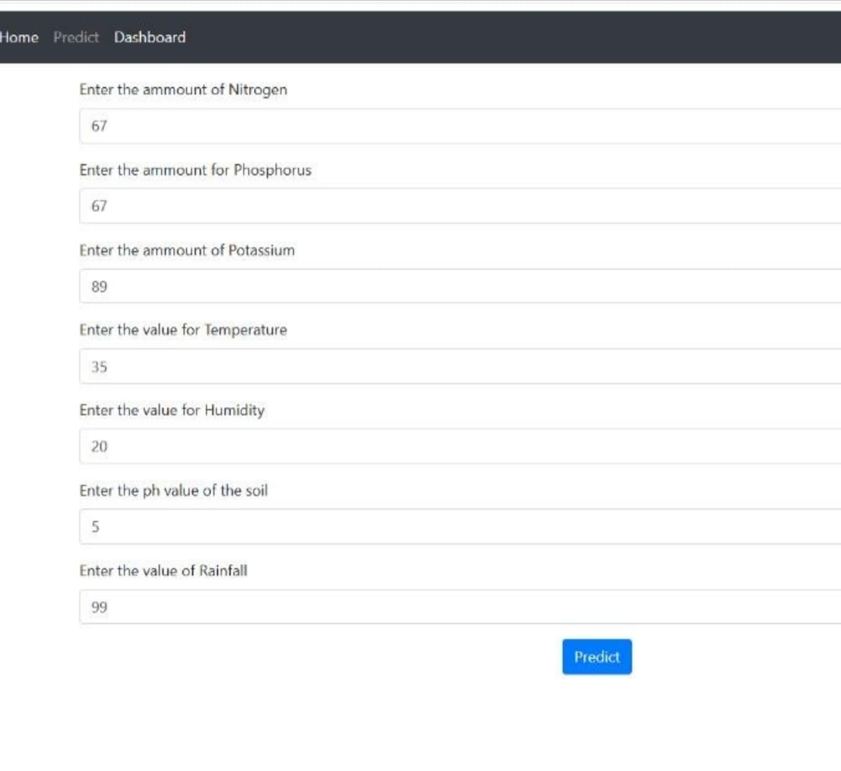

Slide 5
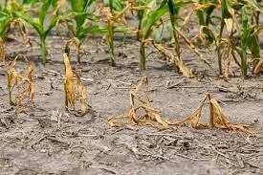
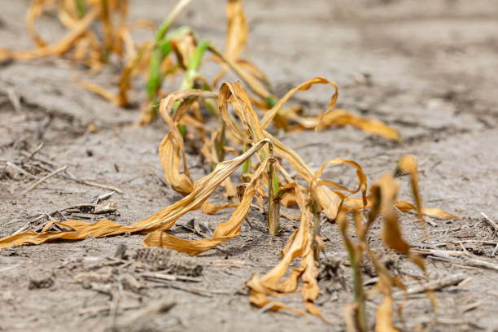
ABSTRACT :
In many villages, farmers still rely on traditional irrigation methods.
They are surface flooding, canal irrigation, and manual water lifting.
While these methods have been used for generations, they often lead to water wastage, uneven distribution, and reduced crop yields.
This project addresses these challenges by introducing modern irrigation techniques.
Such as drip, sprinkler, subsurface ,surface,center pivot irrigation.
The website platform aims to optimize water usage, increase agricultural productivity, and support long-term environmental balance.

Slide 6




SOFTWARE AND HARDWARE REQUIREMENTS
SOFTWARE REQUIREMENTS :
HARDWARE REQUIREMENTS :
PERSONAL COMPUTER OR LAPTOP FOR DEVELOPMENT.
INTERNET CONNECTIVITY.

Slide 7
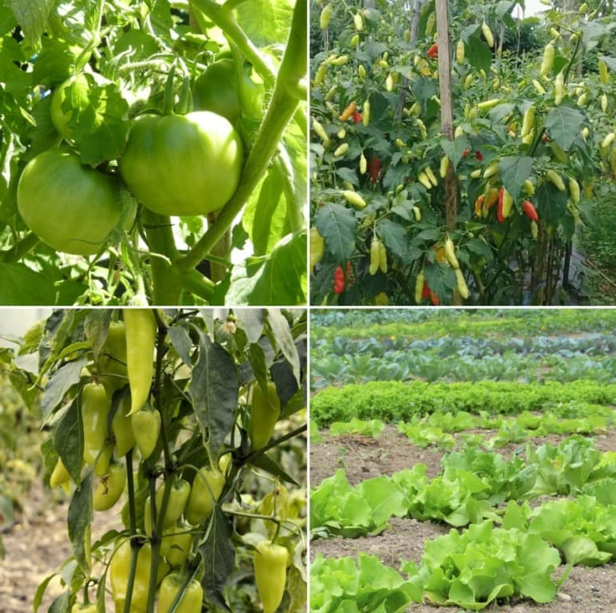
OBJECTIVES :
To design and develop a website providing irrigation guidance for sustainable crop yield.
To integrate modern irrigation methods such as drip, sprinkler, and automated sensor-based systems.
To provide real-time weather updates and soil moisture analytics for efficient water use.
To promote sustainable agriculture by reducing water wastage and increasing productivity.
To make irrigation knowledge easily accessible to farmers through a simple, mobile-friendly platform.

Slide 8
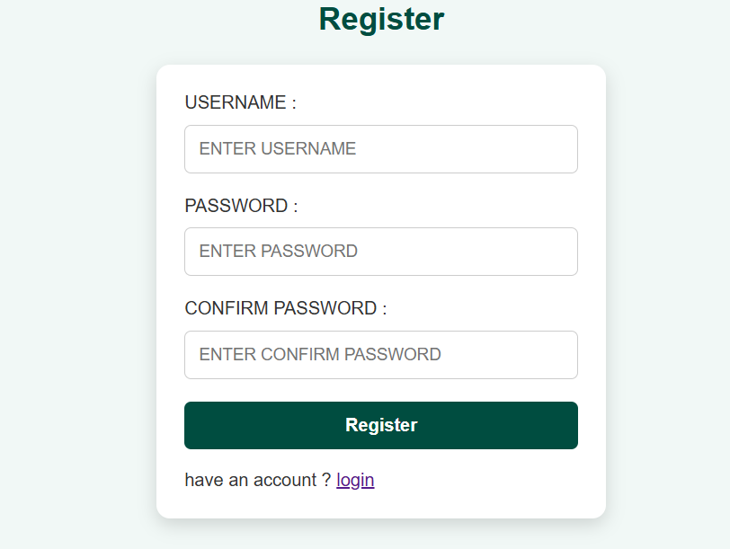
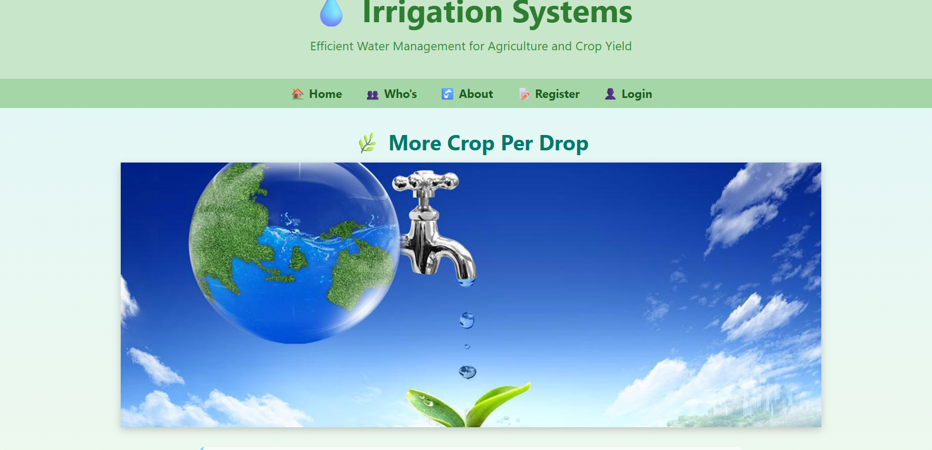
WEBSITE PICTURES

Slide 9
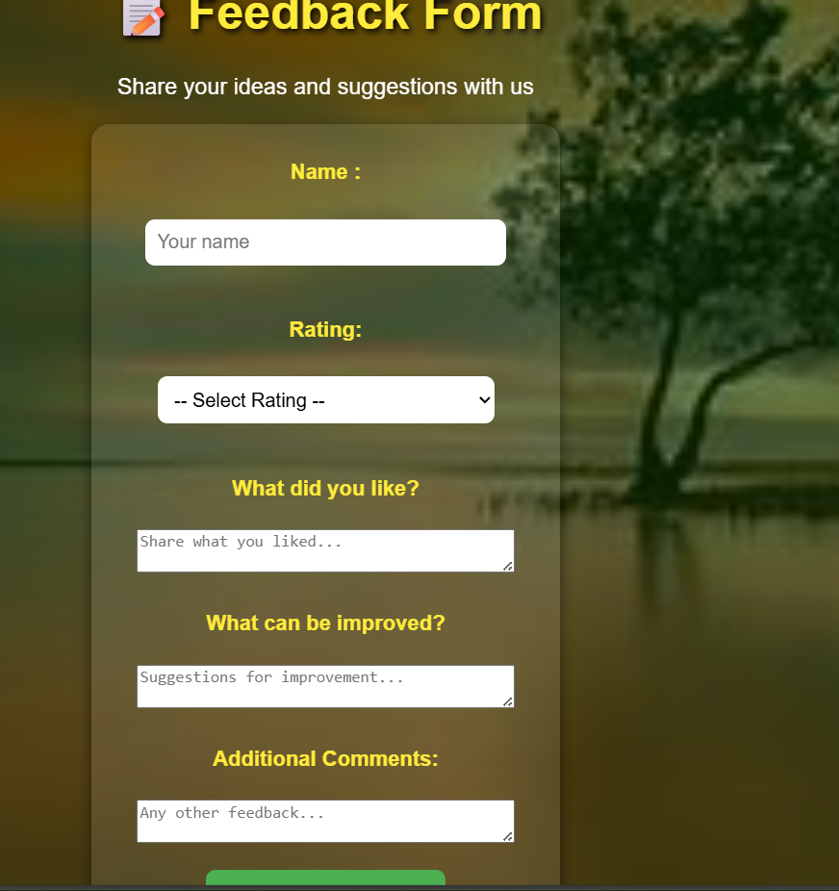
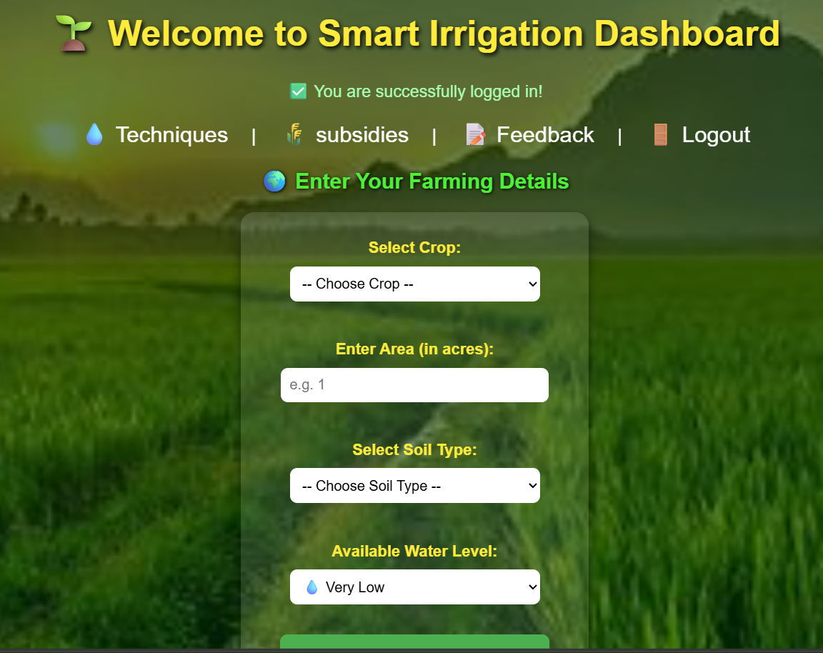
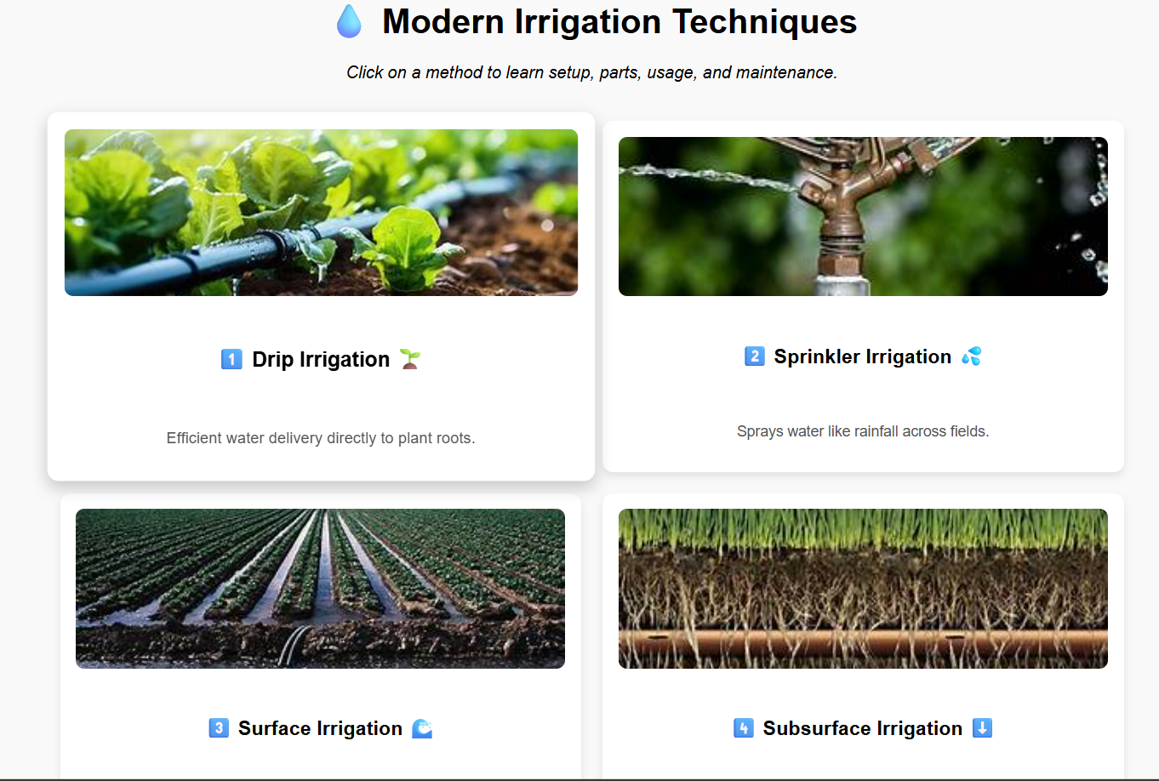

Slide 10
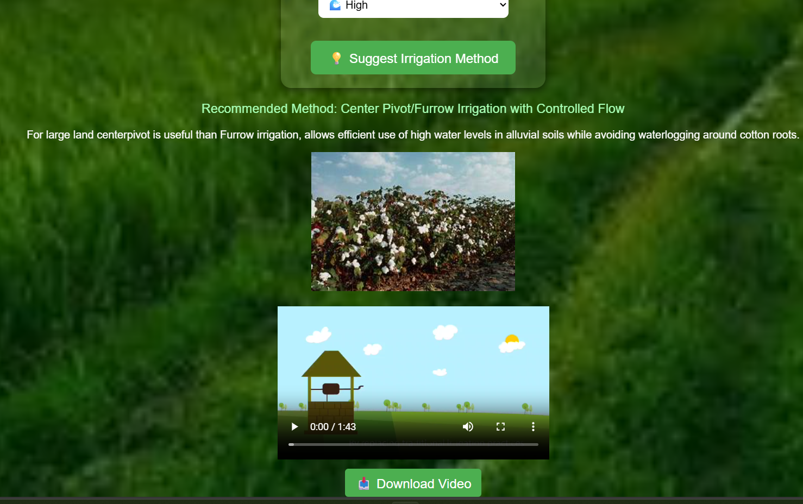
SOLUTION

Slide 11
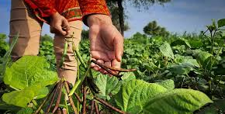
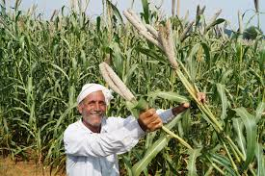
CONCLUSION :
The project demonstrates that combining modern irrigation techniques with a digital platform can significantly improve agricultural productivity .
The website serves as a bridge between traditional farming practices and modern agricultural technology.

Slide 12
THANK YOU

