Slide 1
DATABASE MANAGEMENT
SYSTEM
TEAM NO: 01
TEAM MEMBERS:
AISWARAYA .R
AJAY KARTHICK. K
ANANDAVARMAN. KS
AVANTHIKA. S
BHAALA NATARAJEN. S
BHUMIKA. K

Slide 2
TABLE OF CONTENTS
SCENARIO
ER – DIAGRAM
HTML AND PHP CODE
FRONT PAGE SCREEN SHOTS
SQL CODE AND QUERIES
OUTPUT SCREENSHOTS

Slide 3
1: SCENARIO: Relational data base design for healthcare
This organization provides following functionalities Emergency Care 24x7 Support Groups Support and Help Through calls Any new Patient is first registered in their database before meeting the doctor. The Doctor can update the data related to the patient upon diagnosis (Including the disease diagnosed and prescription). This organization also provides rooms facility for admitting the patient who is critical. Apart from doctors, this organization has nurses and ward boy. Each nurse and ward boy is assigned to a doctor. Also, they can be assigned to patients (to take care of them). The bill is paid by the patient with cash and E-banking. Record of each payment made is also maintained by the organization. The record of each call received to provide help and support to its existing person is also maintained.
Deliverables :
E-R diagram
SQL queries (min 5) for extracting and displaying few activities of hospital

Slide 4
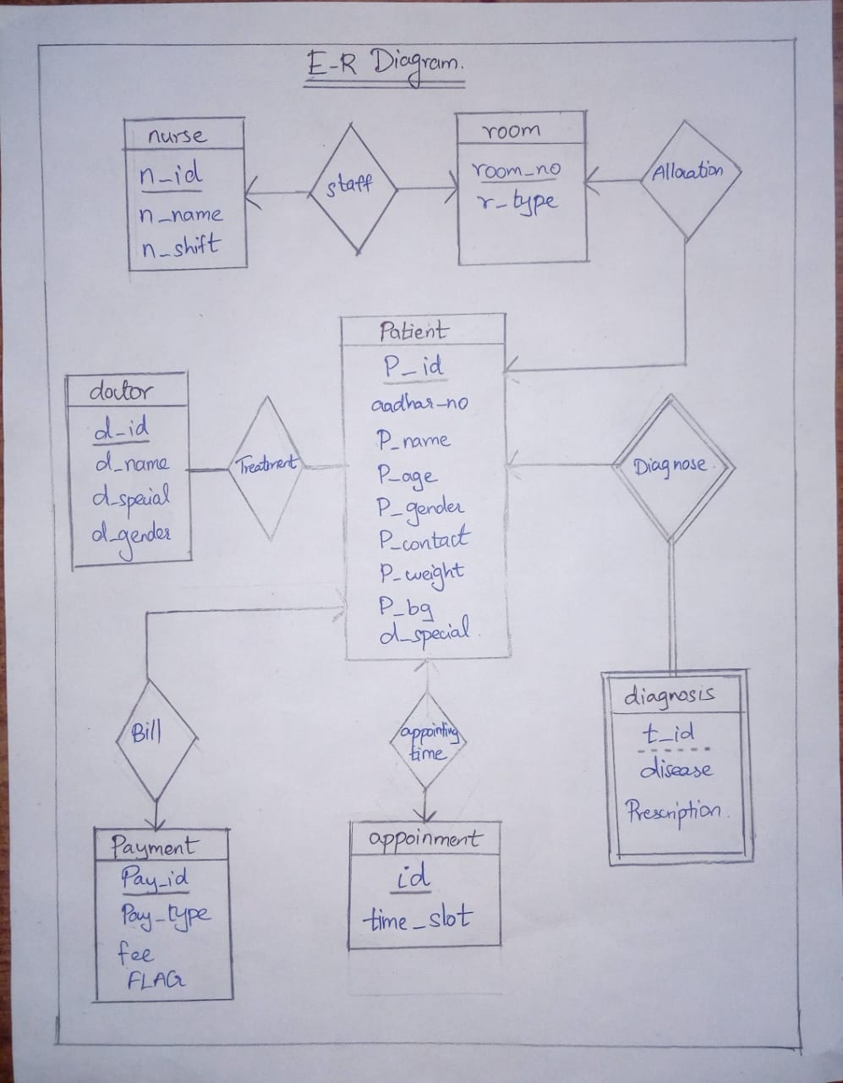
2: ER- DIAGRAM:

Slide 5
HTML AND PHP CODE
HTML CODE:
<!DOCTYPE html>
<html>
<body>
<form method="post" action="process.php">
Patient name:<br>
<input type="text" name="p_name">
<br>
Aadhar no:<br>
<input type="text" name="aadhar_no">
<br>
Age:<br>
<input type="text" name="p_age">
<br>
Gender:<br>
<input type="text" name="p_gender">
<br>
Contact no:<br>
<input type="text" name="p_contact">
<br>

Slide 6
Weight:<br>
<input type="text" name="p_weight">
<br>
Specialization:<br>
<input type="text" name="d_special">
<option>PEDIATRICIAN</option>
<option>PSYCHIATRIST</option>
<option>NUTRITIONIST</option>
<option>DENTIST</option>
<option>GENERAL SURGEON</option>
<option>CARDIOLOGIST</option>
<option>DOCTOR</option>
<br>
Blood group:<br>
<input type="text" name="p_bg">
<br>
<input type="submit" name="save" value="submit">
</form>
</body>

Slide 7
PHP CODE:
<?php
$servername='localhost';
$username='root';
$password='';
$dbname = "hospital_management";
$conn=mysqli_connect($servername,$username,$password,"$dbname");
if(!$conn){
die('Could not Connect My Sql:' .mysql_error());
}
?>
<?php
include_once 'database.php';
if(isset($_POST['save']))
{
$aadhar_no = $_POST['aadhar_no'];
$p_name = $_POST['p_name'];
$p_age = $_POST['p_age'];
$p_gender = $_POST['p_gender'];

Slide 8
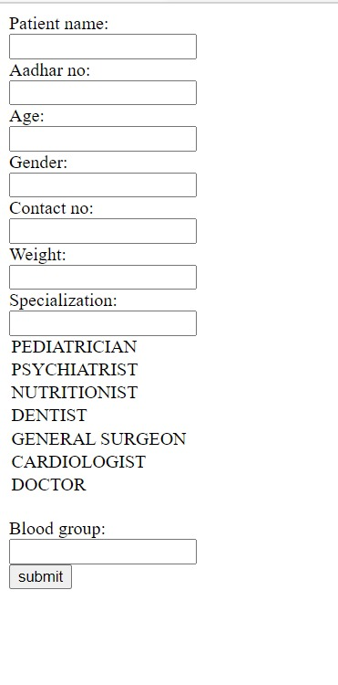

Slide 9
$p_contact = $_POST['p_contact'];
$p_weight = $_POST['p_weight'];
$d_special = $_POST['d_special'];
$p_bg=$_POST['p_bg'];
$sql = "INSERT INTO patient (aadhar_no,p_name,p_age,p_gender,p_contact,p_weight,d_special,p_bg)
VALUES ('$aadhar_no','$p_name','$p_age','$p_gender','$p_contact','$p_weight','$d_special','$p_bg')";
if (mysqli_query($conn, $sql)) {
echo "New record created successfully !";
} else {
echo "Error: " . $sql . "
" . mysqli_error($conn);
}
mysqli_close($conn);
}
?>

Slide 10
3: SQL CODE AND QUERIES:
CREATE DATABASE hospital_management;
USE hospital_management;
CREATE TABLE patient
( p_id INT NOT NULL AUTO_INCREMENT PRIMARY KEY,
aadhar_no INT NOT NULL,
p_name VARCHAR(20) NOT NULL ,
p_age INT NOT NULL ,
p_gender VARCHAR(7) NOT NULL ,
p_contact INT NOT NULL ,
p_weight INT NOT NULL ,
p_bg VARCHAR(15) NOT NULL,
d_special VARCHAR(15) NOT NULL) ;
CREATE TABLE doctor
( d_id INT NOT NULL PRIMARY KEY,
d_name VARCHAR(20) NOT NULL ,
d_special VARCHAR(15) NOT NULL ,
d_gender VARCHAR(7) NOT NULL);

Slide 11
CREATE TABLE nurse
( n_id INT NOT NULL PRIMARY KEY,
n_name VARCHAR(15) NOT NULL ,
n_shift VARCHAR(15) NOT NULL);
CREATE TABLE appoinment
( id INT NOT NULL AUTO_INCREMENT PRIMARY KEY ,
time_slot TIME NOT NULL ,
p_id INT NULL DEFAULT NULL);
CREATE TABLE room
( room_no INT NOT NULL AUTO_INCREMENT PRIMARY KEY,
p_id INT NULL DEFAULT NULL ,
r_type VARCHAR(15) NOT NULL ,
n_id INT NOT NULL );

Slide 12
ALTER TABLE room AUTO_INCREMENT=200;
INSERT INTO Doctor(D_id,D_name,D_special,D_gender)
VALUES(100,"AVANTHIKA ","PEDIATRICIAN","FEMALE"),
(101,"BHUMIKA ","PSYCHIATRIST","FEMALE"),
(102,"AISHWARYA ","NUTRITIONIST","FEMALE"),
(103,"AJAY KARTHIK","DENTIST","MALE"),
(104,"BHAALA","GENERAL SURGEON","MALE"),
(105,"ANANDAVARMAN","CARDIOLOGIST","MALE"),
(106,"AVAISH","DOCTOR","FEMALE");
INSERT INTO nurse(n_id,n_name,n_shift)
VALUES(1,"SARANYA","AN"),
(2,"SNEGITHA","FN"),
(3,"VAISHNAVI","AN"),
(4,"BASITH","AN"),
(5,"ABDUL","FN"),
(6,"ARVI","AN"),
(7,"GAYATHRI DEVI","AN"),
(8,"SHIBANI","AN");

Slide 13
INSERT INTO room(r_type,n_id)
VALUES("NON-AC",7),
("NON-AC",6),
("NON-AC",5),
("NON-AC",4),
("NON-AC",3),
("NON-AC",1),
("EMERGENCY WARD",2),
("EMERGENCY WARD",8);
INSERT INTO appoinment(time_slot)
VALUES('18:00:00'),
('18:15:00'),
('18:30:00'),
('18:45:00'),
('19:00:00'),
('19:15:00'),
('19:30:00'),
('19:45:00'),
('20:00:00'),
('20:15:00'),
('20:30:00'),
('20:45:00');

Slide 14
CREATE TABLE diagnosis
( t_id INT NOT NULL AUTO_INCREMENT PRIMARY KEY ,
disease VARCHAR(15) NOT NULL ,
prescription VARCHAR(100) NOT NULL ,
p_id INT NOT NULL );
INSERT INTO diagnosis(t_id,disease,prescription,p_id)
VALUES(NULL,"vitamin deficiency","vitamin capsules",1),
(NULL,"root canal treatment","pain killer",2),
(NULL,"fever","paracetamol",3),
(NULL,"fever","paracetamol",4),
(NULL,"leg fracture","pain killer",5),
(NULL,"cold","osk2,paracetamol",6);
CREATE TABLE payment
(pay_id INT NOT NULL PRIMARY KEY ,
aadhar_no INT NOT NULL ,
pay_type VARCHAR(10) NOT NULL ,
fee INT NOT NULL ,
FLAG VARCHAR(10) NOT NULL );

Slide 15
COMMANDS FOR ROOM BOOKING:
1.SELECT room_no FROM room WHERE p_id IS NULL;
2.SELECT room_no FROM room WHERE p_id IS NULL AND r_type="EMERGENCY WARD";
3.UPDATE room SET p_id=2 WHERE room_no=7;
4.SELECT *FROM room WHERE p_id IS NOT NULL;
COMMANDS FOR APPOINMENT:
1.SELECT time_slot FROM appoinment WHERE p_id IS NULL;
2.UPDATE appoinment SET p_id=1 WHERE time_slot="18:00:00";
3.UPDATE appoinment SET p_id=2 WHERE time_slot="18:15:00";
4.UPDATE appoinment SET p_id=3 WHERE time_slot="18:30:00";
5.UPDATE appoinment SET p_id=4 WHERE time_slot="18:45:00";
6.UPDATE appoinment SET p_id=5 WHERE time_slot="19:00:00";
7.UPDATE appoinment SET p_id=6 WHERE time_slot="19:15:00";

Slide 16
COMMANDS FOR PAYMENT:
1.SET @pay=10;
SET @aadhar=235236;
SET @ptype="CASH";
SET @fee=70;
INSERT INTO payment(pay_id,aadhar_no,pay_type,fee,FLAG) VALUES (@pay,@aadhar,@ptype,@fee,"PENDING");
2.SET @aadhar=235236;
SET @pay=10;
UPDATE payment SET FLAG=
CASE
WHEN @aadhar=aadhar_no AND fee<=100 AND pay_id=@pay
THEN "PAID"
ELSE
"PENDING"
END;

Slide 17
COMMAND FOR DISCHARGE SUMMARY:
1.CREATE VIEW discharge_summary AS
SELECT a.p_name AS name,
a.p_age AS age,
a.p_weight AS weight,
a.p_gender AS gender,
a.p_bg AS blood_group,
b.d_name AS doctor_name,
b.d_special AS doctor_specialization,
c.time_slot AS appoinment_time,
d.disease AS disease,
d.prescription AS prescription,
e.pay_type AS payment_type,
e.fee AS fee,
e.FLAG as status
FROM patient a,doctor b,appoinment c,diagnosis d,payment e
WHERE a.d_special=b.d_special AND a.p_id=c.p_id=d.p_id AND a.aadhar_no=e.aadhar_no;
COMMAND FOR OLD/NEW PATIENT:
1.SELECT IF((SELECT COUNT(aadhar_no)FROM payment WHERE aadhar_no=12345678)>1,"old","new")

Slide 18
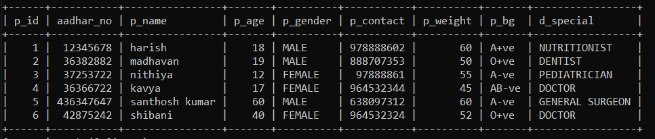
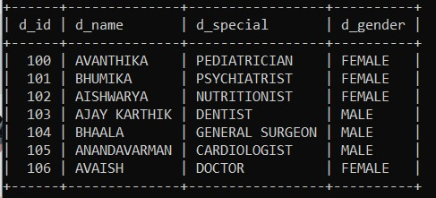
OUTPUT SCREENSHOTS:

Slide 19
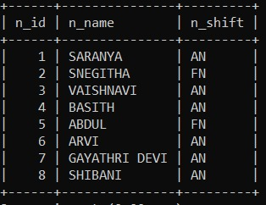
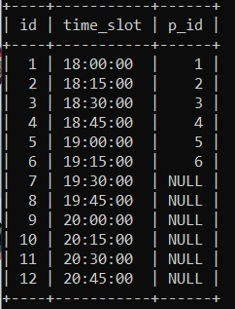

Slide 20
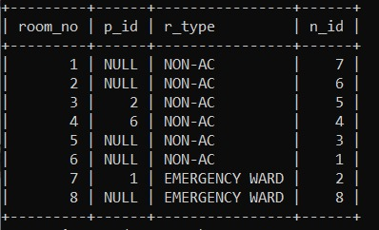
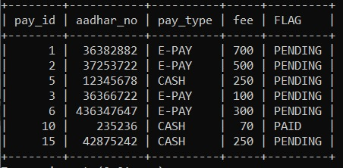

Slide 21
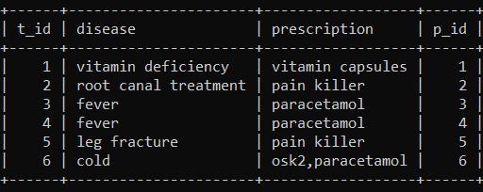
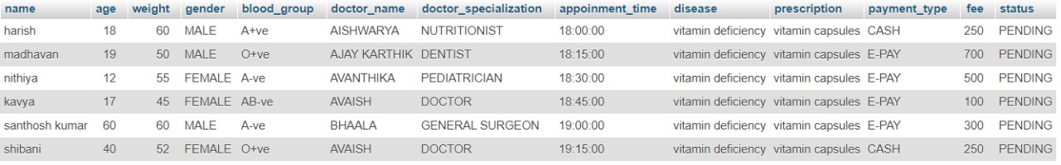
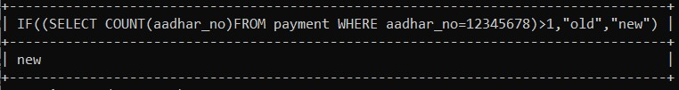

Slide 22
Thank you

