Slide 1
Machine learning characterization of pollutants using satellite-based measurement
Data 602
Intro to Data Analysis and Machine Learning
Team 3

Slide 2
Outline
Introduction
Project and experimental design
Data wrangling and Exploratory Data Analysis (EDA)
Model design and development
Results and discussion
Conclusion

Slide 3
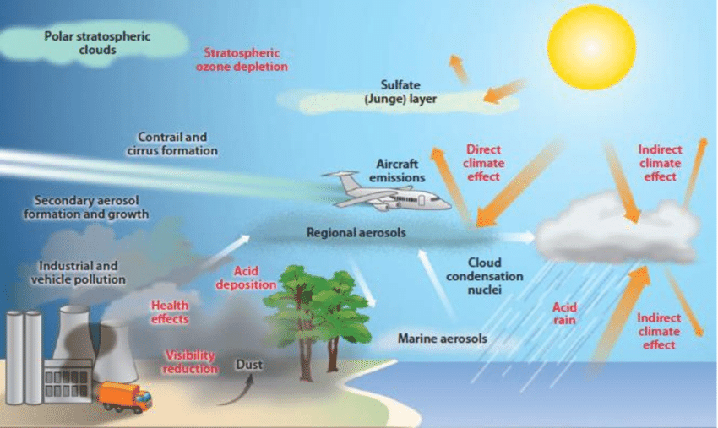
Introduction

Slide 4
Aerosols in perspective
Aerosols (pollutants) are particles that are omnipresent in the atmosphere
They vary in size, shape and composition
They also impact climate and weather in a geographical location
Proper classification can help to quantify climate change and global warming

Slide 5
Aerosol radiative forcing is a significant metric in assessing the influence of aerosols on climate change, which is mostly determined by the optical characteristics of the aerosol.
Classification of aerosols:
Carbonaceous
Radiation absorptivity
Soil dust
Aerosols
Size
Sulphates
Sea dust particles

Slide 6

Project and Experimental Design

Slide 7
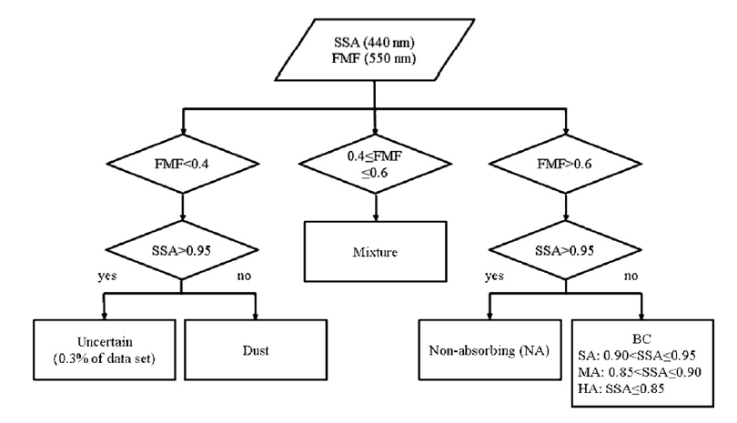
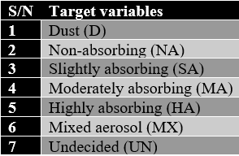
Creation of target features
Aerosols scatter or absorb solar radiation to varying degree depending on
their physical properties: geometry and composition.

Slide 8
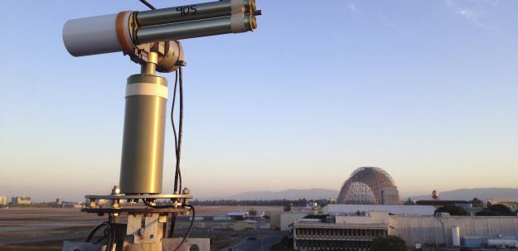
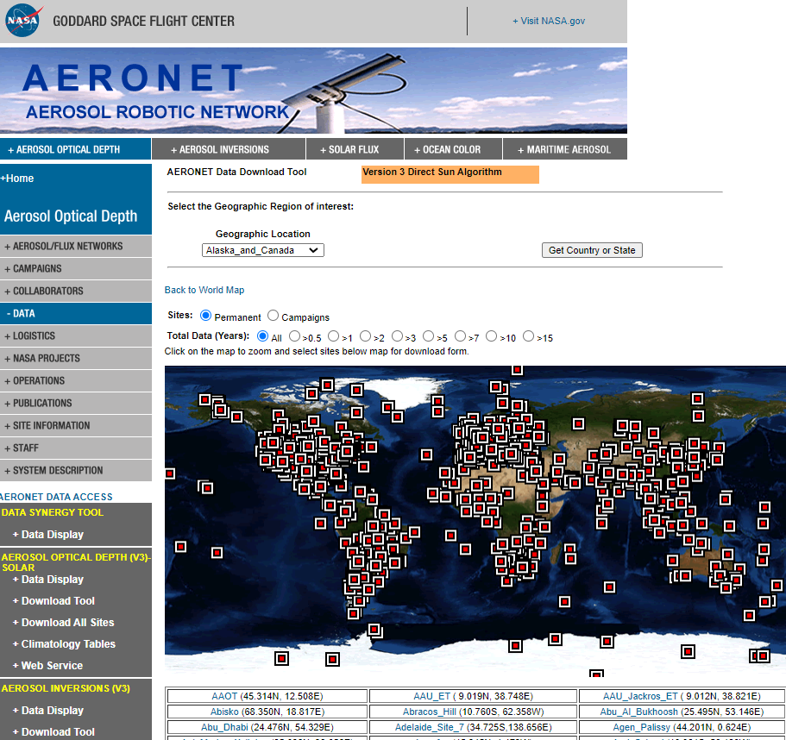
Creation of target features
The classification is based on the threshold approach in which aerosols are classified based on single scattering albedo (SSA) and fine mode fraction (FMF) values from AERONET sites.
Daily SSA and FMF values are downloaded from July 2010 to June 2022
AERONET data sites
Appalachian state University, USA
King Abdullah University of Science and technology (KAUST), Saudi-Arabia

Slide 9
Satellite feature Variables
Aerosol index (AI)
Scattering
angle
CO column amount
No2 column density
HCHO column amount
Fine mode (AOD)
Angstrom Exponent (AE)
Coarse mode (AOD)
Air temperat-ure

Slide 10
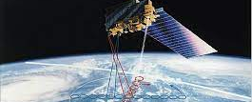

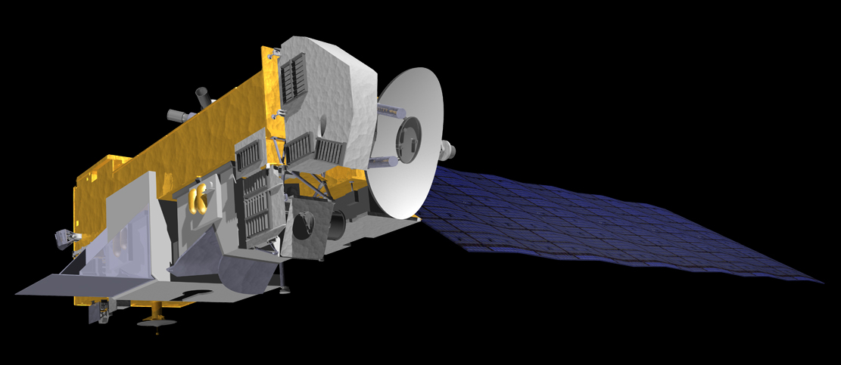
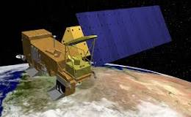
MODIS
(Moderate Resolution Imaging Spectroradiometer)
OMI
(Ozone Monitoring Instrument )
AIRS
(Atmospheric Infrared Sounder)

Slide 11
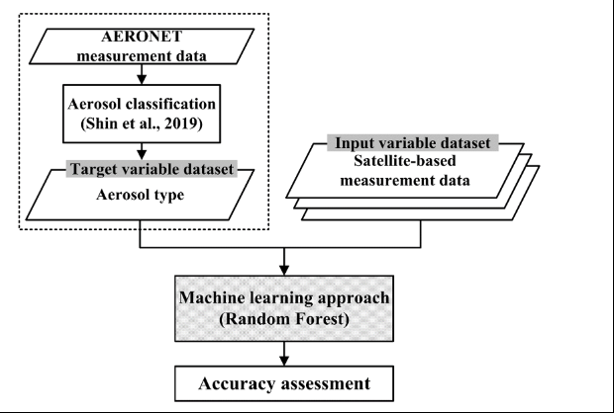
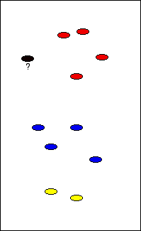
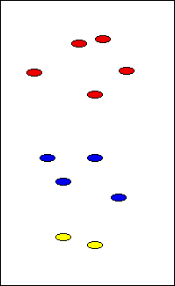
Multi label classification

Slide 12

Data Wrangling and Exploratory Data Analysis

Slide 13
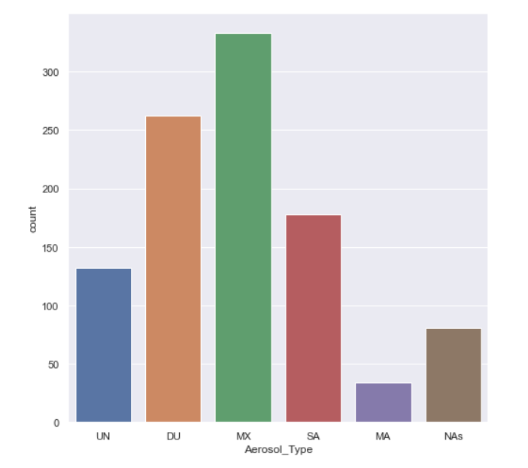
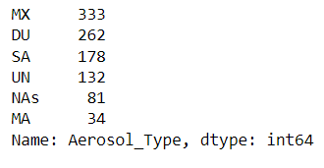
Metrics of the dataset
Dataset size: 1020
Label size: 6
Class type: Unbalanced
Feature size: 10
Feature type: Continuous
Distribution of classes

Slide 14
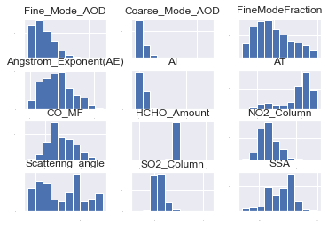
Data Wrangling 1) Outlier Removal (Mean) 2) Data Normalization 3) Data Standardization 4) Class Balancing
The above histograms depicts the distribution of our data

Slide 15
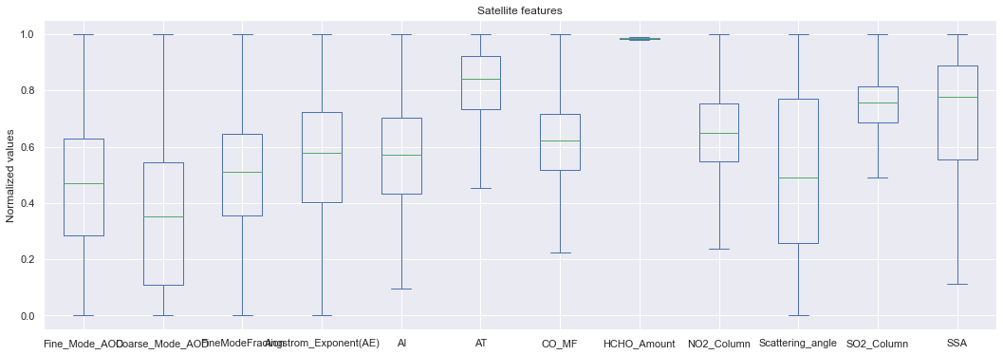
Using box plots to look for outliers

Slide 16
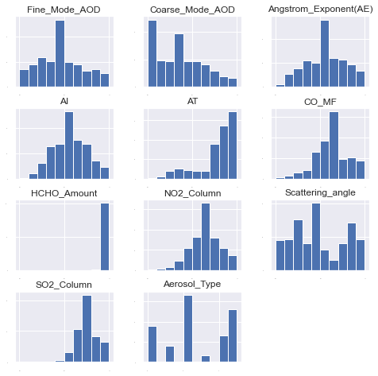
Standardization of data

Slide 17
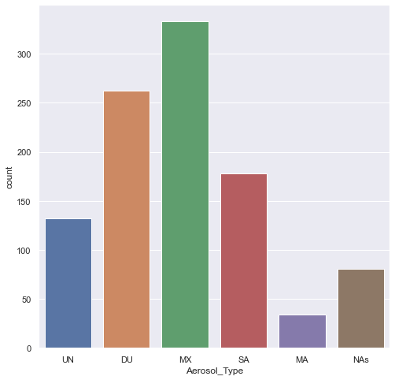
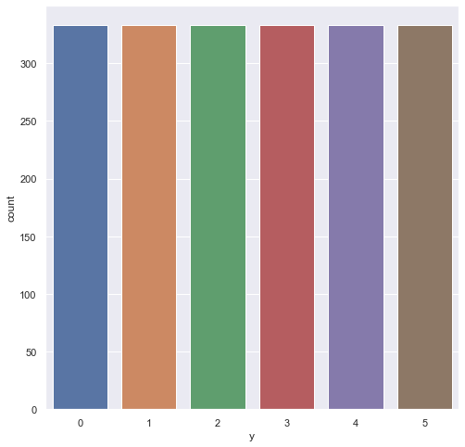
Balancing data: SMOTE

Slide 18
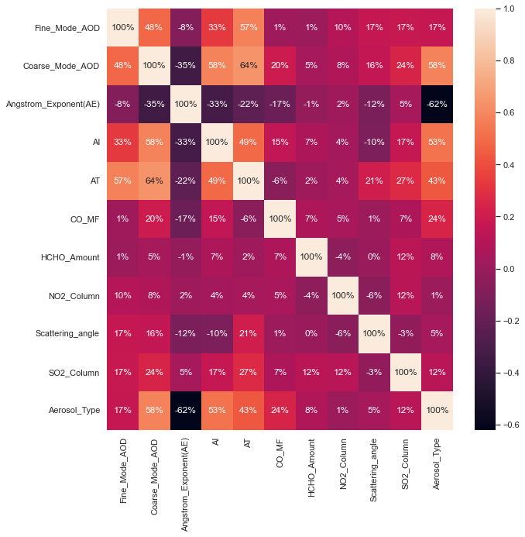
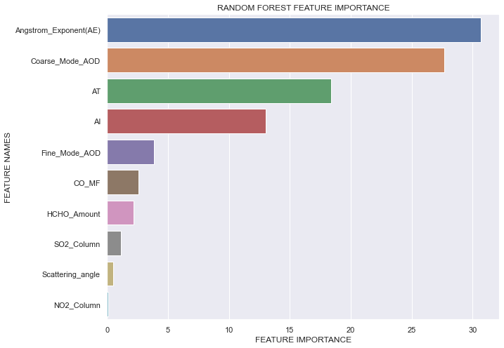

Slide 19
Model Design and Development

Slide 20
Machine Learning Models Information
Algorithms tested:
XGBoost Classifier
Random Forest
Naïve Bayes
Adaboost Classifier
Catboost Classifier
Support Vector Machine
Gradient Boost Classifier
Model Accuracy: Confusion matrix
Size of the dataset: 1020
Train-test split: 80-20
5-fold cross validation

Slide 21
ML model development
Try different ML algorithms
Create pipeline and scale ML algorithm
Select top algorithms from results
Check with tests data
Check ensemble model with test result
Try different ensemble ML algorithms
Create pipeline and scale ensemble ML algorithm
Select top ensemble algorithms from results
Create stack models with top ensemble algorithm

Slide 22

Results and Discussions

Slide 23
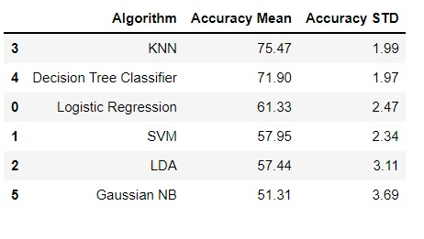
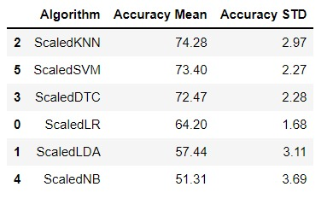
ML Algorithms: Unscaled vs Scaled data

Slide 24
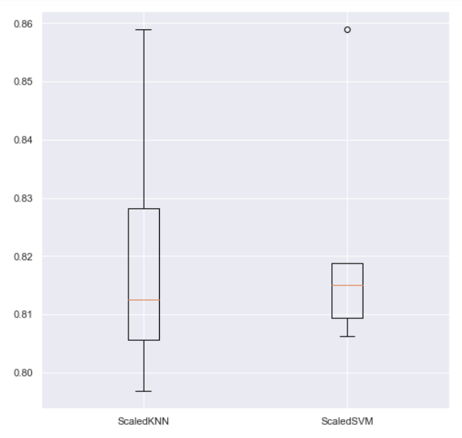
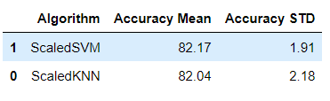
ML Algorithms: Optimized

Slide 25
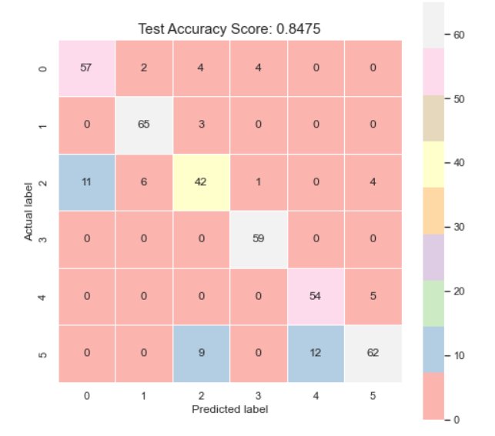
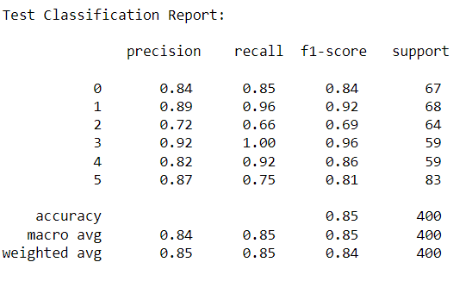
Performance of SVM on test data

Slide 26
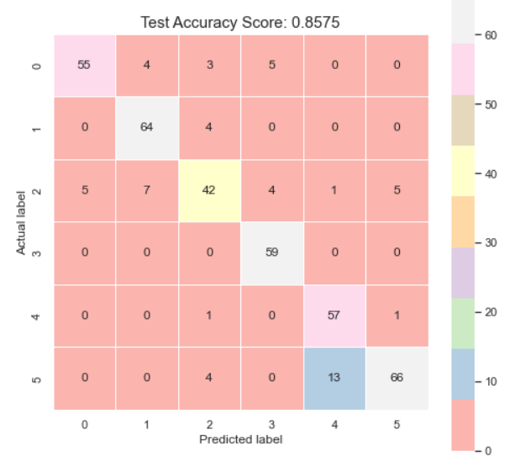
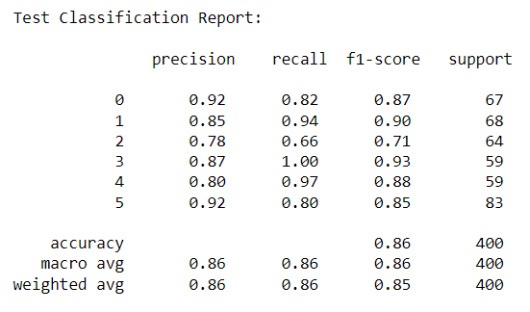
Performance of KNN on test data

Slide 27
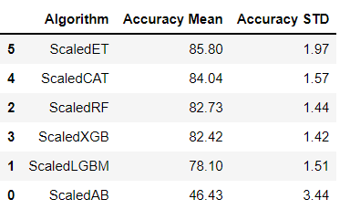
ML Algorithms: Ensemble methods

Slide 28
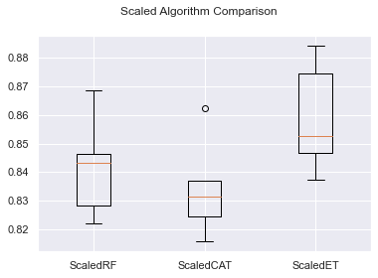
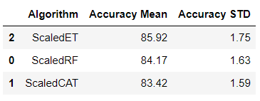
ML ensemble algorithms: Optimized

Slide 29
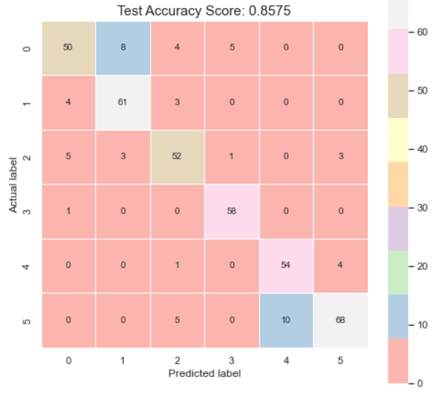
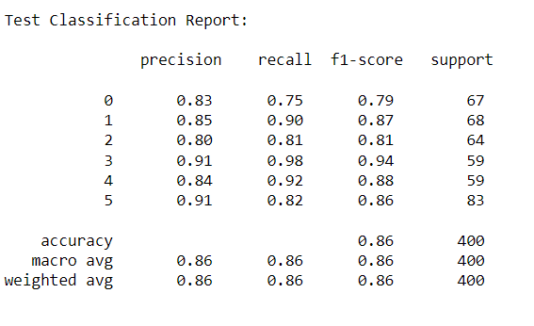
Performance of Random Forest on test data

Slide 30
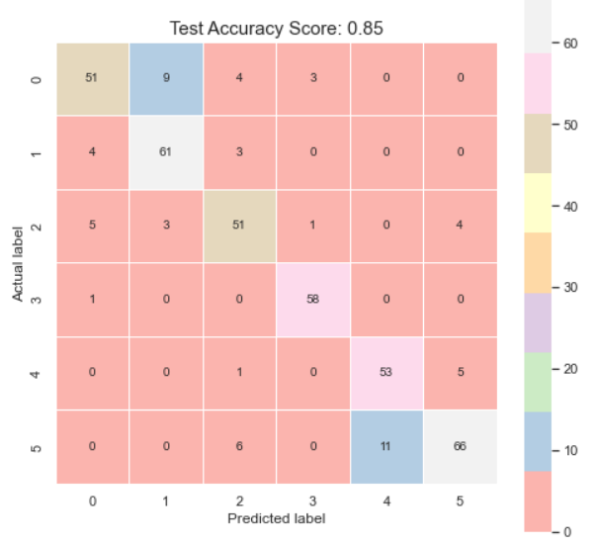
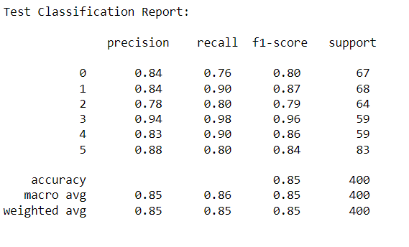
Performance of Catboost Classifier on test data

Slide 31
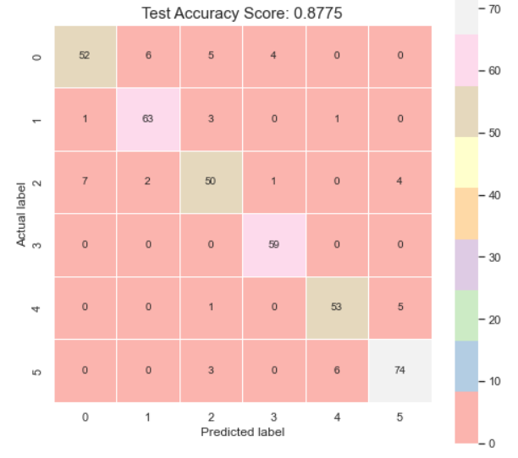
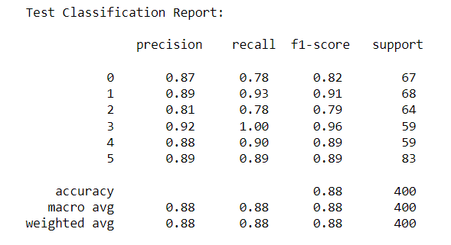
Performance of Extra-tree Classifier on test data

Slide 32
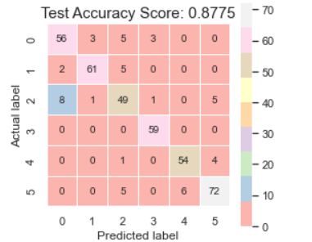
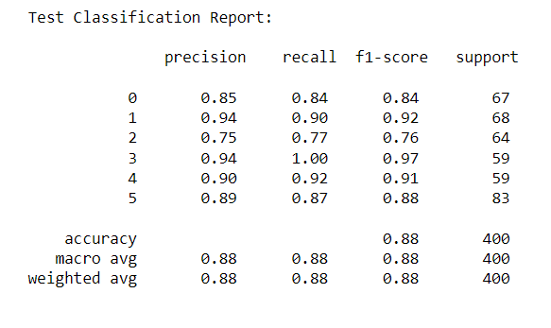
Performance of Stacked Model on test data
Estimators: Ensemble models, Final estimators: Support vector machine

Slide 33
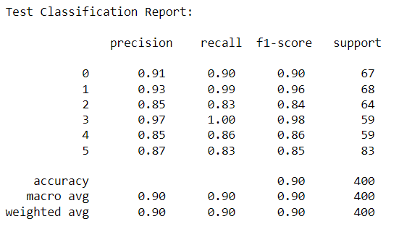
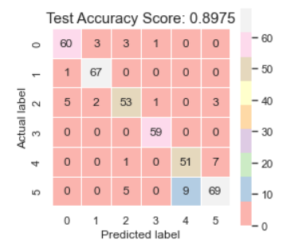
Feature reduction -7 features Performance of Stacked Model on test data
Estimators: Ensemble models, Final estimators: Support vector machine

Slide 34
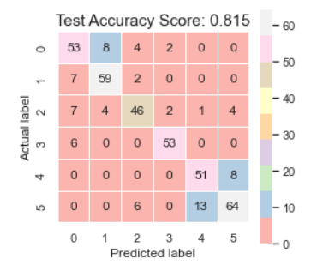
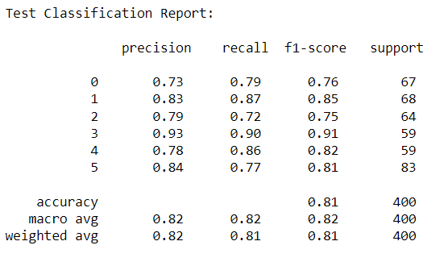
Feature reduction -4 features Performance of Stacked Model on test data
Estimators: Ensemble models, Final estimators: Support vector machine

Slide 35
Conclusion
Aerosols can be grouped into six simplified classes
Stacked model improved the accuracy of classification
Accuracy improves with feature reduction to a point where it began to decrease
ML based approach is viable for aerosol classification.

Slide 36

Thank you!

