Slide 1
DATABASE MANAGEMENT SYSTEMS
UNIT-I PPT SLIDES
Text Books: (1) DBMS by Navathe
(2) DBMS by Sudarshan and Korth

Slide 2
INDEX
UNIT-1 PPT SLIDES
S.NO Module as per Lecture PPT
Session planner No Slide NO
------------------------------------------------------------------------------------------
DBS Application and L1 L1- 1 to L1- 9
DBMS Vs File Systems
2. View of DATA L2 L2- 1 to L2- 7
3. DB Language (DML, DDL) L3 L3- 1 to L3- 6
4. DB Users and Administrator L4 L4- 1 to L4- 3
5. Data storage and Querying L5 L5- 1 to L5 -5
6. DBMS Architecture L6 L6- 1 to L6- 3

Slide 3
Database System Applications
DBMS contains information about a particular enterprise
  Collection of interrelated data
  Set of programs to access the data
  An environment that is both convenient and efficient to use
Database Applications:
  Banking: all transactions
  Airlines: reservations, schedules
  Universities: registration, grades
  Sales: customers, products, purchases
  Online retailers: order tracking, customized recommendations
  Manufacturing: production, inventory, orders, supply chain
  Human resources: employee records, salaries, tax deductions
Databases touch all aspects of our lives
Slide No:L1-1

Slide 4
What Is a DBMS?
A very large, integrated collection of data.
Models real-world enterprise.
  Entities (e.g., students, courses)
  Relationships (e.g., Madonna is taking CS564)
A Database Management System (DBMS) is a software package designed to store and manage databases.
Slide No:L1-2

Slide 5

Why Use a DBMS?
Data independence and efficient access.
Reduced application development time.
Data integrity and security.
Uniform data administration.
Concurrent access, recovery from crashes.
Slide No:L1-3
Notes:
3

Slide 6

Why Study Databases??
?
Shift from computation to information
  at the “low end”: scramble to webspace (a mess!)
  at the “high end”: scientific applications
Datasets increasing in diversity and volume.
  Digital libraries, interactive video, Human Genome project, EOS project
  ... need for DBMS exploding
DBMS encompasses most of CS
  OS, languages, theory, AI, multimedia, logic
Slide No:L1-4

Slide 7
Files vs. DBMS
Application must stage large datasets between main memory and secondary storage (e.g., buffering, page-oriented access, 32-bit addressing, etc.)
Special code for different queries
Must protect data from inconsistency due to multiple concurrent users
Crash recovery
Security and access control
Slide No:L1-5

Slide 8
Purpose of Database Systems
In the early days, database applications were built directly on top of file systems
Drawbacks of using file systems to store data:
  Data redundancy and inconsistency
    Multiple file formats, duplication of information in different files
  Difficulty in accessing data
    Need to write a new program to carry out each new task
  Data isolation — multiple files and formats
  Integrity problems
    Integrity constraints (e.g. account balance > 0) become “buried” in program code rather than being stated explicitly
    Hard to add new constraints or change existing ones
Slide No:L1-6

Slide 9
Purpose of Database Systems (Cont.)
Drawbacks of using file systems (cont.)
  Atomicity of updates
    Failures may leave database in an inconsistent state with partial updates carried out
    Example: Transfer of funds from one account to another should either complete or not happen at all
  Concurrent access by multiple users
    Concurrent accessed needed for performance
    Uncontrolled concurrent accesses can lead to inconsistencies
      Example: Two people reading a balance and updating it at the same time
  Security problems
    Hard to provide user access to some, but not all, data
Database systems offer solutions to all the above problems
Slide No:L1-7

Slide 10
Levels of Abstraction
Physical level: describes how a record (e.g., customer) is stored.
Logical level: describes data stored in database, and the relationships among the data.
  type customer = record
  customer_id : string;
  customer_name : string;
  customer_street : string;
  customer_city : string;
        end;
View level: application programs hide details of data types. Views can also hide information (such as an employee’s salary) for security purposes.
Slide No:L1-8

Slide 11
Summary
DBMS used to maintain, query large datasets.
Benefits include recovery from system crashes, concurrent access, quick application development, data integrity and security.
Levels of abstraction give data independence.
A DBMS typically has a layered architecture.
DBAs hold responsible jobs and are well-paid! ☺
DBMS R&D is one of the broadest, most exciting areas in CS.
Slide No:L1-9

Slide 12

View of Data
An architecture for a database system
Slide No:L2-1

Slide 13
Instances and Schemas
Similar to types and variables in programming languages
Schema – the logical structure of the database
  Example: The database consists of information about a set of customers and accounts and the relationship between them)
  Analogous to type information of a variable in a program
  Physical schema: database design at the physical level
  Logical schema: database design at the logical level
Slide No:L2-2

Slide 14
Instances and Schemas
Instance – the actual content of the database at a particular point in time
  Analogous to the value of a variable
Physical Data Independence – the ability to modify the physical schema without changing the logical schema
  Applications depend on the logical schema
  In general, the interfaces between the various levels and components should be well defined so that changes in some parts do not seriously influence others.
Slide No:L2-3

Slide 15
Data Models
A collection of tools for describing
  Data
  Data relationships
  Data semantics
  Data constraints
Relational model
Entity-Relationship data model (mainly for database design)
Object-based data models (Object-oriented and Object-relational)
Semi structured data model (XML)
Other older models:
  Network model
  Hierarchical model
Slide No:L2-4

Slide 16
Data Models
A data model is a collection of concepts for describing data.
A schema is a description of a particular collection of data, using the a given data model.
The relational model of data is the most widely used model today.
  Main concept: relation, basically a table with rows and columns.
  Every relation has a schema, which describes the columns, or fields.
Slide No:L2-5

Slide 17
Example: University Database
Conceptual schema:
  Students(sid: string, name: string, login: string,
  age: integer, gpa:real)
  Courses(cid: string, cname:string, credits:integer)
  Enrolled(sid:string, cid:string, grade:string)
Physical schema:
  Relations stored as unordered files.
  Index on first column of Students.
External Schema (View):
  Course_info(cid:string,enrollment:integer)
Slide No:L2-6
Notes:
7

Slide 18
Data Independence
Applications insulated from how data is structured and stored.
Logical data independence: Protection from changes in logical structure of data.
Physical data independence: Protection from changes in physical structure of data.
One of the most important benefits of using a DBMS!
Slide No:L2-7

Slide 19
DATA BASE LANGUAGE
Data Manipulation Language (DML)
Language for accessing and manipulating the data organized by the appropriate data model
  DML also known as query language
Two classes of languages
  Procedural – user specifies what data is required and how to get those data
  Declarative (nonprocedural) – user specifies what data is required without specifying how to get those data
SQL is the most widely used query language
Slide No:L3-1

Slide 20
Data Definition Language (DDL)
Specification notation for defining the database schema
  Example: create table account (
  account_number char(10),
  branch_name char(10),
  balance integer)
DDL compiler generates a set of tables stored in a data dictionary
Data dictionary contains metadata (i.e., data about data)
  Database schema
  Data storage and definition language
    Specifies the storage structure and access methods used
  Integrity constraints
    Domain constraints
    Referential integrity (e.g. branch_name must correspond to a valid branch in the branch table)
  Authorization
Slide No:L3-2

Slide 21
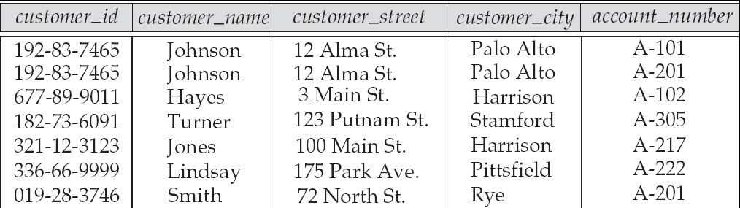
Relational Model
Example of tabular data in the relational model
Attributes
Slide No:L3-3

Slide 22

A Sample Relational Database
Slide No:L3-4

Slide 23
SQL
SQL: widely used non-procedural language
  Example: Find the name of the customer with customer-id 192-83-7465
  select customer.customer_name
  from customer
  where customer.customer_id = ‘192-83-7465’
  Example: Find the balances of all accounts held by the customer with customer-id 192-83-7465
  select account.balance
  from depositor, account
  where depositor.customer_id = ‘192-83-7465’ and
  depositor.account_number = account.account_number
Slide No:L3-5

Slide 24
SQL
Application programs generally access databases through one of
  Language extensions to allow embedded SQL
  Application program interface (e.g., ODBC/JDBC) which allow SQL queries to be sent to a database
Slide No:L3-6

Slide 25
Database Users
Users are differentiated by the way they expect to interact with
the system
Application programmers – interact with system through DML calls
Sophisticated users – form requests in a database query language
Specialized users – write specialized database applications that do not fit into the traditional data processing framework
Naïve users – invoke one of the permanent application programs that have been written previously
  Examples, people accessing database over the web, bank tellers, clerical staff
Slide No:L4-1

Slide 26
Database Administrator
Coordinates all the activities of the database system
  has a good understanding of the enterprise’s information resources and needs.
Database administrator's duties include:
  Storage structure and access method definition
  Schema and physical organization modification
  Granting users authority to access the database
  Backing up data
  Monitoring performance and responding to changes
    Database tuning
Slide No:L4-2

Slide 27
Data storage and Querying
Storage management
Query processing
Transaction processing
Slide No:L5-1

Slide 28
Storage Management
Storage manager is a program module that provides the interface between the low-level data stored in the database and the application programs and queries submitted to the system.
The storage manager is responsible to the following tasks:
  Interaction with the file manager
  Efficient storing, retrieving and updating of data
Issues:
  Storage access
  File organization
  Indexing and hashing
Slide No:L5-2

Slide 29

Query Processing
1.Parsing and translation
2. Optimization
3. Evaluation
Slide No:L5-3

Slide 30
Query Processing (Cont.)
Alternative ways of evaluating a given query
  Equivalent expressions
  Different algorithms for each operation
Cost difference between a good and a bad way of evaluating a query can be enormous
Need to estimate the cost of operations
  Depends critically on statistical information about relations which the database must maintain
  Need to estimate statistics for intermediate results to compute cost of complex expressions
Slide No:L5-4

Slide 31
Transaction Management
A transaction is a collection of operations that performs a single logical function in a database application
Transaction-management component ensures that the database remains in a consistent (correct) state despite system failures (e.g., power failures and operating system crashes) and transaction failures.
Concurrency-control manager controls the interaction among the concurrent transactions, to ensure the consistency of the database.
Slide No:L5-5

Slide 32
Database Architecture
The architecture of a database systems is greatly influenced by
the underlying computer system on which the database is running:
Centralized
Client-server
Parallel (multiple processors and disks)
Distributed
Slide No:L6-1

Slide 33
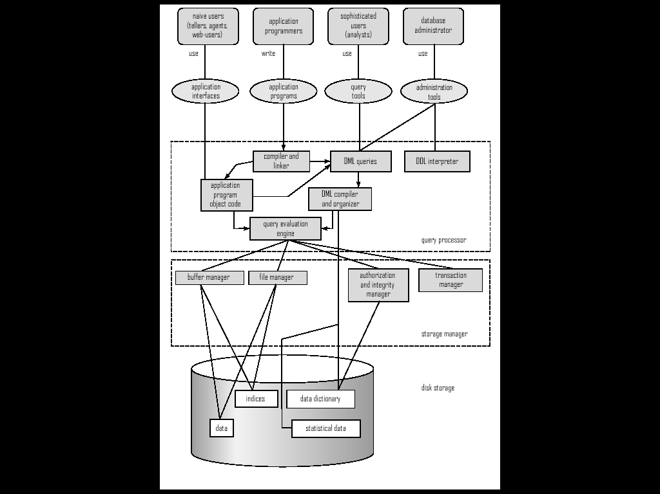
Overall System Structure
Slide No:L6-2

Slide 34
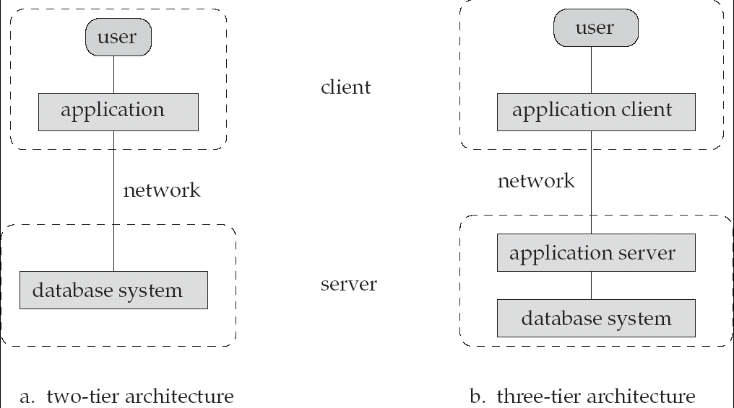
Database Application Architectures
(web browser)
Old
Modern
Slide No:L6-3

