Slide 1
DATABASE MANAGEMENT SYSTEMS
UNIT-II PPT SLIDES
Text Books: (1) DBMS by Navate
(2) DBMS by Sudarshan and Korth

Slide 2
INDEX
UNIT-2 PPT SLIDES
S.NO Module as per Lecture PPT
Session planner No Slide NO
------------------------------------------------------------------------------------------
History of Database Systems L1 L1- 1 to L1- 10
2. DB design and ER diagrams L2 L2- 1 to L2- 10
3. Relationships & sets L3 L3- 1 to L3- 5
Addn features of the ER model L4 L4- 1 to L4- 7
Addn features of the ER model L5 L5- 1 to L5- 6
6. Conceptual design with ER model L6 L6- 1 to L6 -6
7. Large enterprises L7 L7- 1 to L7- 3

Slide 3
History of Database Systems
1950s and early 1960s:
Data processing using magnetic tapes for storage
Tapes provide only sequential access
Punched cards for input
Late 1960s and 1970s:
Hard disks allow direct access to data
Network and hierarchical data models in widespread use
Ted Codd defines the relational data model
Would win the ACM Turing Award for this work
IBM Research begins System R prototype
UC Berkeley begins Ingres prototype
High-performance (for the era) transaction processing
Slide No:L1-1

Slide 4



Magnetic tape
Hard disk
Magnetic tape unit
Slide No:L1-2

Slide 5
History (cont.)
1980s:
Research relational prototypes evolve into commercial systems
SQL becomes industry standard
Parallel and distributed database systems
Object-oriented database systems
1990s:
Large decision support and data-mining applications
Large multi-terabyte data warehouses
Emergence of Web commerce
2000s:
XML and XQuery standards
Automated database administration
Increasing use of highly parallel database systems
Web-scale distributed data storage systems
Slide No:L1-3

Slide 6
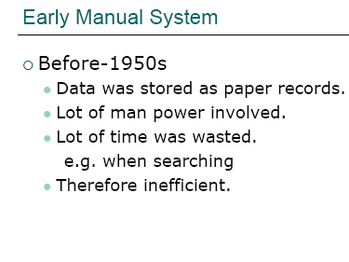
Slide No:L1-4

Slide 7
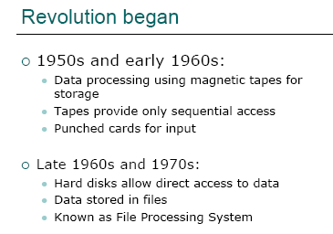
Slide No:L1-5

Slide 8
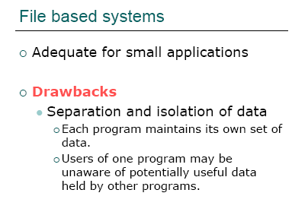
Slide No:L1-6

Slide 9
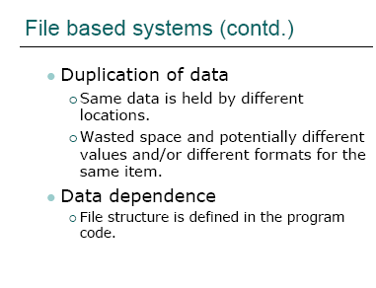
Slide No:L1-7

Slide 10
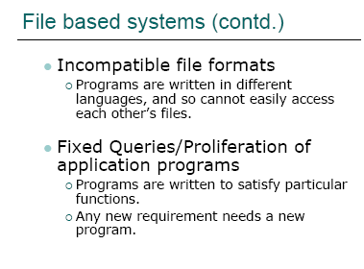
Slide No:L1-8

Slide 11
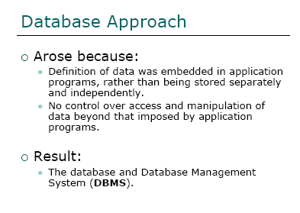
Slide No:L1-9

Slide 12
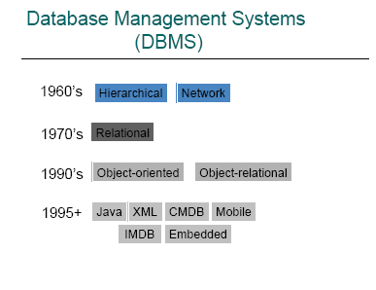
Slide No:L1-10

Slide 13
Database Design
Conceptual design: (ER Model is used at this stage.)
What are the entities and relationships in the enterprise?
What information about these entities and relationships should we store in the database?
What are the integrity constraints or business rules that hold?
A database `schema’ in the ER Model can be represented pictorially (ER diagrams).
Can map an ER diagram into a relational schema.
Slide No:L2-1
Notes:
‹#›
2

Slide 14
Modeling
A database can be modeled as:
a collection of entities,
relationship among entities.
An entity is an object that exists and is distinguishable from other objects.
Example: specific person, company, event, plant
Entities have attributes
Example: people have names and addresses
An entity set is a set of entities of the same type that share the same properties.
Example: set of all persons, companies, trees, holidays
Slide No:L2-2

Slide 15
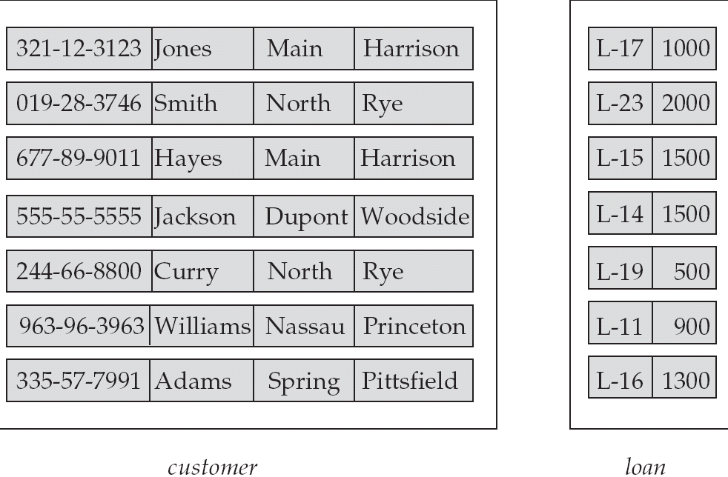
Entity Sets customer and loan
customer_id customer_ customer_ customer_ loan_ amount name street city number
Slide No:L2-3

Slide 16
Attributes
An entity is represented by a set of attributes, that is descriptive properties possessed by all members of an entity set.
Domain – the set of permitted values for each attribute
Attribute types:
Simple and composite attributes.
Single-valued and multi-valued attributes
Example: multivalued attribute: phone_numbers
Derived attributes
Can be computed from other attributes
Example: age, given date_of_birth
Example:
customer = (customer_id, customer_name, customer_street, customer_city ) loan = (loan_number, amount )
Slide No:L2-4

Slide 17
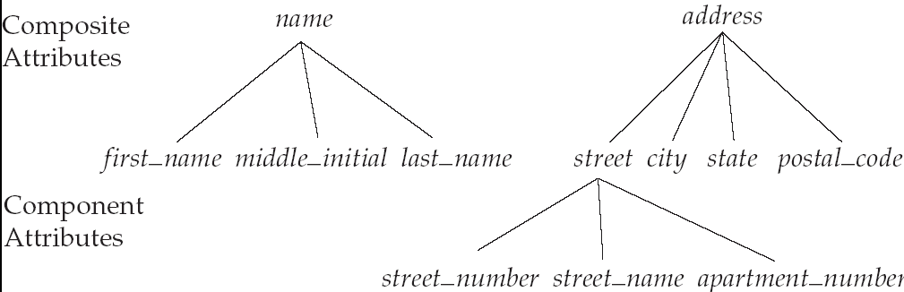
Composite Attributes
Slide No:L2-5

Slide 18
Mapping Cardinality Constraints
Express the number of entities to which another entity can be associated via a relationship set.
Most useful in describing binary relationship sets.
For a binary relationship set the mapping cardinality must be one of the following types:
One to one
One to many
Many to one
Many to many
Slide No:L2-6

Slide 19
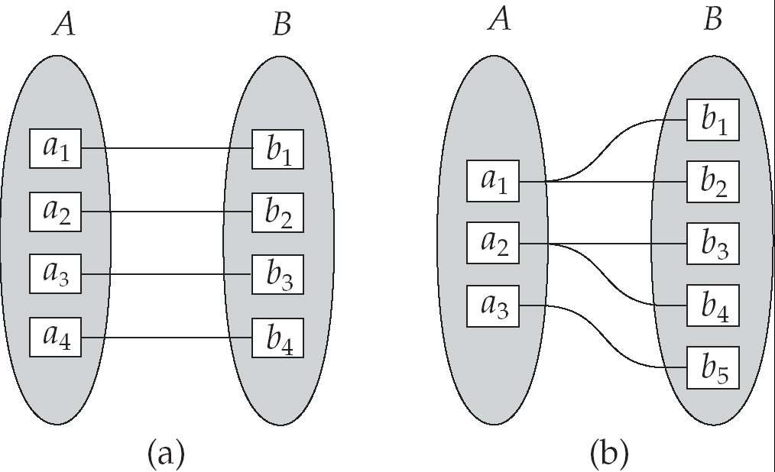
Mapping Cardinalities
One to one
One to many
Note: Some elements in A and B may not be mapped to any
elements in the other set
Slide No:L2-7

Slide 20
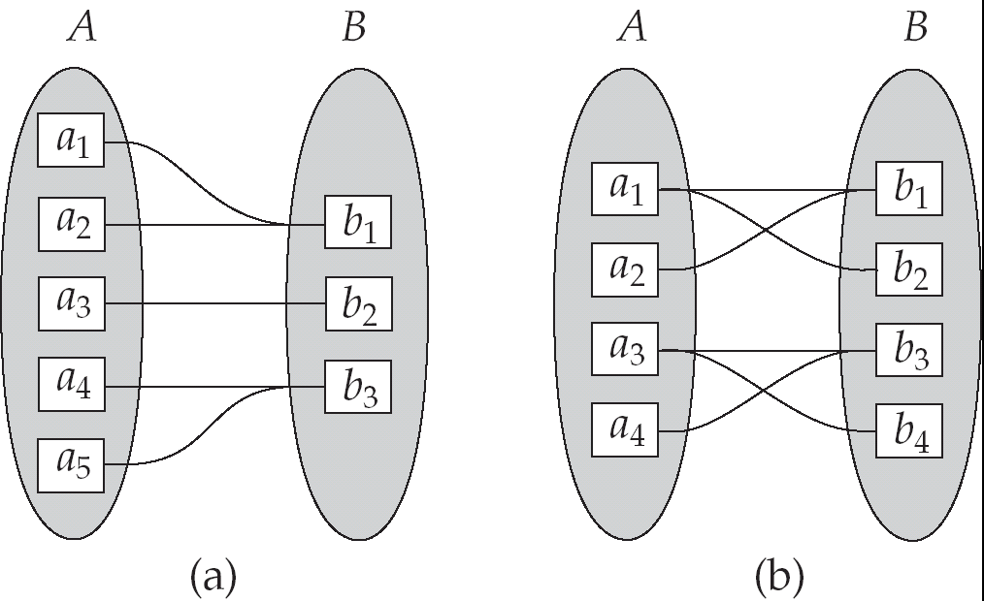
Mapping Cardinalities
Many to one
Many to many
Note: Some elements in A and B may not be mapped to any
elements in the other set
Slide No:L2-8

Slide 21
ER Model Basics
name
ssn
lot
Employees
Entity: Real-world object distinguishable from other objects. An entity is described (in DB) using a set of attributes.
Entity Set: A collection of similar entities. E.g., all employees.
All entities in an entity set have the same set of attributes. (Until we consider ISA hierarchies, anyway!)
Each entity set has a key.
Each attribute has a domain.
Slide No:L2-9
Notes:
‹#›
3

Slide 22
ER Model Basics (Contd.)
name
ssn
lot
since
name
dname
ssn
lot
did
budget
Employees
super-visor
subordinate
Employees
Works_In
Departments
Reports_To
Relationship: Association among two or more entities. E.g., Attishoo works in Pharmacy department.
Relationship Set: Collection of similar relationships.
An n-ary relationship set R relates n entity sets E1 ... En; each relationship in R involves entities e1 E1, ..., en En
Same entity set could participate in different relationship sets, or in different “roles” in same set.
Slide No:L2-10
Notes:
‹#›
4

Slide 23
Relationship Sets
A relationship is an association among several entities
Example: Hayes depositor A-102 customer entity relationship set account entity
A relationship set is a mathematical relation among n ≥ 2 entities, each taken from entity sets
{(e₁, e₂, … e_{n}) | e₁ ∈ E₁, e₂ ∈ E₂, …, e_{n} ∈ E_{n}} where (e₁, e₂, …, e_{n}) is a relationship
Example:
(Hayes, A-102) ∈ depositor
Slide No:L3-1

Slide 24
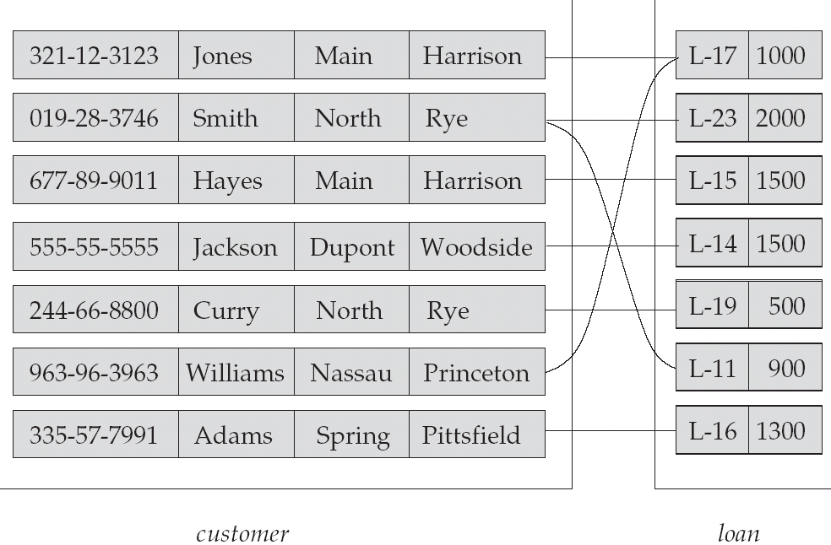
Relationship Set borrower
Slide No:L3-2

Slide 25
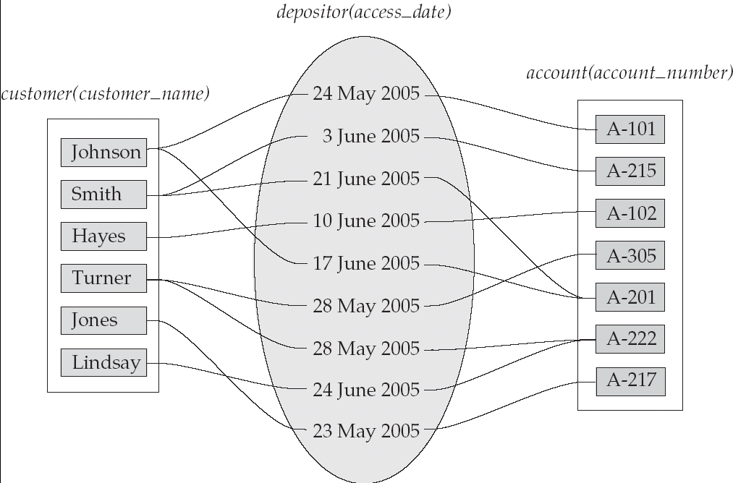
Relationship Sets (Cont.)
An attribute can also be property of a relationship set.
For instance, the depositor relationship set between entity sets customer and account may have the attribute access-date
Slide No:L3-3

Slide 26
Degree of a Relationship Set
Refers to number of entity sets that participate in a relationship set.
Relationship sets that involve two entity sets are binary (or degree two). Generally, most relationship sets in a database system are binary.
Relationship sets may involve more than two entity sets.
Slide No:L3-4

Slide 27
Degree of a Relationship Set
Example: Suppose employees of a bank may have jobs (responsibilities) at multiple branches, with different jobs at different branches. Then there is a ternary relationship set between entity sets employee, job, and branch
Relationships between more than two entity sets are rare. Most relationships are binary. (More on this later.)
Slide No:L3-5

Slide 28
Key Constraints
Additional features of the ER model
since
name
dname
ssn
lot
did
budget
Employees
Manages
Departments
Consider Works_In: An employee can work in many departments; a dept can have many employees.
In contrast, each dept has at most one manager, according to the key constraint on Manages.
1-to-1
1-to Many
Many-to-1
Many-to-Many
Slide No:L4-1
Notes:
‹#›
6

Slide 29
Participation Constraints
Does every department have a manager?
If so, this is a participation constraint: the participation of Departments in Manages is said to be total (vs. partial).
Every Departments entity must appear in an instance of the Manages relationship.
since
since
name
name
dname
dname
ssn
did
did
budget
lot
budget
Employees
Manages
Departments
Works_In
since
Slide No:L4-2
Notes:
‹#›
8

Slide 30
Weak Entities
A weak entity can be identified uniquely only by considering the primary key of another (owner) entity.
Owner entity set and weak entity set must participate in a one-to-many relationship set (one owner, many weak entities).
Weak entity set must have total participation in this identifying relationship set.
name
ssn
lot
cost
pname
age
Employees
Policy
Dependents
Slide No:L4-3
Notes:
‹#›
10

Slide 31
Weak Entity Sets
An entity set that does not have a primary key is referred to as a weak entity set.
The existence of a weak entity set depends on the existence of a identifying entity set
it must relate to the identifying entity set via a total, one-to-many relationship set from the identifying to the weak entity set
Identifying relationship depicted using a double diamond
The discriminator (or partial key) of a weak entity set is the set of attributes that distinguishes among all the entities of a weak entity set.
The primary key of a weak entity set is formed by the primary key of the strong entity set on which the weak entity set is existence dependent, plus the weak entity set’s discriminator.
Slide No:L4-4

Slide 32
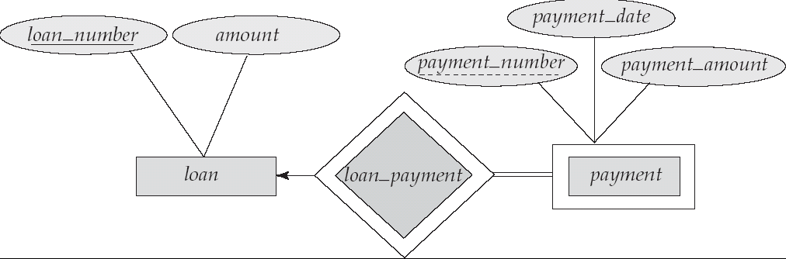
Weak Entity Sets (Cont.)
We depict a weak entity set by double rectangles.
We underline the discriminator of a weak entity set with a dashed line.
payment_number – discriminator of the payment entity set
Primary key for payment – (loan_number, payment_number)
Slide No:L4-5

Slide 33
Weak Entity Sets (Cont.)
Note: the primary key of the strong entity set is not explicitly stored with the weak entity set, since it is implicit in the identifying relationship.
If loan_number were explicitly stored, payment could be made a strong entity, but then the relationship between payment and loan would be duplicated by an implicit relationship defined by the attribute loan_number common to payment and loan
Slide No:L4-6

Slide 34
More Weak Entity Set Examples
In a university, a course is a strong entity and a course_offering can be modeled as a weak entity
The discriminator of course_offering would be semester (including year) and section_number (if there is more than one section)
If we model course_offering as a strong entity we would model course_number as an attribute.
Then the relationship with course would be implicit in the course_number attribute
Slide No:L4-7

Slide 35
ISA (`is a’) Hierarchies
name
As in C++, or other PLs, attributes are inherited.
If we declare A ISA B,
every A entity is also
considered to be a B
entity.
ssn
lot
Employees
hourly_wages
hours_worked
ISA
contractid
Contract_Emps
Hourly_Emps
Overlap constraints: Can Joe be an Hourly_Emps as well as a Contract_Emps entity? (Allowed/disallowed)
Covering constraints: Does every Employees entity also have to be an Hourly_Emps or a Contract_Emps entity? (Yes/no)
Reasons for using ISA:
To add descriptive attributes specific to a subclass.
To identify entitities that participate in a relationship.
Slide No:L5-1
Notes:
‹#›
12

Slide 36
Aggregation
Used when we have to model a relationship involving (entitity sets and) a relationship set.
Aggregation allows us to treat a relationship set as an entity set for purposes of participation in (other) relationships.
name
ssn
lot
Employees
Monitors
until
started_on
since
dname
pid
pbudget
did
budget
Projects
Sponsors
Departments
Aggregation vs. ternary relationship:
Monitors is a distinct relationship, with a descriptive attribute.
Also, can say that each sponsorship is monitored by at most one employee.
Slide No:L5-2
Notes:
‹#›
2

Slide 37
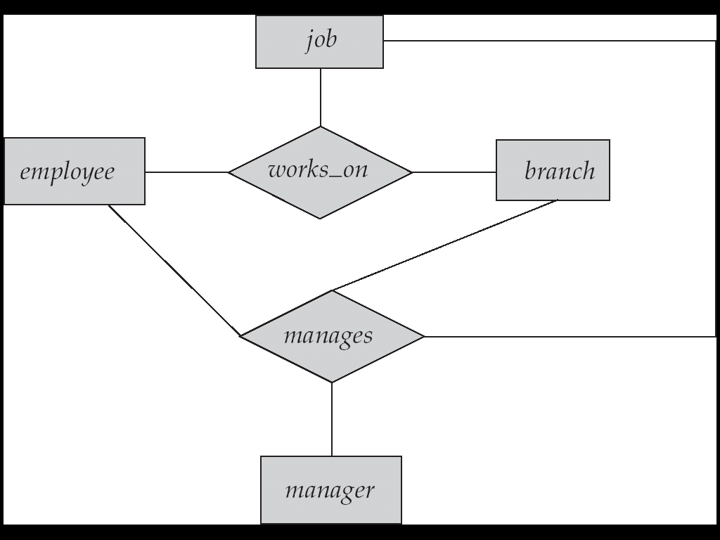
Aggregation
Consider the ternary relationship works_on, which we saw earlier
Suppose we want to record managers for tasks performed by an employee at a branch
Slide No:L5-3

Slide 38
Aggregation (Cont.)
Relationship sets works_on and manages represent overlapping information
Every manages relationship corresponds to a works_on relationship
However, some works_on relationships may not correspond to any manages relationships
So we can’t discard the works_on relationship
Eliminate this redundancy via aggregation
Treat relationship as an abstract entity
Allows relationships between relationships
Abstraction of relationship into new entity
Slide No:L5-4

Slide 39
Aggregation (Cont.)
Eliminate this redundancy via aggregation
Treat relationship as an abstract entity
Allows relationships between relationships
Abstraction of relationship into new entity
Without introducing redundancy, the following diagram represents:
An employee works on a particular job at a particular branch
An employee, branch, job combination may have an associated manager
Slide No:L5-5

Slide 40
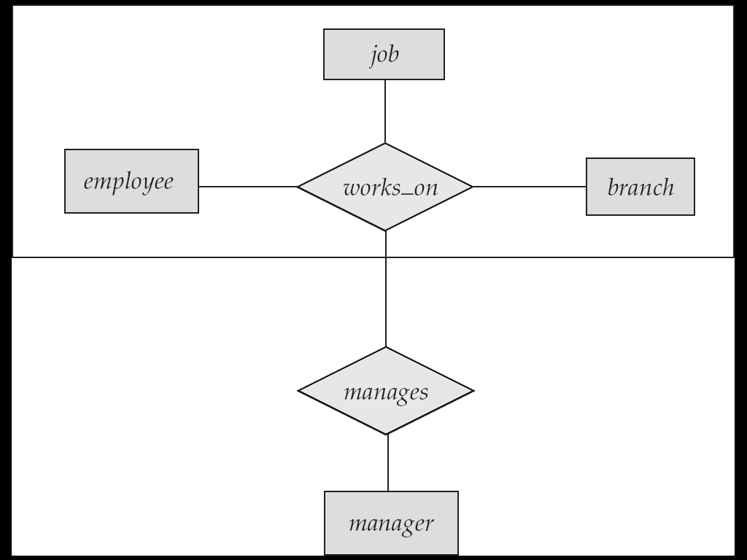
E-R Diagram With Aggregation
Slide No:L5-6

Slide 41
Conceptual Design Using the ER Model
Design choices:
Should a concept be modeled as an entity or an attribute?
Should a concept be modeled as an entity or a relationship?
Identifying relationships: Binary or ternary? Aggregation?
Constraints in the ER Model:
A lot of data semantics can (and should) be captured.
But some constraints cannot be captured in ER diagrams.
Slide No:L6-1
Notes:
‹#›
3

Slide 42
Entity vs. Attribute
Should address be an attribute of Employees or an entity (connected to Employees by a relationship)?
Depends upon the use we want to make of address information, and the semantics of the data:
If we have several addresses per employee, address must be an entity (since attributes cannot be set-valued).
If the structure (city, street, etc.) is important, e.g., we want to retrieve employees in a given city, address must be modeled as an entity (since attribute values are atomic).
Slide No:L6-2
Notes:
‹#›

Slide 43
Entity vs. Attribute (Contd.)
Works_In4 does not allow an employee to work in a department for two or more periods.
Similar to the problem of wanting to record several addresses for an employee: We want to record several values of the descriptive attributes for each instance of this relationship. Accomplished by introducing new entity set, Duration.
from
to
name
dname
ssn
lot
did
budget
Employees
Works_In4
Departments
name
dname
ssn
lot
did
budget
Employees
Works_In4
Departments
from
Duration
to
Slide No:L6-3
Notes:
‹#›
5

Slide 44
Entity vs. Relationship
First ER diagram OK if a manager gets a separate discretionary budget for each dept.
What if a manager gets a discretionary budget that covers all managed depts?
Redundancy: dbudget stored for each dept managed by manager.
Misleading: Suggests dbudget associated with department-mgr combination.
since
dbudget
name
dname
ssn
lot
did
budget
Employees
Manages2
Departments
name
ssn
lot
since
dname
Employees
did
budget
Manages2
Departments
ISA
This fixes the
problem!
Managers
dbudget
Slide No:L6-4
Notes:
‹#›
6

Slide 45
Binary vs. Ternary Relationships
If each policy is owned by just 1 employee, and each dependent is tied to the covering policy, first diagram is inaccurate.
What are the additional constraints in the 2nd diagram?
name
ssn
lot
pname
age
Employees
Covers
Dependents
Bad design
Policies
policyid
cost
name
pname
age
ssn
lot
Dependents
Employees
Purchaser
Beneficiary
Better design
Policies
Slide No:L6-5
policyid
cost
Notes:
‹#›
7

Slide 46
Binary vs. Ternary Relationships (Contd.)
Previous example illustrated a case when two binary relationships were better than one ternary relationship.
An example in the other direction: a ternary relation Contracts relates entity sets Parts, Departments and Suppliers, and has descriptive attribute qty. No combination of binary relationships is an adequate substitute:
S “can-supply” P, D “needs” P, and D “deals-with” S does not imply that D has agreed to buy P from S.
How do we record qty?
Slide No:L6-6
Notes:
‹#›
9

Slide 47
Summary of Conceptual Design
Conceptual design follows requirements analysis,
Yields a high-level description of data to be stored
ER model popular for conceptual design
Constructs are expressive, close to the way people think about their applications.
Basic constructs: entities, relationships, and attributes (of entities and relationships).
Some additional constructs: weak entities, ISA hierarchies, and aggregation.
Note: There are many variations on ER model.
Slide No:L7-1
Notes:
‹#›
11

Slide 48
Summary of ER (Contd.)
Several kinds of integrity constraints can be expressed in the ER model: key constraints, participation constraints, and overlap/covering constraints for ISA hierarchies. Some foreign key constraints are also implicit in the definition of a relationship set.
Some constraints (notably, functional dependencies) cannot be expressed in the ER model.
Constraints play an important role in determining the best database design for an enterprise.
Slide No:L7-2
Notes:
‹#›
12

Slide 49
Summary of ER (Contd.)
ER design is subjective. There are often many ways to model a given scenario! Analyzing alternatives can be tricky, especially for a large enterprise. Common choices include:
Entity vs. attribute, entity vs. relationship, binary or n-ary relationship, whether or not to use ISA hierarchies, and whether or not to use aggregation.
Ensuring good database design: resulting relational schema should be analyzed and refined further. FD information and normalization techniques are especially useful.
Slide No:L7-3
Notes:
‹#›
13

