Slide 1


Chapter 4 Normalization
1
Data Normalization
Formal process of decomposing relations with anomalies to produce smaller, well- structured and stable relations
Primarily a tool to validate and improve a logical design so that it satisfies certain constraints that avoid unnecessary duplication of data
2

Slide 2
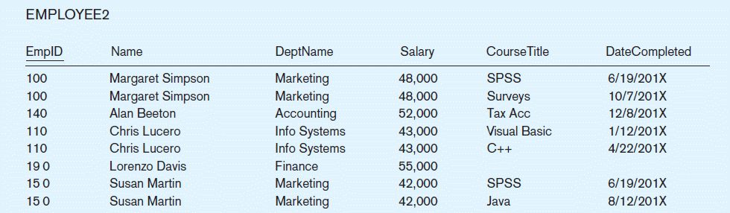
Well-Structured Relations
A relation that contains minimal data redundancy and allows users to insert, delete, and update rows without causing data inconsistencies
Goal is to avoid (minimize) anomalies
Insertion Anomaly – adding new rows forces user to create duplicate data
Deletion Anomaly – deleting a row may cause loss of other data representing completely different facts
Modification Anomaly – changing data in a row forces changes to other rows because of duplication
General rule of thumb: a table should not pertain to more than one entity type
3
Example – Figure 4.2b
Question – Is this a relation?
Answer – Yes: unique rows and no multivalued attributes
Question – What’s the primary key?
Answer – Composite: EmpID, CourseTitle
4

Slide 3
Anomalies in this Table
Insertion – can’t enter a new employee without having the employee take a class
Deletion – if we remove employee 140, we lose information about the existence of a Tax Acc class
Modification – giving a salary increase to employee 100 forces us to update multiple records
Why do these anomalies exist?
Because there are two themes (entity types – what are they?) in this one relation (two themes, entity types, were combined). This results in duplication, and an unnecessary dependency between the entities
5
Figure: 4-22 Steps in Normalization
Table with Multivalued attributes
First normal form (1NF)
Second normal form(2NF)
Third normal form (3NF)
Boyce-Codd normal form (BC-NF)
Fourth normal Form (4NF)
Fifth normal form (5NF)
Remove Multivalued Attributes
6

Slide 4
First Normal Form (1NF)
Only atomic attributes (simple, single-value)
A primary key has been identified
Every relation is in 1NF by definition
1NF example:
Student
StudentId | StuName | CourseId | CourseName | Grade
100 | Mike | 112 | C++ | A
100 | Mike | 111 | Java | B
101 | Susan | 222 | Database | A
140 | Lorenzo | 224 | Graphics | B
7
Figure: 4-22 Steps in Normalization
Table with Multivalued attributes
First normal form (1NF)
Second normal form(2NF)
Third normal form (3NF)
Boyce-Codd normal form (BC-NF)
Fourth normal Form (4NF)
Fifth normal form (5NF)
Remove Multivalued Attributes
Remove Partial Dependencies
8

Slide 5
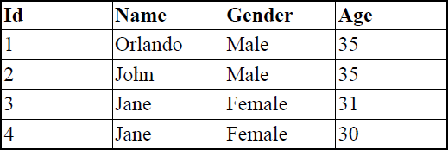

Functional Dependencies
Functional Dependency: The value of one attribute (the
determinant) determines the value of another attribute.
A→→B reads “Attribute B is functionally dependent on A”
A→→B means if two rows have same value of A they necessarily have same value of B
FDs are determined by semantics: You can’t say that a FD exists just by looking at data. But can say whether it does not exist by looking at data.
9
Quick Check
Id →→ Name?
Age →→ Gender?
Name →→ Id?
Name, Age →→ Id?
10

Slide 6
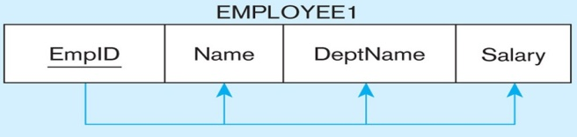

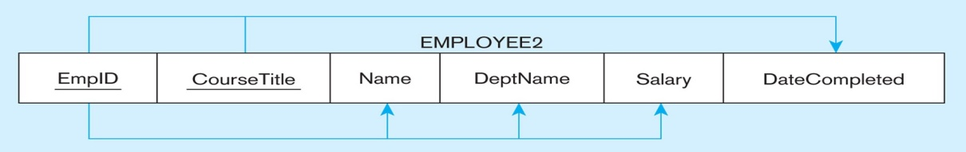

Functional Dependencies and Keys
Functional Dependency: The value of one attribute (the
determinant) determines the value of another attribute.
Candidate Key
Attribute that uniquely identifies a row in a relation
Could be a combination of (non-redundant) attributes
Each non-key field is functionally dependent on every candidate key
12
Figure 4-23: Representing Functional Dependencies (cont.)
EmpID →→
EmpID, CourseTitle →→
13

Slide 7


Second Normal Form (2NF)
1NF PLUS every non-key attribute is fully functionally dependent on the ENTIRE primary key
Every non-key attribute must be defined by the entire key, not by only part of the key
No partial functional dependencies
16
Functional Dependencies in Student
StudentId
StuName
CourseId
CourseName
Grade
Can represent FDs with arrows as above, or
StudentId →→StuName,
CourseId →→ CourseName
StudentId,CourseId →→ Grade (and StuName, CourseName)
Any partial FDs ?
17

Slide 8


Functional Dependencies in Student
StudentId
StuName
CourseId
CourseName
Grade
Can represent FDs with arrows as above, or
StudentId →→StuName,
CourseId →→ CourseName
StudentId,CourseId →→ Grade (and StuName, CourseName)
Therefore, NOT in 2nd Normal Form!!
18
2NF: Normalizing
How do we convert the partial dependencies into normal ones ? By breaking into more tables.
StudentId
StuName
CourseId
CourseName
Grade
Becomes … (notice above arrows mean functional dependency, below they mean FK constraints)
StudentId
StuName
CourseId
CourseName
StudentId | CourseId | Grade
19

Slide 9


You Try …
SeriesId | EpisodeId | SeriesTitle | EpisodeTitle | AiringDate
List all FDs
Eliminate partial FDs, if any
20
Figure: 4-22 Steps in Normalization
Table with Multivalued
attributes
Remove Multivalued Attributes
First normal form (1NF)
Second normal form(2NF)
Remove Partial Dependencies
Third normal form (3NF)
Remove Transitive Dependencies
Boyce-Codd normal form (BC-NF)
Fourth normal Form (4NF)
Fifth normal form (5NF)
22

Slide 10


Third Normal Form
2NF and no transitive dependencies
A transitive dependency is when a non-key attribute depends on another non-key attribute
Note: This is called transitive, because the primary key is a determinant for another attribute, which in turn is a determinant for a third attribute
23
3NF Example
Course | SectNum | Classroom |  | Capacity
Classroom →→ Capacity
Any partial FDs?
Any transitive FDs?
How do we eliminate it?
TRANSITIVE NO
YES !
By breaking into its own table
25

Slide 11


3NF Normalization
Course | SectNum | Classroom
Classroom
Capacity
27
You Try …
StudentId | ProgramId | StudentName | ProgramName
Partial FDs? Eliminate, if any.
Transitive FDs? Eliminate, if any.
28

Slide 12


Figure: 4-22 Steps in Normalization
Table with Multivalued
attributes
Remove Multivalued Attributes
First normal form (1NF)
Second normal form(2NF)
Remove Partial Dependencies
Third normal form (3NF)
Remove Transitive Dependencies
Remove remaining anomalies resulting from multiple candidate keys
Boyce-Codd normal form (BC-NF)
Fourth normal Form (4NF)
Fifth normal form (5NF)
33
Further Normalization
Boyce-Codd Normal form (BCNF)
Slight difference with 3NF
To be in 3NF but not in BNF, needs two composite candidate keys, with one attribute of one key depending on one attribute of the other
Not very common ☺☺
If a table contains only one candidate key, the 3NF and the BCNF are equivalent.
Fourth Normal Form (4NF)
To break it, need to have multivalued dependencies, a generalization of functional dependencies
Usually, if you’re in 3NF you’re in BCNF, 4NF, …
34

Slide 13


BCNF Example
Assume that
For each subject, each student is taught by one Instructor
Each Instructor teaches only one subject
Each subject is taught by several Instructors
Course, Student →→ Instructor
Instructor →→ Course
Course Instructor Student
CS 121 | Dr. A. James | Bill Payne
CS 121 | Dr. A. James | Tony Perez
CS 121 | Dr. A. James | James Atkinson
CS 121 | Dr. A. James | Linda Lee
Course Instructor Student
CS 141 | Dr. T. Watson | Linda Lee
CS 141 | Dr. T. Watson | Judith San
CS 141 | Dr. T. Watson | Bill Jones
CS 141 | Dr. P. Hold | Bill Payne
CS 141 | Dr. P. Hold | A. White
Course Instructor Student
CS 101 | Dr. M. Jones | Linda Lee
CS 101 | Dr. M. Jones | Tony Perez
CS 101 | Dr. M. Jones | Bill Payne
BCNF: Decompose into (Instructor, Course) and (Student, Instructor)
35
BCNF
Boyce-Codd normal form (BCNF)
A relation is in BCNF, if and only if, every determinant is a candidate key.
The difference between 3NF and BCNF is that for a functional dependency A →→ B, 3NF allows this dependency in a relation if B is a primary-key attribute and A is not a candidate key,
whereas BCNF insists that for this dependency to remain in a relation, A must be a candidate key.
36

Slide 14


Figure: 4-22 Steps in Normalization
Table with Multivalued
attributes
Remove Multivalued Attributes
First normal form (1NF)
Second normal form(2NF)
Remove Partial Dependencies
Remove …
Third normal form (3NF)
Boyce-Codd normal form (BC-NF)
Remove remaining anomalies resulting from multiple candidate keys
Fourth normal Form (4NF)
Remove Multivalued Dependencies
Fifth normal form (5NF)
37
4NF
A multi-valued dependency exists when
There are at least 3 attributes A, B, C in a relation and
For each value of A there is a well defined set of values for B, and a well defined set of values for C,
But the set of values for B is independent on the set of values for C
4NF = 3NF with no multi-valued dependency
38

Slide 15


4NF Example
Assume that
Each subject is taught by many Instructors
The same books are used in many subjects
Each Instructor uses a different book
Course, Instructor →→ Text
Course, Text →→ Instructor
Course | Instructor | Text
CS 121 | Dr. A. James | Int to Com Science
CS 121 | Dr. P. Hold | Comp Scien Int
Course Instructor Text
CS 141 | Dr. T. Watson | Int to Com Science
CS 141 | Dr. P. Hold | Comp Scien Int
CS 101 | Dr. M. Jones | COMP SCIEN
4NF: Decompose into (Course, Instructor) and (Course, Text)
39
40

Slide 16
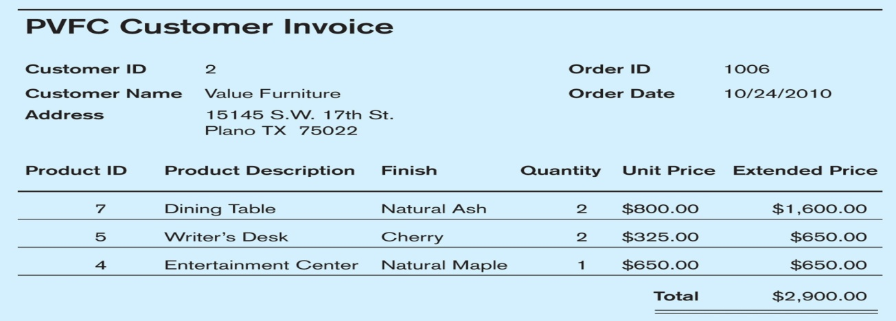

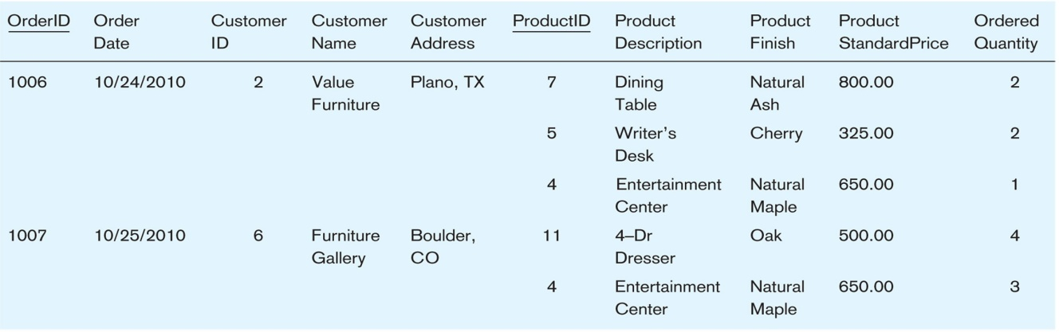

The Normalization Example in the Text Book
Figure 4-24 INVOICE (Pine Valley Furniture Company)
41
Figure 4-25 INVOICE Data
Table with multivalued attributes, not in 1st normal form
Note: this is NOT a relation. WHY?
42

Slide 17
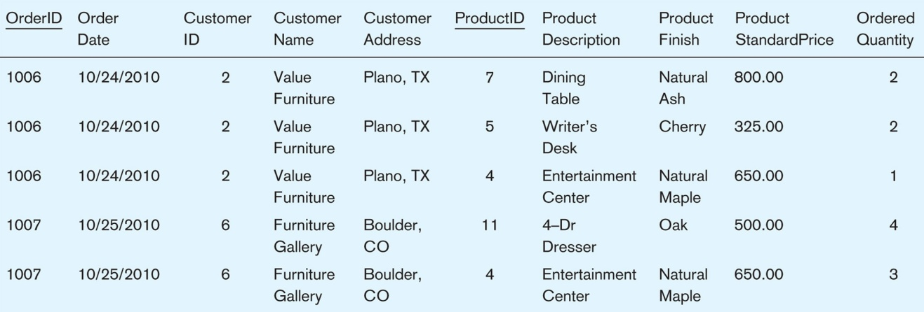


Figure 4-26 INVOICE relation (1NF)
Table with no multivalued attributes and unique rows
Note: this is relation, but not a well-structured one. WHY?
43
Anomalies in this Table
Insertion–if new product is ordered for order 1007 of existing customer, customer data must be re-entered, causing duplication
Deletion–if we delete the Dining Table from Order 1006, we lose information concerning this item's finish and price
Update–changing the price of product ID 4 requires update in several records
44

Slide 18
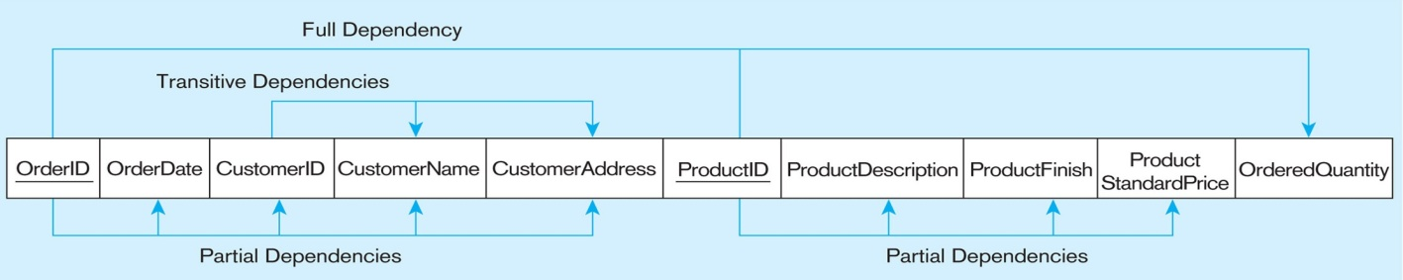

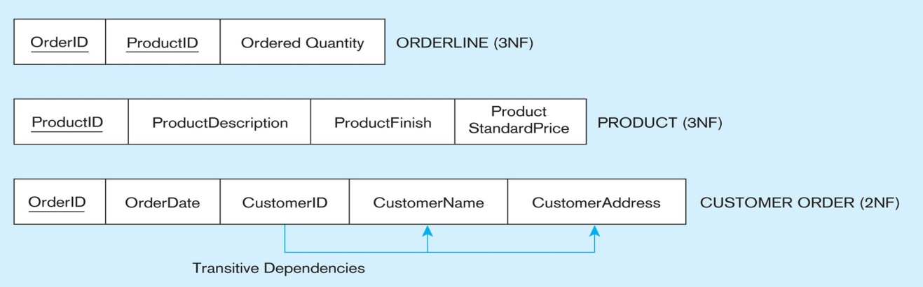

Figure 4-27 Functional dependency diagram for INVOICE
Order_ID ➔➔ Order_Date, Customer_ID, Customer_Name, Customer_Address Customer_ID ➔➔ Customer_Name, Customer_Address
Product_ID ➔➔ Product_Description, Product_Finish, Unit_Price Order_ID, Product_ID ➔➔ Order_Quantity
Therefore, NOT in 2nd Normal Form
45
Figure 4-28 Partial Dependencies were Removed (2NF)
2NF
Partial dependencies are removed, but there are still transitive dependencies
46

Slide 19
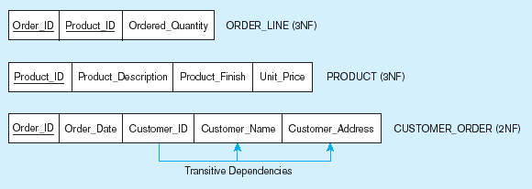
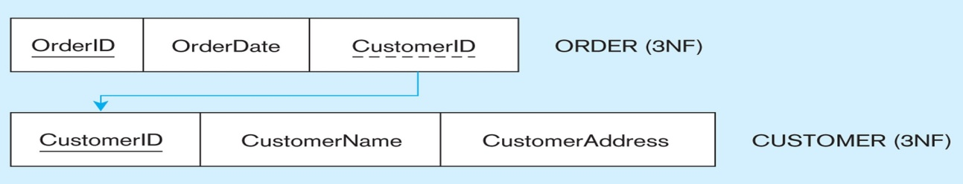

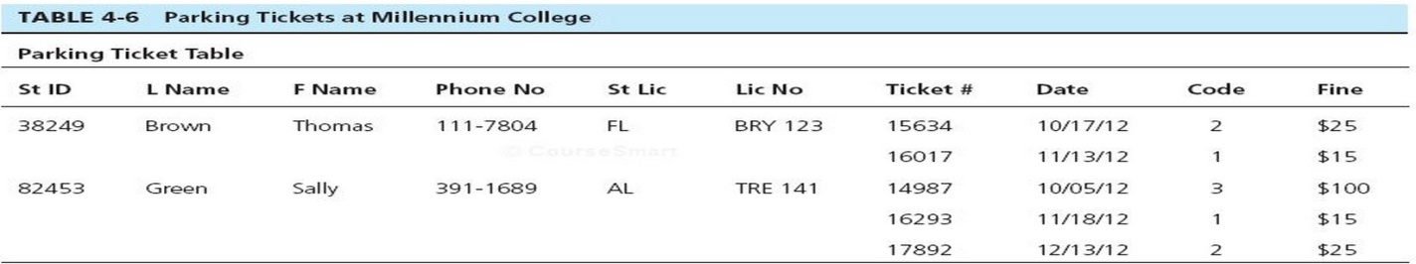

Figure 4-29 Transitive Dependencies were Removed (3NF)
Two Relations Remain
Getting it into Third Normal Form
3NF
47
You Try …
Convert to 1NF Relation
Draw dependency diagram showing all functional dependencies
Identify anomalies
Convert to 3NF Relations
Develop EER Diagram with appropriate cardinalities
48

Slide 20



49
Logical Database Design
You have just learned and completed one of the most important concepts and theories, integrity constraints and normalization, for developing a quality of database.
50

Slide 21







After learning one of most important database concepts and theories...
WHAT’S NEXT ?
51
Steps of Database Development
…
…
User view-1 User view-2
User view-3
User view-N
User interview &
…
Integrated Model
Conceptual Schema (Model)
Logical Model
(ERD or E/ERD)
(Six) Relations Transformation
(more relations produced)
NORMALIZATION (up to 3NF)
(more tables created)
IMPLEMENTATION
52

