Slide 1



SPRINGDALE ENGLISH BOARDING SCHOOL
AI-Powered Academic
Workflow Platform
Continuous Assessment, automated — for Grades 1 to 5
Same paper-register scoring teachers already know
GPA · WGPA · Percentage calculated automatically
AI reads a photographed ledger page
Presented to school leadership · by the developer who built it

Slide 2
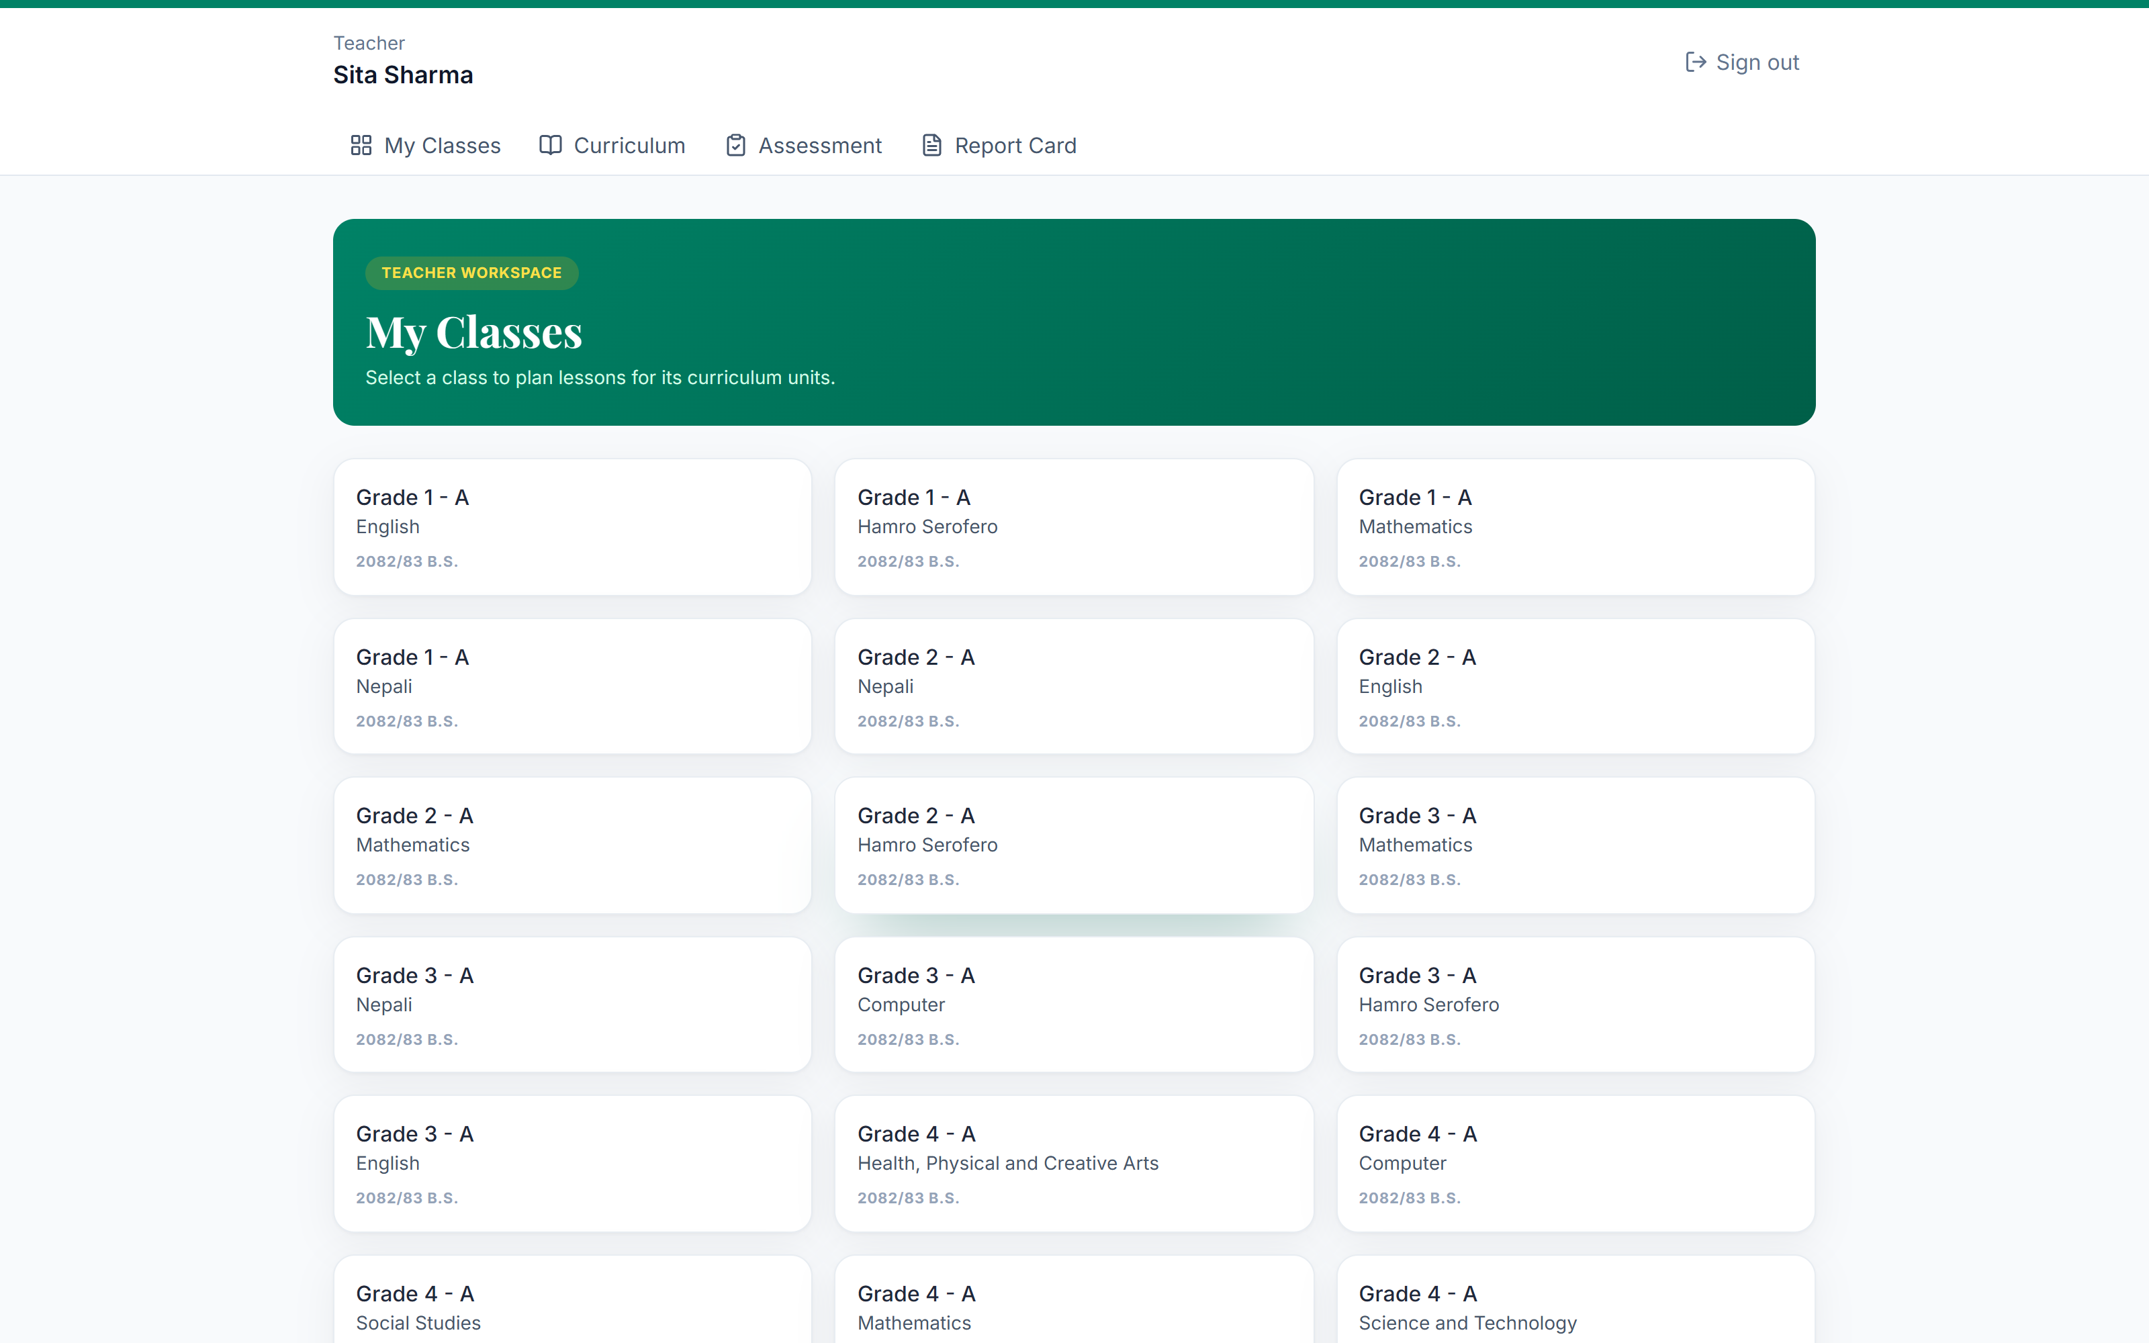
Before I explain it — here it is, running.
Every screenshot in this deck from here on is the live product I built — not a mockup, not a wireframe.
My own teacher login, my own class list — this is what a teacher sees the moment they sign in.

Slide 3



THE PROBLEM TODAY
Marks day still means a stack of paper
and a calculator
100s
Every report card is recalculated by hand — subject by subject, student by student, term after term.
of manual calculations behind a single term's report cards
One arithmetic slip quietly changes a GPA, and there's no easy way to catch it.
The only copy of a term's marks is the physical register itself — no backup, no search, no history.
5 grades × 7 subjects × 4 skill areas × every student
Springdale English Boarding School · Academic Workflow Platform
3

Slide 4


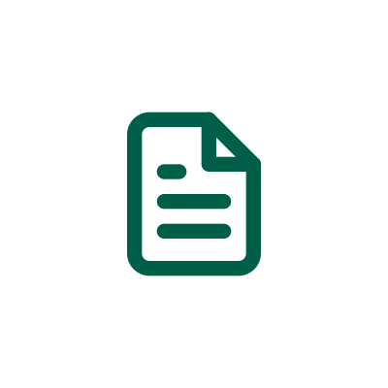


I digitized the register
without changing how teachers work.
Same 1–4 scoring scale. Same formula. Everything after that is automatic.

Slide 5


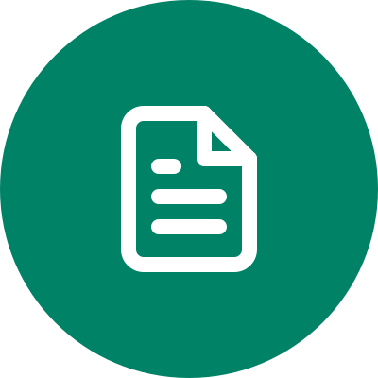


THE CORE PIPELINE
One pipeline, start to finish
1. Marks Entry
2. Auto-Calculate
3. Report Card
4. Done
Teacher scores each student 1–4 per skill area — exactly like the paper register.
GPA, WGPA and Percentage computed instantly. Zero manual math, zero spreadsheets.
Every subject rolls up into one clear summary, per student, in real time.
Ready to review and share — no calculator, no re-typing, no waiting.
I verified this line-by-line against the school's own photographed register — the formula and grade scale match exactly.
Springdale English Boarding School · Academic Workflow Platform
5

Slide 6
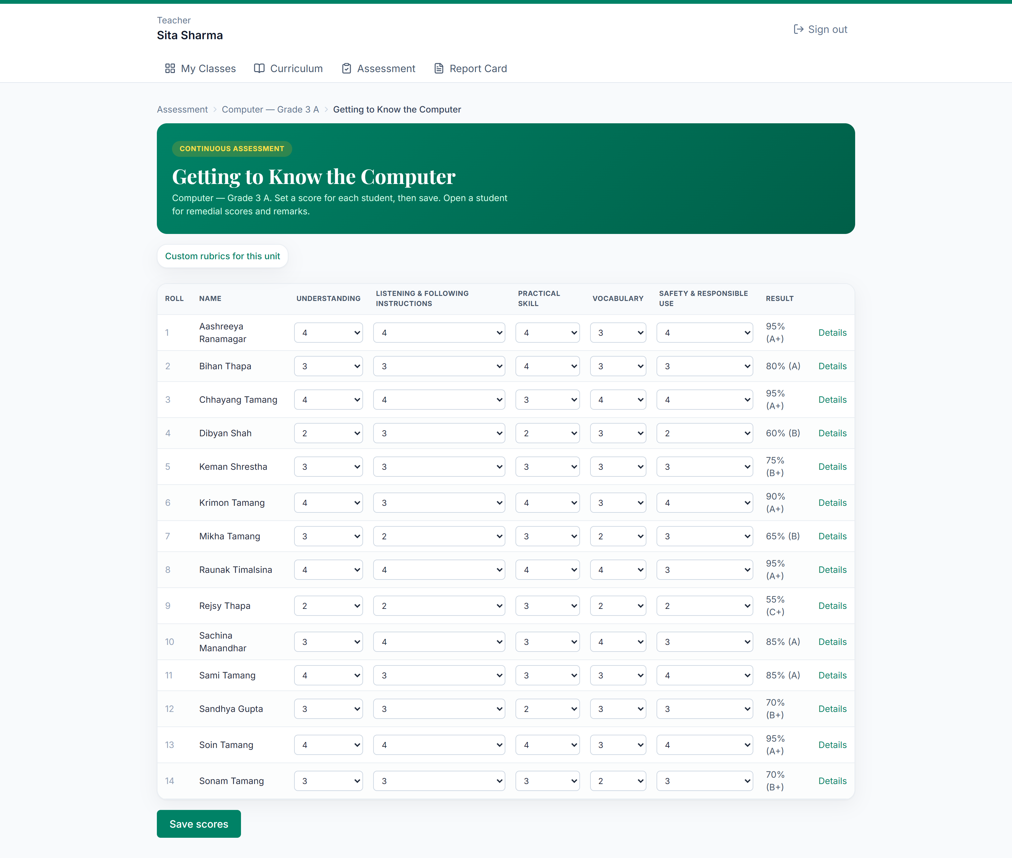

FAMILIAR BY DESIGN
Feels exactly like the paper
register teachers already use
Same 1–4 achievement scale, nothing new to learn
Same formula: % = (sum of scores) ÷ (4 × rows) × 100
Verified grade scale, 90%+ = A+ down to below 35% = NG
No retraining required for teachers or staff
This is a real class — I scored it myself in the app to prepare for this demo.
Springdale English Boarding School · Academic Workflow Platform
6

Slide 7
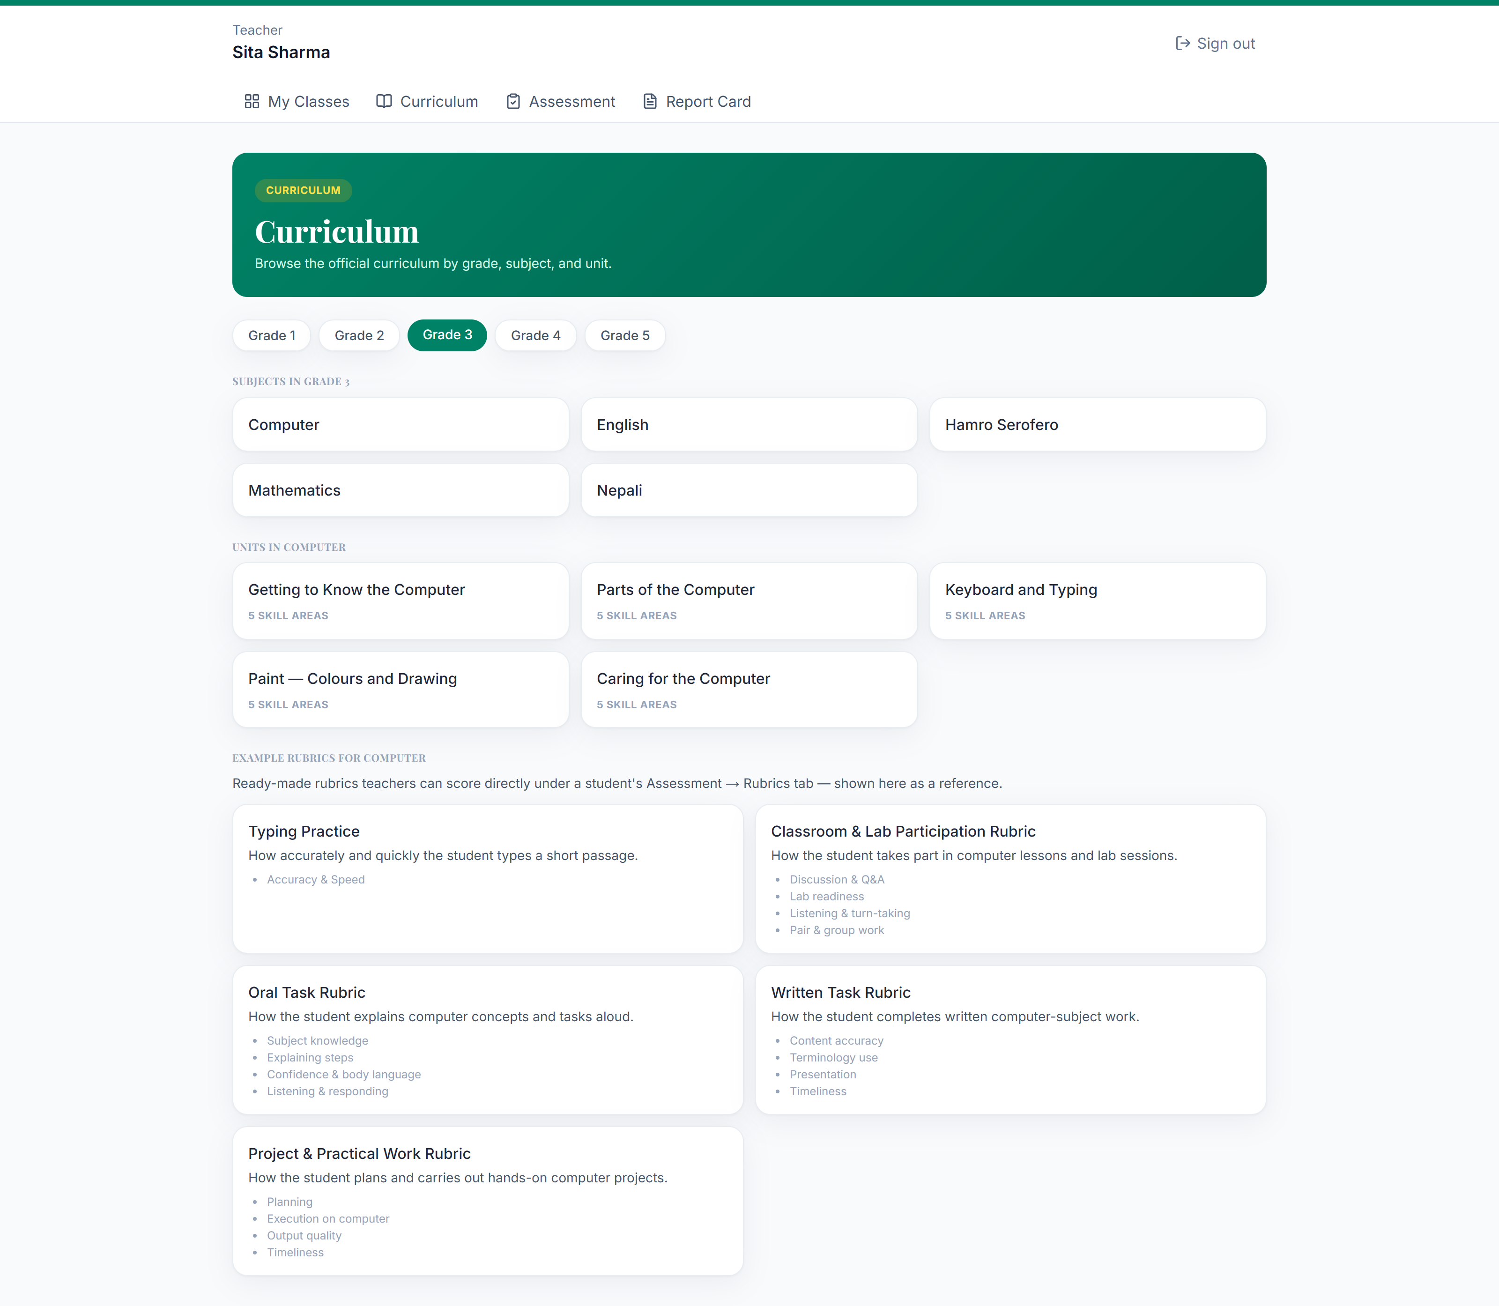
CURRICULUM & RUBRICS
A full curriculum library,
with rubrics already built in
7 subjects, 5 grade levels, 4+ curriculum units each
Nepali, Social Studies and Hamro Serofero taught in Devanagari — the rest in English
4 standard rubrics per subject, transcribed verbatim from the school's own rubric booklet
Teachers can also add a custom rubric for any unit
Springdale English Boarding School · Academic Workflow Platform
7

Slide 8
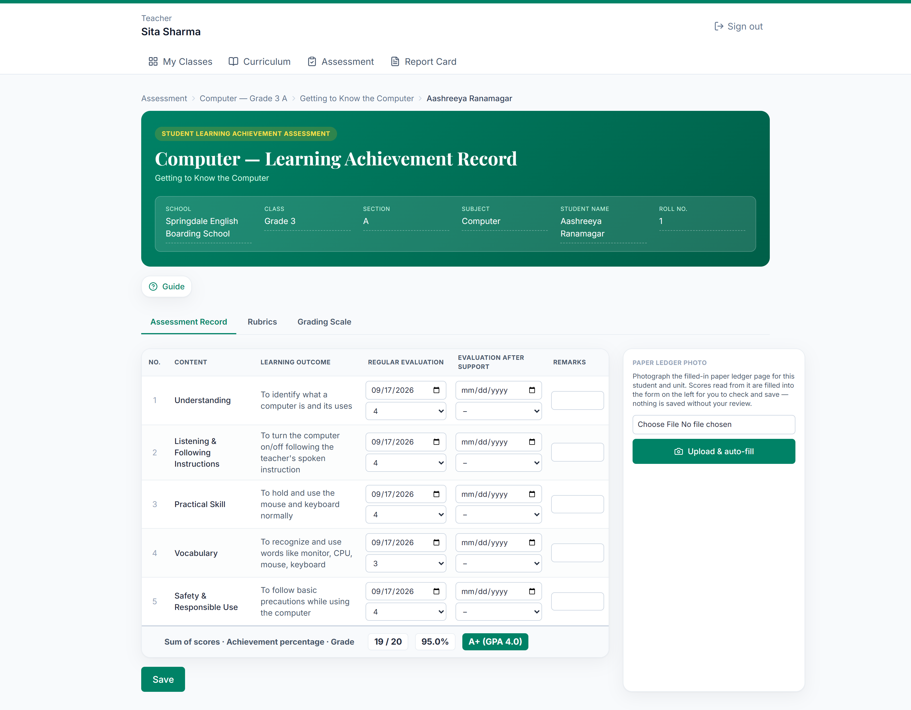
WHERE AI ACTUALLY HELPS
AI does the tedious part —
I keep the judgment calls
Computer-Vision Ledger Ingestion
I photograph the filled-in paper register page. Gemini vision reads every cell and skips any it can't read clearly, rather than guessing — the scores auto-fill the form for me to review before saving.
AI Lesson Planning
From any curriculum unit, I can generate a grade- and subject-appropriate lesson plan in seconds — not a free evening.
I tested the ledger scan against real Gemini vision calls — accurate on independent test images, including mixed regular/after-support marks.
The actual assessment page — the paper ledger panel is on the right of the form.
Springdale English Boarding School · Academic Workflow Platform
8

Slide 9
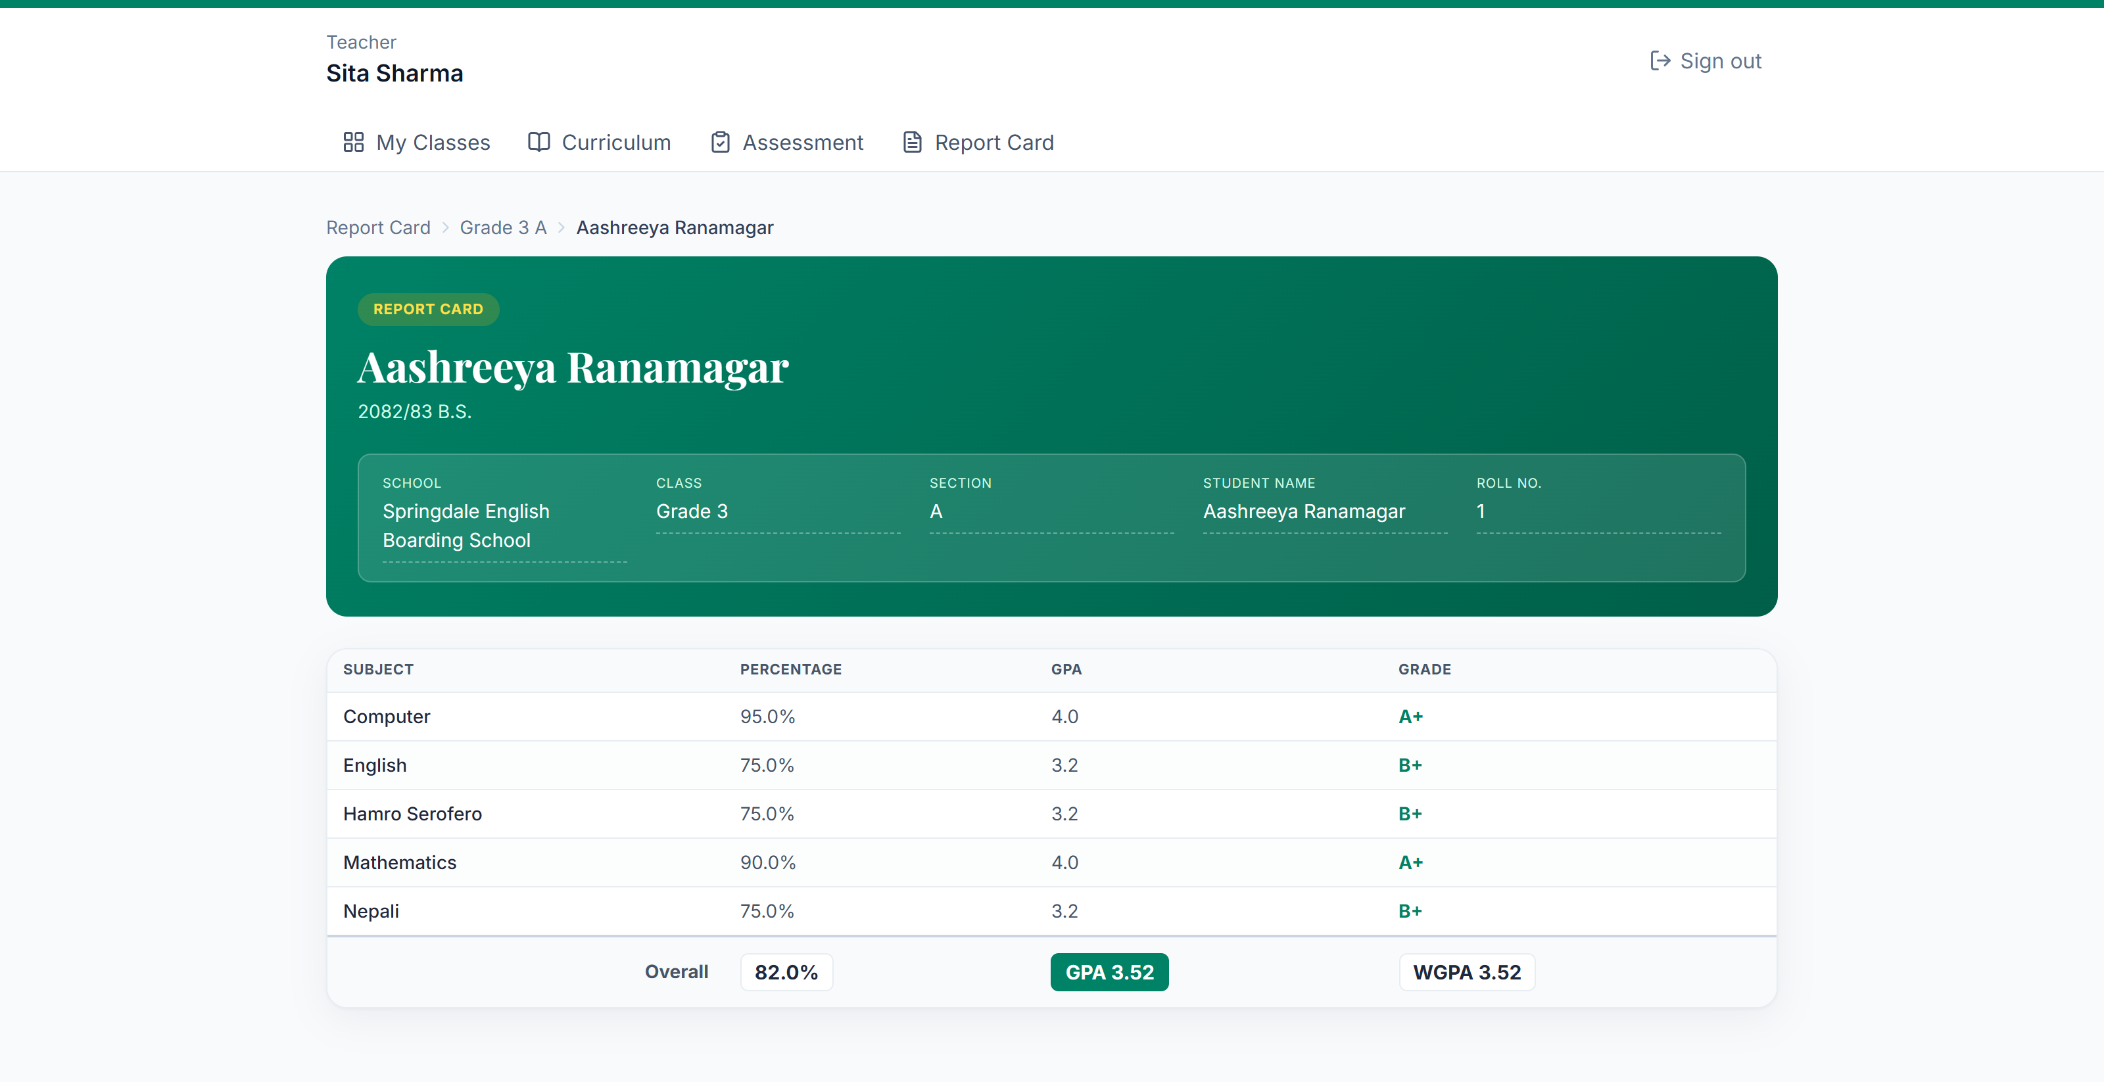
EVERY SUBJECT, ONE PICTURE
The report card builds itself
GPA
WGPA
Percentage
Average of every subject's GPA across the curriculum.
Same average, weighted by each subject's credit weight.
Average of every subject's percentage score.
This student's actual report card, right now — I entered real scores across all five subjects to prepare for today.
Springdale English Boarding School · Academic Workflow Platform
9

Slide 10




BUILT TO BE TRUSTED
I reviewed this like it's going
live — because it will be
Full security audit
Locked-down access
I re-verified, on the server, every action that touches another user's data — not just trusted the screen.
Passwords are hashed; every admin and teacher route is gated by role-aware checks.
Clean production build
Fixed, not just flagged
A fresh build and lint pass with zero blocking errors.
Every issue I found in this review, I fixed and re-verified live in the same session.
Springdale English Boarding School · Academic Workflow Platform
10

Slide 11


MY HONEST VERDICT
Ready to demo. Here's what I still
need before it goes live.
READY TODAY
BEFORE REAL STUDENTS
•
Marks entry → GPA/WGPA/Percentage → report card, working end-to-end
•
Real hosting and automated database backups
•
Rubrics, custom rubrics, and CV ledger scanning all tested live
•
A teacher's sign-off on the curriculum content
•
Full security review completed, findings fixed
•
Printable / PDF report cards
•
Clean production build
•
Real Grade 1–5 rosters loaded in, replacing demo data
Springdale English Boarding School · Academic Workflow Platform
11

Slide 12





THE PATH TO LIVE
From demo to live, in five steps
1
2
3
4
5
Deploy & Back Up
Curriculum Sign-Off
Printable Report Cards
Real Rosters
Go Live
Real hosting, HTTPS, automated database backups
A teacher reviews and approves the seeded content
PDF export, ready to hand to a parent
Actual Grade 1–5 students replace demo data
Real teachers, real terms, real report cards
Springdale English Boarding School · Academic Workflow Platform
12

Slide 13

I built it. I tested it.
Ready to show you.
Let me walk you through it live — then let's talk about what it takes to go live for every classroom.
Springdale English Boarding School · Academic Workflow Platform

