Slide 1



Internship Experience — Maple Capital Advisors
Investment Banking Intern | June 2025 – July 2025
Bhadresh Mohanty
2022umt1218

Slide 2
About Maple Capital Advisors:
Boutique investment bank headquartered in New Delhi
Specializes in Mergers & Acquisitions, Private Equity & Venture Capital, Structured & Leveraged Finance, and Capital Markets Advisory
Expertise in India-oriented cross-border transactions and London AIM listings
Core sectors: B2B Tech, Consumer, Agritech, Renewable Energy

Slide 3
Vision & Mission
Vision: “Engaging to Create Value” for clients through professional entrepreneurship
Mission: Deliver seamless, end-to-end advisory solutions from concept to closure
Core Values :
Integrity & Transparency
Global Perspective with Local Expertise

Slide 4
Service Offerings
M&A Advisory: Buy-side & Sell-side, valuation, due diligence, strategic consulting
Private Equity & Venture Capital: Fundraising & investor connect
Structured / Leveraged Finance: Term loans, mezzanine, convertible debt
Capital Markets Advisory: AIM listings, preferential allotments
Accelerator Program: Scaling asset-light startups with mentoring & investment

Slide 5
Internship Overview
Duration: 2 months (June – July 2025)
Role: Investment Banking Intern
Mode: Hybrid (Office + Remote)
Primary Teams: M&A and Capital Markets Advisory

Slide 6
Key Responsibilities
Conducted market & sector research for B2B Tech and Consumer sectors
Built preliminary valuation models: DCF, Comparable Company Analysis, Precedent Transactions
Assisted in pitch deck preparation for client meetings
Supported due diligence and compliance documentation processes
Researched AIM listing regulations for potential cross-border clients

Slide 7
Major Contributions
Developed 15-page industry report on Agritech & Consumer sectors for buy-side deal analysis
Created Excel-based financial model used in client valuation discussions
Designed target screening templates → reduced research time by 20%
Prepared investment memos for 3 shortlisted startups under the Accelerator Program

Slide 8
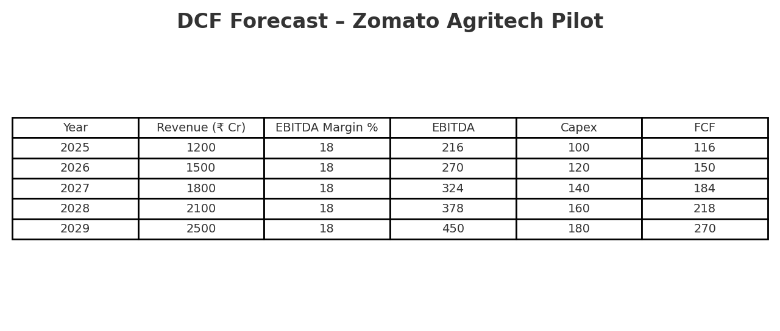
My projects: 1)mergers case study ii)industry research reports:

Slide 9
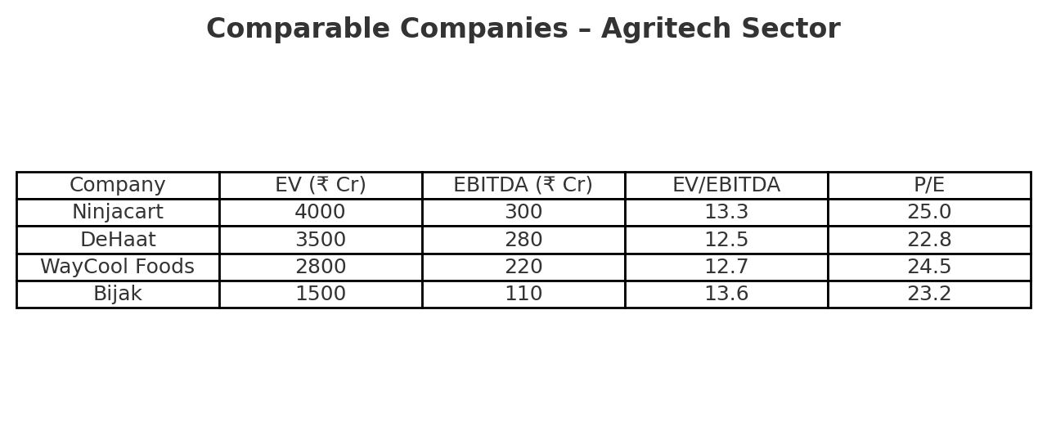
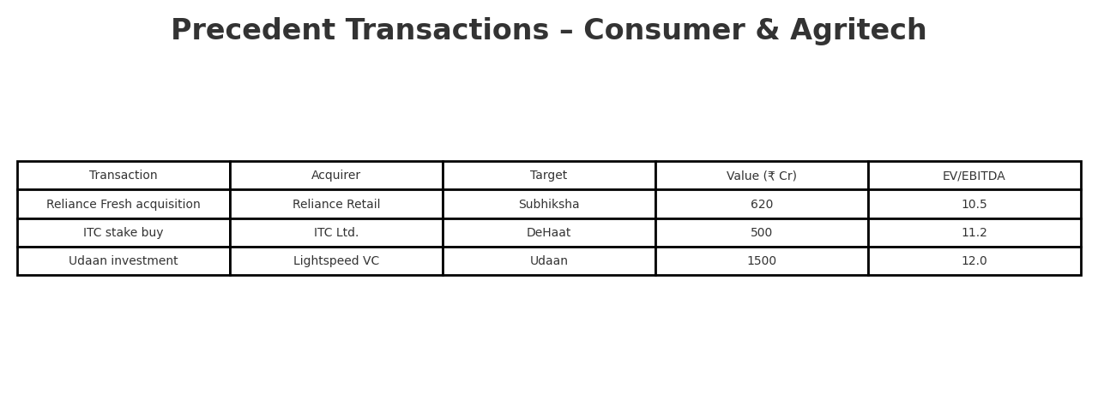

Slide 10
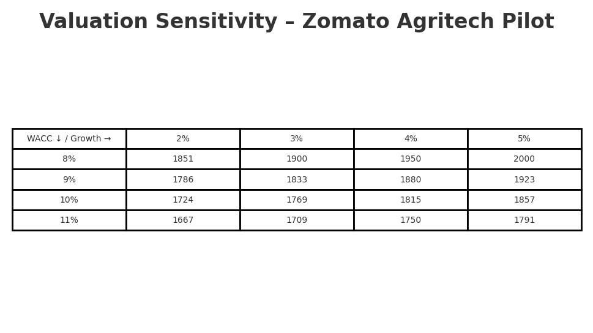
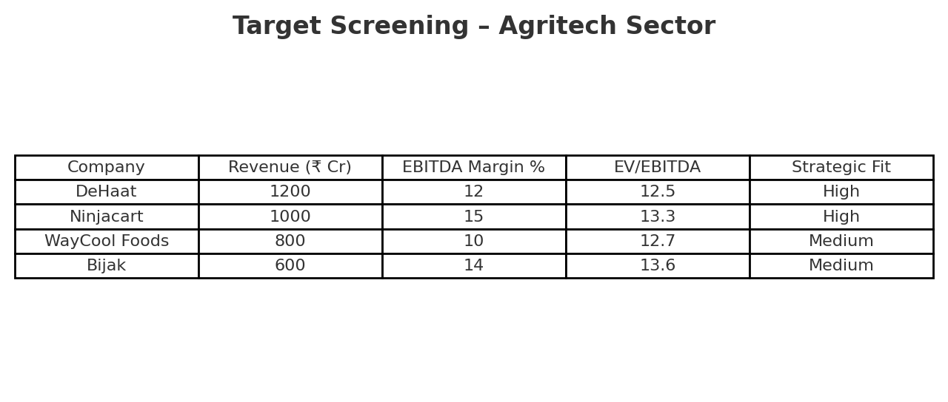

Slide 11
Learning Outcomes
Gained in-depth understanding of the M&A lifecycle from deal origination to closure
Enhanced skills in financial modelling and valuation techniques
Strengthened presentation and client communication skills
Exposure to cross-border transaction advisory processes

Slide 12
Challenges & Solutions
Tight research deadlines → Created standardized templates for data collection
Limited AIM listing knowledge → Self-studied regulations & prepared internal guide
Task prioritization issues → Implemented personal project tracking methods

Slide 13
Conclusion & Acknowledgment
Valuable exposure to real-world investment banking projects
Applied academic finance knowledge in practical transaction contexts
Developed multi-sector research expertise and deal execution understanding
Grateful to mentors & the Maple Capital Advisors team for guidance and support

Slide 14
