Slide 1

CONTACT-FORM
Under the esteemed guidance of
T.SANTHOSHA
Assistant Professor
DEPARTMENT OF COMPUTER ENGINEERING
INDUR INSTITUTE OF ENGINEERING AND
TECHNOLOGY PONNALA(V), SIDDIPET, SIDDIPET(DIST)- 502103
2021-2022

Slide 2
contents
1. Abstract
2. Introduction
3. Existing System
3.1 Disadvantages
4. Proposed System
4.1 Advantages
5. Hardware Requirements
6. Software Requirements

Slide 3
7. Implementation
7.1 Module description
8. Sample screens
9. Conclusion

Slide 4
Abstract
Contact Form using HTML, CSS, JavaScript makes the wep page look satisfied whenever a user or a customer experiences
And PHP makes the web page to work efficiently when a user/customer tries to contact the owner of that web page using the designed Contact form
Any visitor can fill out the form and submit it to send a message to the site owner
Behind the scenes your contact form trigger an email message.

Slide 5
Introduction
A contact form gives your visitors an easy way to send you a message right from your website
If you want your customers to communicate with you or your business,use this contact form
It is easy way to direct contact with admin of the web page
This software is designed in visual studio editor
This software is highly programmed in PHP HTML JAVA SCRIPT technology

Slide 6
Existing system
In the existing system, all the records are not kept perfectly because all the work is done manually
existing system is very time consuming and being manual took sometimes lead to great loss.
Disadvantages
For contact the admin the user must visit the web page
without filling the subject box also the mail will send to the admin/owner

Slide 7
Proposed System
The proposed system is highly automated and makes the user access the web site or system much easier and flexible
The user can get very right way access
Advantages
Protect your inbox from spam
keep track of your messages
Simple for your customers

Slide 8
Having a clean and clear contact from makes your Website look more efficiently
Get the information you needed

Slide 9
Hardware Requirements
The selection of hardware is very important in the existence and proper working of any software. In the selection of hardware, the size and the capacity requirements are also important
Processor : Pentium
Hard disk : 250 GB or above
Monitor : 15VGA colour
Mouse : Logitech
Ram : 2GB or above

Slide 10
Software requirements
The software requirements specification is produces at the culmination of the analysis tasks
One of the most difficult tasks is that, the selection of the software, once system requirement is known by determining whether a particular software package fits the requirements
Operating System : Windows
Front End : WD,MAD
Script : HTML,PHP,CSS,JAVA

Slide 11
Implementation
Modules description
Index.html
Message.php
Style.css
Java script

Slide 12
Index.html
Here HTML is used to create the skeleton of the contact form/web page like the input fields and submit button layout
Message.php
And PHP Makes the web page to work efficiently when a user/customer tries to contact the owner of that web page using the designed Contact form.
Style.css
And CSS is used to add colorings and design to the HTML Page which ultimately results in the beautiful appearance of the web page/contact form

Slide 13
Java script
JavaScript Makes the webpage look satisfied whenever a user or a customer experiences.

Slide 14
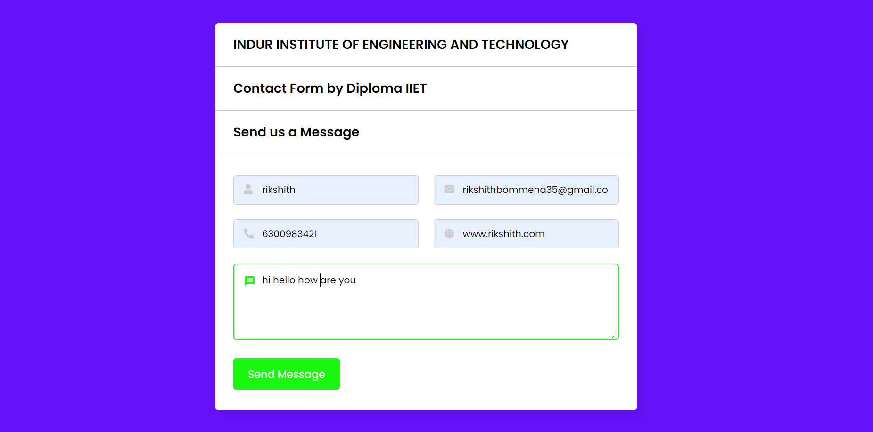
Sample screens After filling the required details click on send message it shows message send successfully

Slide 15
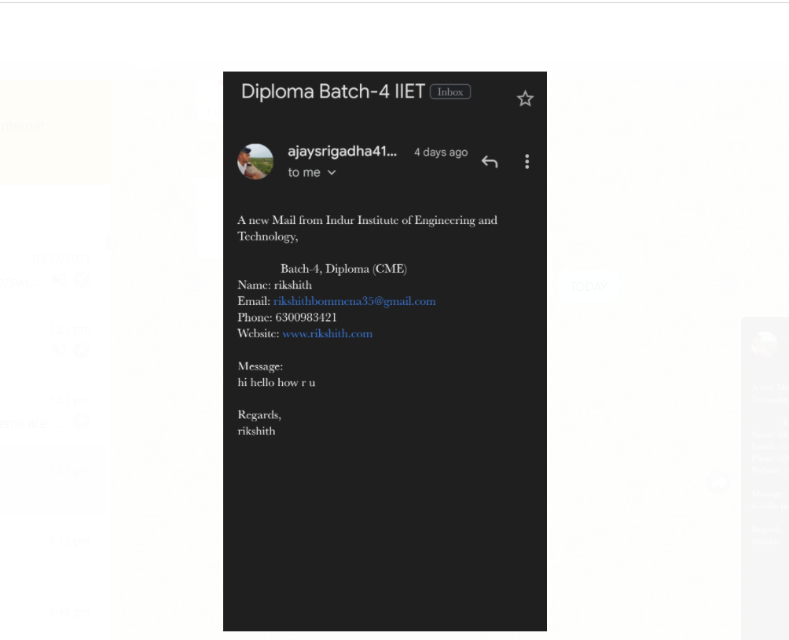
This is an demo of the output the admin gets the mail message about the customer doubts/queries

Slide 16
Conclusion
This contact form As you can see with possibilities are endless. By adding contact forms to your website, you can ensure a lot of positive impacts.
Prominently, a simple form can help you get more customer satisfaction and a better user experience. The following reasons are worth mentioning again

