Slide 1
ARMY BURN HALL COLLEGE
ASSESSMENT CONFERENCE
overall batch performance & academic diagnostics
Bhadur Ali Computer Science
02/06/2026

Slide 2
TABLE OF CONTENTS
01 | Executive Summary
(Highlighting the overall 9th-grade pass rate and term health)
02 | Section-by-Section Comparison
(Identifying the top-performing and struggling classes)
03 | Subject-wise Deep Dive
(Analyzing department strengths and minimum score gaps)
04 | House Performance Breakdown
(Direct comparison of SIS, SAS, STS, and SSS)
05 | Live Interactive Q&A
(Real-time student lookup and specific academic reviews

Slide 3
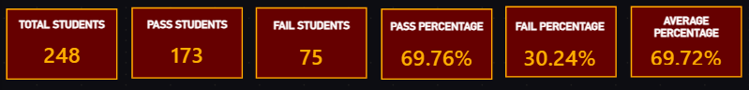
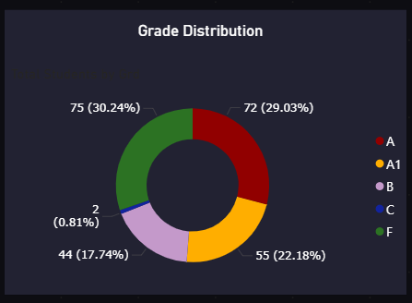
EXECUTIVE SUMMARY: 1ST TERM 2026
KEY BATCH INSIGHTS:
Overall term standing is stable with a 69.76% passing rate.
Strong top-tier performance: 51.21% of the batch secured A1 or A grades.
75 students currently require immediate academic intervention and support.

Slide 4
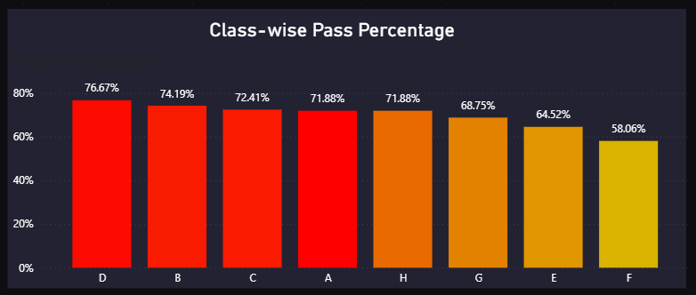
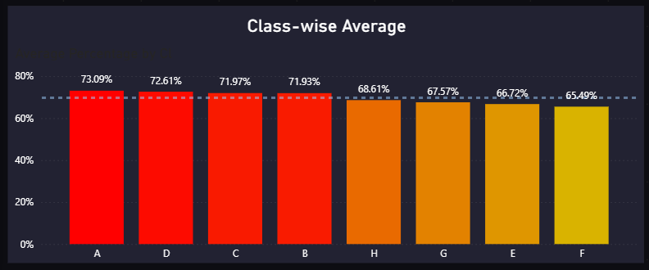
SECTION-BY-SECTION COMPARISON
HIGHEST ACHIEVEMENT:
Section D leads with a 73.09% pass rate.
TARGET FOR IMPROVEMENT:
Sections E and F show a higher concentration of academic gaps requiring focus.

Slide 5
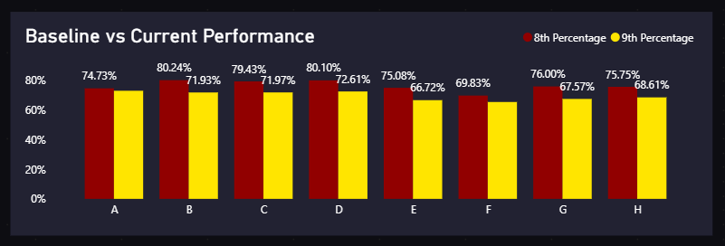
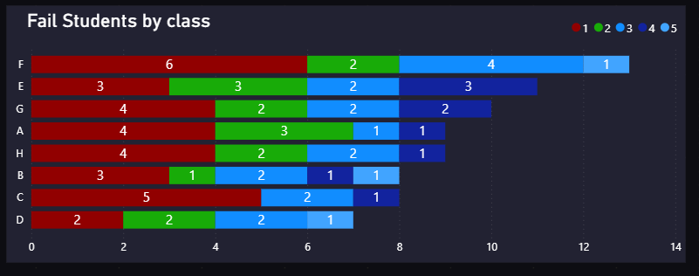
ACADEMIC GROWTH & TARGETED INTERVENTION
TREND ANALYSIS:
Tracking current 9th-grade performance against historical 8th-grade baselines. The result clearly indicate that result have been dropped.
INTERVENTION PRIORITY:
Isolating the density of failing subjects per section to deploy targeted remedial support. So, it is quite clear that Section E, F, G require constant supervision

Slide 6
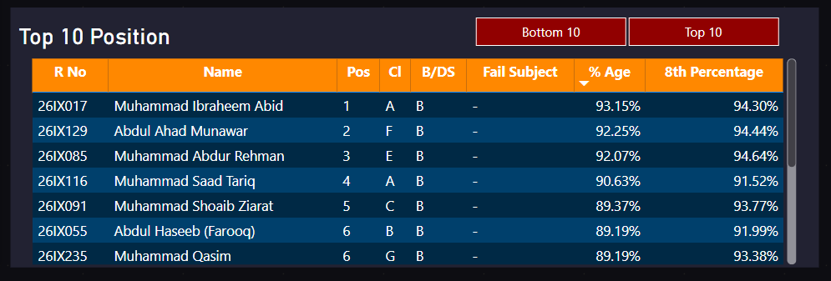
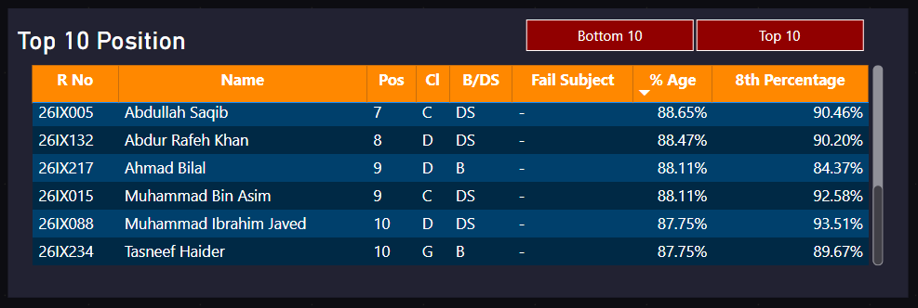
TOP PERFORMERS & GRADE DISTRIBUTION
TERM 1 LEADER:
Muhammad Ibraheem Abid secured the first position with 93.15%.
Quality Benchmarks:
Distinct concentrations of A1 and A grades established across all sections, setting the target baseline for Term 2.

Slide 7
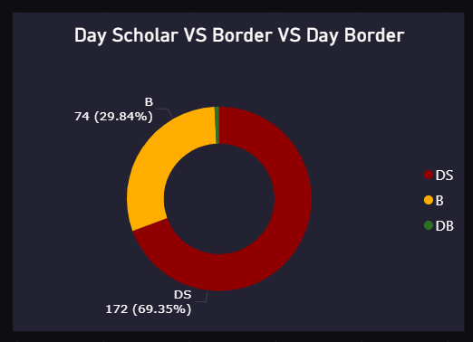
DEMOGRAPHIC DISTRIBUTION
BATCH COMPOSITION:
MAJORITY COHORT:
Day Scholars (DS) comprise 69.35% of the 9th-grade batch (172 students).
RESIDENTIAL COHORT:
Boarders (B) make up nearly 30% of the batch (74 students), providing a strictly controlled group for evening academic prep.

Slide 8
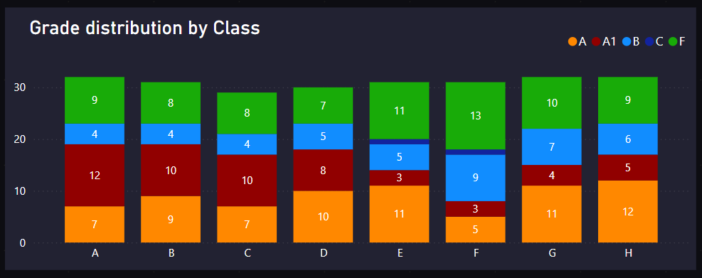
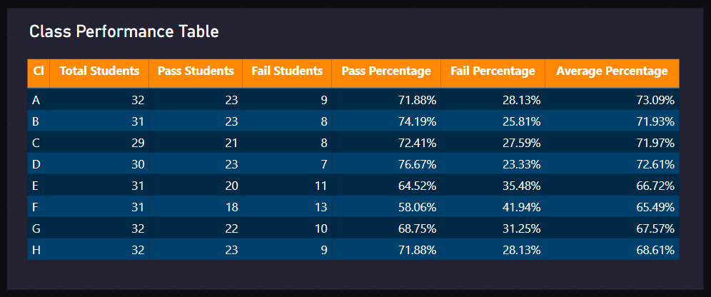
CLASS PERFORMANCE MEASURES
TOP-TIER DENSITY:
Sections A, B, and C hold the strongest concentration of exceptional A1 grades (Dark Red).
PRIMARY INTERVENTION:
Sections E and F show the highest volume of failing grades (Green), isolating our immediate targets for academic support.
LEADING SECTION:
Section D holds the highest academic standing with a 76.67% pass rate and a leading average of 72.61%.
TARGETED SUPPORT:
Sections E and F present the lowest pass percentages, isolating a combined 24 students requiring immediate instructional intervention.

Slide 9
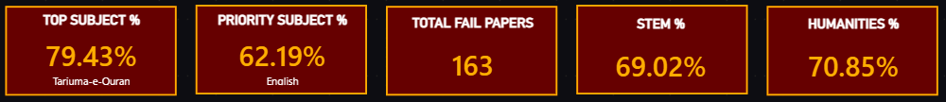
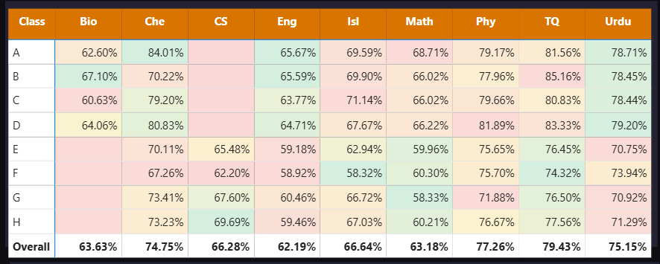
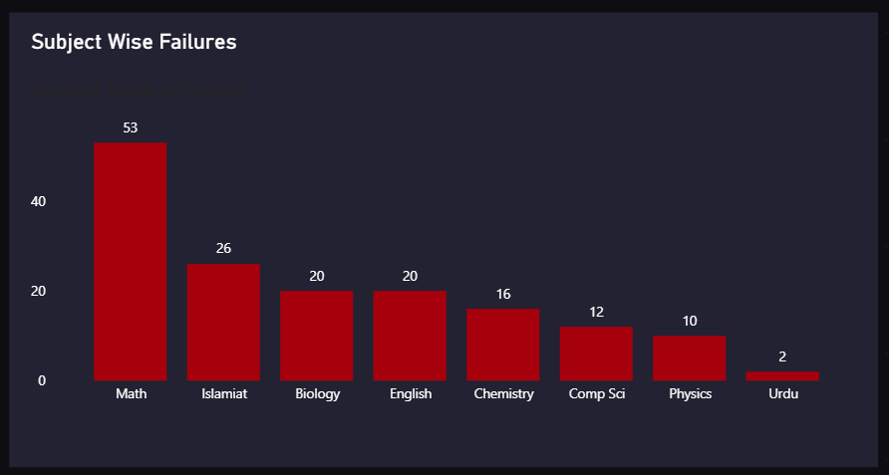
SUBJECT-LEVEL DIAGNOSTICS & FAILURES
DEPARTMENTAL OVERVIEW:
TOP PERFORMANCE:
Tarjuma-e-Quran leads all subjects with a 79.43% average.
DEPARTMENTAL OVERVIEW:
CRITICAL BOTTLENECK:
Mathematics accounts for the highest volume of academic gaps, with 53 failed papers and the overall average for English subject is very less

Slide 10
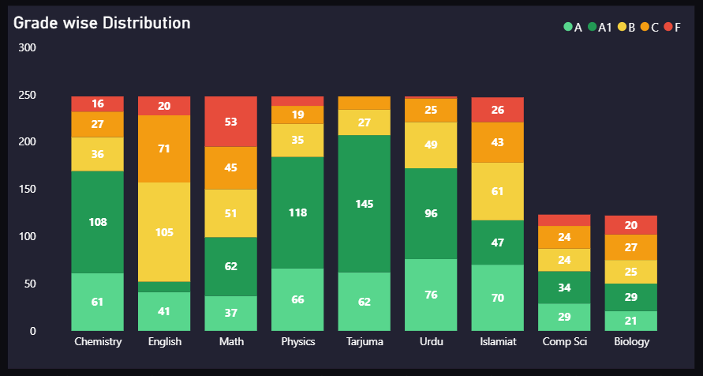
DEPARTMENTAL GRADE DEPTH
KEY DEPARTMENTAL TRENDS:
ACADEMIC EXCELLENCE:
Tarjuma and Physics hold the highest volume of A1 grades (Dark Green).
AVERAGE CONCENTRATION:
English shows a massive concentration of B and C grades (Yellow/Orange), indicating a "middle-heavy" curve.
CRITICAL REVIEW:
Math holds the largest block of failing grades (Red block of 53), requiring immediate departmental strategy adjustments.

Slide 11
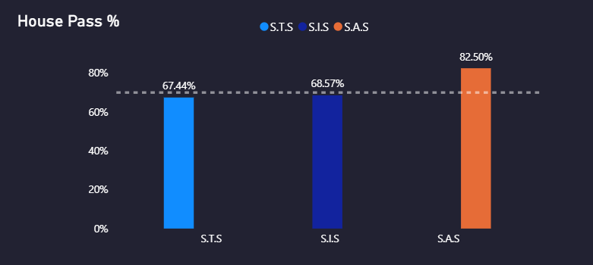
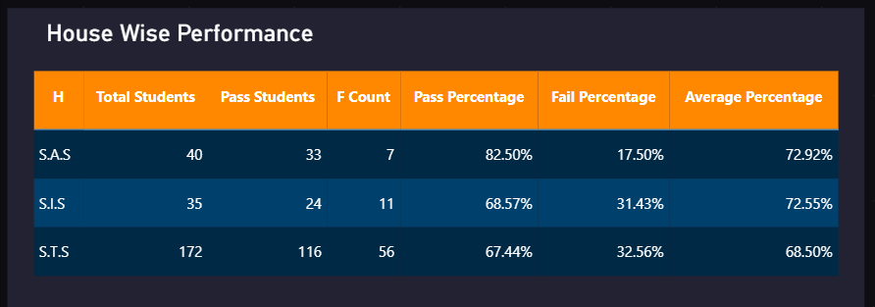
HOUSE PERFORMANCE & COMPETITIVE STANDINGS
TERM 1 HOUSE STANDINGS:
TOP PERCENTAGE:
House S.A.S leads the 1st Term with an 82.50% pass rate and the highest average standing (72.92%).
COHORT VOLUME:
House S.T.S successfully managed the largest student volume (172 boys), holding a stable 67.44% pass rate.

Slide 12
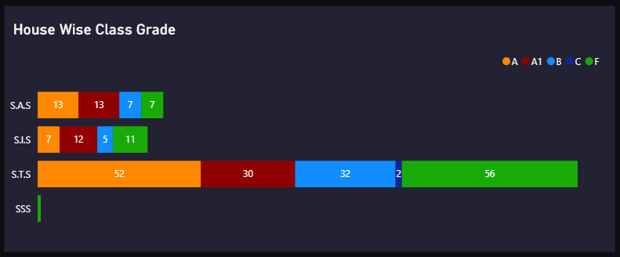
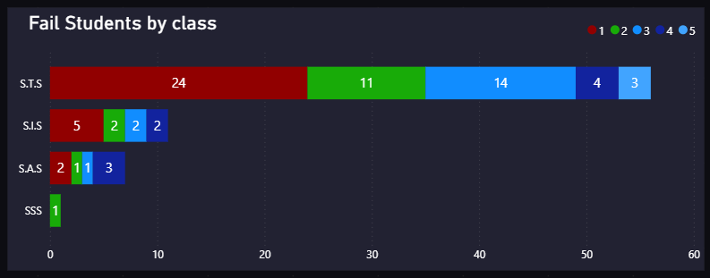
HOUSE GRADE DEPTH & FAILURE SEVERITY
DIAGNOSTIC INSIGHTS:
QUALITY DENSITY:
House S.A.S demonstrates a highly concentrated block of top-tier academic performance (A and A1 grades).
FAILURE SEVERITY:
Within S.T.S, 24 students are only failing a single subject, isolating a highly recoverable group for Term 2.

Slide 13
LIVE DASHBOARD & Q&A
ACCESSING THE LIVE MARKS SYSTEM...

