Slide 1


NEXT GEN EMPLOYABILITY PROGRAM
CREATING A FUTURE-READY WORKFORCE
Student Name :
Tushar Madhukar Bhagat
Student ID :
College Name :
STU65b0e553c33071706091859
Navsahyadri college of Engineering Naigaon Pune

Slide 2
CAPSTONE PROJECT SHOWCASE
Project Title
Customer Segmentation using K-means Clustering
Abstract | Problem Statement | Project Overview | Proposed Solution | Technology Used | Modelling & Results | Conclusion | Q&A

Slide 3
Abstract
1
Data Cleaning & Transformation: cleaning data, handling missing values, outliers
2
Feature Engineering: development of new customer centric feature
3
Outlier Treatement : handling of outliers to make dataset useable
4
Data Preprocessing: Used techniques to streamline the data
5
Correlation Analysis : to check the correlation between features
6
Customer Segmentation: Made different cluster using different methods of K-means
7
Cluster Analysis & Evaluation: Clusters are evaluated on different metrics
8
Recommendation System: System that predicts on behavioral Patterns

Slide 4


Problem Statement
In this project, we delve deep into the thriving sector of online retail by analyzing a transactional dataset from a UK-based retailer, available at the UCI Machine Learning Repository. This dataset documents all transactions between 2010 and 2011. Our primary objective is to amplify the efficiency of marketing strategies and boost sales through customer segmentation. We aim to transform the transactional data into a customer-centric dataset by creating new features that will facilitate the segmentation of customers into distinct groups using the K-means dustering algorithm. This segmentation will allow us to understand the distinct profiles and preferences of different customer groups. Building upon this, we intend to develop a recommendation system that will suggest top-selling products to customers within each segment who haven't purchased those items yet, ultimately enhancing marketing efficacy and fostering increased sales.

Slide 5

Project Overview
Data Cleaning & Transformation: first phase of project handled missing value , errors,anamolies and duplicate value to clean data
Feature Engineering :RFM analysis is done on dataset to create new feature & behavioural patterns of customer analyzed ,geographic , seasonality and trend was observed
Data Preprocessing: data processed for model building outlier treatment is done correlation between features is observed to make decisions
Customer Segmentation using K-Means Clustering: Dimensionality reduction is done using PCA to find optimal component, Elbow method and silhouette method for optimal cluster identification
Cluster Analysis & Evaluation: Metrics such as Silhoutte Score, Calinski Harabasz Score, Calinski Harabasz Score is introduced to measure the quality of Clusters

Slide 6
Proposed Solution
Customer Segmentation using K-Means Clustering:
By using the K- means and the following steps we can Build a segmentation model.
Dimensionality Reduction: PCA analysis to boil down the features in small measureable components
which can be passed to model to evaluate optimum numbers of cluster.
Cluster Formation: To get optimal numbers of clusters here we used to method Elbow method and
Silhoutte method as get surity for numbers of cluster are optimal for model. Silhoutte method comes
with advantages of Silhoutte score to find optimum number of cluster.
K-Means Clustering: as Optimal number of Cluster are found we can passed them K-means
Clustering model to then aplly on our processed data to made different cluster based on the
behavioral patterns , Purchasing trend and other features which was lately developed.

Slide 7
Technology used
Python: Implement K-means using python programming lanuguage.
Python libraries : Mathematical Libraries like Numpy , tabulate, Pandas. Plotting Libraries like
Plotly , Matplotlib, Seaborn . Model specific Libraries like yellowbrick ,
sklearn , scipy and there different modules.
Data Preparation: Clean and preprocess customer data using different inbuilt function from
pandas. And by other methods.
Feature Selection: Choose relevant features from the dataset (e.g.,purchaising pattern ,
spending habits). RFM (Recency, Frequency, Monetary) analysis for feature
selection
Outlier Detection Tratement: Isolation forest algorithm is used to handle the outliers.
Scaling: correlation analysis and matrix for PCA , Dimensionality reduction and component
identification using PCA
Clustering : Elbow curve method is used and Silhoutte method is used for identifying optimal
numbers of clusters . K-means Clustering applied on the data

Slide 8
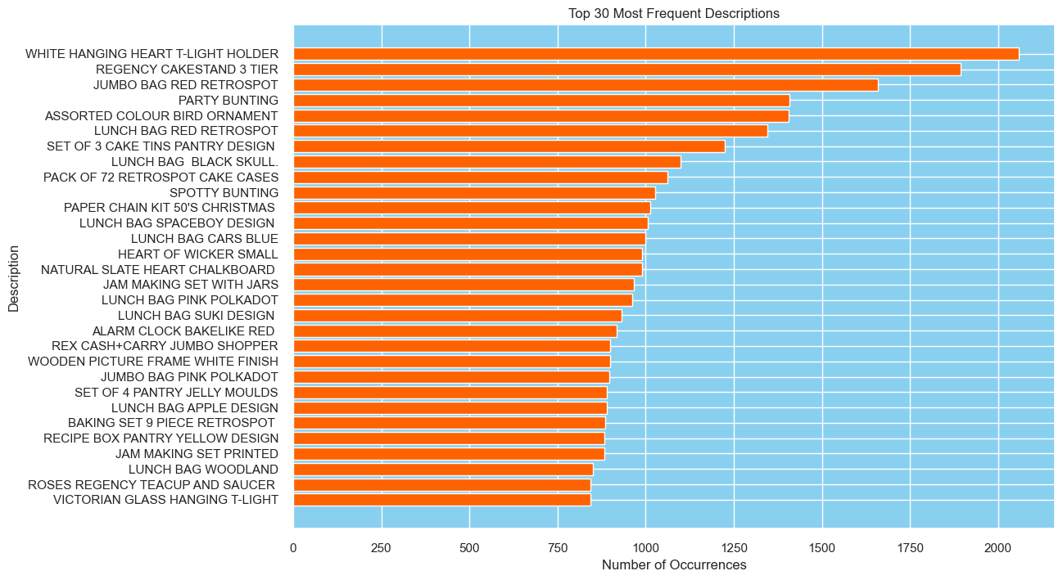
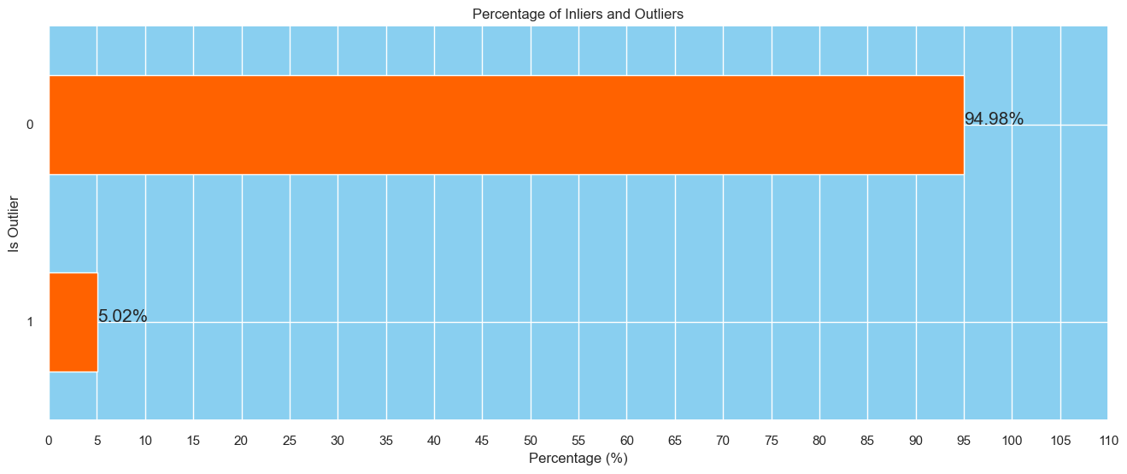
Modelling & Result
This bar plot shows the 30 highest selling products in the dataset which are purchased by the customer in customer transaction dataset from the 2010 to 2011
Where WHITE HANGING HEART T-LIGHT HOLDER
Has the highest occurrence in the dataset more than 2000 times.
This bar plot represnts the in-liers and outliers present in the dataset inliers are 94.98% and outliers are 5.02% which are managable and has not major impact on further analysis.

Slide 9
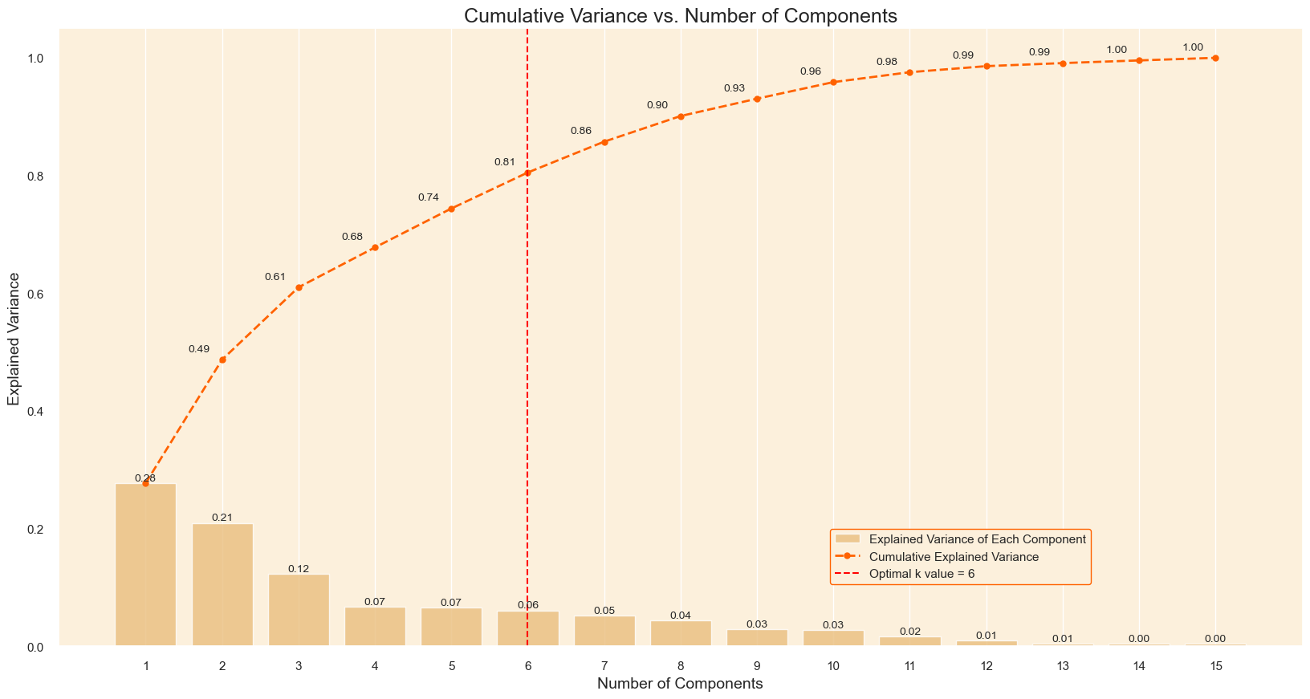
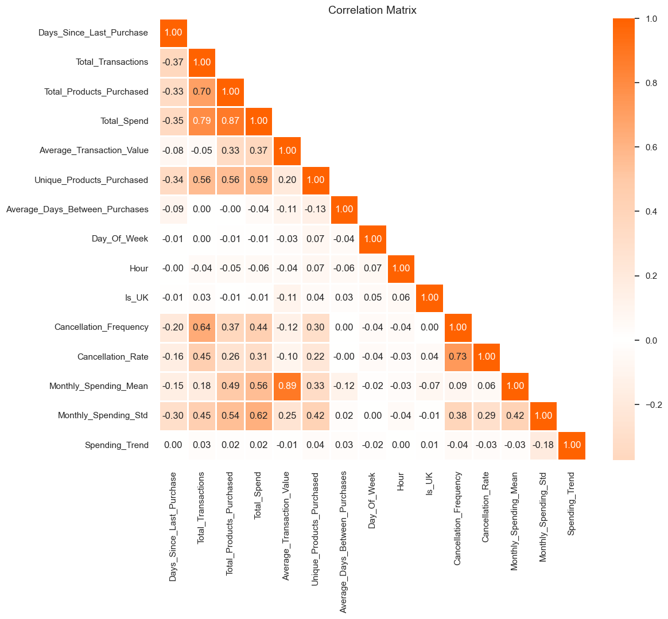
Modelling & Result
Left: Correlation matrix shows multicollinearity between different features
Right: PCA dimensionality reduction plot in variance which shows the optimal no of components

Slide 10
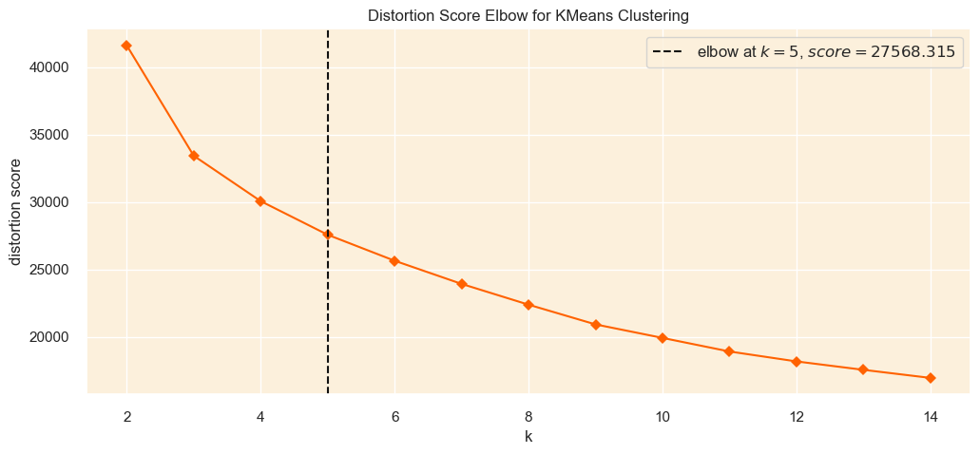
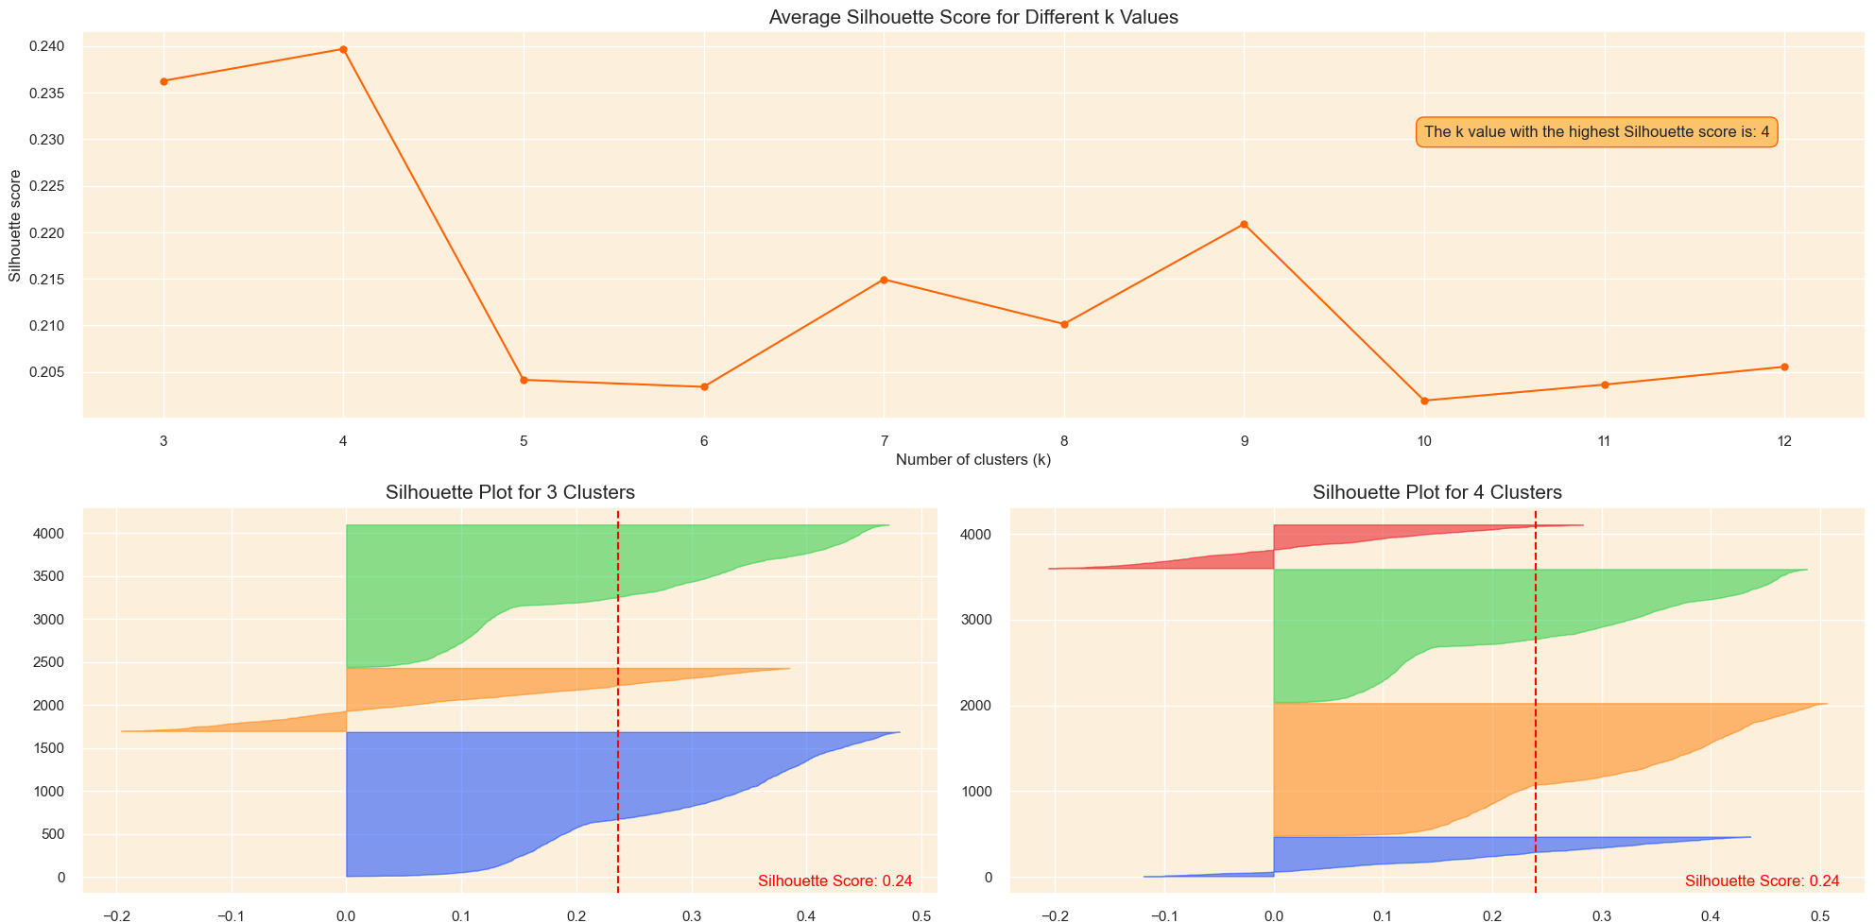
Modelling & Result
Here Elbow method is apllied where it shows there are 5 number of optimal clusters are present
Here Silhoutte method is apllied where it shows multiple number of optimal clusters with there Silhoutte score which represent optimal no of clusters -1 to 1 here 3 and 4 cluster has highest score of 0.23 but elbow method given us 5 hence by analyzing both we choose 4 number of optimal clusters.

Slide 11
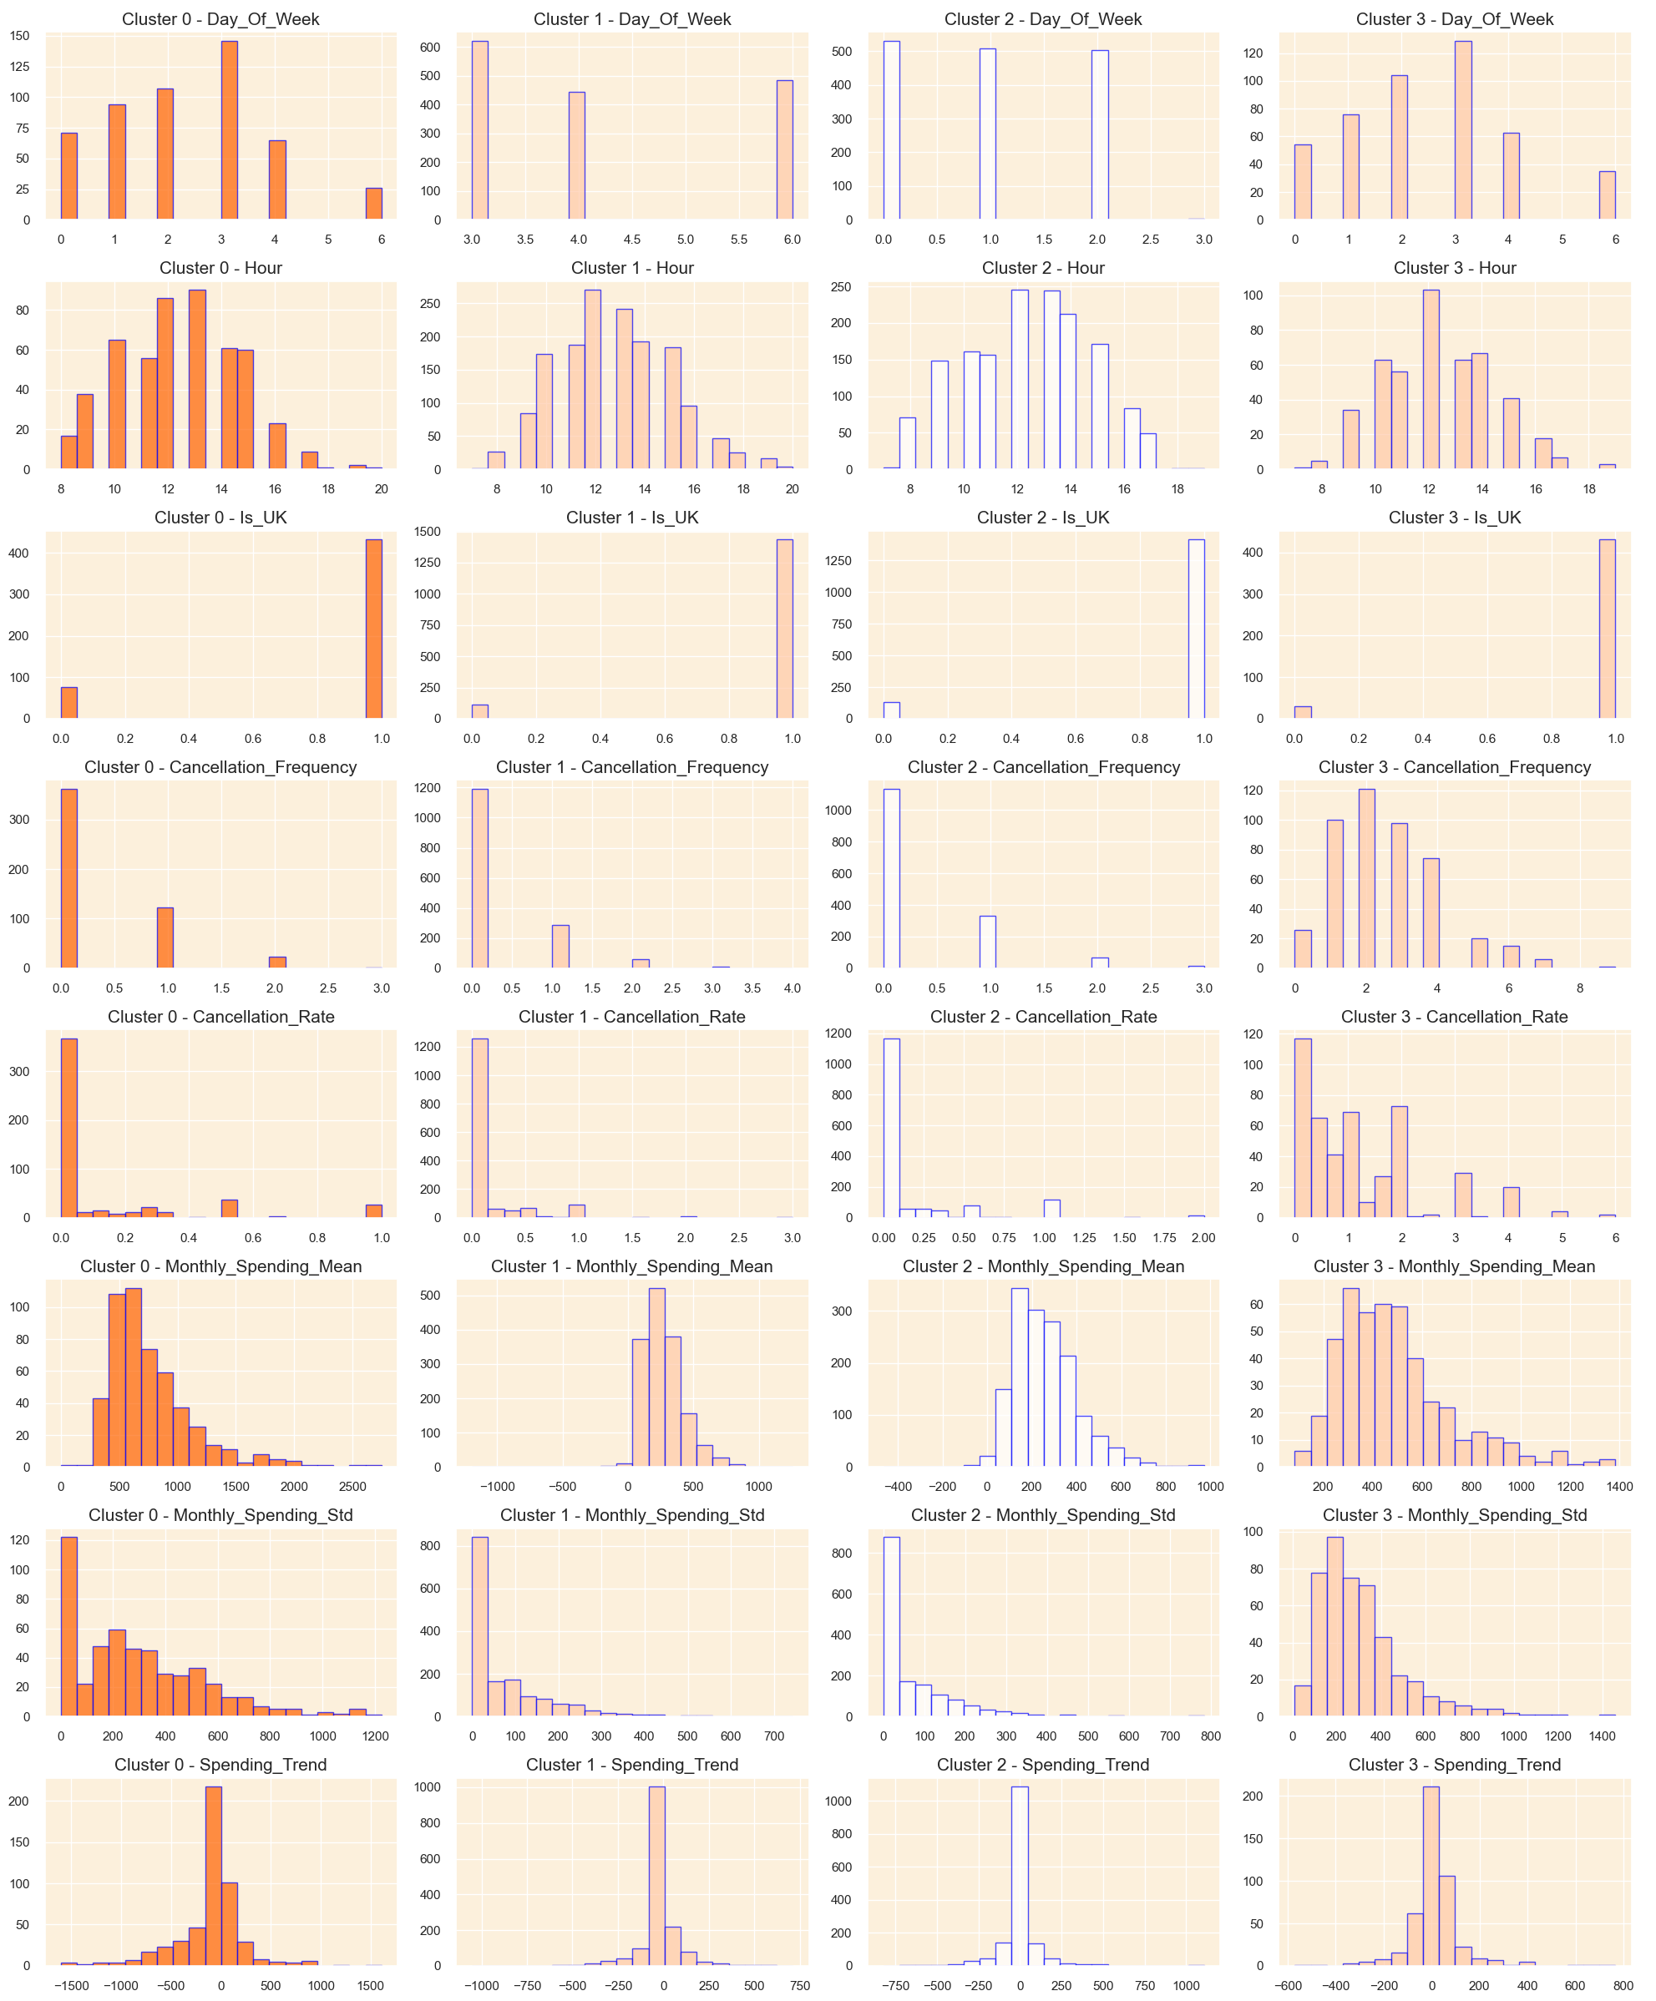
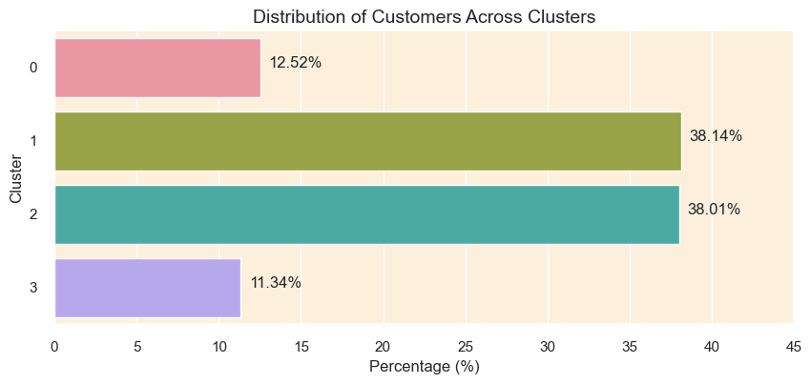
Modelling & Result
The bar plot shows the cluster distribution in percentage
Cluster 1 cand 2 are significantly larger than 0 and 4 .
And the right hand is the feature wise distribution of cluster by applying the k means clusterrng .

Slide 12

Conclusion
There are Four clusters are formed segmenting different types of user .
The Evaluation metrics such as Silhouette Score 0.23970 denotes higher separation in clusters Calinski Harabasz Score 1083.166 clusters are well are separated and distinct, Davies Bouldin Score 1.47 which show low similarity between clusters.
At the end we can observe that there are preety much similarity in some features of cluster but it is good enough to distinguish them
K-means clustering is successfully applied on the transaction dataset with sufficient underlying parameters.

Slide 13


Notes:
Thank You !!

