Slide 1

Customer Shopping Behavior Analysis
3,900 transactions · 18 features · Python · SQL · Power BI

Slide 2

Dataset at a Glance
3,900
18
Purchases
Features
37
$59.76
Missing Ratings
Avg. Spend
Key Features
Demographics: Age, Gender, Location, Subscription
Purchases: Item, Category, Amount, Season
Behavior: Discount, Promo Code, Frequency, Rating

Slide 3

Data Preparation in Python
01
Load & Explore
pandas: df.info(), .describe()
02
Clean
Imputed missing Review Ratings by category median
03
Engineer
Created age_group bins & purchase_frequency_days
04
Load to DB
Exported cleaned DataFrame to PostgreSQL

Slide 4
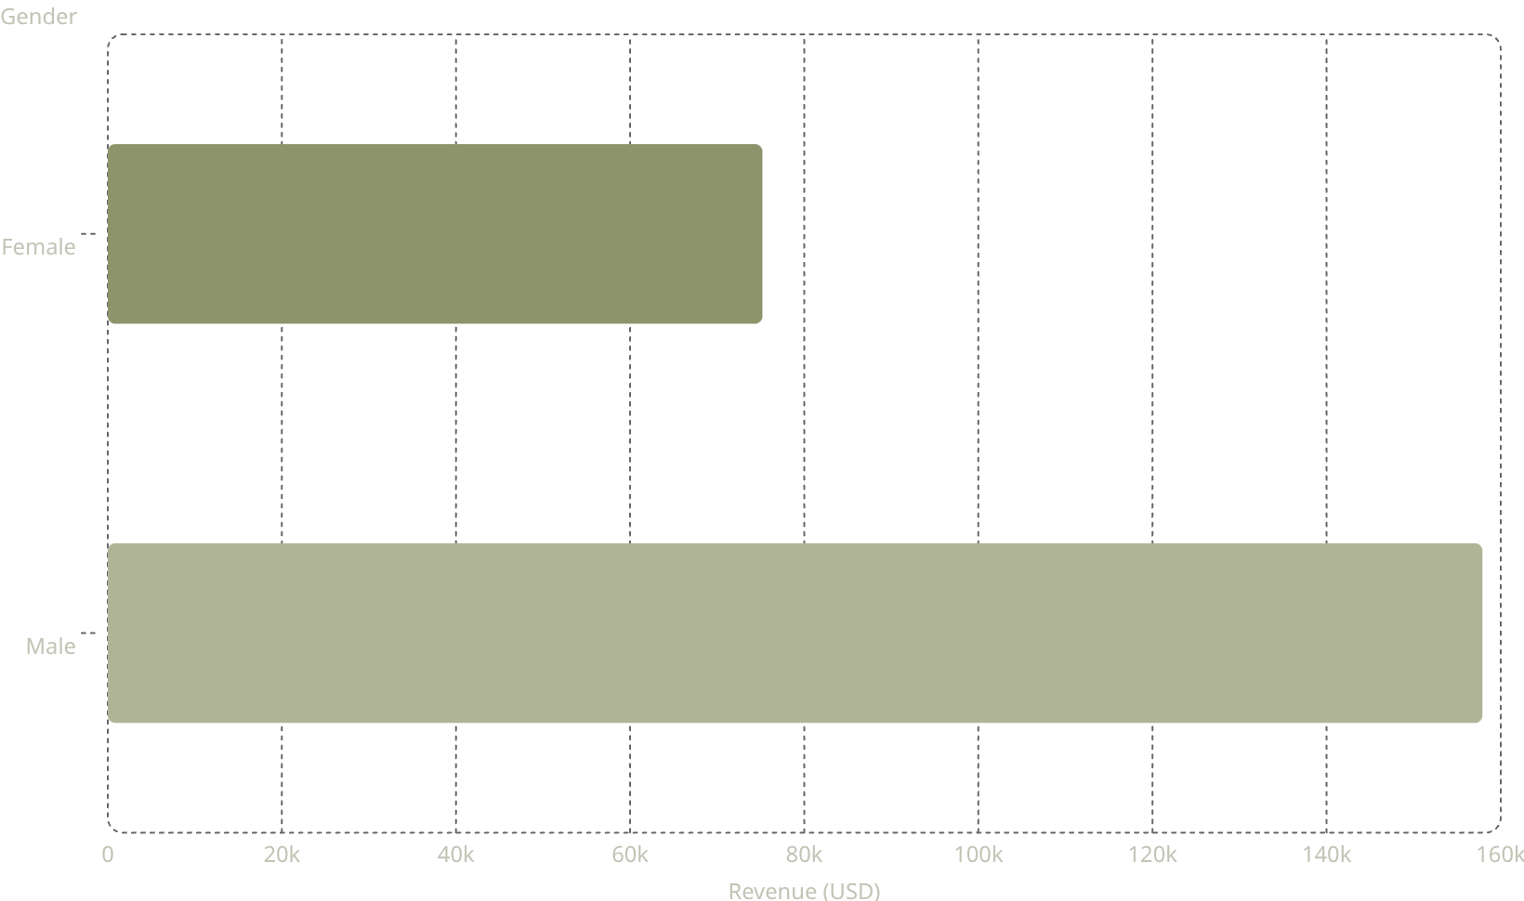
Revenue by Gender
Male Customers Drive 2× Revenue
Male: $157,890 vs. Female: $75,191
Male customers represent a significantly larger share of total spend across all categories.

Slide 5
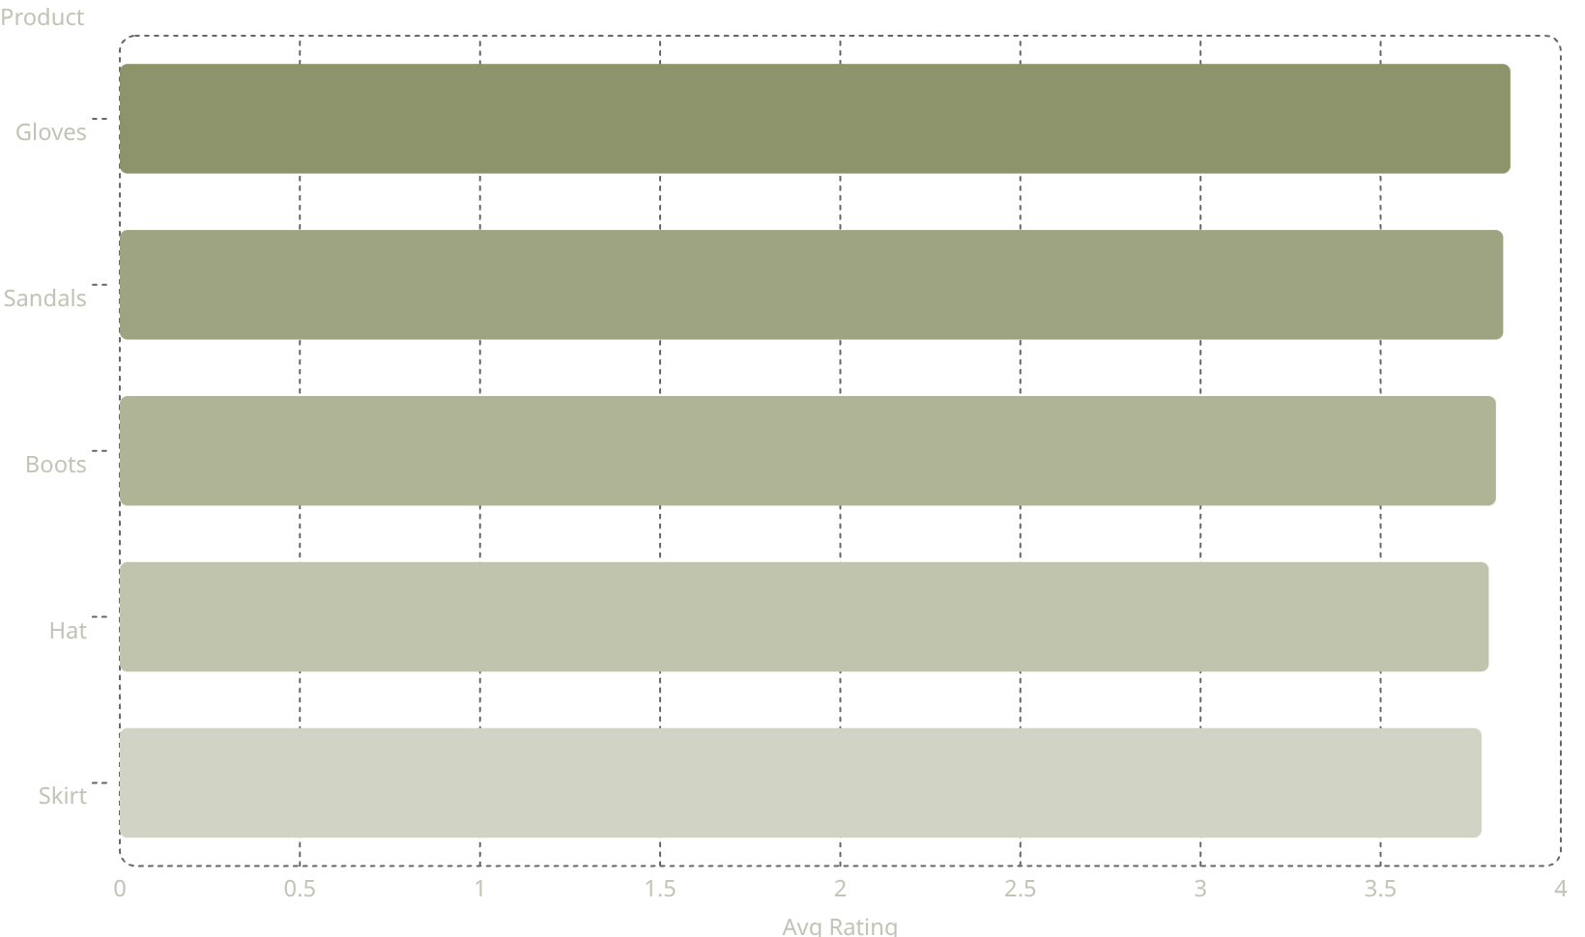
Top Products & Shipping Insights
Top 5 Products by Rating
Shipping Type Comparison
Standard
Express
Avg spend: $58.46
Avg spend: $60.48
Express shippers spend slightly more on average.

Slide 6
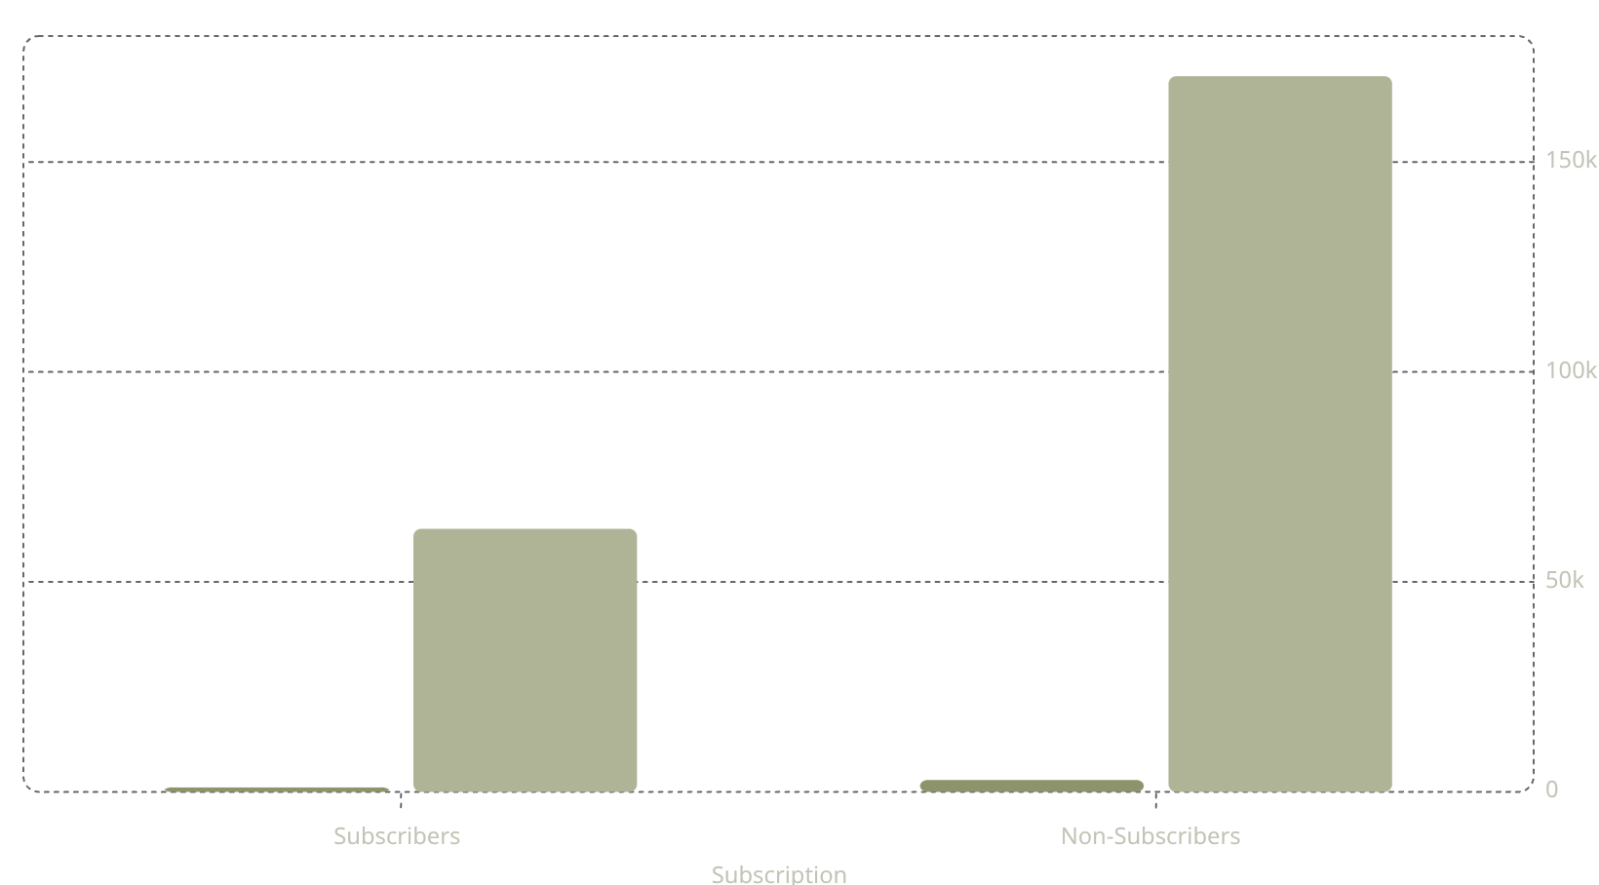

Subscribers vs. Non-Subscribers
Customers
Revenue (USD)
Key Findings
Non-subscribers: 73% of customers
Avg spend nearly identical (~$59)
Repeat buyers: 2,518 non-subscribers vs. 958 subscribers
Huge opportunity to convert high-frequency non-subscribers.

Slide 7
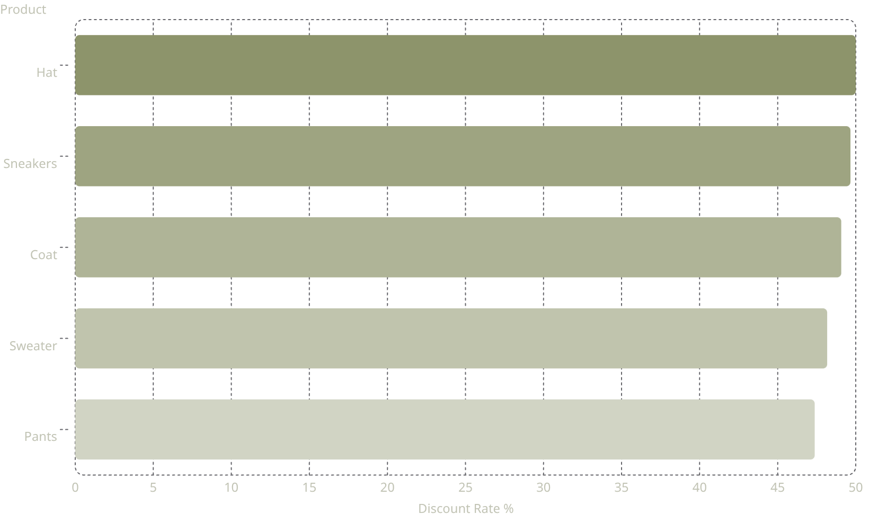
Discount-Dependent Products
Nearly Half of Sales Are Discounted
Top 5 products have 47–50% discount rates.
Review discount policy to balance sales lift with margin control.

Slide 8
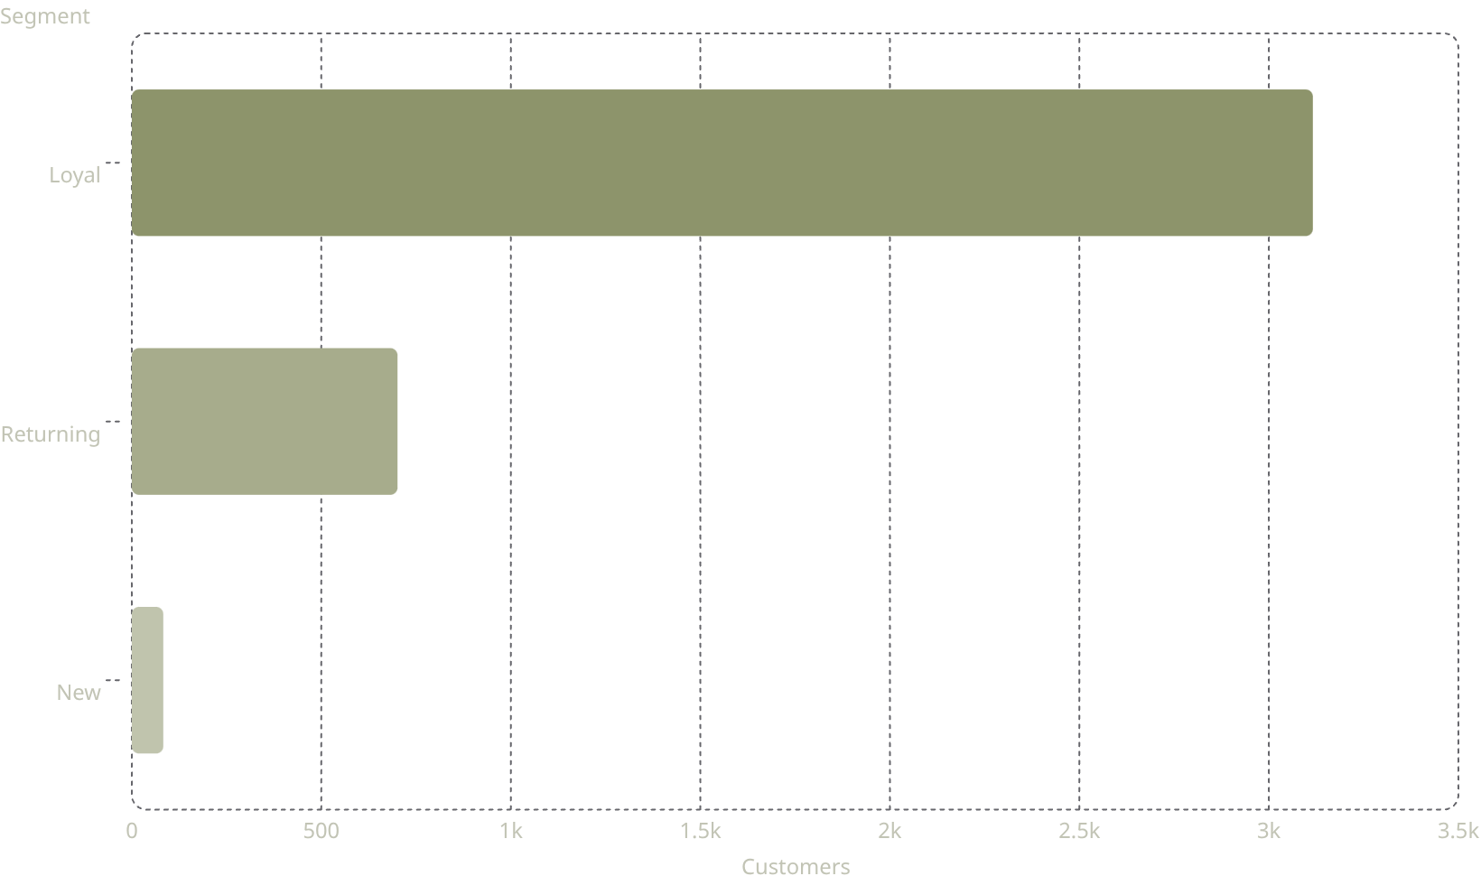
Customer Segmentation
Segment Breakdown
Loyal — 3,116
80% of base
Returning — 701
18% of base
New — 83
2% of base

Slide 9
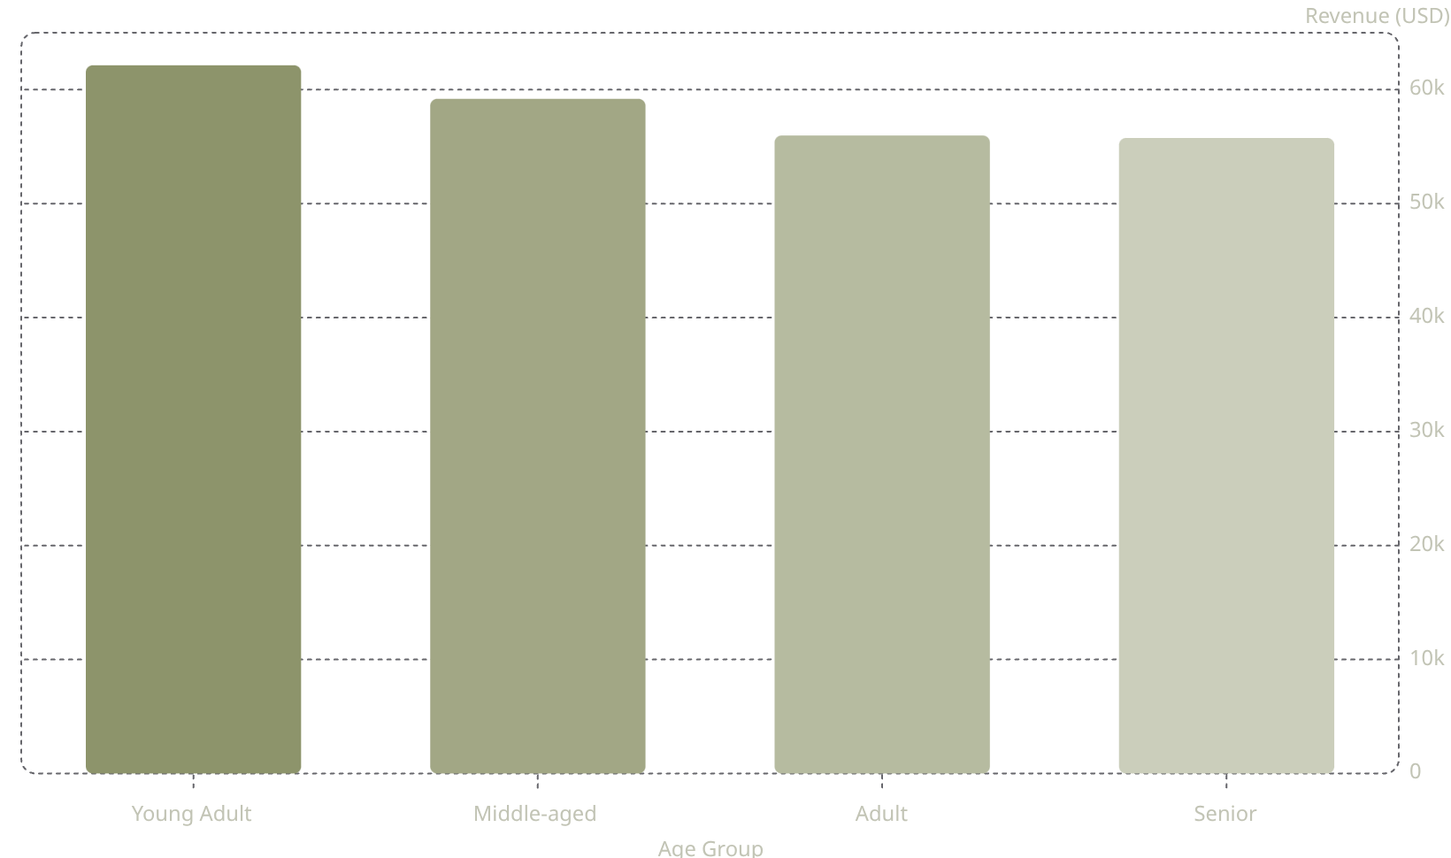
Revenue by Age Group & Category
Top Products by Category
Accessories
Clothing
Jewelry · Sunglasses · Belt
Blouse · Pants · Shirt
Footwear
Outerwear
Sandals · Shoes · Sneakers
Jacket · Coat

Slide 10


Dashboard & Recommendations
Interactive Power BI dashboard: 3.9K customers, $59.76 avg spend, 3.75 avg rating — filters for subscription, gender, category, shipping.
Boost Subscriptions
Promote exclusive subscriber benefits
Loyalty Programs
Reward repeat buyers → Loyal segment
Review Discounts
Balance sales lift vs. margins
Targeted Marketing
Focus on high-revenue age groups & express shippers

