Slide 1



Name of Project
E-Waste Generation Classification using EfficienNetV2B0

Slide 2

Learning Objectives
Understand the application of CNNs in image classification of e-waste.
Explore the architecture and benefits of the EfficientNetV2B0 model.
Evaluate model performance using accuracy metrics and confusion matrix.
Deploy the trained model as a web app using Gradio
GOAL
Source :
www.freepik.com/

Slide 3
Tools and Technology used
Imported the dataset from Kaggle website.
Explored and worked with the Deep Learning libraries like TensorFlow and Keras for model training.
For data handling we used the Python libraries NumPy and Pandas.
Visualized the data using the Matplotlib and Seaborn libraries.
Used scikit-learn for model evaluation (used for accuracy prediction, confusion matrix and metrics).
Explored the architecture and benefits of the EfficientNetV2B0(a pretrained model good at recognizing images).
Deployed the trained model as a user-friendly web app using Gradio.
PIL for opening and working with the image files themselves.
OS to navigate and interact with the folders and files on the local machine.

Slide 4

Methodology
E-Waste Image Dataset
Data Acquisition
Data Preprocessing
Data Augmentation
Transfer Learning(EfficientNetV2B0)
Model Training and Evaluation
Deployment

Slide 5
Problem Statement:
E-Waste Generation Classification using EfficientNetV2B0(Transfer learning)
E-Waste is growing rapidly and causing a significant environmental challenge. Manual categorization is inefficient and often inaccurate. Proper sorting and categorization of e-waste is essential for efficient recycling and disposal, but manual classification is error-prone and labor-intensive.
This project aims to build an automated e-waste classification system using artificial intelligence and machine learning. By training a deep learning model on images of different types of e-waste, we can identify and categorize them accurately. We categorize it using a pretrained model(EfficientNetV2B0) for object classification.

Slide 6
Solution:
Use a labeled dataset of 10 E-Waste categories, each directory contains 10 subfolders, each representing one class of e-waste: [ PCB (Printed Circuit Board), Player, Battery, Microwave, Mobile, Mouse, Printer ,Television, Washing Machine ,Keyboard ].
Employ a Convolutional Neural Network (CNN) built on EfficientNetV2B0.
Perform training and evaluation with accuracy tracking and confusion matrix.
Visualize the training vs validation accuracy and training vs validation loss.
Display few sample predictions.
Host the model with an intitutive web interface using Gradio.

Slide 7
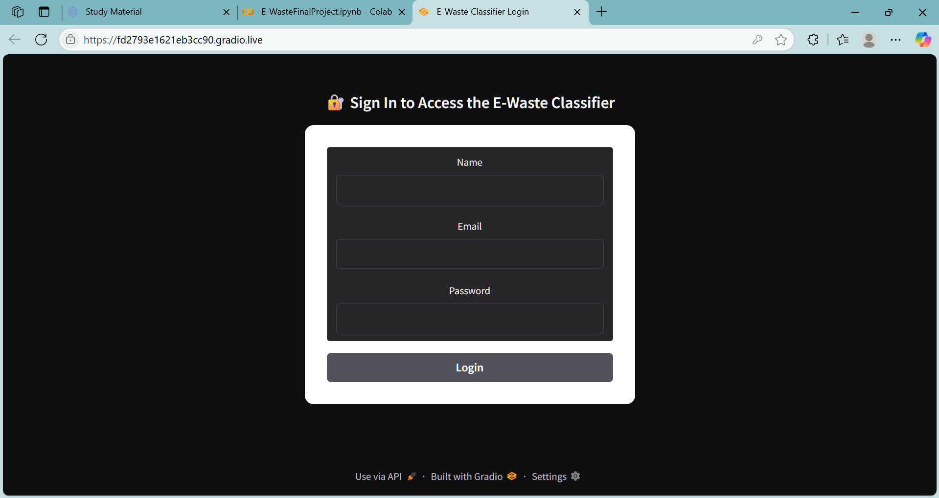
Screenshot of Output:

Slide 8
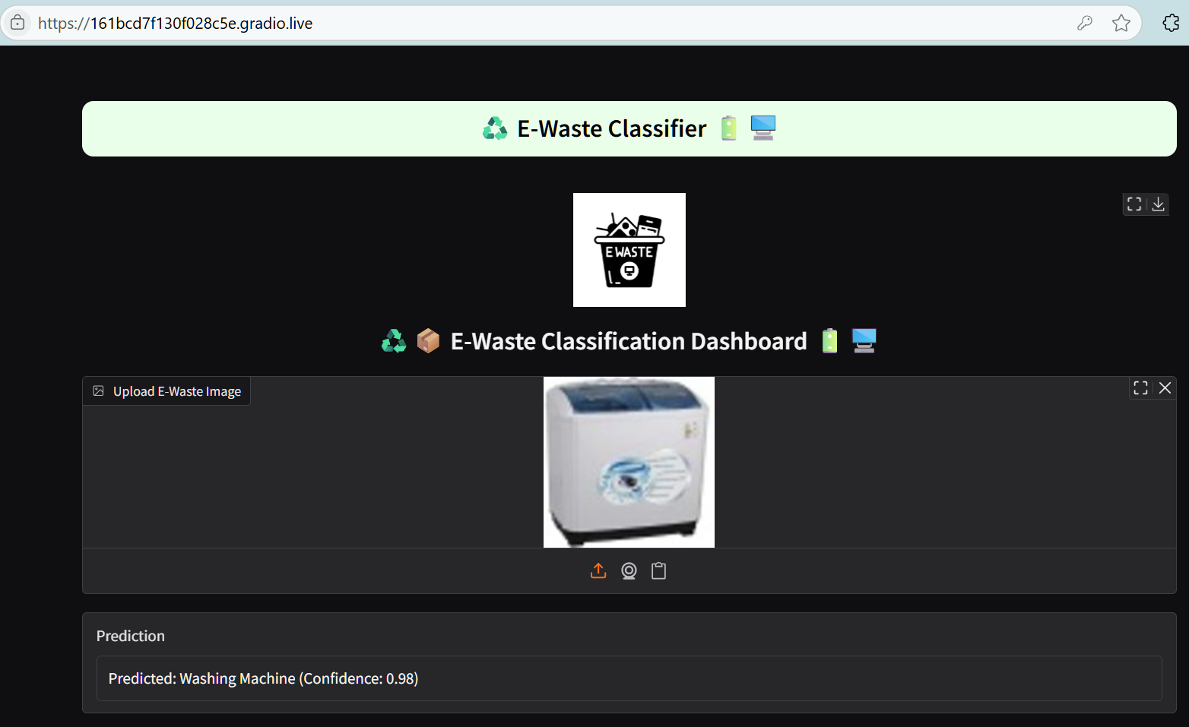

Slide 9
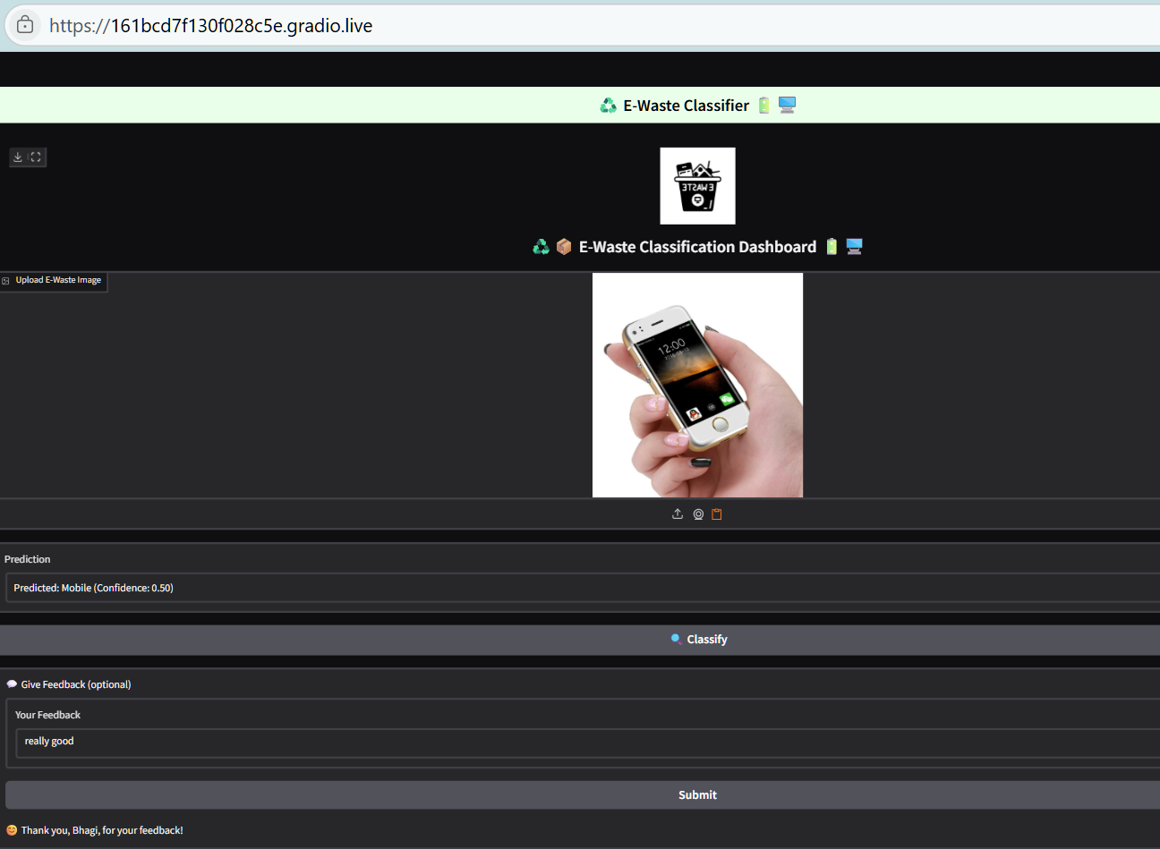

Slide 10
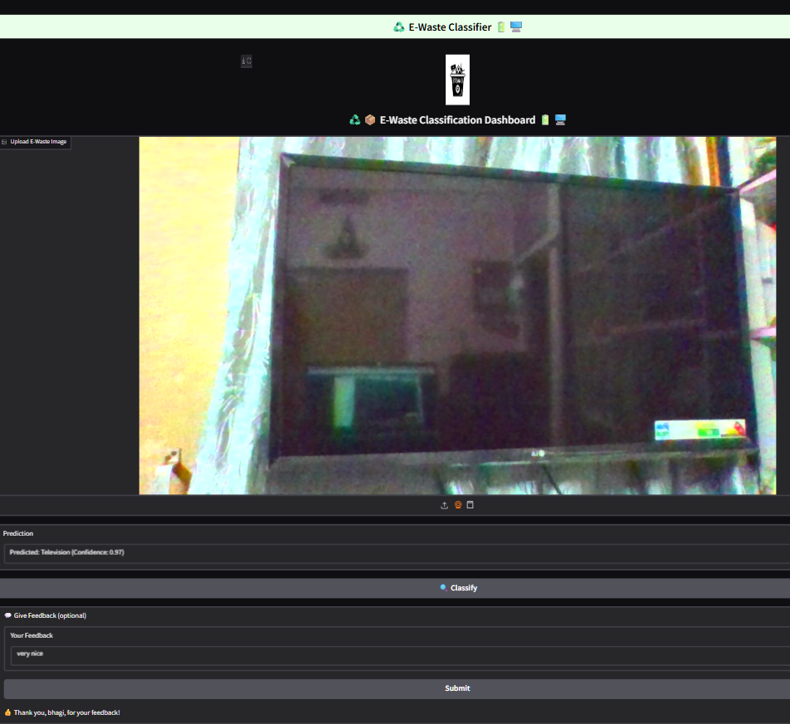

Slide 11
Conclusion:
Achieved accurate E-Waste classification with a robust, pretrained model.
Visual performance metrics support strong generalization.
Fully functional web interface for real-time predictions created.
Created a website where you can do live classification of objects and the model is fully trained and tested under several environments.
A HTML and CSS code is also added to make the website look more formal way and also created a login page before going for the image classification to capture the user details.
Future scope: Expand dataset, integrate feedback loop, optimize for mobile.
Website link :https://161bcd7f130f028c5e.gradio.live

Slide 12
THANK YOU

