Slide 1
BUSINESS INFORMATION SYSTEM DISSERTATION PROJECT
Intelligent Customer Relationship Management System with Facial emotion Recognition
A.L.D Bhagya Madhushani
ICBT ID – CL/CBISM/14/25
University ID – st20253412

Slide 2
Contents
Introduction
Problem Statement
Drawbacks that are facing of the current system
Research objectives
Proposed solution
Data analysis
Design diagrams
Conclusion

Slide 3
Introduction
Frequently, customers come to supermarkets to buy their required consumer goods. Consumers prefer to consume products that meet certain environmental and ethical standards. Customers are the assets and helpful to survival of the business. So, keeping their interesting is most important. Therefore, customer feedbacks are integrating with growth of the business. And they allows to express customer feedbacks.
This effective to quickly and conveniently resolve any defects in the product and achieve customer satisfaction. And find what are the facts they have to improve for provide good service to customers. On the other hand, it is opportunity to customers able to express their ideas or react about their expectations will meet or not through service. But there having problems and not seems active participation of customers.

Slide 4

Problem Statement
Providing quality products to customers is main responsibility of sellers .
Sellers also willingness to know how much customers were pleased and what are the feedbacks whether satisfied or not.
Mostly supermarkets use to receive customer feedbacks by keeping a box to put customer feedbacks and some organizations use forms to fill .
If customers are not satisfied with their products or service they do no urge to expressed their feedbacks due to the issues occurred in current using method. It is time consuming, visible to everyone and sometimes feedback sheets can be missing.

Slide 5
Drawbacks that are facing of the current system
They cannot measure customer satisfaction properly.
Failure to meet customer expectations
Every customer is not participating only required customers will do it.
It was very time consuming.
There are having possibility of risk of losing.
Customers cannot expect immediate response through it.

Slide 6
Research objectives
In my research, I hope to achieve mainly To gain effective and reliable AI Based customer face detection and face emotion feedback system.
Protect Customer’s privacy of expressing opinions.
Getting accurate feedback on the products they buy through their facial expressions.
Save customer time on filling out feedback forms manually or online. Time is more important with the busy lifestyles of customer.
Increasing the security of the system.
Thereby giving a direct idea of ​​the customer for the goods they are selling.

Slide 7
Proposed solution
Currently supermarkets in our country not having proper system to manage their customer feedbacks . According to my proposed system expected to gain customer feedbacks by using technological strategy. It allows to find proper solution to current difficulties and prevent time consuming. AAccordingly, helpful to build up better relationship between customer and seller. This system identify customer feedbacks from their face emotions by using AI based technology.

Slide 8
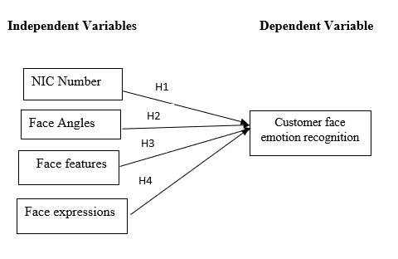
Conceptual framework and Hypothesis
Hypothesis
H1 - There is a relationship between NIC Number and customer face emotion recognition when receiving feedbacks to the organization by using this application.
H2 - There is a relationship between face angles and customer face emotion recognition when receiving feedbacks to the organization by using this application.
H3 - There is a relationship between face features and customer face emotion recognition when receiving feedbacks to the organization by using this application.
H3₁ – There is a positive relationship between face features and customer face emotion recognition when receiving feedbacks to the organization by using this application
H4 - There is positive relationship between face expressions and customer face emotion recognition when receiving feedbacks to the organization by using this application.

Slide 9
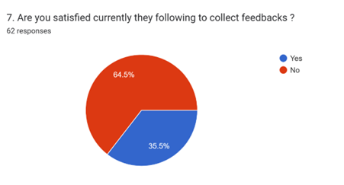
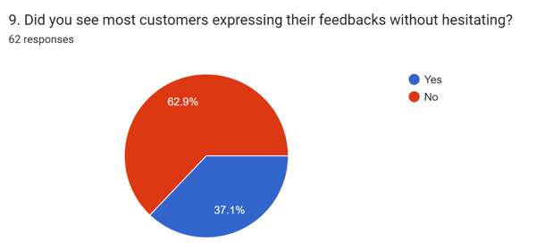
Data analysis
Customer satisfaction about current system
Possibility of expressing feedback under the current system
Majority of customers expressed their willingness to the proposed system.
Satisfaction – 35.5%
Dissatisfaction – 64.5%
Satisfaction – 37.1%
Dissatisfaction – 62.9%

Slide 10
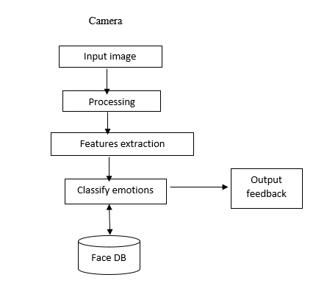
Design Diagrams
Architecture Diagram
Use case Diagram

Slide 11
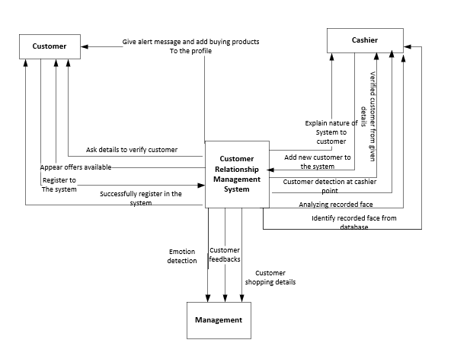
Context diagram

Slide 12
Conclusion
In conclusion, the findings of this study provide valuable benefits into the supermarkets. The place where most customers come to buy their required products. Overall, the objective of this research is to provide a most appropriate solution for having deficiency of current system and useful to avoid them. And raise awareness among supermarket owners about a more useful customer feedback platform. Which carries out benefits like prevent time consuming, accuracy and manage easily to both parties supermarkets and customers . utilizing The AI based reliable face emotional recognition customer feedback.

Slide 13
References
Azazi, A., Lutfi, S. L. & Venkat, I., 2014. Identifying universal facial emotion markers for automatic 3D facial expression recognition. Kuala Lumpur, s.n.
canedo , d. & Neves, A., 2019. Facial Expression Recognition Using Computer Vision. [Online] Available at: https://www.researchgate.net/publication/337007209_Facial_Expression_Recognition_Using_Computer_Vision_A_Systematic_Review [Accessed November 2019].
Haque, I. U., 2019. Facial Expression Recognition from Different Angles Using DCNN for Children with ASD to Identify Emotions. [Online] Available at: https://www.researchgate.net/publication/332686911_Facial_Expression_Recognition_from_Different_Angles_Using_DCNN_for_Children_with_ASD_to_Identify_Emotions [Accessed April 2019].
Jang, G.-j., sikpark, J., Jo, A. & Kim, J. h., 2014. Facial Emotion Recognition Using Active Shape Models and Statistical Pattern Recognizers. Guangdong, IEEE.
Mohensi, S., Zarei, N. & Ramazani, S., 2014. Facial Expression Recognition using Anatomy Based Facial Graph. [Online] Available at: https://www.researchgate.net/publication/276204176_Facial_Expression_Recognition_using_Anatomy_Based_Facial_Graph [Accessed October 2014].
Sariyanidi, E., Gunes, H. & Cavallaro, A., 2014. Automatic Analysis of Facial Affect: A Survey of Registration, Representation, and Recognition. 37(6).

Slide 14


Thank You

