Slide 1

SESHADRI RAO
GUDLAVALLERU ENGINEERING COLLEGE
Department Of Computer Science And Engineering
Main Project On
SIGN LANGUAGE PREDICTOR
Under the guidance of: Team members
Dr .G. Sridevi R. BHAGYA SRI(19481A05K6)
Professor | M.Tech, PhD, PDF R. PRASANTH SAI(19481A05K7)
SK. DAVOOD ALI(19481A05L7)
P. PRAVEEN KUMAR REDDY(19481A05K1)

Slide 2
CONTENTS :
ABSTRACT
EXISTING MODEL
PROPOSED MODEL
IMPLEMENTATION
RESULTS

Slide 3
ABSTRACT :
Generally, humans communicate with each other by means of voice. But how do a dumb person communicate with other humans? They use a sign language to communicate with others. One can anticipate that within a few decades, digital technology would have a significant impact on how people go about their daily lives and that everyone will communicate with machines either by gestures or speech recognition. If we are able to foresee such a future, we should consider the physically disabled and take action to help them. The current proposed idea recognizes the gesture based on the American Sign Language expressed by the dumb person using deep learning.

Slide 4
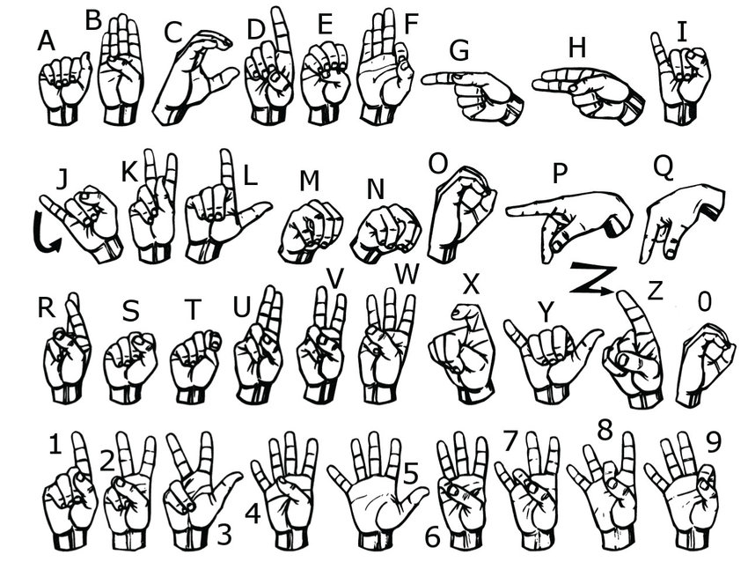
GESTURES :
.

Slide 5
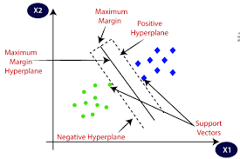
EXISTING MODEL :
The existing model is implemented using Support Vector Machine (SVM) algorithm
It gave an accuracy of 87%
.

Slide 6
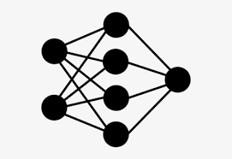
PROPOSED MODEL:
The Proposed model is trained using two models. One is CNN(Convolutional Neural Network) and the other is its pre-trained model MobileNet.
Alphabets from A-Z were trained.

Slide 7
IMPLEMENTATION

Slide 8
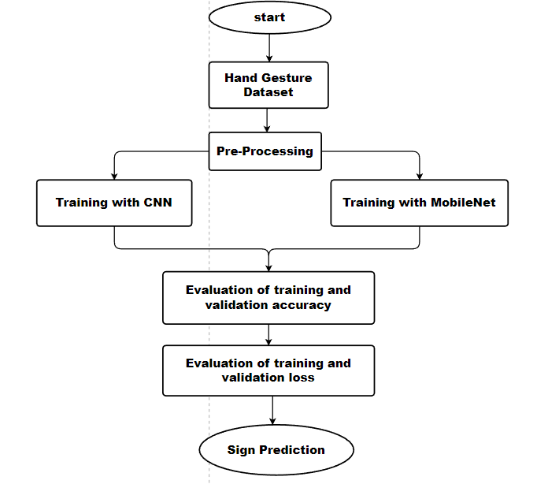
Process Flow :

Slide 9
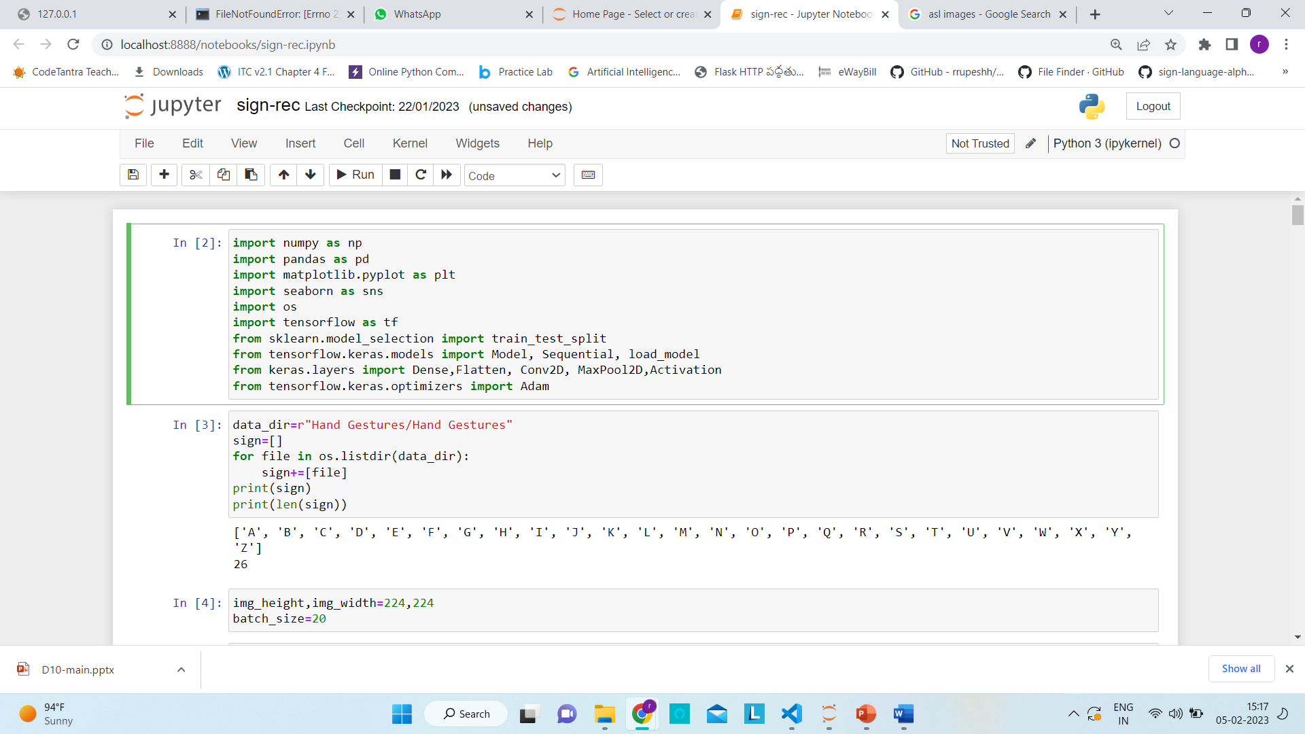
Folders, Image Size and Batch size:

Slide 10
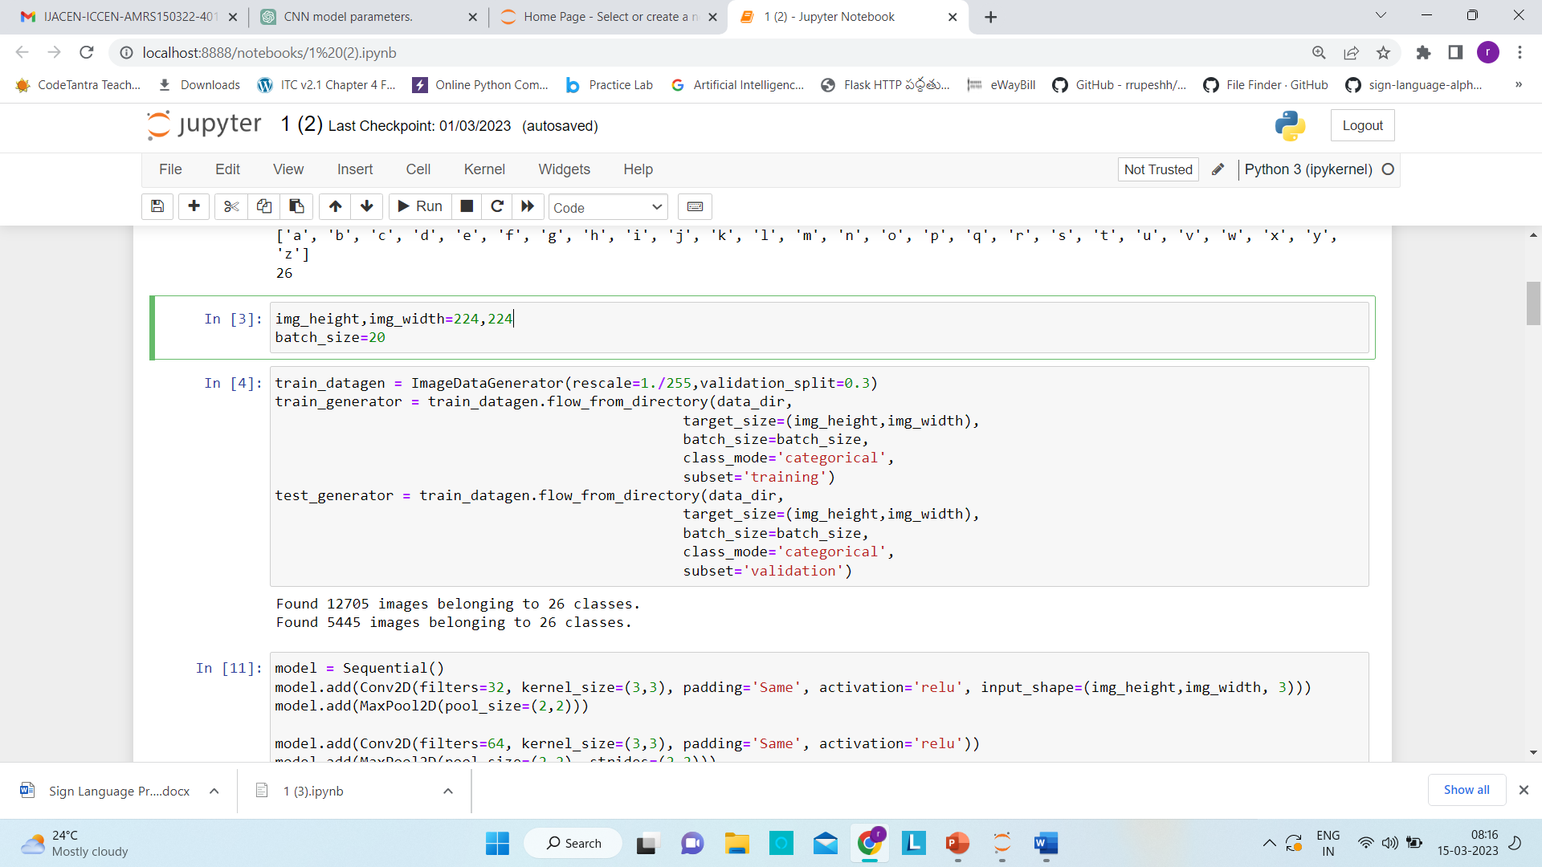
Preprocessing and Splitting:

Slide 11
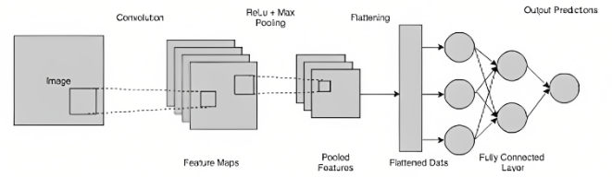
CNN(Convolutional Neural Networks) :
A CNN (Convolutional Neural Network) is a Deep Learning training algorithm which can take an image as input, given various elements and objects like biases and weights in the image importance and distinguish between them.
They are made up of several layers that separate the features from the incoming data before categorising it into one or more groups.
Backpropagation is a technique used to train CNNs, where the algorithm modifies the elements of the network like weights to reduce the discrepancy between the expected and actual output.

Slide 12
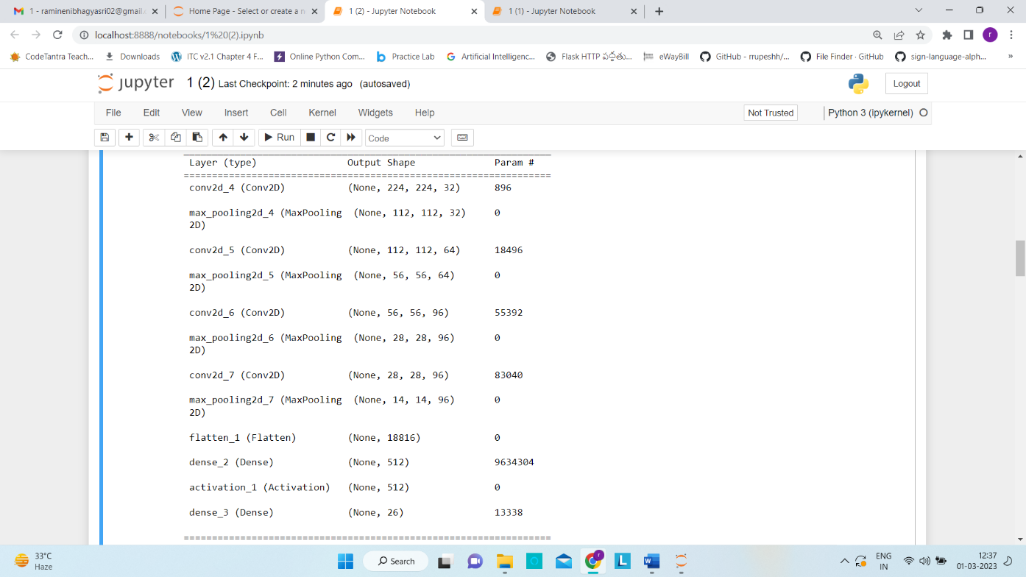
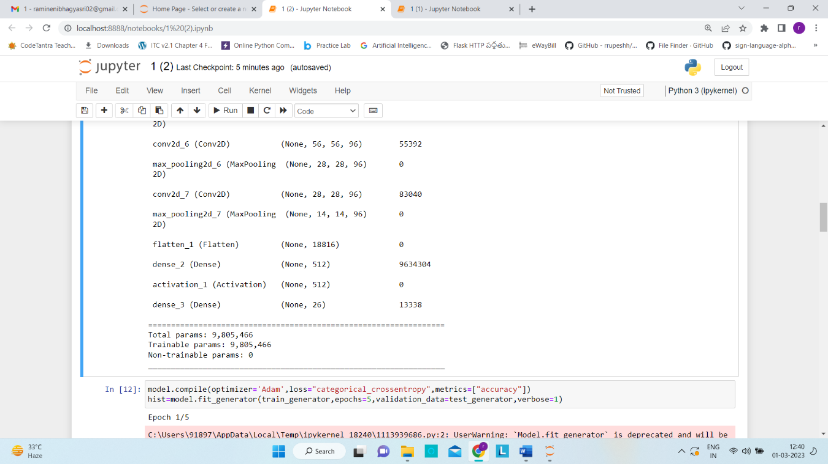
CNN Model Summary :

Slide 13
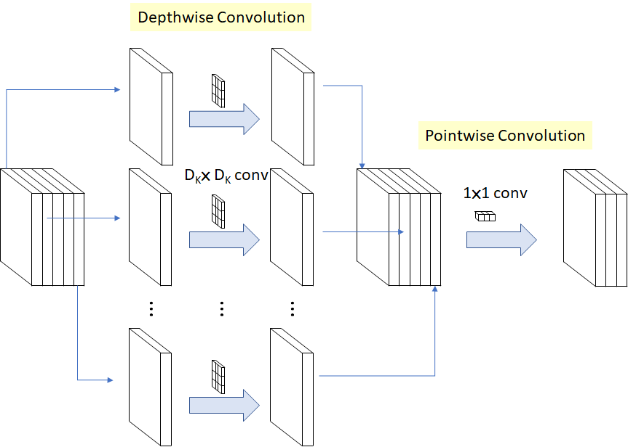
MobileNet (A Pre-trained CNN Model) :
MobileNet is a CNN architecture that is efficient and adaptable for real-world uses.
The 27 convolution layers of the MobileNet model are composed of 13 depthwise convolutional layers, one average pooling layer, one fully connected layer, and one softmax layer.
A single filter is applied to each channel of the input tensor in a depthwise convolution, whereas a set of 1x1 filters are applied to the output of a depthwise convolution in a pointwise convolution as shown in figure.

Slide 14
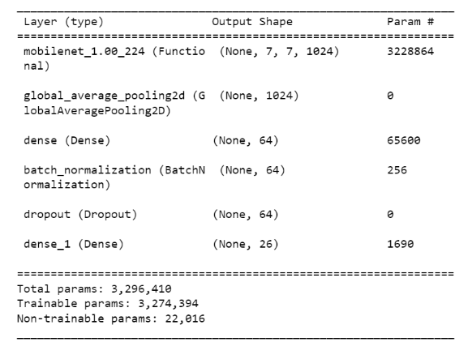
MobileNet Model Summary :

Slide 15
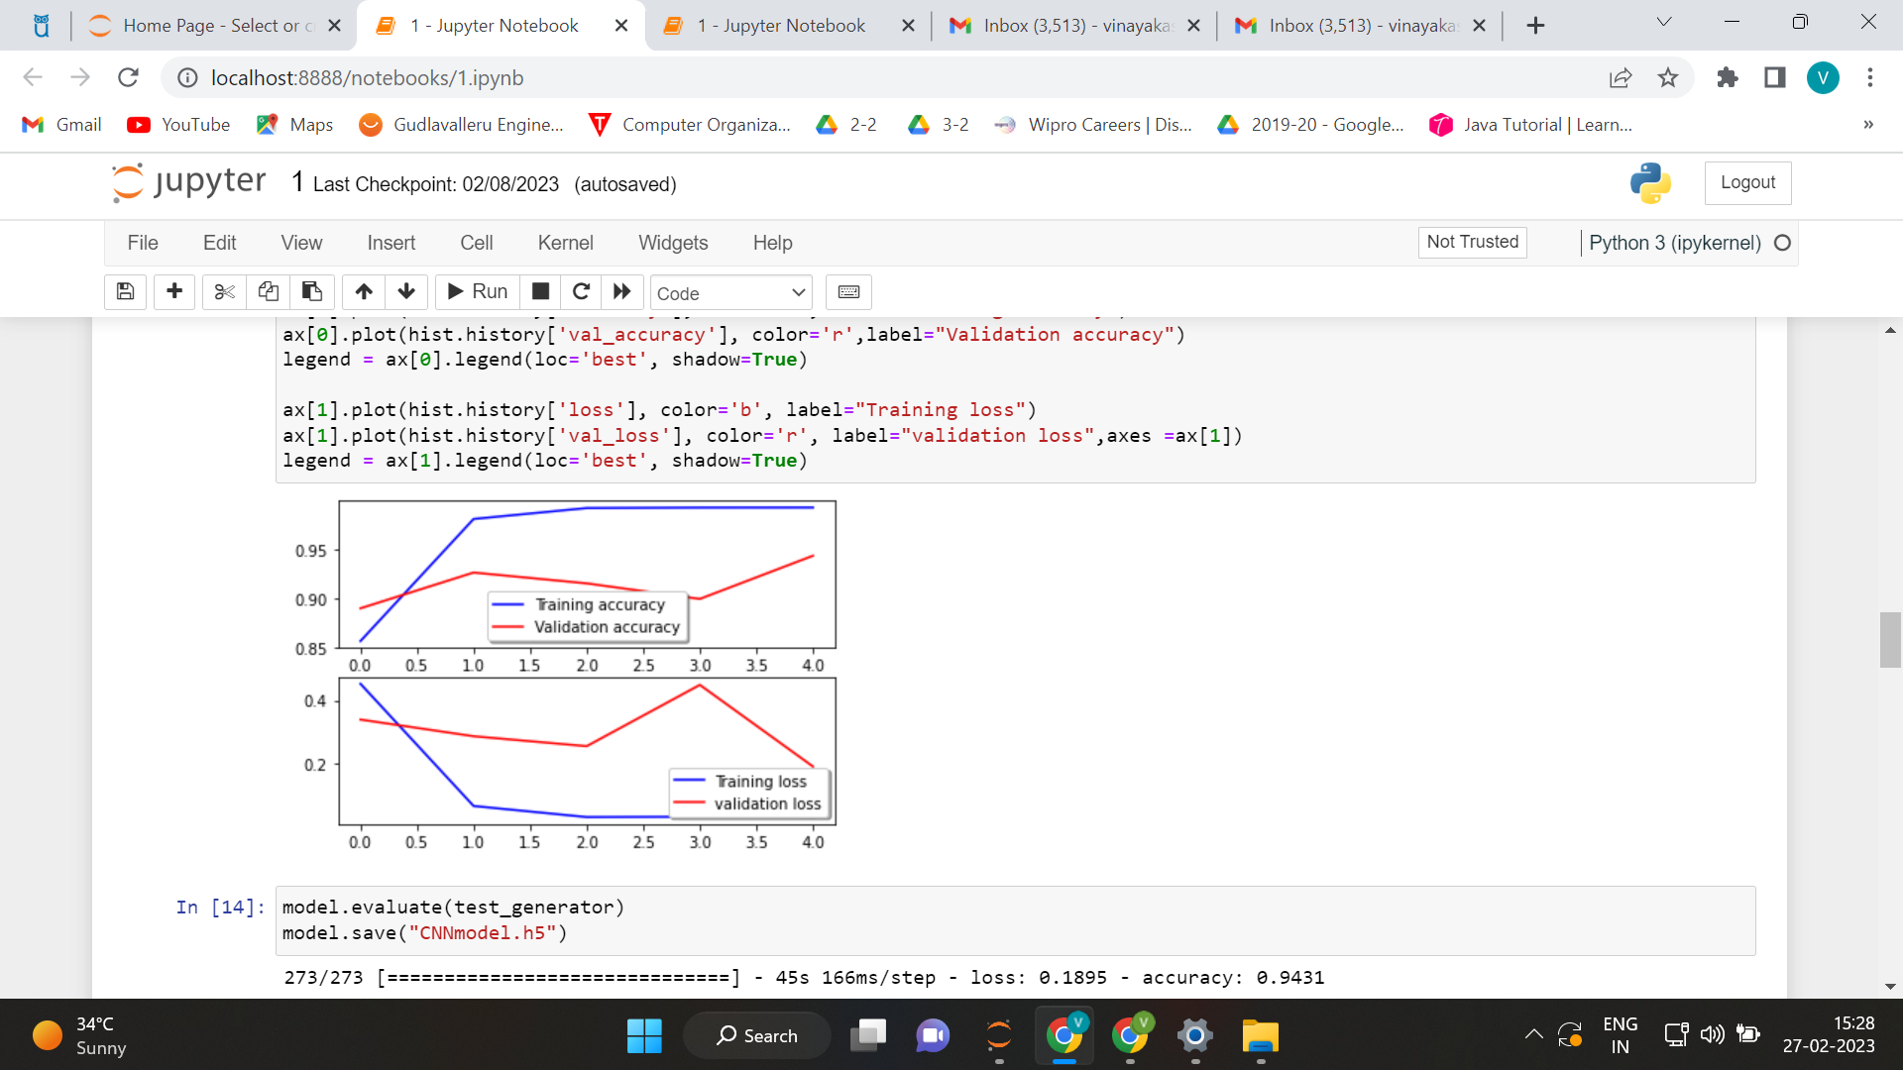
RESULTS :
MobileNet's model provides a higher accuracy of 98 percent than that of CNN, which gives an accuracy of 94 percent.
Adam(optimizer) is used to lower the losses by adjusting the neural network's weights and learning rate.
Accuracy for CNN
Loss for CNN

Slide 16
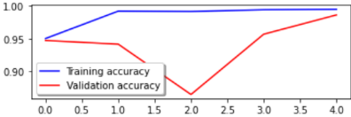
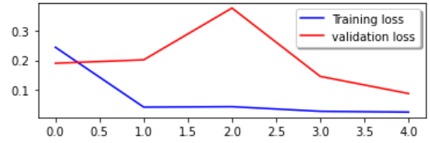
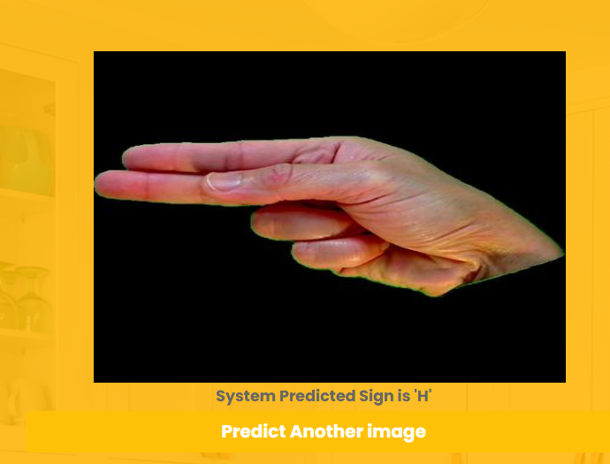
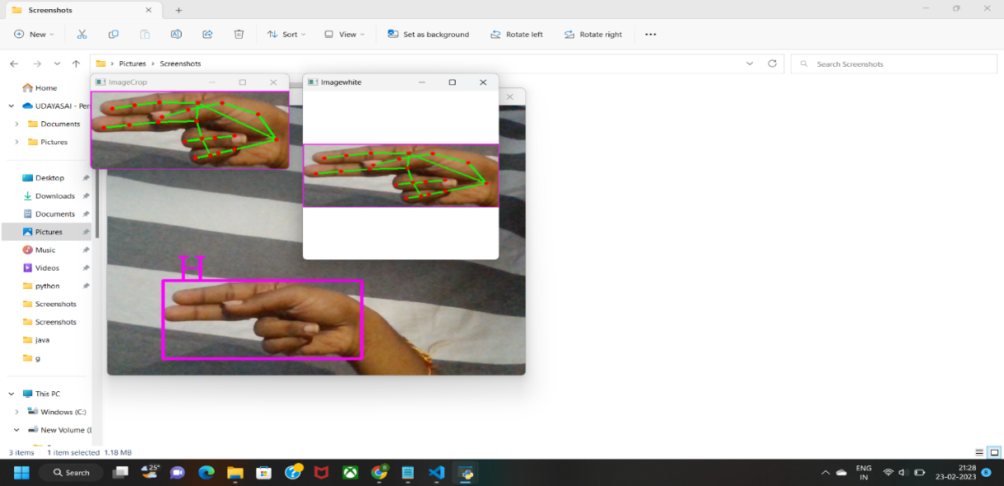
RESULTS :
Live Prediction of ‘H’
Accuracy for MobileNet
Loss for MobileNet
Prediction of ‘H’ Live Prediction of ‘H’

Slide 17


