Slide 1
NoC-based methodology for designing and simulating neural network accelerator
-Bhagyalaxmi Dinesh Somayaji
st164379@stud.uni-stuttgart.de Matriculation Number: 3374788

Slide 2
CONTENTS
Introduction
Motivation
Network-on-Chip Interconnection
Artificial Neural Network
NN-Noxim
Convolution neural network
NoC-based CNN
Structure of LeNet and VGG-16
Table-based Routing
Time Plan
Conclusion

Slide 3
INTRODUCTION
Machine learning algorithms are ubiquitous employed to extract knowledge from complex systems today giving the ability to the systems to learn patterns rather than describing the flow of execution
Neural Networks ,inspired from the human brain have revolutionized ML algorithms which when deployed on large-scale servers in data centers demand high energy along with performance
At the data centers, hardware accelerators like FPGA, ASICS, GPUs are integrated alongside general purpose CPUs in the market today

Slide 4
MOTIVATION
FPGA-based neural network accelerators, GPUs and CPUs are currently being used for training, validating and testing various neural models
The underlying idea of the thesis is to build a neural-network accelerator using network-on-chip interconnection
The neural network under consideration is convolution neural network that is widely used in computer vision

Slide 5
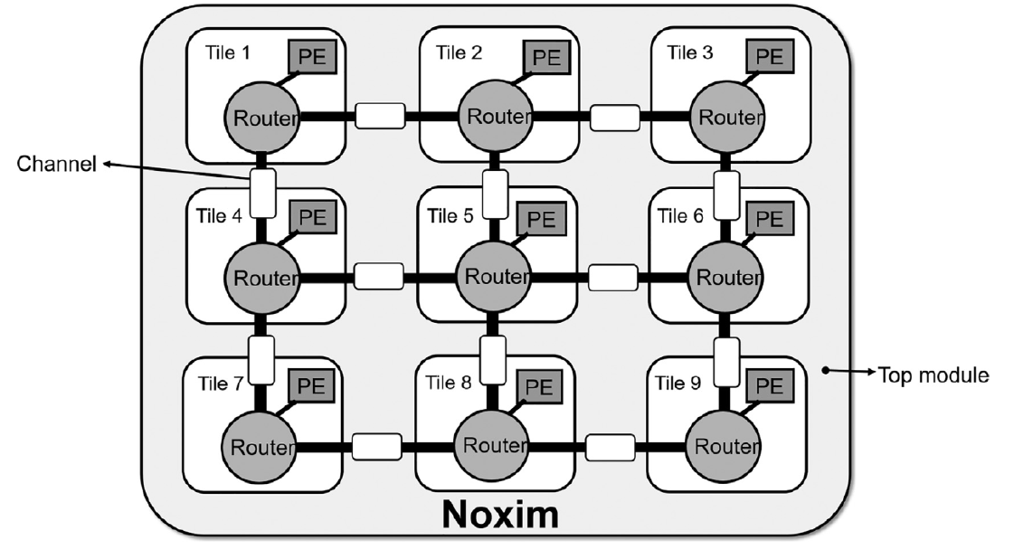
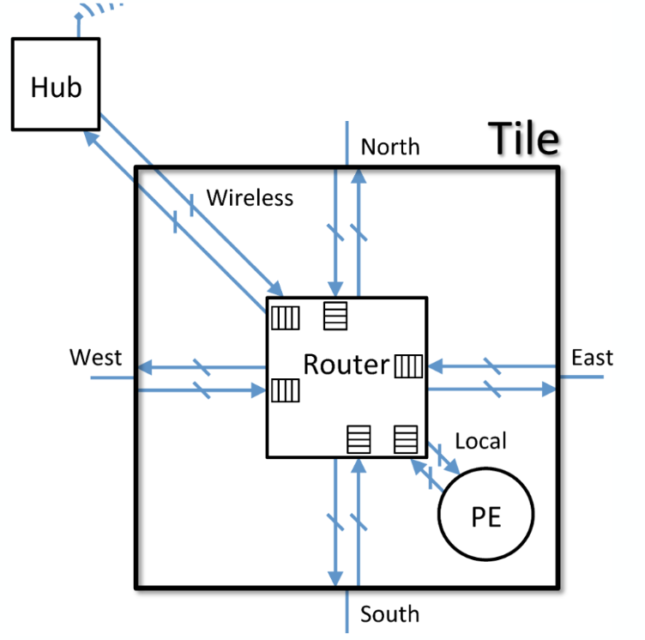
Network on Chip interconnection
An interconnection that emerged due to the rise of Multi-core CPUs
A mesh of routers interconnected to support communication
between the processing elements

Slide 6
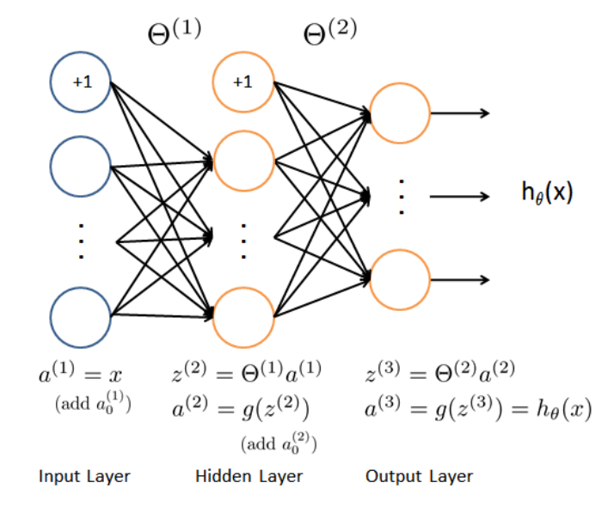
Artificial Neural Network
The network has input layer, output layer and many hidden layers depending on whether the network is shallow or deep network
The connection between the layers is said to be fully-connected with every unit in the previous layer connected to every unit in the next layer
Each unit has an activation function to compute the output which is then passed to every other unit in the next layer
This continues until the data reaches the output layer

Slide 7
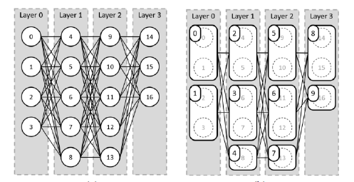
NN-NOXIm Accelerator
The idea lies as follows:
Group the neurons in each layer
Map the group to the processing elements present in the NoC
Flow control is critical here as computation must take place once all the data from the neurons in the previous layer is received
Once all the data is received, perform multiply and accumulate operation and transfer the data to the next layer

Slide 8
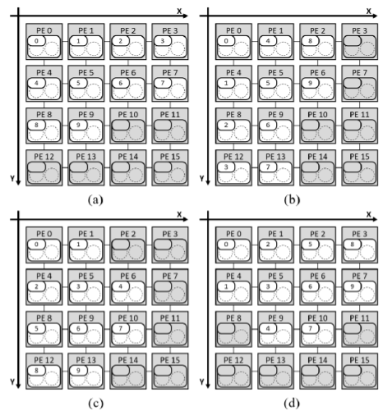
Continued..
There are different mapping algorithms:
Direction X mapping where the neuron groups are mapped to the PEs along the horizontal direction
Direction Y mapping where neuron groups are mapped to the PEs along the vertical direction
Layer X mapping where neuron group is mapped to PE layer by layer in the X direction
Layer Y mapping where neuron group is mapped to PE layer by layer in the Y direction

Slide 9
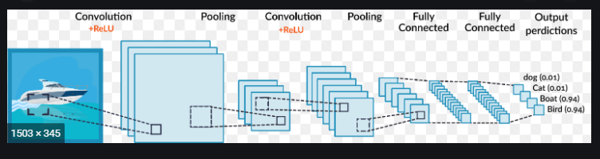
Convolution Neural Network
A class of neural network which are commonly applied to images widely used in Computer Vision
The main difference between ANN and CNN lies in the connection between the units in the layers
The main operations in CNN are convolution and pooling

Slide 10
Noc-based CNN
The idea of implementation:
CNN expanding conversion where CNN consisting of convolution layers, pooling layers and fully-connected layers are converted into an AA-like partially connected neural network
ANN-like reshaping which is grouping of neurons in each layer
PE computing flow control same as NN-noxim

Slide 11
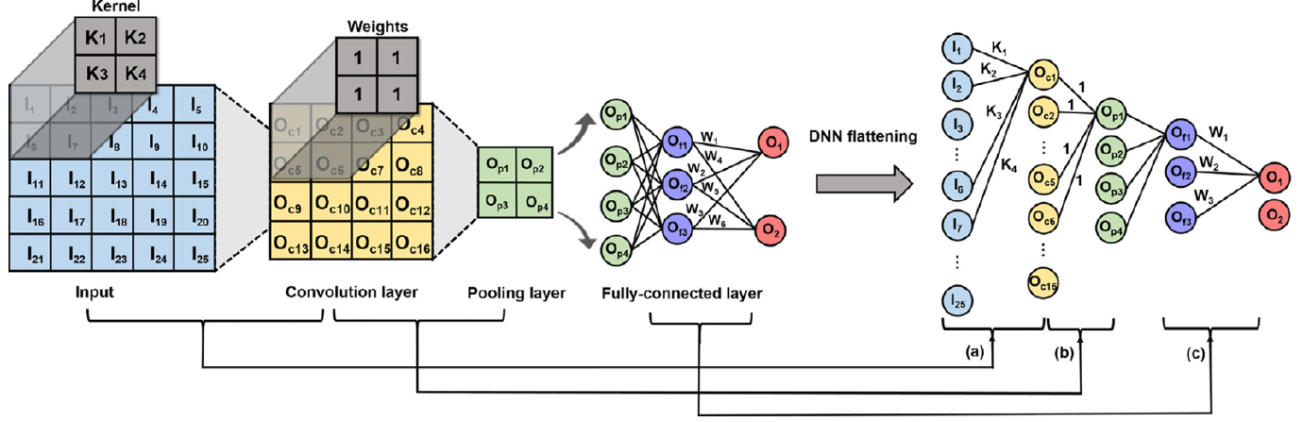
Continued..

Slide 12
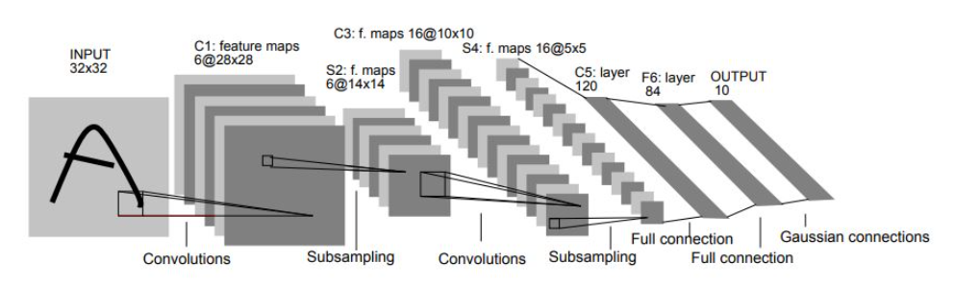
Structure of Lenet-6

Slide 13
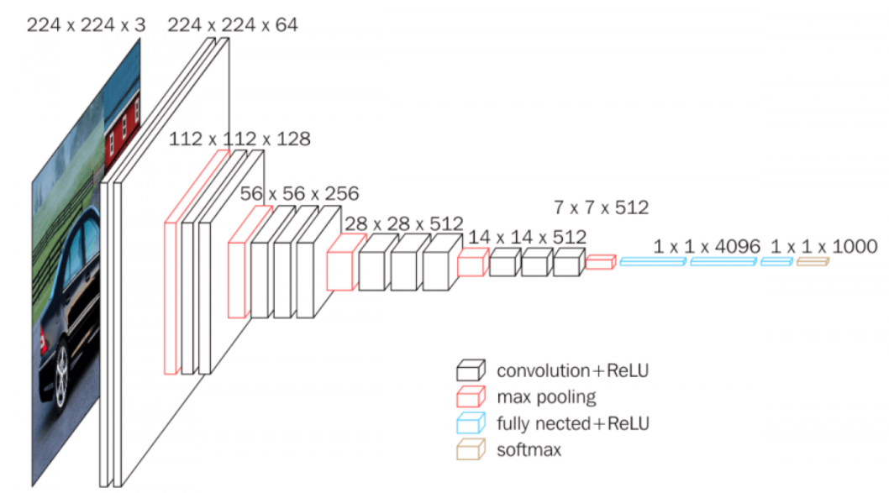
Structure of VGG-16 architecture

Slide 14
Routing and mapping in case of faulty routers
In the presence of faulty nodes, mapping must be efficiently carried out to prevent mapping of the neurons to the faulty processing elements
Routing is critical for which table-based routing called source-based routing is one of the options where each source nodes extracts the routing information from the routing table thereby guiding the routing of the packets
The routing table will contain entries of the shortest path between the source and destination which will be deduced from Dijkstra algorithm

Slide 15
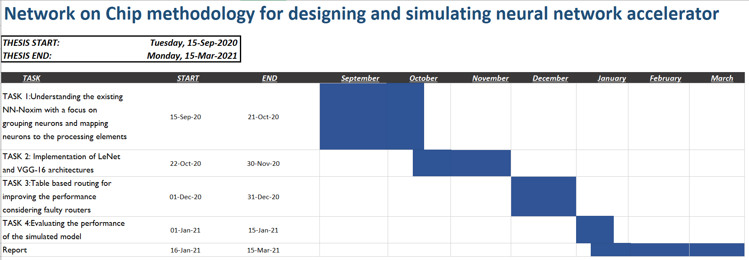
Time Plan

Slide 16
Progress until now
I have built a simple artificial neural network with 784 neurons in the input layer, 1 hidden layer with 25 neurons and finally output layer with 10 neurons in matlab to classify digits that are represented by a 28x28x1 grey scale image
This neural network was then implemented using NN-Noxim and the trained weights were applied
This accelerator was successful in classifying the input images
A LeNet network is successfully built in tensorflow for predicting handwritten digits with
Test loss: 0.05952128767967224
Test accuracy: 0.9830999970436096

Slide 17
Conclusion
The accelerator will simulate LeNet and VGG architecture
A CNN neural network on tensorflow will be built to train the model and the trained data will be considered for the accelerator
The GitHub repository: NoC-based neural network accelerator

Slide 18
Literature Survey
Chen, K.C.J., Wang, T.Y.G. and Yang, Y.C.A., 2019, May. Cycle-accurate noc-based convolutional neural network simulator. In Proceedings of the International Conference on Omni-Layer Intelligent Systems (pp. 199-204).
Kwon H, Samajdar A, Krishna T. Rethinking nocs for spatial neural network accelerators. In2017 Eleventh IEEE/ACM International Symposium on Networks-on-Chip (NOCS) 2017 Oct 19 (pp. 1-8). IEEE
Chen KC, Wang TY. Nn-noxim: High-level cycle-accurate noc-based neural networks simulator. In2018 11th International Workshop on Network on Chip Architectures (NoCArc) 2018 Oct 20 (pp. 1-5). IEEE.
Chen, K.C.J., Ebrahimi, M., Wang, T.Y., Yang, Y.C. and Liao, Y.H., 2020. A NoC-based Simulator for Design and Evaluation of Deep Neural Networks. Microprocessors and Microsystems, p.103145.

