Slide 1
farMart

Slide 2
Team name and member details
Team name | Member names | Education institute name
Coding comrades | Akhilasree M(Team Leader) | Sri Ramakrishna Engineering College, Coimbatore
 | Bhagya Lakshmi T | Sri Ramakrishna Engineering College, Coimbatore

Slide 3
Ensure that farmers get fair value for their product by providing better information about crop fairs and the appropriate buyers.
Problem Statement

Slide 4
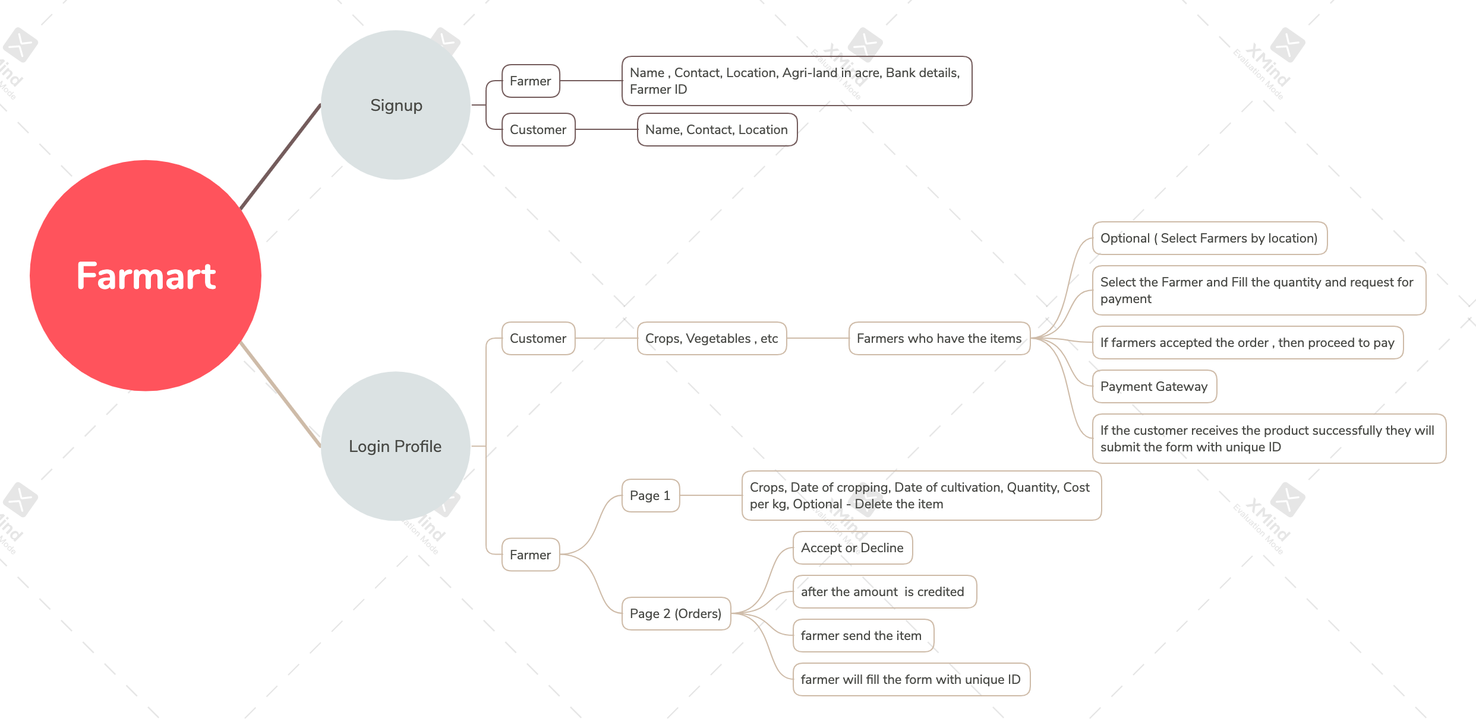
Solution / your big Idea

Slide 5
Solution / your big Idea
Customers and farmers fill out basic information in the signup form to receive login credentials
Create a separate profile for each farmer and current customer after logging in
Customers can pay and purchase their products by requesting the farmer
Farmers have two pages with crop details and a payment request form page
Once the request has been accepted, bank details are shown to customers
Customer can choose the product according to the farmers
The farmers send the unique product id so they can retrieve the product using the same id
TECHNOLOGY USED : Full Stack Development

Slide 6
Impact
A common online marketplace for farmers will remove interstate barriers to farm produce movement and could be a game changer, according to analysts.
The customer is guaranteed a fresh product from the farmer without any impurity at a reasonable price.
An intermediate position may be eliminated, resulting in loss of employment.

Slide 7
How is the solution innovative?
In order to access the farmer account, you must be an authorized farmer.
No middlemen between the buyer and seller.
Buyers can get affordable, good-quality products.

Slide 8
Testimony
Agri-Market
PM - Kissan Samman Nidhi
IFFCO kisan
Currently, these apps act as an intermediary between farmers and customers. Our concept eliminates that intermediary

Slide 9
Thankyou ☺

