Slide 1
String Hashing
Sidhant Bansal
Credits: CP-Algorithms, Codeforces Blogs

Slide 2
Agenda
Motivation
What is String Hashing
How to do String Hashing
Analysis
Applications
Pitfalls

Slide 3
Motivation

Slide 4
Why?
String Hashing lets you most often than not “optimise” a brute-force approach to a string related question.
How ?
Well at a very high-level, think of it like it speeds-up the “comparison of any two strings”.
Earlier comparing two strings (are equal or not or which one is smaller/larger) used to be O(N) now it is O(1) (NOTE: correct with high probability, NOT 100% of the times) or O(logN) for smaller/larger lexical comparison.

Slide 5
Most Powerful String DS
There are many string DS:
KMP, Suffix Array, Suffix Trees, Palindromic Trees, Aho-Cohrasik
However all problems ≤ Medium-Hard difficulty of these Tags are most often than not solvable by String Hashing as well. (As an alternate solution)

Slide 6
So why doesn’t everyone use it?
It can be slightly tedious to implement. And you have to be smart about the modulos, primes, etc you pick.
Basically your implementation needs to be clean for it to pass (i.e not give WA neither give TLE)

Slide 7
What is String Hashing

Slide 8
What is String Hashing?
The goal is to be able to have a “fast” method to map any string to an integer, such that
If s₁ != s₂, then H(s₁) != H(s₂)
If s₁ == s₂, then H(s₁) == H(s₂)
Given s, we should be able to compute H(s) fast (i.e. in O(1) or O(logN))
H(s) should be an integer/long long/pair of ints/pair of long long

Slide 9
Poll Question
Do you think there exists a string hashing which can provide us with all that power mentioned in the previous slide? (True / False)

Slide 10
But wait...
Let’s say we consider all alphabet-based strings of length 100 and boiling them down to an integer.
How many unique strings can we have? (26¹⁰⁰)
And how many different integers do we have? (2³² ~ 10⁹)
But you can see 26¹⁰⁰ >> 10⁹
So how can we ensure that “if s₁ != s₂, then H(s₁) != H(s₂)”

Slide 11
Fixed definition of String Hashing
The goal is to be able to have a “fast” method to map any string to an integer, such that
If s₁ != s₂, then H(s₁) != H(s₂) (with high probability)
If s₁ == s₂, then H(s₁) == H(s₂) (with 100% probability)
Given s, we should be able to compute H(s) fast (i.e. in O(1) or O(logN))
H(s) should be an integer/long long/pair of ints/pair of long long

Slide 12
How to do String Hashing

Slide 13
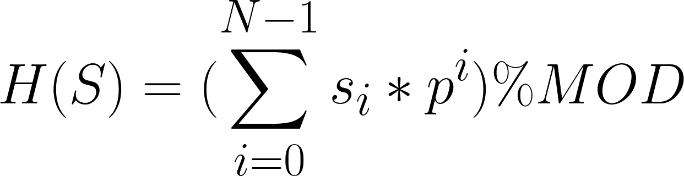
Polynomial Rolling Hash Technique
Given a string S = s₀ s₁ … s_{N-1}
The hash is a polynomial in p
This hash depends on:
The length of the string
The order of the characters
And is contained within an integer (because of modulo arithmetic)

Slide 14
Why did we say “Rolling”
If we know the hash of S, i.e H(S)
Then we can easily calculate the hash of S + x (i.e. H(S + x)) or x + S, where x is a single character.
Extend this further...

Slide 15
Why did we say “Rolling”
If we know the hash of every prefix of string S.
Let the prefixes of string S be P₀, P₁, P₂, … P_{N - 1}
Example: S = “ABCDEF”
P₀ = “A”, P₁ = “AB”, P₂ = “ABC”, ..
Then if we know H(P_{i - 1}) then we can calculate H(P_{i}) in O(1)
So given H(P_{i}) for all i.
Now we can calculate hash of any substring of S, i.e S[i...j].
But how ?

Slide 16
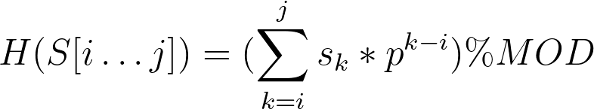
Explain how to get H(S[i...j]) ?

Slide 17
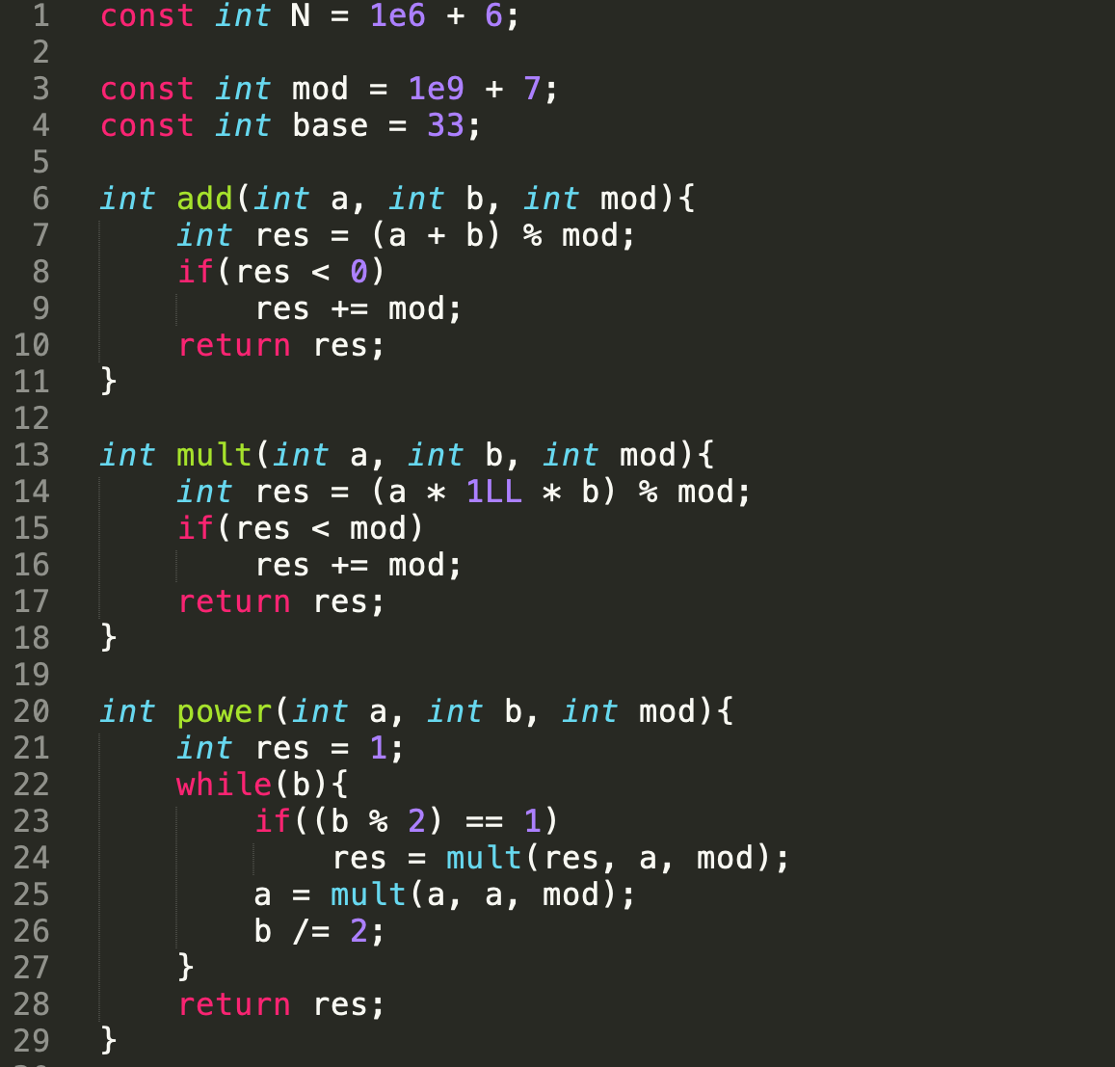

Slide 18
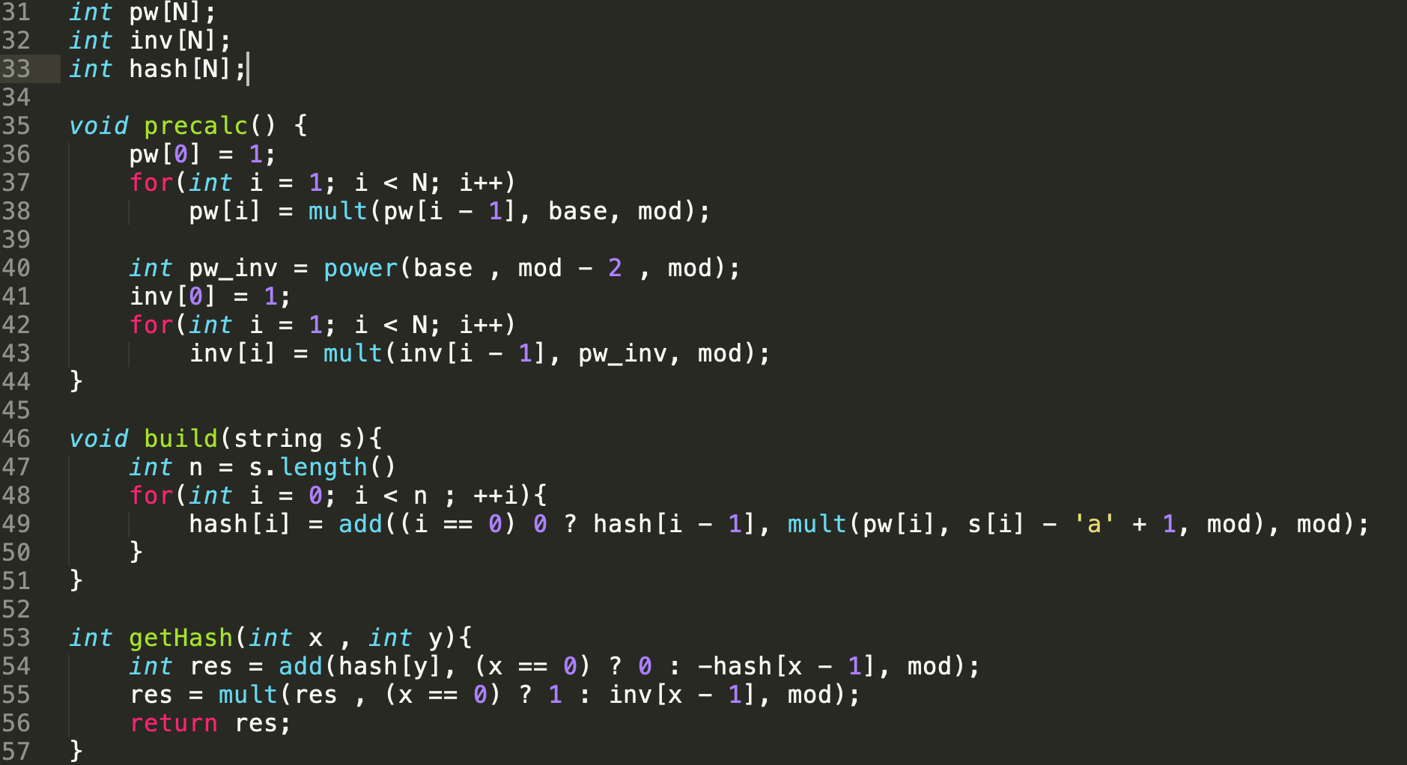

Slide 19
Analysis

Slide 20
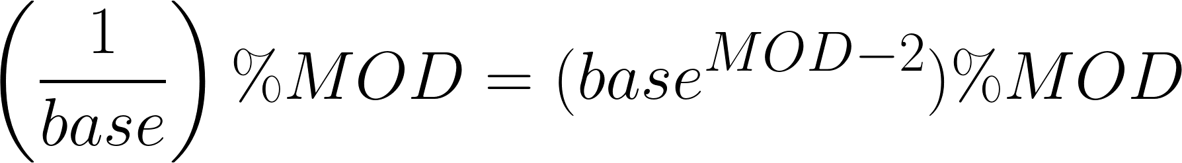
Analysis
Fix the values first.
Firstly, your p = base > #alphabets. So generally keep it > 26 or > 36.
Your MOD should be a prime, so that calculation of (1/base) under MOD is easy. When mod is prime: (Using Euler’s Theorem)

Slide 21
Why high probability? (Poll Question)
Given two random string A != B, what is the probability that H(A) == H(B) ?
0
1 / (sqrt(MOD))
1 / MOD
1 / MOD²

Slide 22
But wait...it amplifies
So for any given comparison the probability that we will get a false positive is 1/MOD.
If we do K such comparisons in our algorithm, then on average (i.e. in expectation) K/MOD of them will give us false positive.

Slide 23
Example where it may break
Let’s say your MOD = 10⁹ + 7
Maybe you hashed a string S of length 10⁶ and put all the 100 length substrings of S in a set to find the number of distinct 100 length substrings
How many comparisons did you do?
Umm, roughly (10⁶ - 100 + 1)² ~ 10¹²
And each comparison had a fail probability of ~ 10⁻⁹
So roughly how many failed comparisons did you do? 10¹² ⁻ ⁹ = 1000 > 0.
This is bad...

Slide 24
The Fix
Use two (or more) mods.
Let H(S) = (H₁(S), H₂(S)) using two different modulos
Ex. MOD₁ = 10⁹ + 7, MOD₂ = 10⁹ + 9
Now probability of accidentally matching for two strings is roughly 10⁻¹⁸.
So # of false positive ~ 10¹² ⁻ ¹⁸ ~ 10⁻⁶ (super low)

Slide 25
Applications

Slide 26
Given a string S, find the largest substring which occurs at-least twice in the string ?

Slide 27
Given a string S and Q queries of the form (L_{i}, R_{i}), tell if S[L_{i}...R_{i}] is a palindrome or not?
What if we character updates also?

Slide 28
Given a string S find the length of the longest palindromic substring in S

Slide 29
Largest common prefix of two strings S and T. If we are allowed to swap two characters in one of the strings ?

Slide 30
Pitfalls

Slide 31
Pitfalls
Slow implementation (unnecessary modulo operations)
Off-by-one errors
Always picking 10⁹ + 7 and 10⁹ + 9 as your mods and 26/30/36 as your base. Well then you can be hacked by the author. Our randomisation argument wasn’t completely correct (It was a simplified version and had some loopholes). Ideally you want to randomly pick the base as well as the mod. See this Codeforces Blog Post for precise details.
So rule of thumb is: Submit the code once with BASE = 33/36 (some typical value) and MOD₁ = 10⁹ + 7 and MOD₂ = 10⁹ + 9. If it WAs then either pick some other primes from your codebook or during runtime randomise the picking of base and mod from a hard-coded list.

Slide 32
Further Readings
https://codeforces.com/blog/entry/60445 (More in-depth)
https://www.quora.com/q/threadsiiithyderabad/String-Hashing-for-competitive-programming (Quora Post)
https://cp-algorithms.com/string/string-hashing.html (CP Algorithms)
https://codeforces.com/blog/entry/4898 (Anti-Hash tests)
https://codeforces.com/blog/entry/60442 (Extensive discussion on anti-hash testing)
http://rng-58.blogspot.com/2017/02/hashing-and-probability-of-collision.html (Hashing for unordered elements)

Slide 33
Thank You
Q&A

