Slide 1
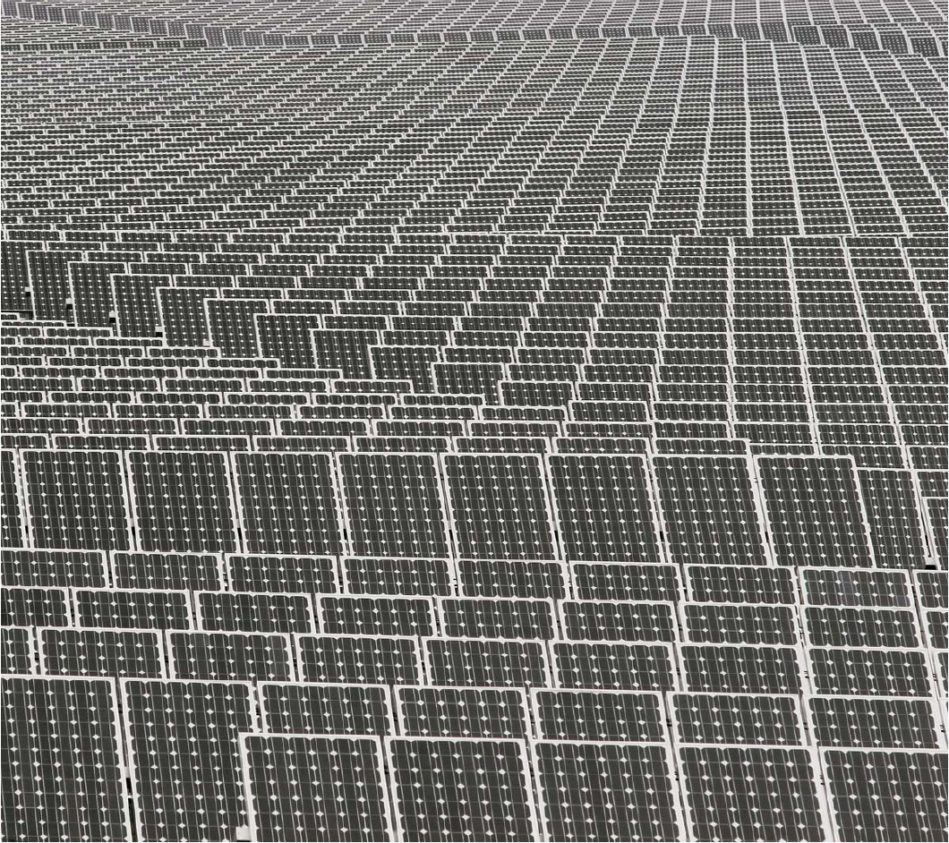
Dr. Bharat Sutaria
SOLAR PHOTOVOLTAIC CELL

Slide 2
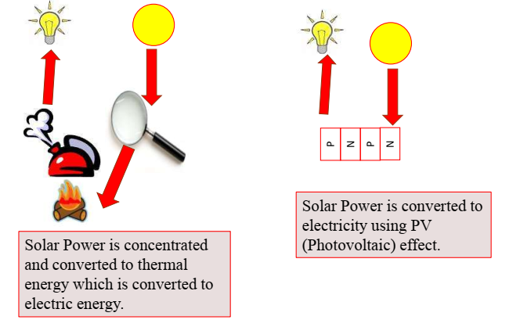
Means to harness solar energy

Slide 3
History of solar cell
The term “Photo” comes from the Greek meaning “light”, and “voltaic”, from the name of the Italian physicist “Volta”.
The PHOTOELECTRIC EFEECT was first recognized in 1839 by French physicist A.E. BECQUEREL. He found that two different brass plates immersed in a liquid produced a continuous current when illuminated with sunlight. It is believed that he had made a copper – cuprous oxide thin - film solar cell. Later in the 1870s, Willoughby Smith, W. G. Adams, and R. E. Day discovered a PV effect in selenium.
ALBERT EINSTEIN explained the photoelectric effect in 1905 for which he received the Nobel prize in Physics in 1921.
The modern photovoltaic cell was developed in 1954 at BELL LABORATORIES.
The highly efficient solar cell was first developed by DARYL CHAPIN, CALVIN SOUTHER FULLER & GERALD PEARSON in 1954 using a diffused silicon p-n junction.
Solar Cells were first used in Vanguard 1 satellite, launched in 1958.

Slide 4
Solar PV cell
A solar cell is a semi-conducting device made of silicon or other materials i.e., Cadmium, Galium arsenide, which, have photovoltaic properties when exposed to sunlight, generates electricity. It uses the Photovoltaic technology.
A solar cell is also known as Photovoltaic Cell or Photoelectric Cell.
Solar PV system converts the energy of visible and infrared regions of solar radiation directly in to electric power.

Slide 5
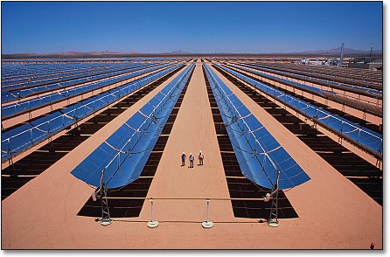
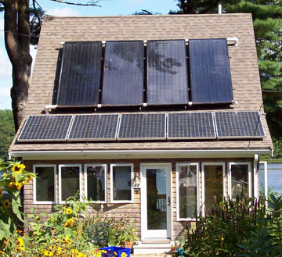
Methods of Harvesting Sunlight
Solar Thermal: ~30% efficient; cost-competitive; requires direct sun; heats fluid in pipes that then boils water to drive steam turbine
Solar hot water: up to 50% efficient; several $k to install; usually keep conventional backup; freeze protection vital (even in S.D.!!)
Photovoltaic (PV): direct electricity; 15% efficient; $5 per Watt to install without rebates/incentives; small fraction of roof covers demand of type. home
Biofuels, algae, etc. also harvest solar energy, at few % eff.

Slide 6
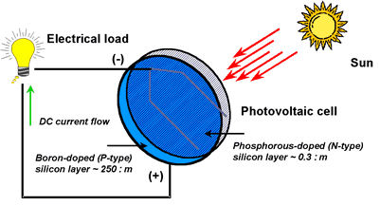
How PV Cells Work ?
PV technology basics
Solar cells are semiconductor devices that produce electricity
from sunlight via the photovoltaic effect.
Sunlight strikes the cell, photons with energy above the
semiconductor bandgap impart enough energy to create
electron-hole pairs.
A junction between dissimilarly doped semiconductor layers
sets up a potential barrier in the cell, which separates the
light-generated charge carriers.
This separation induces a fixed electric current and voltage in
the device. The electricity is collected and transported by
metallic contacts on the top and bottom surfaces of the cell.
A typical silicon PV cell is composed of a thin wafer consisting of an ultra-thin layer of phosphorus-doped (N-type) silicon on top of a thicker layer of boron -doped (P-type) silicon.
An electrical field is created near the top surface of the cell where these two materials are in contact, called the P-N junction.
When sunlight strikes the surface of a PV cell, this electrical field provides momentum and direction to light-stimulated electrons, resulting in a flow of current when the solar cell is connected to an electrical load
Diagram of photovoltaic cell.
Notes:
http://www.fsec.ucf.edu/pvt/pvbasics/index.htm

Slide 7
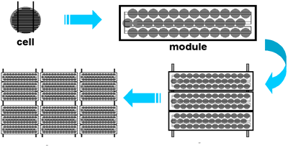
PV Cells, Modules, & Arrays
PV technology basics
In the case of a single-junction device, the efficiency of the solar cell, the ratio of the power produced, and the incident light power are limited.
Photons with energies below the band gap of the material produce only heat. Excess energy above that needed to generate electron-hole pairs also produces heat.
A multi-junction device, in which two or more solar cells are stacked on top of each other, can exploit different portions of the solar spectrum.
For example, a four-junction device with band gaps of 1.8, 1.4, 1.0, and 0.7 electron volts (eV) results in a theoretical efficiency of more than 52%.
The multi-junction approach, however, presents significant challenges in both materials preparation and device design.
Photovoltaic cells are connected electrically in series and/or parallel circuits to produce higher voltages, currents and power levels.
Photovoltaic modules consist of PV cell circuits sealed in an environmentally protective laminate, and are the fundamental building block of PV systems.
Photovoltaic panels include one or more PV modules assembled as a pre-wired, field-installable unit. A photovoltaic array is the complete power-generating unit, consisting of any number of PV modules and panels.

Slide 8
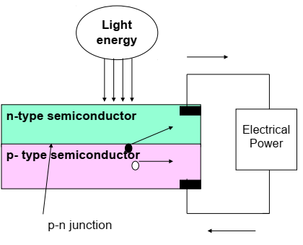
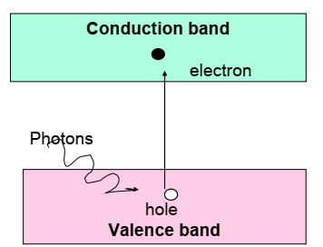
Photoelectric effect

Slide 9
Photovoltaic (PV) Scheme
Highly purified silicon (Si) from sand, quartz, etc. is “doped” with intentional impurities at controlled concentrations to produce a p-n junction
p-n junctions are common and useful: diodes, CCDs, photodiodes, transistors
A photon incident on the p-n junction liberates an electron
photon disappears, any excess energy goes into kinetic energy of electron (heat)
electron wanders around drunkenly, and might stumble into “depletion region” where electric field exists (electrons, being negative, move against field arrows)
electric field sweeps electron across the junction, constituting a current
more photons → more electrons → more current → more power
photon of light
n-type silicon
Si doped with
phosphorous, e.g.
electric field
p-type silicon
Si doped with
boron, e.g.
liberated electron

Slide 10
Provide a circuit for the electron flow
Without a path for the electrons to flow out, charge would build up and end up canceling electric field
must provide a way out
direct through external load
PV cell acts like a battery
current flow
external load

Slide 11
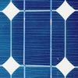
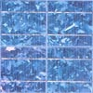
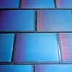
PV types
Single-crystal silicon
15–18% efficient, typically
expensive to make (grown as big crystal)
Poly-crystalline silicon
12–16% efficient, slowly improving
cheaper to make (cast in ingots)
Amorphous silicon (non-crystalline)
4–8% efficient
cheapest per Watt
called “thin film”, easily deposited on a wide range of surface types

Slide 12
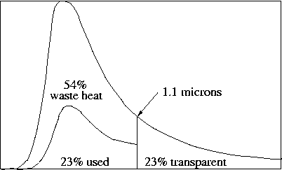
Silicon Photovoltaic Budget
Only 77% of solar spectrum is absorbed by silicon
Of this, ~30% is used as electrical energy
Net effect is 23% maximum efficiency

Slide 13
How good can it get?
Silicon is transparent at wavelengths longer than 1.1 microns (1100 nm)
23% of sunlight passes right through with no effect.
Excess photon energy is wasted as heat
near-infrared light (1100 nm) typically delivers only 51% of its photon energy into electrical current energy, roughly half the electrons stumble off in the wrong direction.
red light (700 nm) only delivers 33%
blue light (400 nm) only delivers 19%
All together, the maximum efficiency for a silicon PV in sunlight is about 23%
defeating “recombination loss” puts the limit in the low 30’s %

Slide 14
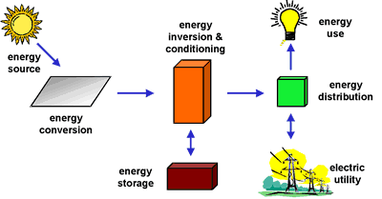
How a PV System Works?
PV technology basics
PV systems are like any other electrical power generating systems, just the equipment used is different than that used for conventional electromechanical generating systems.
Depending on the functional and operational requirements of the system, the specific components required, and may include major components:
Photovoltaic array
DC-AC power inverter,
battery bank,
system and battery charge controller,
Auxiliary energy sources and sometimes the specified electrical load (appliances).
In addition, an assortment of balance of system (BOS) hardware, Including wiring, over current, surge protection and disconnect devices, and other power processing equipment.

Slide 15
How it works?
Photovoltaic cells are made of special materials called semiconductors such as silicon. An atom of silicon has 14 electrons, arranged in three different shells. The outer shell has 4 electrons. Therefore a silicon atom will always look for ways to fill up its last shell, and to do this, it will share electrons with four nearby atoms. Now we use phosphorus(with 5 electrons in its outer shell). Therefore when it combines with silicon, one electron remains free.
When energy is added to pure silicon it can cause a few electrons to break free of their bonds and leave their atoms. These are called free carriers, which move randomly around the crystalline lattice looking for holes to fall into and carrying an electrical current. However, there are so few, that they aren't very useful. But our impure silicon with phosphorous atoms takes a lot less energy to knock loose one of our "extra“ electrons because they aren't tied up in a bond with any neighbouring atoms. As a result, we have a lot more free carriers than we would have in pure silicon to become N-type silicon.
The other part of a solar cell is doped with the element boron(with 3 electrons in its outer shell)to become P-type silicon. Now, when this two type of silicon interact, an electric field forms at the junction which prevents more electrons to move to P-side. When photon hits solar cell, its energy breaks apart electron-hole pairs. Each photon with enough energy will normally free exactly one electron, resulting in a free hole as well. If this happens close enough to the electric field, this causes disruption of electrical neutrality, and if we provide an external current path, electrons will flow through the P side to unite with holes that the electric field sent there, doing work for us along the way. The electron flow provides the current, and the cell's electric field causes a voltage
Now to protect the solar cell, we use antireflective coating to reduce the losses and then a glass plate to protect the cell from elements.

Slide 16

Direct-coupled PV system.
PV technology basics
The simplest type of stand-alone PV system is a direct-coupled system, where the DC output of a PV module or array is directly connected to a DC load.
Since there is no electrical energy storage (batteries) in direct-coupled systems, the load only operates during sunlight hours, making these designs suitable for common applications such as ventilation fans, water pumps, and small circulation pumps for solar thermal water heating systems.
Matching the impedance of the electrical load to the maximum power output of the PV array is a critical part of designing well-performing direct-coupled system.
For certain loads such as positive-displacement water pumps, a type of electronic DC-DC converter, called a maximum power point tracker (MPPT) is used between the array and load to help better utilize the available array maximum power output.

Slide 17
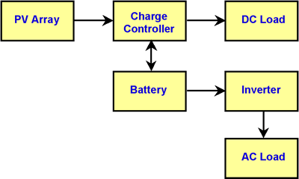
Why Are Batteries Used in Some PV Systems?
PV technology basics
Batteries are often used in PV systems for the purpose of storing energy produced by the PV array during the day, and to supply it to electrical loads as needed (during the night and periods of cloudy weather).
Other reasons batteries are used in PV systems are to operate the PV array near its maximum power point, to power electrical loads at stable voltages, and to supply surge currents to electrical loads and inverters.
In most cases, a battery charge controller is used in these systems to protect the battery from overcharge and over discharge.
Characteristics of the systems
Supply power to a system independently without the use of common connection to any systems.
Operates autonomously and independently
Commonly used for backup power where connecting to grid are costly.
Can be used to power DC loads, also AC loads using inverter.
Diagram of stand-alone PV system with battery storage powering DC and AC loads.

Slide 18
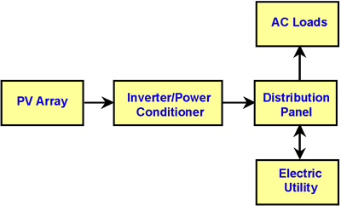
PV technology basics:
Diagram of grid-connected photovoltaic system
Grid-connected Photovoltaic systems:
System generated power by PV array is given to the grid or to the AC loads directly. When power generation exceed the requirement of the loads it is supplied to a common grid. Thus the systems forms a part of a large network. The output from the inverter has to satisfied the norms of the quality of the electrical standards so that it can be much with the grid systems.

Slide 19
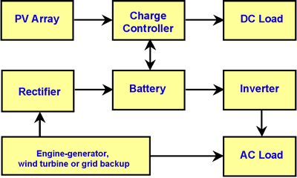
Photovoltaic hybrid system.
PV technology basics
Hybrid stand-alone systems one or more sources in addition to PV panels are designed to operate independent of the electric utility grid, and are generally designed and sized to supply certain DC and/or AC electrical loads.
Sources like stand by engine, turbines fuel cell etc. may be used in conjunction with PV array only,
Thus reliance on any single sources is reduced. This also reduces the battery storage capacity and size of PV

Slide 20
SOLAR CELL TYPES
SOLAR CELL TECHNOLOGY
Discrete Cell technology.
Integrated Thin Film technology.
Multi crystalline Silicon technology.
Thickness of active material
Bulk Material Cell
Thin-Film Cell
Type of active material used
Single Crystal Silicon Cell
Multi-crystalline Silicon Cell
Amorphous Silicon (a-Si) Cell
GaAs Cell
CIGS Cell
CdTe Cell
Organic PV Cell

Slide 21
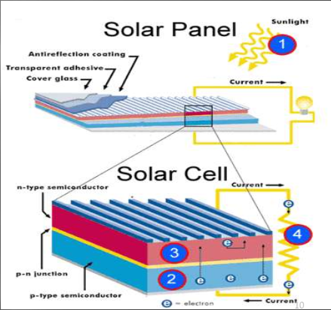
Solar Panel and its cell

Slide 22
Applications
Rural electrification: The provision of electricity to rural areas derives important social and economic benefits to remote communities throughout the world like power supply to remote houses, electrification of the health care facilities, irrigation and water supply and treatment.
Ocean navigation aids: Many lighthouses are now powered by solar cells.
Telecommunication systems: radio transceivers on mountain tops are often solar powered.
Solar cells are often electrically connected and encapsulated as a module. These modules often have a sheet of glass on the front (sun up) side, allowing light to pass while protecting the semiconductor wafers from climate conditions. Solar cells are also usually connected in series in modules, creating an additive voltage.
Photovoltaic solar generators have been and will remain the best choice for providing electrical power to satellites in an orbit around the Earth.

Slide 23
Advantages
The very first benefit of using this technology is that solar energy is renewable.
This is a 100% environment-friendly.
Contrary to fossil fuels, this technology is not going to release any greenhouse gases, harmful agents, volatile material or carbon dioxide into the environment.
Solar panels are highly durable and reliable. These systems don’t have any moving systems and hence they don’t require any replacement.
We can use Solar cell technology to generate thousands of hours of electricity with minimal maintenance. Almost every energy source creates some sort of noise, but that is not the case with solar panels and cells.
Solar cells provide cost effective solutions to energy problems in places where there is no mains electricity.

Slide 24
Direct conversion of energy in to electrical power
Maintenance free solar cell
Compatible with environment
No transmission problems
Flexibility of operation and can be installed at place of use of power
High life span
Can be used in remote area.

Slide 25
Disadvantages
The main disadvantage of solar cell is the initial cost. Most types of solar cell require large areas of land to achieve average efficiency.
Air pollution and weather can also have a large effect on the efficiency of the cells.
The silicon used is also very expensive and the solar cells can only ever generate electricity during the daytime.
Another con to Solar cell technology is that the efficiency level of this technology is low.
The most efficient solar power system gives you an efficiency of not more than 40%. This means that the rest of the 60% power of sunlight is not harnessed.
The most important thing that is necessary is the sky should be clear so that sunlight can fall on the solar cell and we can get electricity.
Large area need for installation
Need large storage systems during non sunshine periods.

